Slide 1
FINAL PROJECT

Slide 2
1.) A minimum of 5 variables in your dataset used during your analysis (for help with selecting, the author made his selection on page 6 of your book). Consider what you think could have an impact on your question – remember this is never perfect, so don’t be worried if you miss one (Chapter 1).
EJECTION_FRACTION
PLATELETS
SMOKING
ANAEMIA
CREATININE_PHOSPHOKINASE

Slide 3
2.) Describe what the 5 variables mean in the dataset (Chapter 1).
EJECTION_FRACTION: Ejection fraction (EF) is a measurement, expressed as a percentage, of how much blood the left ventricle pumps out with each contraction. An ejection fraction of 60 percent means that 60 percent of the total amount of blood in the left ventricle is pushed out with each heartbeat.
PLATELETS: Low platelets causes internal bleedings and High causes Blood clot which leads to heart condition
ANAEMIA: A condition marked by a deficiency of red blood cells or of hemoglobin in the blood, resulting in pallor and weariness.
CREATININE_PHOSPHOKINASE: Creatine kinase, also known as creatine phosphokinase or phosphocreatine kinase, is an enzyme expressed by various tissues and cell types. CK catalyses the conversion of creatine and uses adenosine triphosphate to create phosphocreatine and adenosine diphosphate. If it is high , kidney fails which results in heart failure
SMOKING

Slide 4
3.) Include a histogram of each of the 5 variables – in your summary and analysis, identify any outliers and explain the reasoning for them being outliers and how you believe they should be handled (Chapter 2).

Slide 5
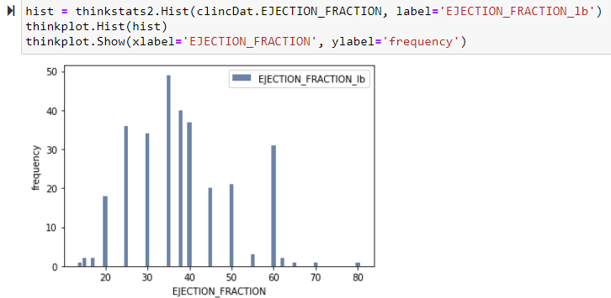
Notes:
Values at the extreme right 70, 80 are the outliers in the data for this variable. We can ignore them in the analysis

Slide 6
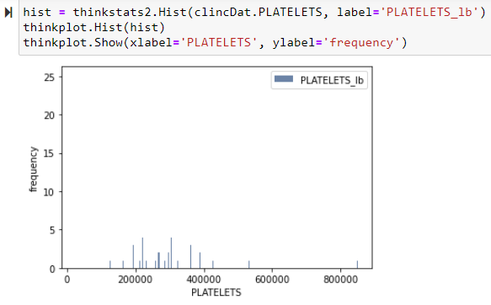
Notes:
We can spot two outliers 550000 and 900000 on the right

Slide 7
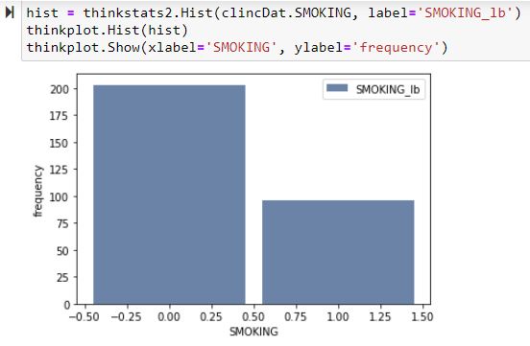

Slide 8
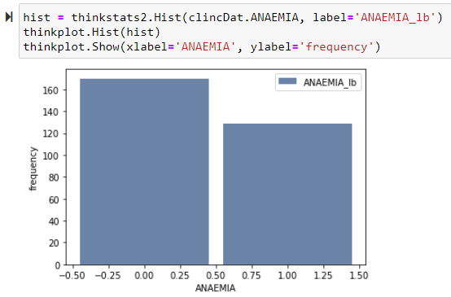

Slide 9
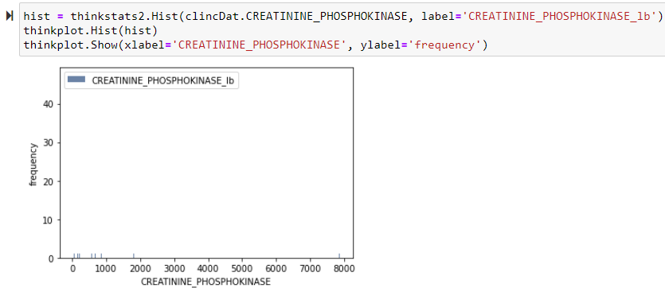
Notes:
We have an outlier at 1900 which is away from the other group

Slide 10
4.) Include the other descriptive characteristics about the variables: Mean, Mode, Spread, and Tails (Chapter 2).

Slide 11
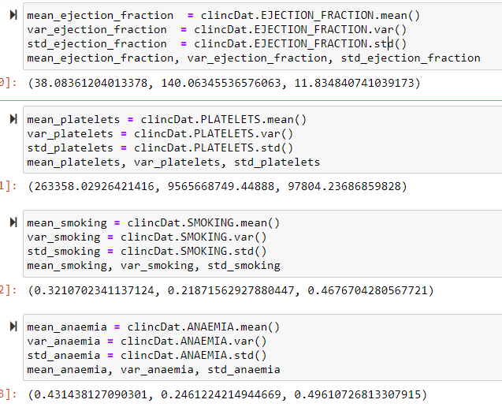

Slide 12
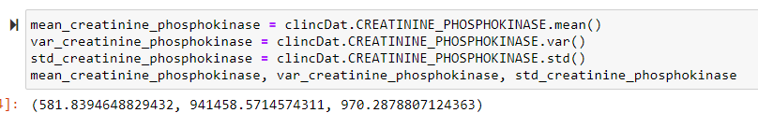

Slide 13
5.) Using pg. 29 of your text as an example, compare two scenarios in your data using a PMF. Reminder, this isn’t comparing two variables against each other – it is the same variable, but a different scenario. Almost like a filter. The example in the book is first babies compared to all other babies, it is still the same variable, but breaking the data out based on criteria we are exploring (Chapter 3).

Slide 14
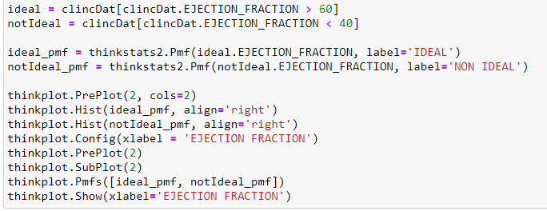
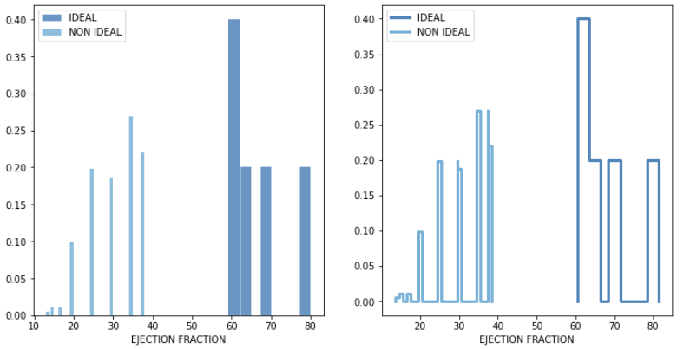

Slide 15
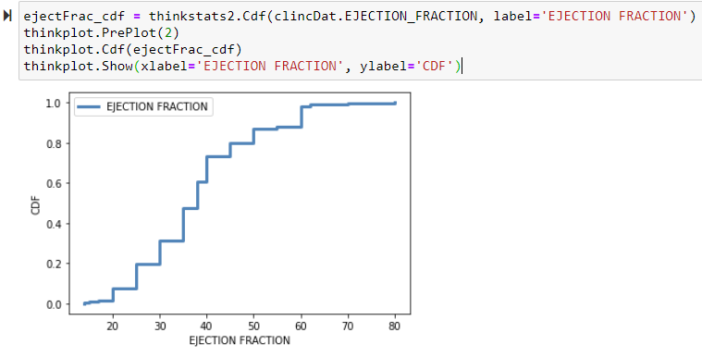
6.) Create 1 CDF with one of your variables, using page 41-44 as your guide, what does this tell you about your variable and how does it address the question you are trying to answer (Chapter 4).
Notes:
CDF on Ejection Fraction provides a visual representation of the distribution. Common values appear as steep or vertical sections of the CDF; only 35% of heart failures occurs when Ejection Fraction is less than 40 which indicates a direct relation between heart failure and Ejection Fraction

Slide 16
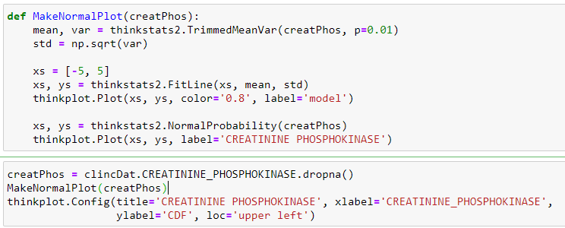
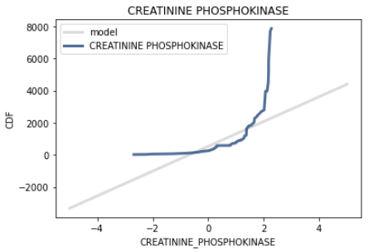
7.) Plot 1 analytical distribution and provide your analysis on how it applies to the dataset you have chosen (Chapter 5).
Notes:
The curve do not match the model near the mean and deviate. The plot suggests that the normal model describes that the distribution is way out with a huge deviation

Slide 17
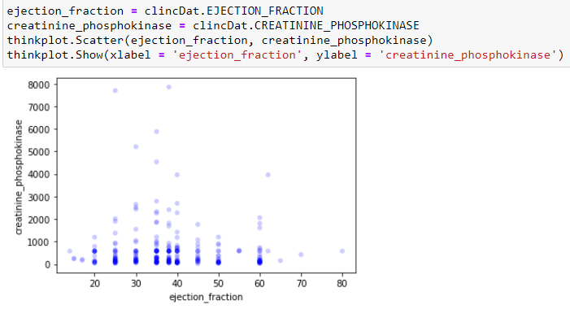
8.) Create two scatter plots comparing two variables and provide your analysis on correlation and causation. Remember, covariance, Pearson’s correlation, and Non-Linear Relationships should also be considered during your analysis (Chapter 7).

Slide 18
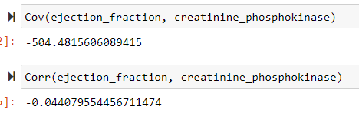
Notes:
Based on the results, it clearly indicates that these two variables are not related to each other

Slide 19
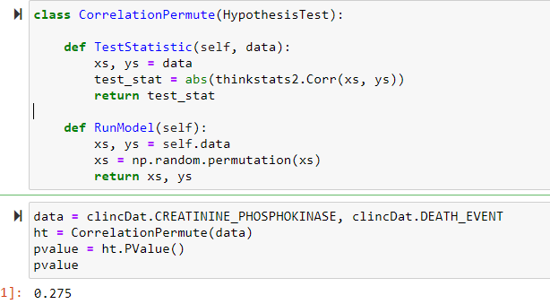
9.) Conduct a test on your hypothesis using one of the methods covered in Chapter 9.

Slide 20
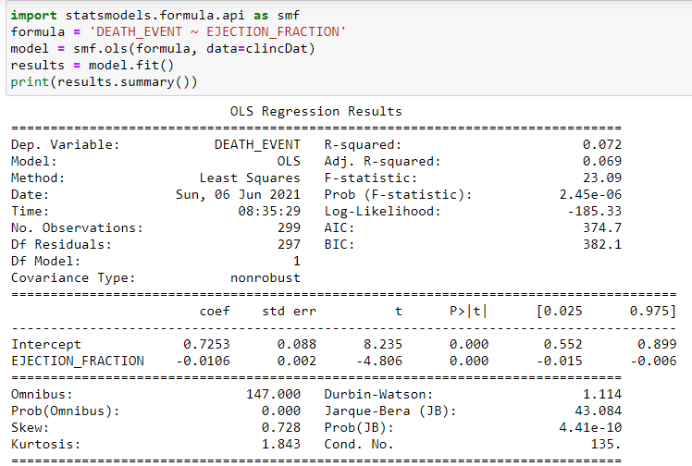
10.) For this project, conduct a regression analysis on either one dependent and one explanatory variable, or multiple explanatory variables (Chapter 10 & 11).

Slide 21
THANK YOU

