Slide 1

I'M Achiever I'M Responsible
Balbhas'6

Slide 2
I'M Achiever I'M Responsible
DevOps & DevOps Tools

Slide 3
I'M Achiever I'M Responsible
AGENDA:
What is DevOps?
DevOps Lifecycle
DevOps solutions to dev&Ops team
DevOps Automation Tools
AWS services

Slide 4

WHAT IS DEVOPS?
The word DevOps is a combination of two words that is development and operations. This is a culture that promotes the collaboration between development team and the operations team. With the help of DevOps, The applications can be delivered faster and serve their customer needs nicely.

Slide 5
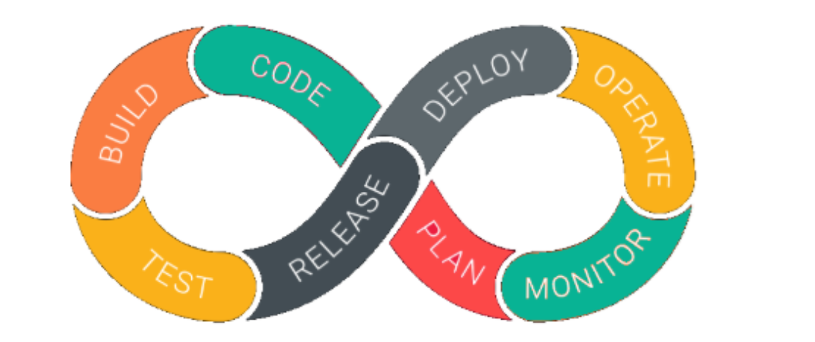
DevOps life cycle
DevOps is the effective collaboration between Development and IT operations. It is not possible to understand DevOps without knowing DevOps lifecycle. The important phase of DevOps life cycle are shown below that promotes continuous integration and continuous monitoring

Slide 6
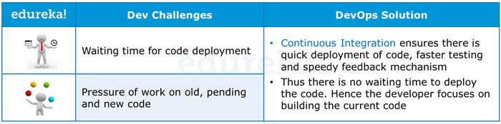
Dev challenges & DevOps solution

Slide 7
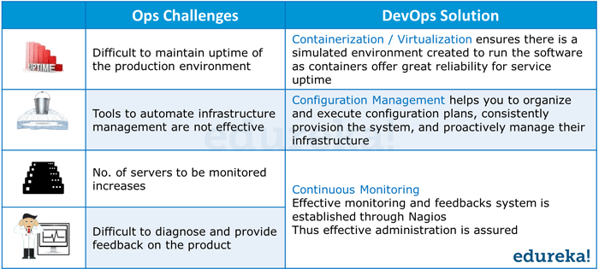
Ops challenges& DevOps solution

Slide 8
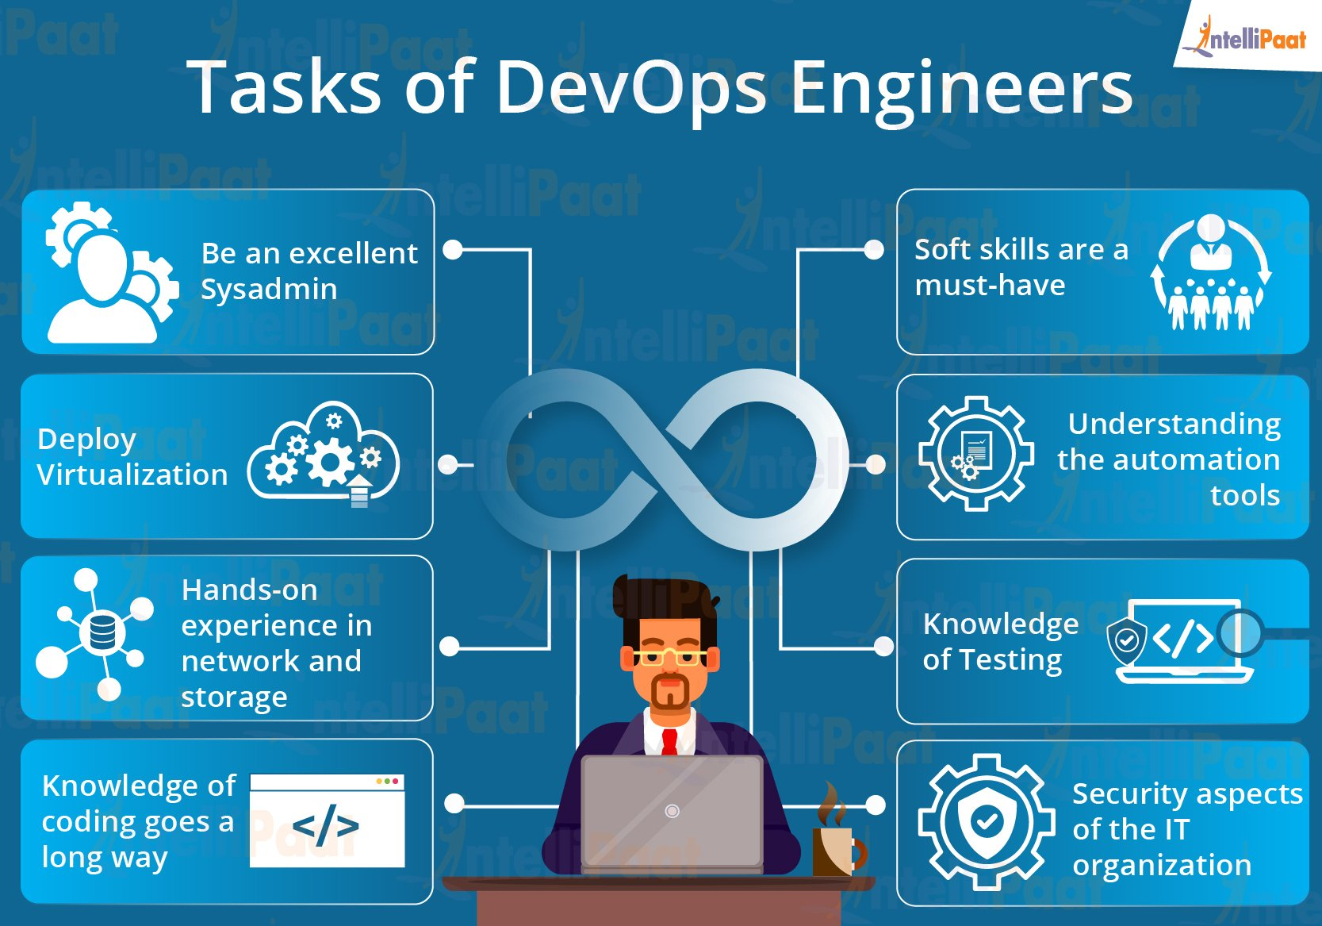
Tasks of DevOps engineer

Slide 9
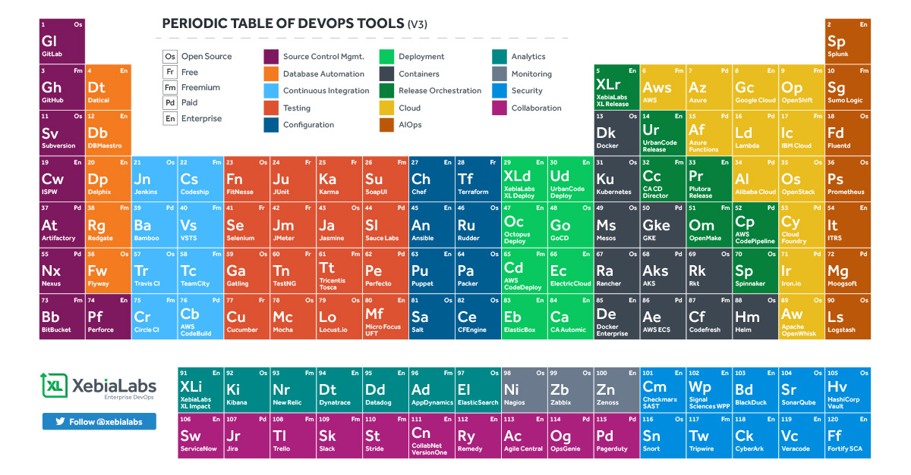
Periodic table DevOps

Slide 10
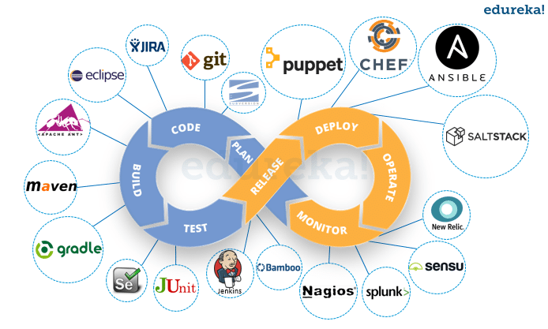
DevOps tools

Slide 11
DevOps Processes:
▰ Automate Provisioning - Code development and review, source code
management tools, code merging
▰ Automate Builds – Continuous Integration, Build Status
▰ Automate Testing – Continuous Testing, Automated Tests
▰ Automate Deployments – Defined Deployment Pipeline and Continuous
Deployments with appropriate configurations for the environments
▰ Automate Monitoring – Proper monitors in place, sending alerts
▰ Automate Metrics – Performance Metrics, Logs

Slide 12
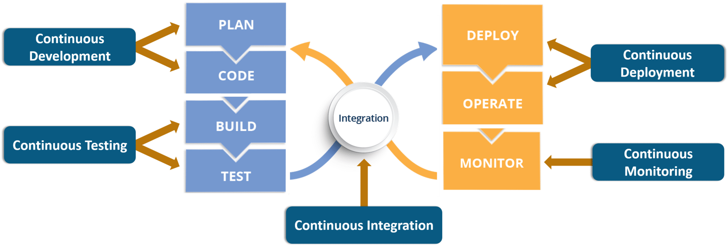
DevOps Stages
Continuous Development
CI(Continuous Integration)
Continuous Testing
CD(Continuous Deployment)
Continuous Monitoring

Slide 13
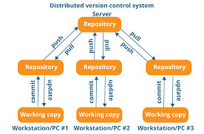
Stage — 1: Continuous Development
Tools Used: Git, SVN, Mercurial, CVS
Process Flow:

Slide 14
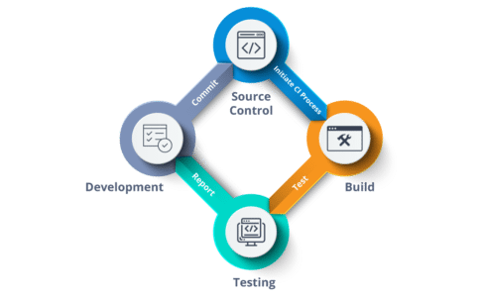
Stage — 2: Continuous Integration
Tools: Jenkins, Gitlab, Travis

Slide 15
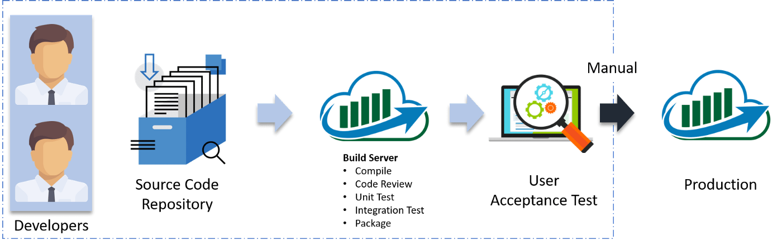
Stage — 3: Continuous Testing
Tools: Jenkins, Selenium TestNG, JUnit
Process Flow:

Slide 16
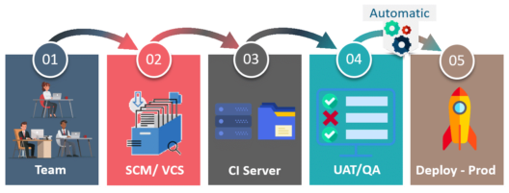
Stage — 4: Continuous Deployment
Tools Used:
Configuration Management — Chef, Puppet, Ansible
Orchestration tool – terraform
Containerization — Docker, Kubernetes
Process Flow:

Slide 17
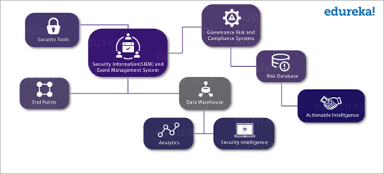
Stage — 5: Continuous Monitoring
Tools Used: Splunk, ELK Stack, Nagios, prometheus and grafana

Slide 18
Configuration management/orchestration
Ansible
Chef
Puppet
Terraform

Slide 19

ANSIBLE:
Ansible is an open soucre IT configuration Management ,Deployment & Orchestration tool.
Its aims to provide large productivity gains to a wide variety of automation challenges.
This tool is very simple to use yet powerful enough to automate complex multi-tier IT application environments

Slide 20
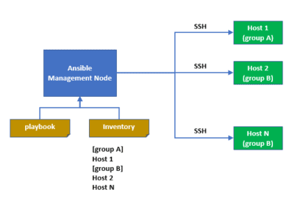
ANSIBLE:

Slide 21
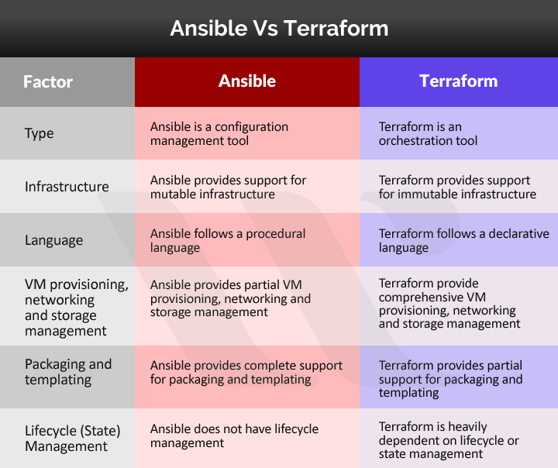
ANSIBLE Vs TERAFORM

Slide 22
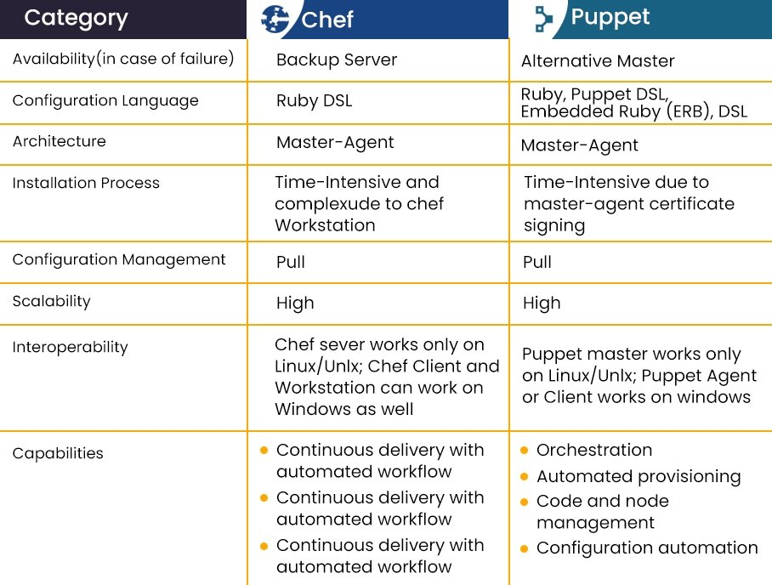
Chef/puppet

Slide 23
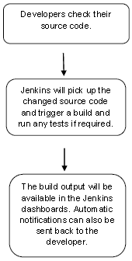
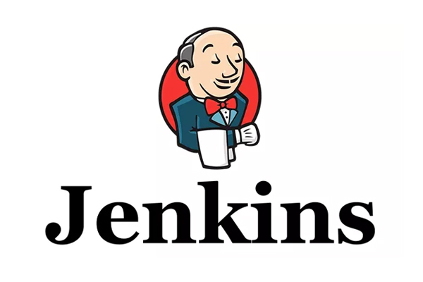
JENKINS:CI/CD
Jenkins is a software that allows continuous integration. Jenkins will be installed on a server where the central build will take place

Slide 24
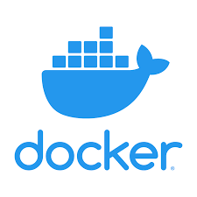
DOCKER:
Docker is a software platform that simplifies the process of building, running, managing and distributing applications.
Docker is developed using the GO programming language.
A Docker Container doesn’t have any operating system installed and running on it. But it would have a virtual copy of the process table, network interface(s), and the file system mount point(s). These have been inherited from the operating system of the host on which the container is hosted and running.

Slide 25
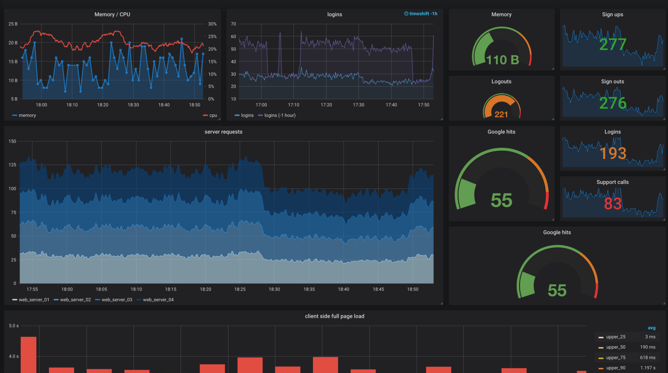
Grafana /Prometheus
Prometheus and Grafana are both built for time-series data. Prometheus excels in metric data collection, whereas Grafana champions metric visualizations. Both tools are open source, free and have vibrant communities of open source developers supporting their development.

Slide 26
AWS services – EC2 Instance
ELASTIC COMPUTE CLOUD:
Amazon EC2 provides a wide selection of instance types optimized to fit different use cases. Instance types comprise varying combinations of CPU, memory, storage, and networking capacity and give you the flexibility to choose the appropriate mix of resources for your applications.

Slide 27
AWS services – S3
Amazon S3
Is an object storage service that stores data as objects within buckets. An object is a file and any metadata that describes the file. A bucket is a container for objects. To store your data in Amazon S3, you first create a bucket and specify a bucket name and AWS Region.

Slide 28
AWS services –Load Balancer
Load balancer:
load balancer serves as the single point of contact for clients. The load balancer distributes incoming application traffic across multiple targets, such as EC2 instances, in multiple Availability Zones. This increases the availability of your application. You add one or more listeners to your load balancer.
Types of load balancer
AWS offers three types of load balancers, adapted for various scenarios:
Elastic Load Balancers, Application Load Balancers, and Network Load Balancers

Slide 29
AWS services –Auto scaling
Auto scaling
Amazon EC2 Auto Scaling helps you maintain application availability and allows you to automatically add or remove EC2 instances according to conditions you define. You can use the fleet management features of EC2 Auto Scaling to maintain the health and availability of your fleet.
What are the benefits of using Auto Scaling?
The overall benefit of autoscaling is that it eliminates the need to respond manually in real-time to traffic spikes that merit new resources and instances by automatically changing the active number of servers.

Slide 30
AWS services – Route53
Amazon Route 53 is a highly available and scalable Domain Name System (DNS) web service. It is designed for developers and corporates to route the end users to Internet applications by translating human readable names like www.mydomain.com, into the numeric IP addresses like 192.0.2.1 that computers use to connect to each other

Slide 31
AWS services – EFS
AWS Elastic File System (EFS) is one of three main storage services offered by Amazon. It is a scalable, cloud-based file system for Linux-based applications and workloads that can be used in combination with AWS cloud services and on-premise resources. EFS offers a choice between two storage classes, Infrequent Access and Standard access, depending on your needs. Standard access storage is designed for frequently accessed files while Infrequent Access is intended for storing long-lived but less used files at a lower cost.

Slide 32
AWS services – EKS
EKS – ELASTIC KUBERNETES SERVICES
Amazon Elastic Kubernetes Service (Amazon EKS) is a managed service that you can use to run Kubernetes on AWS without needing to install, operate, and maintain your own Kubernetes control plane or nodes.

Slide 33
I'M Achiever I'M Responsible
Demo with AWS services and Terraform

Slide 34
I'M Achiever I'M Responsible
Thank you

