Slide 1
Organisational joy!
Stacia Stetkiewicz
Postdoc in Global Food Security

Slide 2
Why do I love organisation?
Poor memory…
Work-life balance
Maximise my efficiency
Never worry about deadlines creeping up on you
Better able to estimate how long it will take to complete projects
Know when to say no!
Know where you are when ‘in progress’

Slide 3
What I’ll cover
Key concepts
Deep work
Generative writing
Why I love Pommodoros

Slide 4
What I’ll cover
Key concepts
Deep work
Generative writing
Why I love Pommodoros
Some things that work for me
Organising my notes from papers
Organising my day to day work
Organising over the longer term
Spreadsheet templates available by email!

Slide 5
What I’ll cover
Key concepts
Deep work
Generative writing
Why I love Pommodoros
Avoiding burnout
Some things that work for me
Organising my notes from papers
Organising my day to day work
Organising over the longer term
Further resources
General tip sharing
Spreadsheet templates available by email!

Slide 6
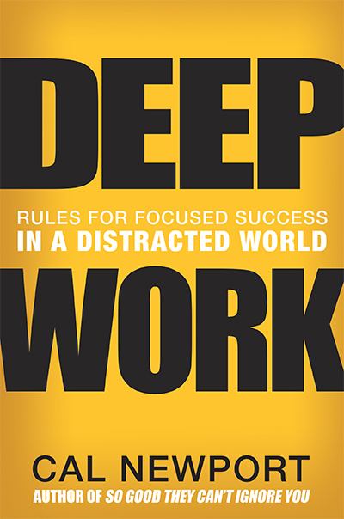
Deep work
“the ability to focus without distraction on a cognitively demanding task. It’s a skill that allows you to quickly master complicated information and produce better results in less time.”

Slide 7
Deep work
Pushes you to new levels
‘in the zone’
Max of 4 hours per day (sustainably)
With pommodoros, you can up this number slightly

Slide 8
Why is it important to understand Deep Work?
So you can decide what deep work to focus on today/tomorrow/this month/year – treat it as a finite resource
So you can play around with it via pommodoros and writing retreats
So you know when to push through and when to stop for a while…

Slide 9
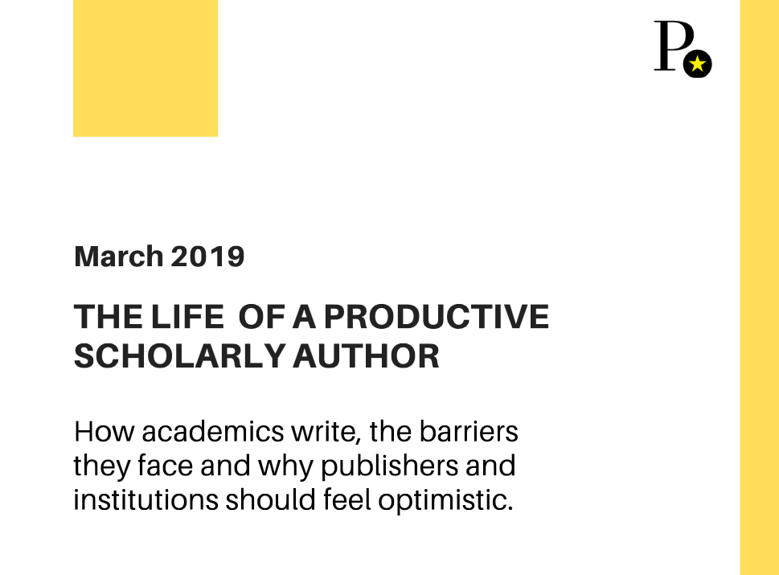
Why is it important to understand Deep Work?
Time blocking – linked with productivity
Daily writing – linked with satisfaction

Slide 10
Generative writing
Writing with no filter
‘there is no writing; only re-writing’

Slide 11
Generative writing
The current global food system is unsustainable. Food systems produce (how much?) greenhouse gas annually, much of which is in the form of N2O (check N2O emissions factor). Changes in consumption can be important – ref from Westhoek re % ghg and heart attacks). ..

Slide 12
Generative writing
Food systems account for an estimated 19 – 29% of global greenhouse gas emissions¹ and agriculture is the driver of approximately 80% of global deforestation². Consumption behaviour can have a significant impact –halving meat, dairy, and egg consumption alone would reduce food-related greenhouse gas emissions in the EU by 25 – 40%, and reduce cardiovascular mortality, due to the estimated 40% reduction in intake of saturated fats⁴…

Slide 13
Generative writing
Writing with no filter
‘there is no writing; only re-writing’
Particularly useful for scholarly writing
In order to plan ahead and organise your writing, you need to know:
How many words you can produce per pommodoro
How long it takes to edit those words into a reasonable draft

Slide 14
Planning a good writing session
Outline your paper/chapter structure in advance
Read in advance
Know how many words/chapters/sections you need to finish
Create a pommodoro plan to get you to your goal

Slide 15
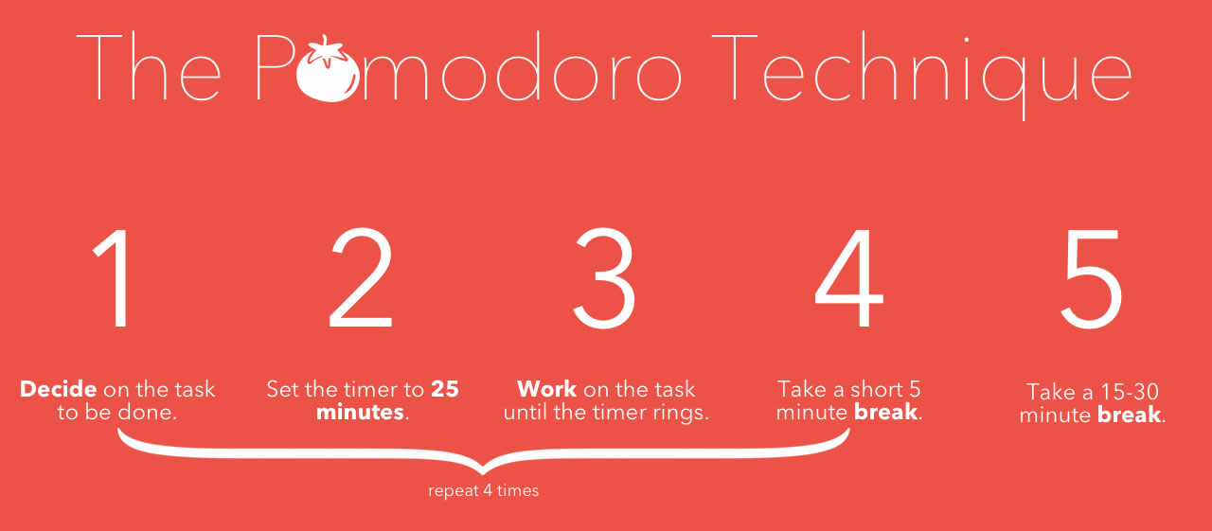
What is a pommodoro?
Invented by Francesco Cirillo, named after the tomato timer

Slide 16
Why I love pommodoros
Length is adjustable
Breaks a large task into manageable chunks
Can always fit one in
Helps me keep my focus
Reduces back, eye, neck, wrist, etc. strain
Take PROPER breaks!
Extends my deep work ability
Suited for daily or weekly writing plans

Slide 17
Avoiding burnout: setting realistic goals
Setting goals based on pie-in-the-sky ideas is a recipe for burnout!
To create a realistic goal:
What are you currently accomplishing?
How much could you add to that?
Level up once per week/month/semester

Slide 18
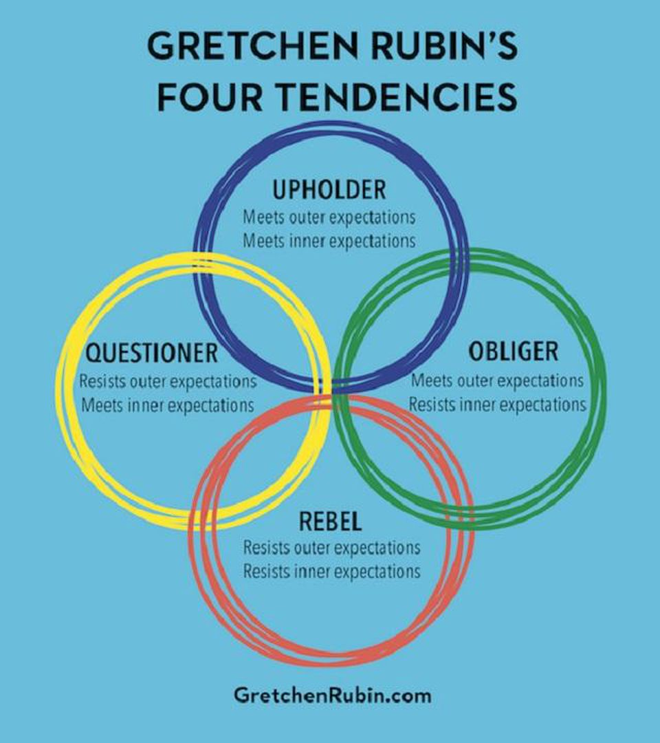
Avoiding burnout – fit your personality
What has worked for you in the past? Build on that!

Slide 19
What I’ll cover
Key concepts
Deep work
Generative writing
Why I love Pommodoros
Some things that work for me
Organising my notes from papers
Organising my day to day work
Organising over the longer term
General tip sharing
Further resources
Spreadsheet templates available by email!

Slide 20
Organising reading
How to track your notes?
My preferred method:
Direct quotes & notes typed into excel as I read

Slide 21
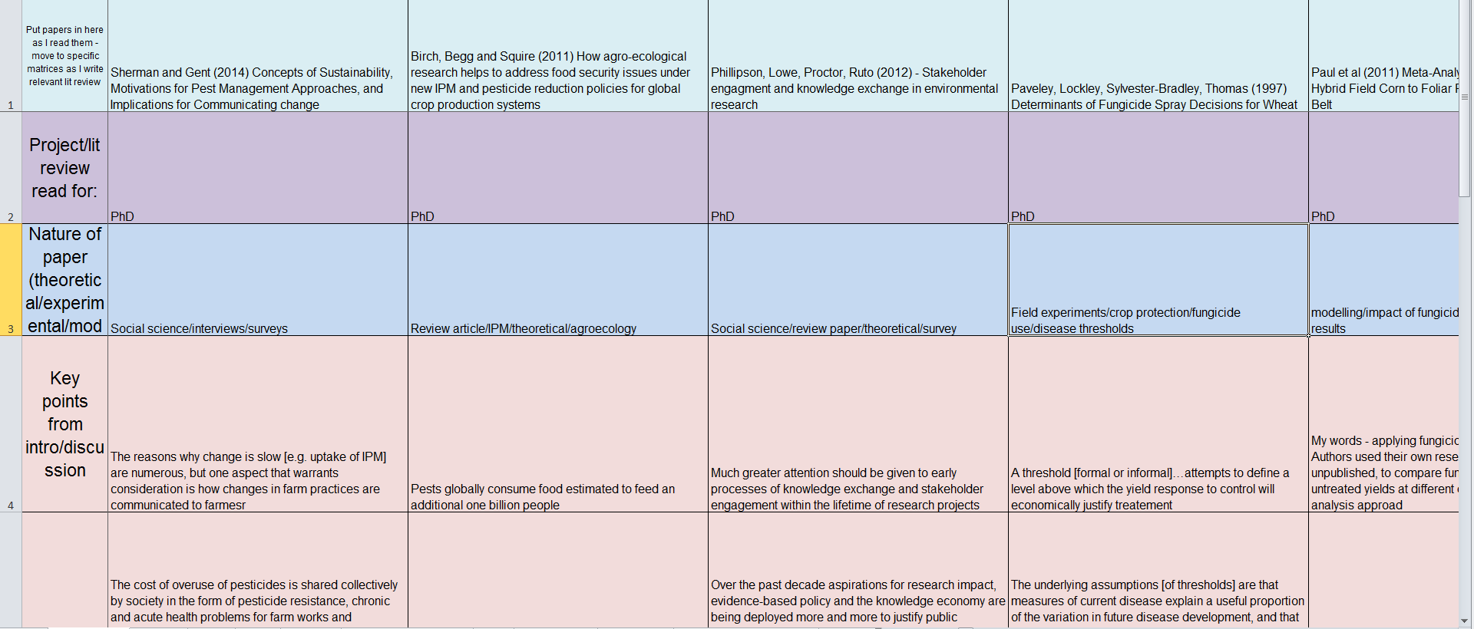
Organising your reading

Slide 22
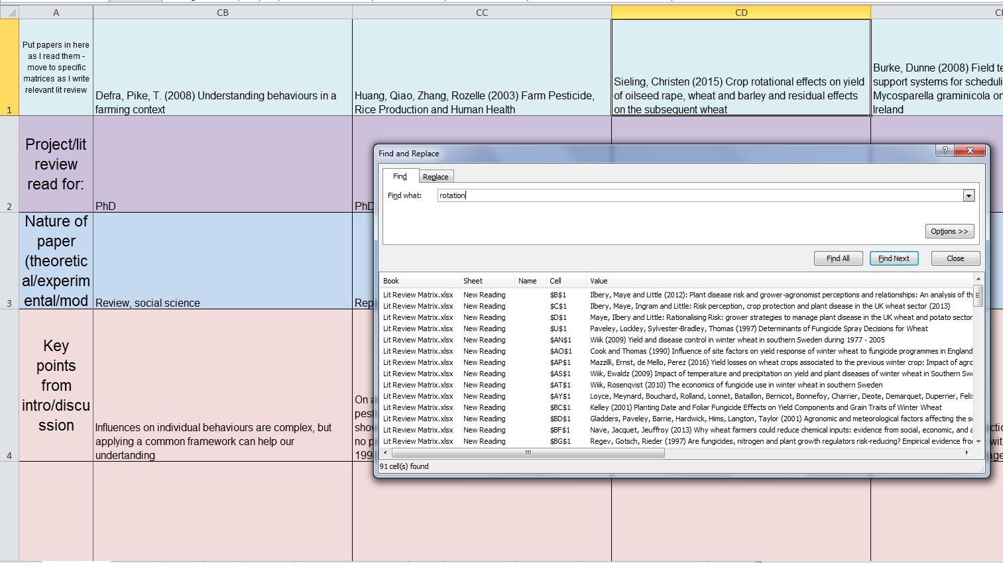
Organising your reading

Slide 23
Organising your reading
Paper title/authors
Project/lit review read for:
Nature of paper (theoretical/experimental/modelling/social science)
Key points from intro/discussion
Aims of work
Importance of work – why was it done?
Method of data collection
Method of data analysis
Key findings
Implications of findings
Limitations of study
Conclusions
My comments

Slide 24
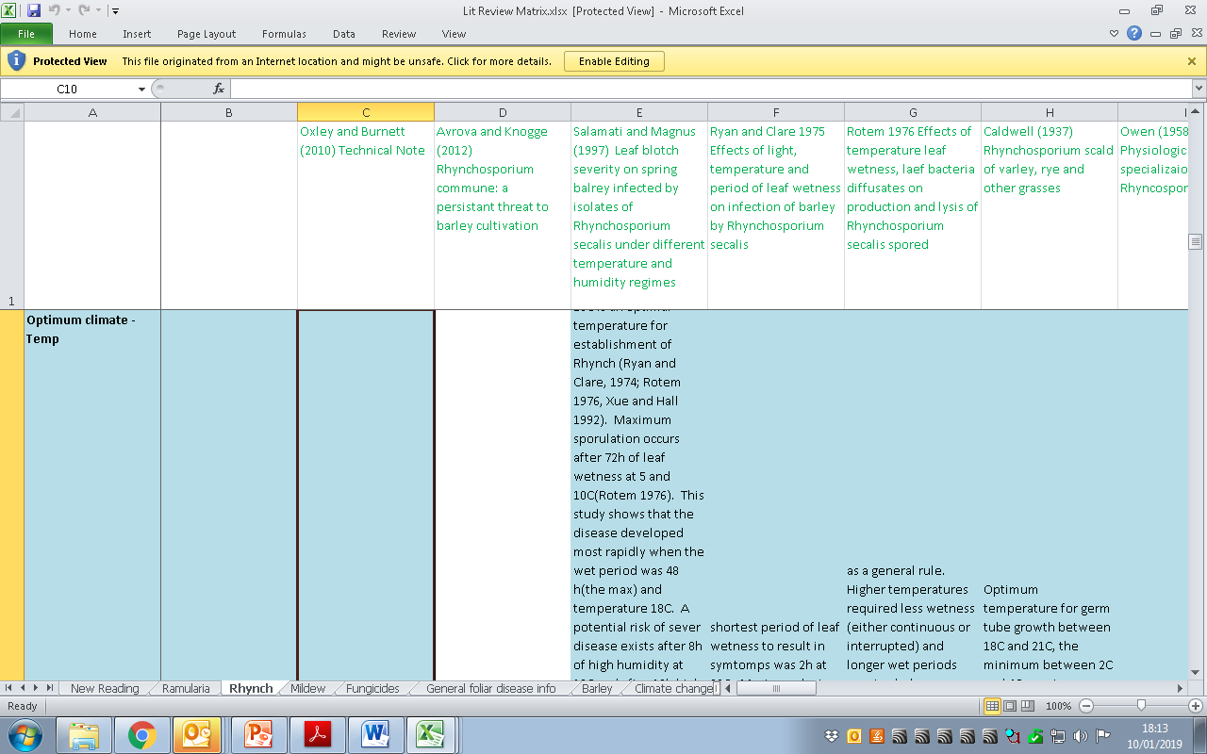
Organising your reading – specific lit reviews

Slide 25
Organising over the long term
Yearly plan
Monthly review
Weekly review

Slide 26
Organising: yearly to do

Slide 27
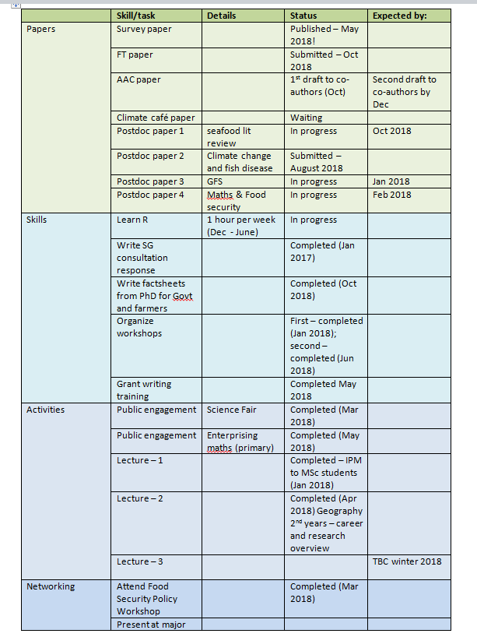
Yearly plan

Slide 28
Organising: monthly to do

Slide 29
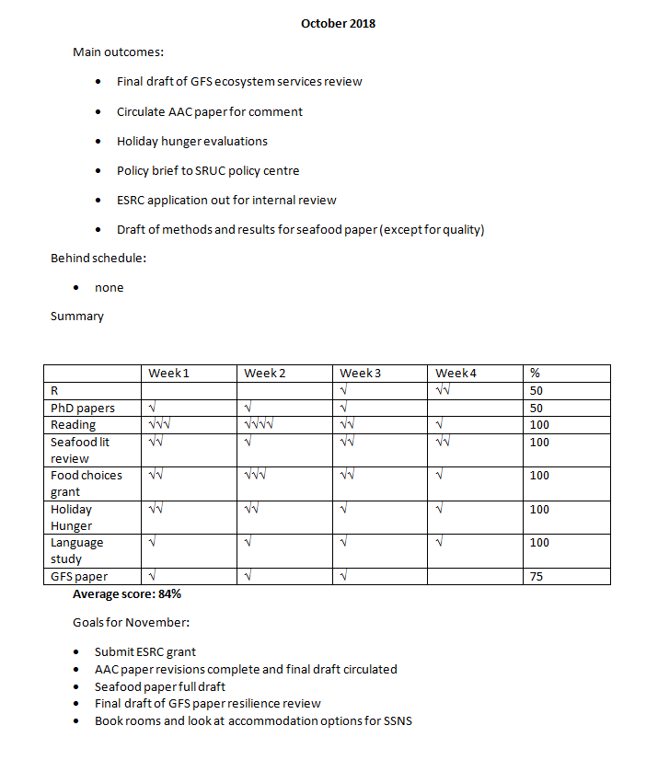
Monthly review

Slide 30
Organising: weekly to do
Check where I am in accomplishing monthly goals
Check what needs to be done for each project I’m working on next week

Slide 31
Organising your day to day work
Collect your to-do items
Reliable, portable, 24/7 accessible
I use email
To do list
Two versions: PhD, Postdoc

Slide 32
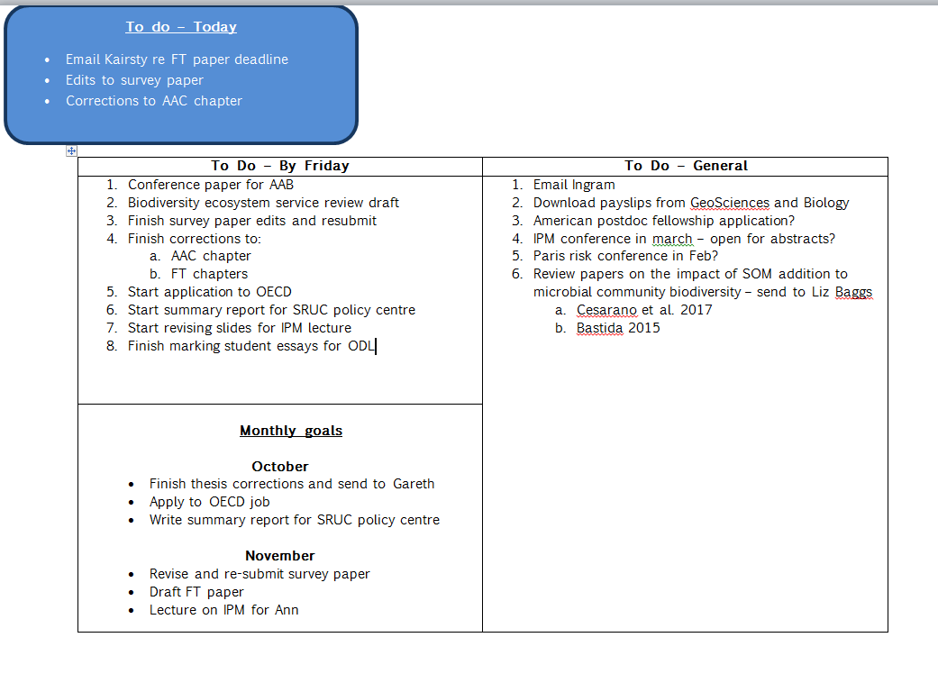
PhD To Do List

Slide 33
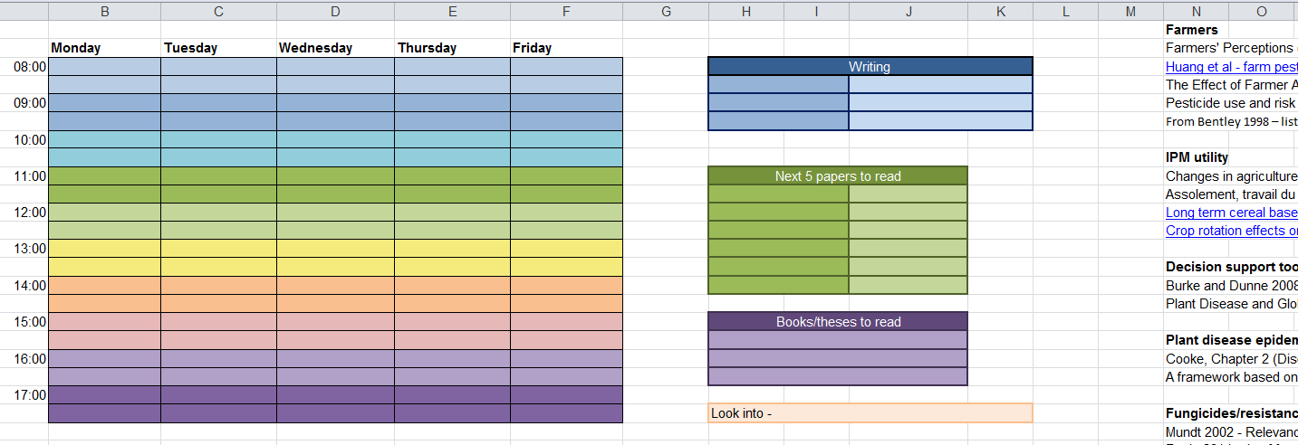
PhD To Do List (write up phase)

Slide 34
PhD To Do List

Slide 35
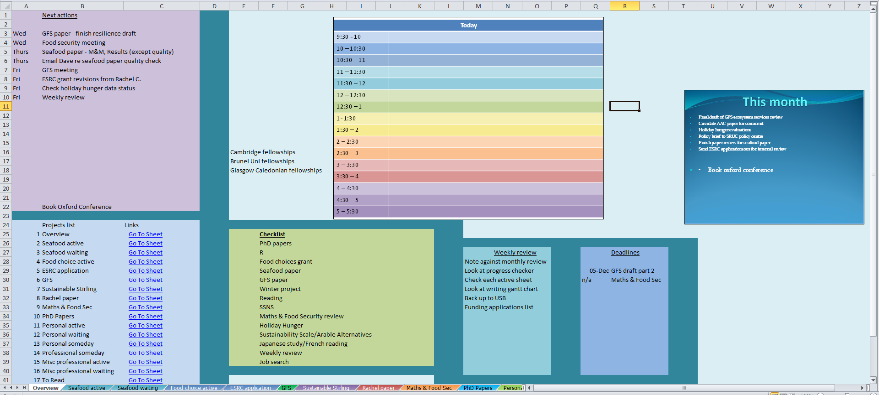
Postdoc To Do List

Slide 36
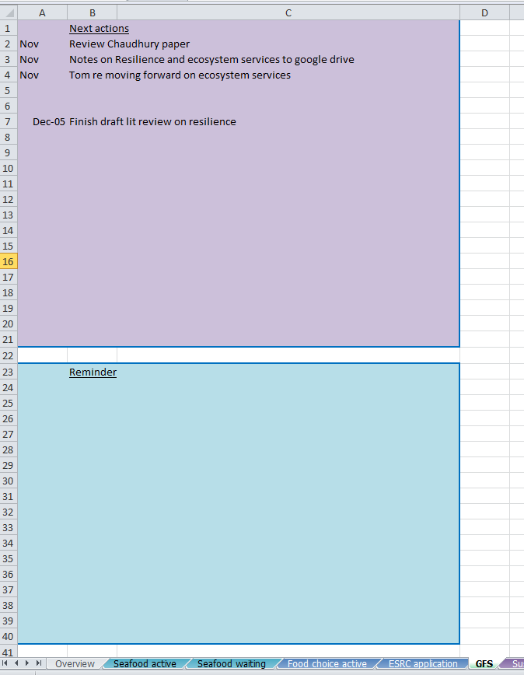
Postdoc To Do List

Slide 37
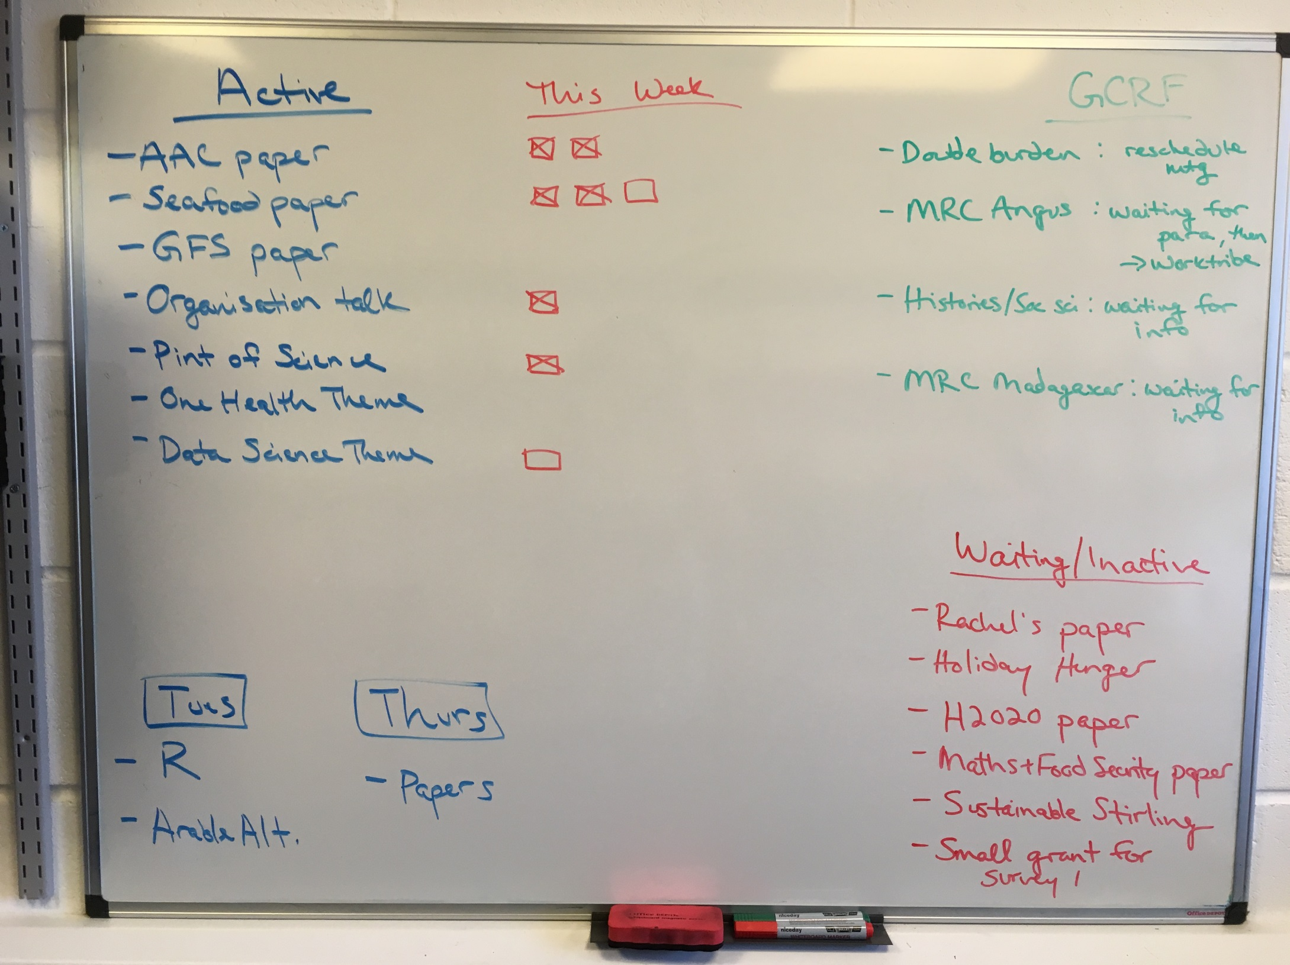
Yearly plan

Slide 38
Further resources
Deep work by Cal Newport (book)
The Four Tendencies by Gretchen Rubin (book)
Imagine: how creativity works by Jonah Lehrer (book)
Thesis Whisperer (blog)
Research Whisperer (blog)
The Professor is In (blog)
Get a Life PhD (blog)
Getting things done by David Allen (book)

Slide 39
I’m happy to share templates! Other organisational tips? Questions?

Slide 40
Writing plans/Gantt charts
An example from writing my thesis:

Slide 42
Writing plans

