Slide 1
Midterm
Mubeen,Rashmi,Sandeep

Slide 2
Part 1: Regression/Classification
Data Exploration
RandomSplit
Feature Engineering
Standardscalar
Normalizer
Model
LinearRegression
Model Evaluation
Crossvalidator with BinaryClassificationEvaluator
PCA
Ridge
Lasso
Model
LogisticRegression
SVMwithSGD

Slide 3
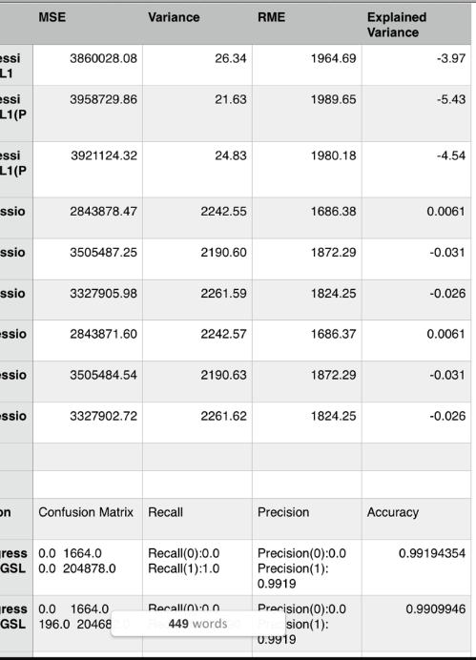

Slide 4
Part 2: Classification
Data Exploration
Pandas API/RandomSplit
Feature Engineering
Standardscalar
Normalizer
Model
LogisticRegressionwithLBFGS
Model Evaluation
Crossvalidator with BinaryClassificationEvaluator
PCA
Logistic Rgression

Slide 5
Results
SVMwithSGD
Area Under ROC -Area under ROC = 0.8990239900396924
LogisticRegression With SGD
Recall:0.8437906994560638
Precision:0.8437906994560638
accuracy:0.8437907
LogisticRegression With LBFGS
Precision(0):0.8804617439419958
Precision(1):0.7479579929988331
Accuracy:0.85436296
Training error for Logistic Regression with PCA
0.24089

Slide 6
Part 3:Clustering Algorithm
Data Exploration
RandomSplit
Data Summarization
Feature Engineering
Standardscalar
Normalizer
Model
K Means
Model Evaluation
MultivariateStatisticalSummary
WSSE graph
Model selection
Cluster = 5

Slide 7
Graph

