Slide 1
Sentiment Analysis
Submitted By:
Sandeep
Mubeen
Rashmi

Slide 2
Problem Statement
Sentiment analysis of text is a challenging subject due to complexity of language and human expressions.
NLP provides a way to make a machine determine the sentiment of a review based on the text.
To analyze the sentiments represented in movie reviews from IMDB using NLP

Slide 3
Approach
Exploratory Data Analysis:
Cleaning data- BeautifulSoup, Regular expressions
Building graphs to figure out key words
NLTK toolkit for removing stop words

Slide 4

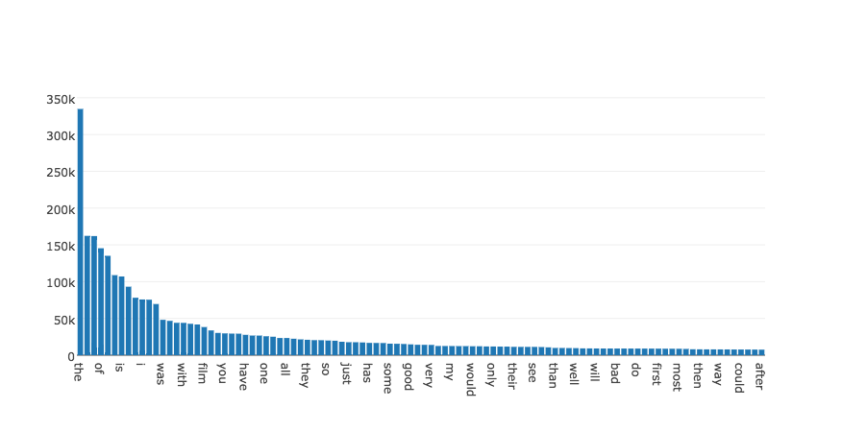
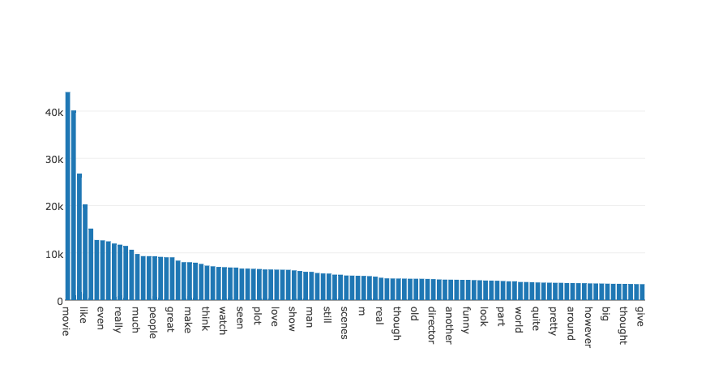
A very naive count:
Removing stop words

Slide 5
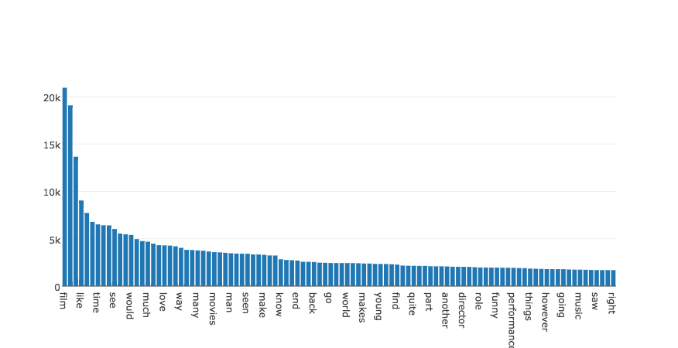
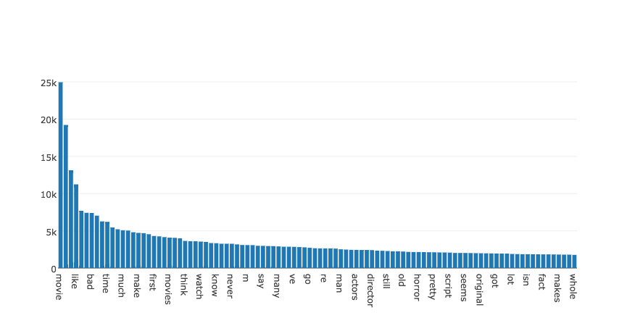
Positive Reviews:
Negative Reviews

Slide 6
Feature Engineering
TF_IDF
Creating vectors for text depending upon the occurrence and repetitions
Word2Vec
Creation of vectors by training a model to understand the semantics of the text.

Slide 7
Algorithms
Classification algorithms
Naive Bayes
Random Forest
Logistic Regression

Slide 8
Results
Algorithm
Logistic Regression | areaUnderPR 0.7920658874070523 | Area under ROC 0.8061931789957208 | training error: 0.26133306765
Naive Bayes | accuracy 72 | recall 71.5 | precision 72.05
ML-Logistic Regression | areaUnderPR 0.8065552181670259 | Area under ROC 0.8275891274493837 | training error: 0.244788029925

Slide 9
Cross Validator
TF-IDF: On pipelining, for logistic regression algorithm with features 300 and 400 and regression parameter value of 0.01,0.1 and 1 improved the auRoC unto 84%

Slide 10
Clustering Algorithm
K-Means: used k-means algorithm to cluster the vectors generated from feature engineering

Slide 11
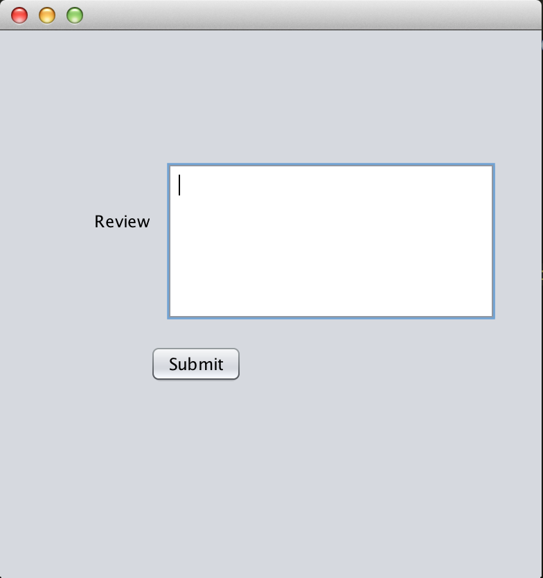
User interface

Slide 12

SparkStreaming
To test sentiment for a new review, we have created a new java application to input reviews
S3 stream review
Write back result
Spark streaming
JavaApp
write review to
S3

