Slide 1
JavaScript Juggernauts

Slide 2
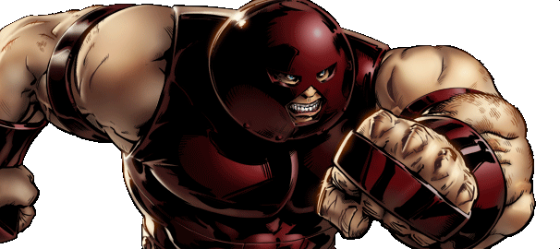
This will soon be you…
JavaScript Juggernauts.

Slide 3
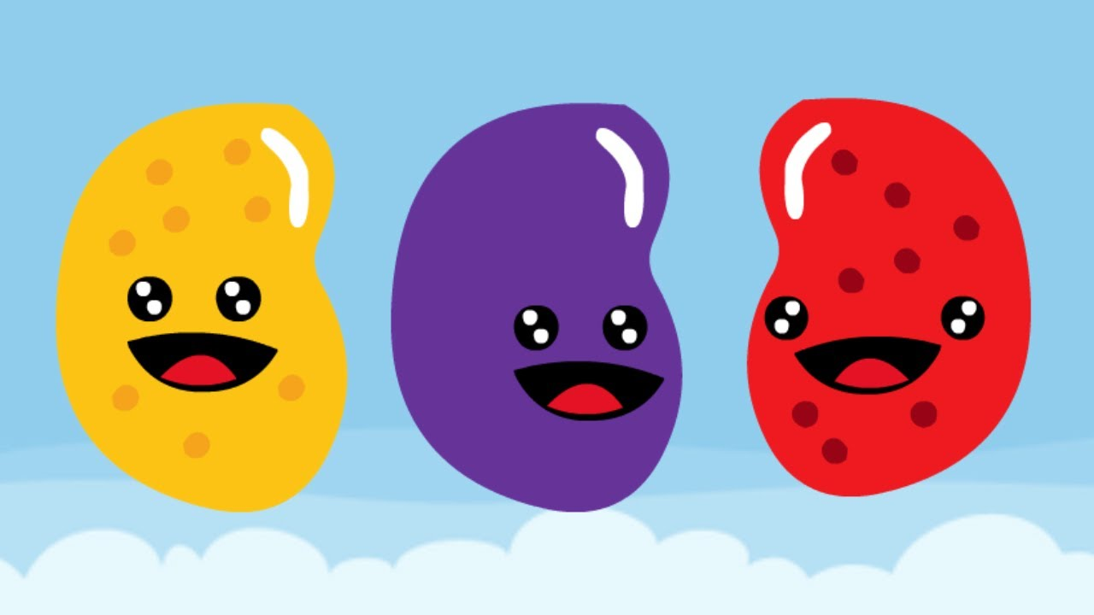
But right now…
Maybe feeling like
JavaScript Jellybeans.

Slide 4
Transformation to Come
HANG IN THERE!

Slide 5
Today’s Class

Slide 6
Objectives
In today’s class we’ll be covering:
D3.js.
DOM Manipulation and Events.
Filtering

Slide 7
Let’s get started!

