Slide 1
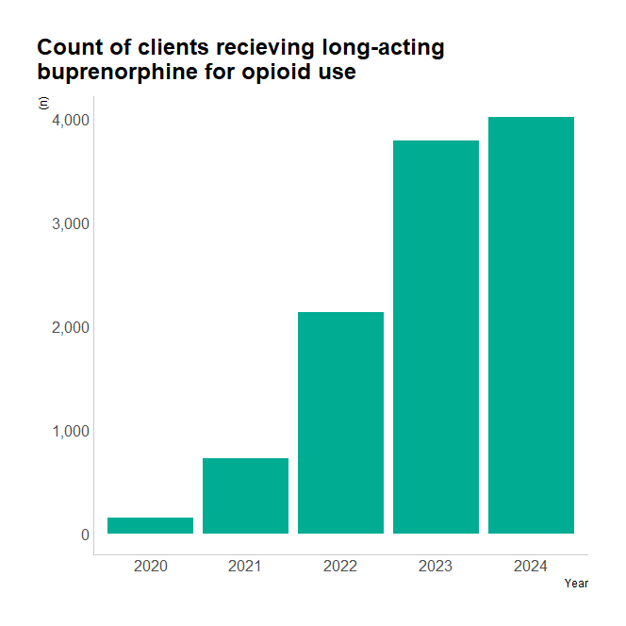
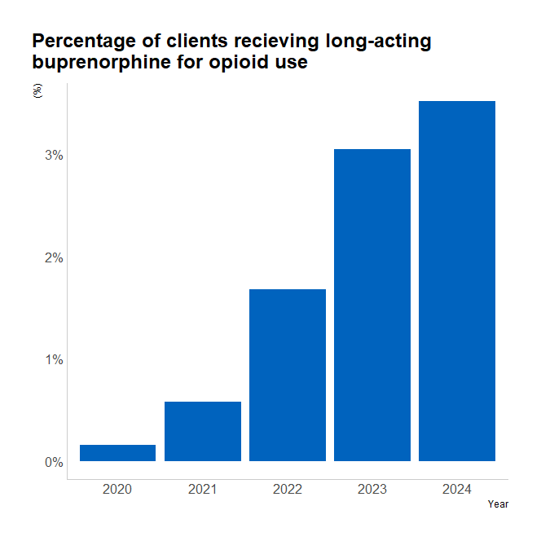
National data
Count of people reported as receiving depot buprenorphine injections on one or more sub-intervention review in the calendar year

Slide 2
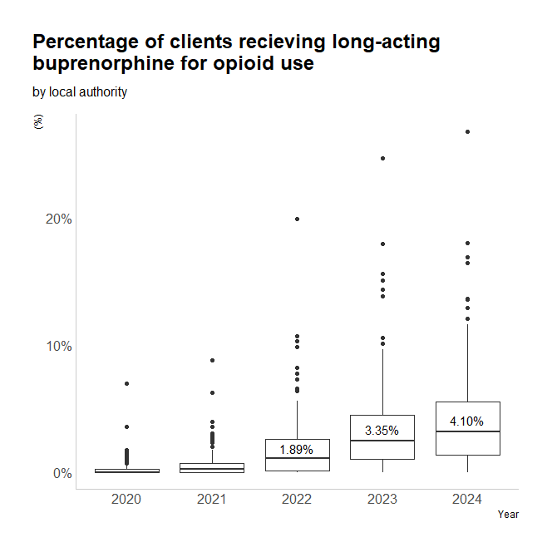
Local authority data
Year | Mean | IQR
2024 | 4.10% | 4.15%
2023 | 3.35% | 3.49%
2022 | 1.89% | 2.48%
2021 | 0.66% | 0.72%
2020 | 0.25% | 0.26%
Area | Other OU treatment | Long-acting buprenorphine (LAB) | LAB (%)
Redbridge | 228 | 61 | 26.75%
Lambeth | 672 | 121 | 18.01%
Bexley | 201 | 34 | 16.92%
Richmond upon Thames | 152 | 25 | 16.45%
Kingston upon Thames | 147 | 20 | 13.61%
Slough | 302 | 41 | 13.58%

Slide 3
Cost comparison
 | Buprenorphine depot injection weekly | Buprenorphine depot injection monthly
Oral methadone daily | £2,454 | £900
Oral methadone weekly | £4,269 | £2,716
Oral methadone fortnightly | £4,420 | £2,866
Oral methadone supervised daily | £722 | -£832
Oral buprenorphine unsupervised | £2,611 | £1,057
Oral buprenorphine supervised daily | £878 | -£676
Assumptions:
1. Oral OST supervision is by an AfC band 4 pharmacy technician.
2. Depot buprenorphine injection is administered by a pharmacist ~ AfC band 7.
3. Other costs such as licencing, controlled drug storage, and training are assumed to be similar for all OST types and therefore not relevant for a comparison

