Slide 1
Long-acting buprenorphine
Your Name

Slide 2
Comparative outcomes
From October to October from 2020 to 2024

Slide 3
Summary results
Year | Outcome | LAB (n) | LAB (%) | No LAB (n) | No LAB (%)
2021 | Died | 26 | 0.5% | 2,494 | 1.9%
2022 | Died | 24 | 0.9% | 2,667 | 2.3%
2023 | Died | 17 | 1.5% | 2,598 | 2.5%
2024 | Died | 4 | 1.2% | 1,359 | 1.7%
2021 | Other | 575 | 12.1% | 19,840 | 15.4%
2022 | Other | 497 | 17.7% | 22,535 | 19.4%
2023 | Other | 206 | 18.7% | 22,662 | 21.6%
2024 | Other | 42 | 12.4% | 12,425 | 15.7%
2021 | Prison or transferred in custody | 280 | 5.9% | 8,752 | 6.8%
2022 | Prison or transferred in custody | 205 | 7.3% | 8,215 | 7.1%
2023 | Prison or transferred in custody | 73 | 6.6% | 6,837 | 6.5%
2024 | Prison or transferred in custody | 20 | 5.9% | 3,661 | 4.6%
2021 | Retained | 3,242 | 68.1% | 89,749 | 69.8%
2022 | Retained | 1,646 | 58.5% | 74,325 | 63.9%
2023 | Retained | 640 | 58.2% | 64,219 | 61.3%
2024 | Retained | 233 | 68.7% | 56,880 | 71.8%
2021 | Successful completion | 637 | 13.4% | 7,684 | 6.0%
2022 | Successful completion | 443 | 15.7% | 8,507 | 7.3%
2023 | Successful completion | 163 | 14.8% | 8,393 | 8.0%
2024 | Successful completion | 40 | 11.8% | 4,947 | 6.2%

Slide 4
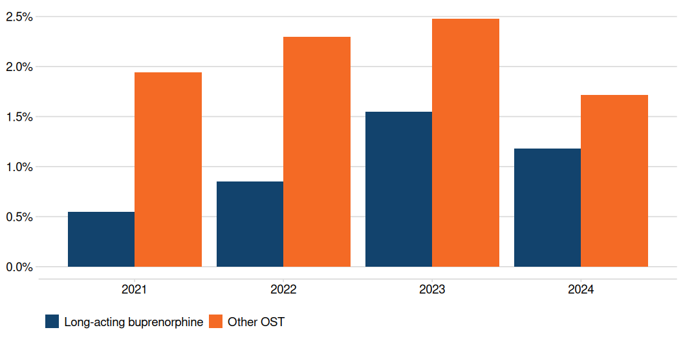
Mortality rates

Slide 5
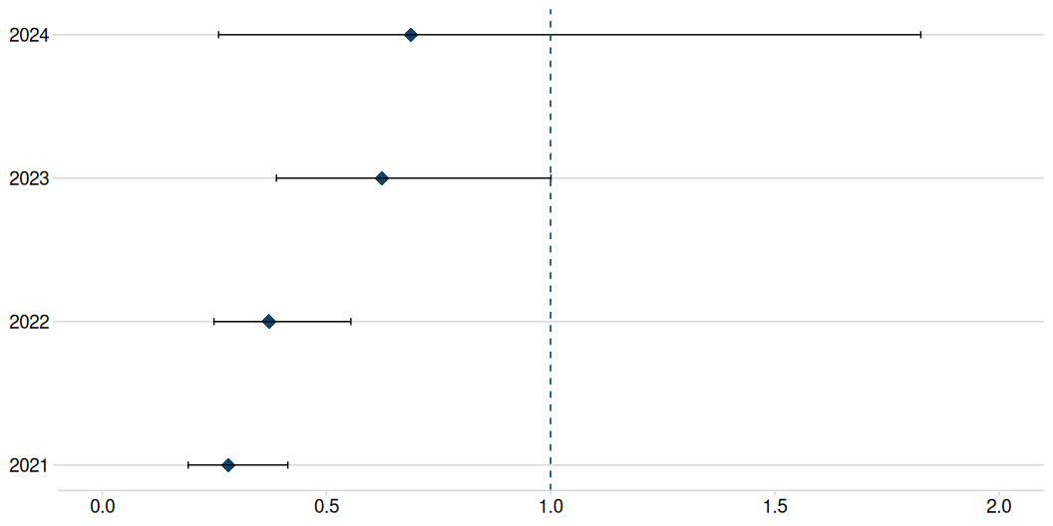
Relative risk of mortality
Relative risk of mortality for those receiving long-acting buprenorphine
Mean relative mortality risk over four years: 0.49
Plot shows 95% confidence intervals

Slide 6
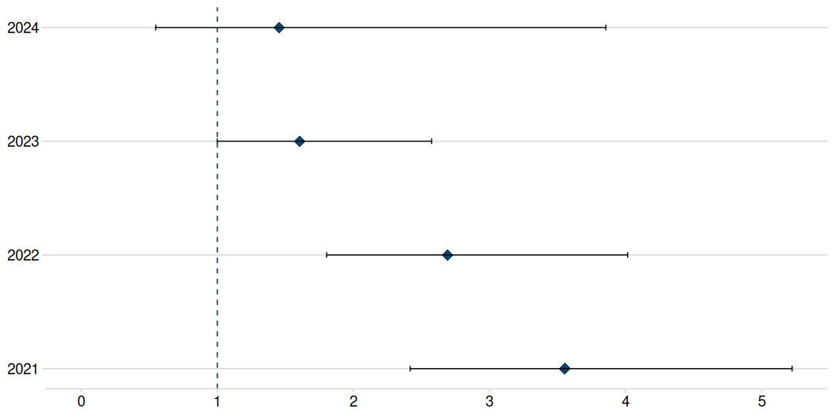
Relative risk of mortality
Relative risk of mortality for those not receiving long-acting buprenorphine
Mean relative mortality risk over four years: 2.33
Plot shows 95% confidence intervals

Slide 7
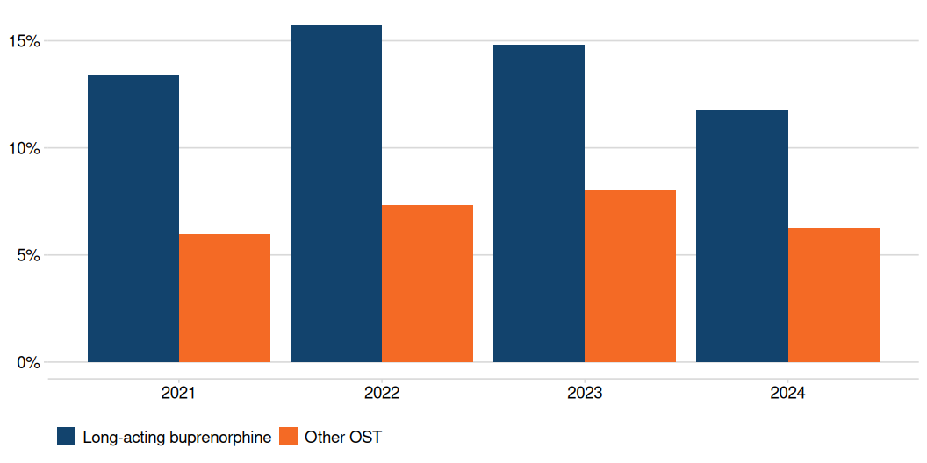
Succesful completion rates

Slide 8
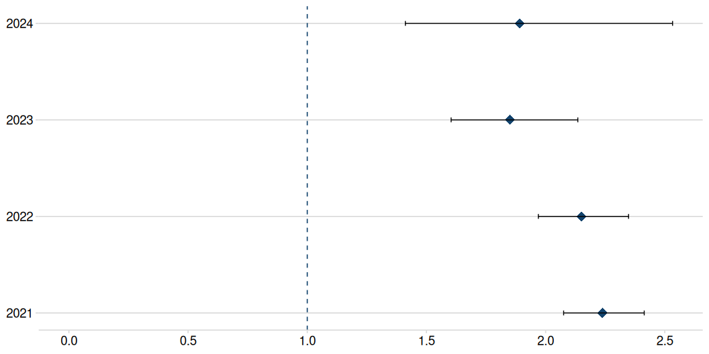
Relative risks: successful completion
Relative ‘risk’ of successful completion for those receiving long-acting buprenorphine
Mean relative risk over four years: 2.03

Slide 9
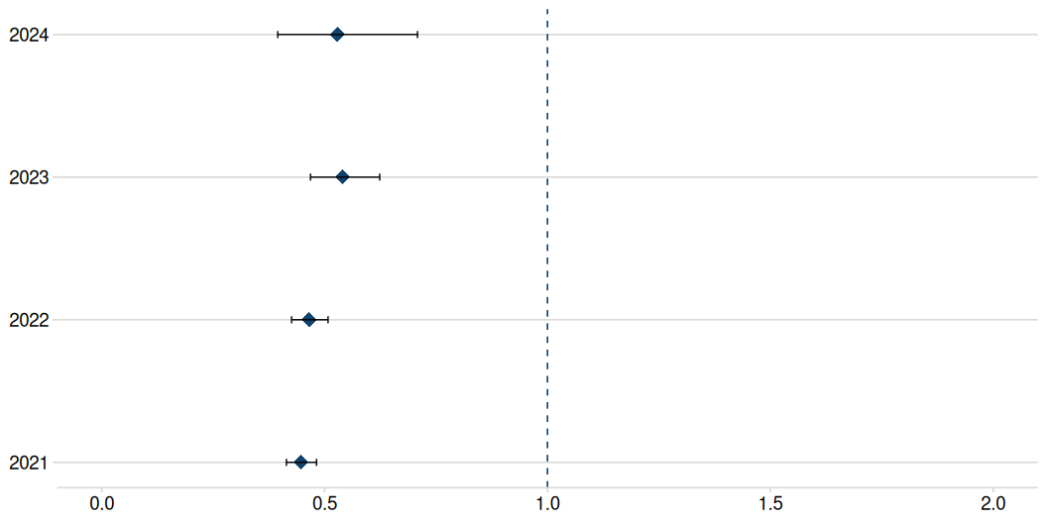
Relative risks: successful completion
Relative ‘risk’ of successful completion for those not receiving long-acting buprenorphine
Mean relative risk over four years: 0.5

Slide 10
Comparative outcomes
Financial year 2020/21 to 2023/24

Slide 11
Summary results
Year | Outcome | LAB (n) | LAB (%) | No LAB (n) | No LAB (%)
2021 | Died | 21 | 0.6% | 2,616 | 2.1%
2022 | Died | 28 | 1.5% | 2,730 | 2.5%
2023 | Died | 3 | 0.5% | 2,552 | 2.5%
2024 | Died |  |  | 221 | 0.4%
2021 | Other | 599 | 16.0% | 21,820 | 17.6%
2022 | Other | 361 | 18.8% | 22,745 | 20.8%
2023 | Other | 93 | 16.8% | 22,334 | 22.2%
2024 | Other | 9 |  | 1,614 | 2.8%
2021 | Prison or transferred in custody | 248 | 6.6% | 9,069 | 7.3%
2022 | Prison or transferred in custody | 135 | 7.0% | 7,321 | 6.7%
2023 | Prison or transferred in custody | 37 | 6.7% | 6,652 | 6.6%
2024 | Prison or transferred in custody | 2 |  | 522 | 0.9%
2021 | Retained | 2,323 | 62.1% | 81,703 | 66.1%
2022 | Retained | 1,070 | 55.7% | 68,405 | 62.4%
2023 | Retained | 331 | 59.7% | 60,496 | 60.0%
2024 | Retained | 149 |  | 53,976 | 94.6%
2021 | Successful completion | 547 | 14.6% | 8,424 | 6.8%
2022 | Successful completion | 327 | 17.0% | 8,369 | 7.6%
2023 | Successful completion | 90 | 16.2% | 8,745 | 8.7%
2024 | Successful completion | 3 |  | 733 | 1.3%

Slide 12
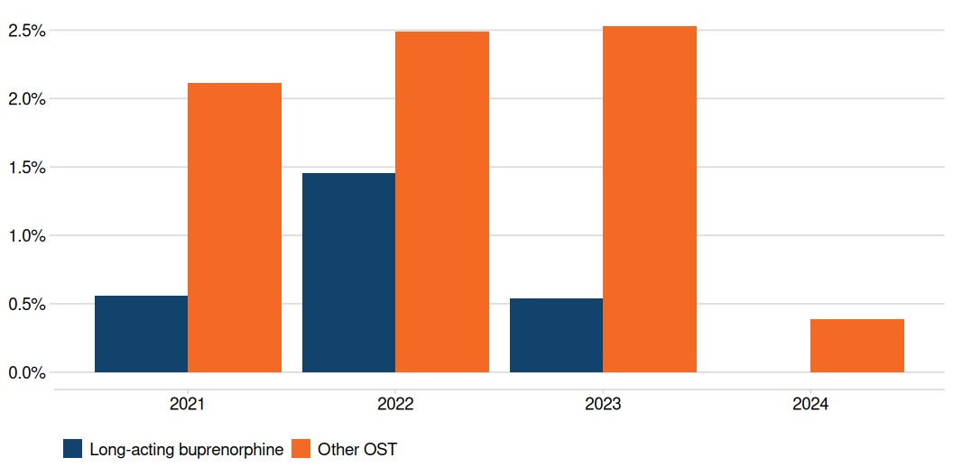
Mortality rates

Slide 13
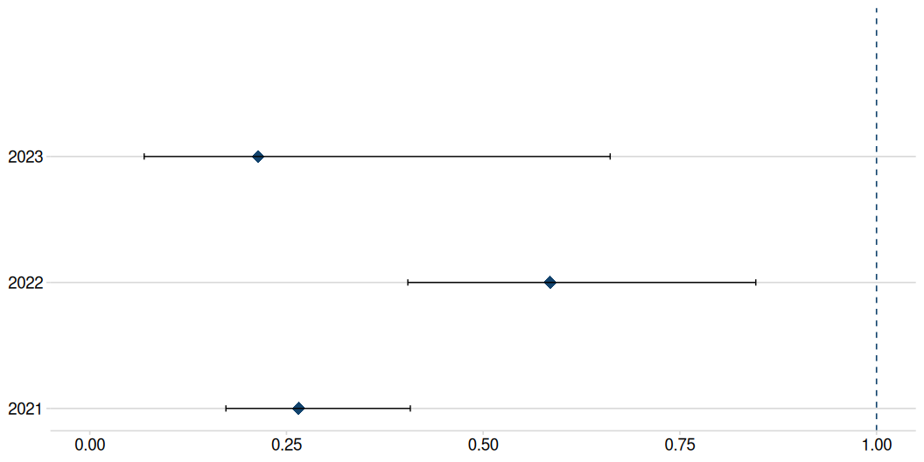
Relative risk of mortality
Relative risk of mortality for those receiving long-acting buprenorphine
Mean relative mortality risk over four years: NA
Plot shows 95% confidence intervals

Slide 14
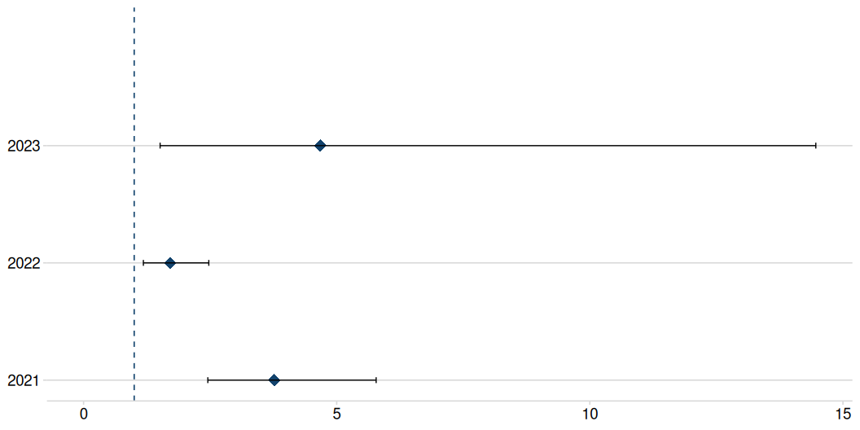
Relative risk of mortality
Relative risk of mortality for those not receiving long-acting buprenorphine
Mean relative mortality risk over four years: NA
Plot shows 95% confidence intervals

Slide 15
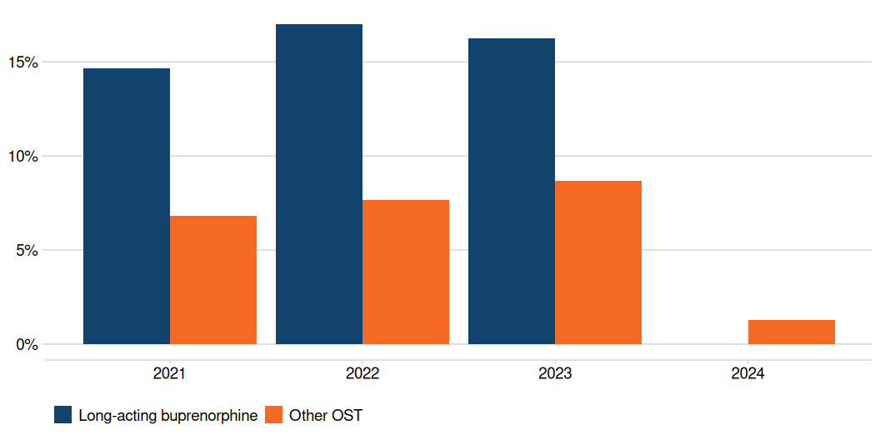
Succesful completion rates

Slide 16
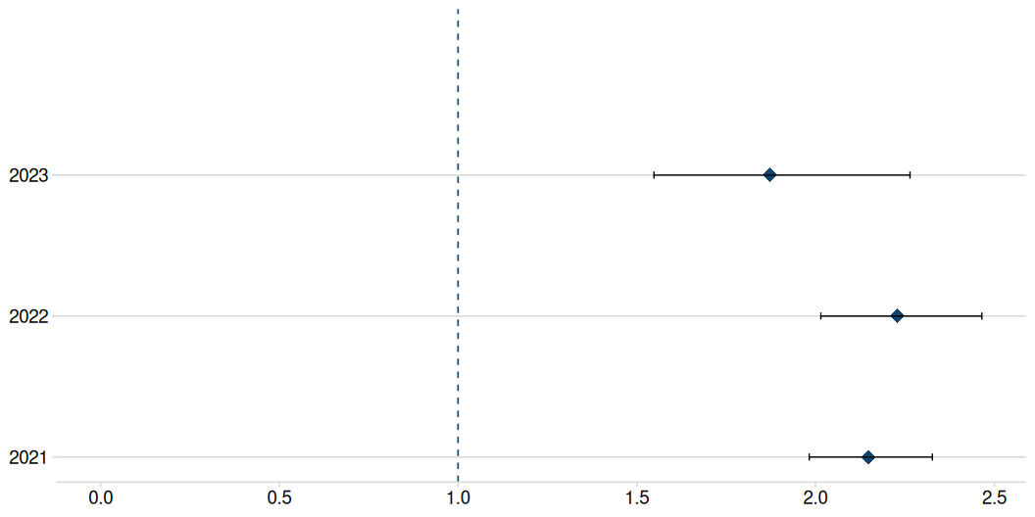
Relative risks: successful completion
Relative ‘risk’ of successful completion for those receiving long-acting buprenorphine
Mean relative risk over four years: NA

Slide 17
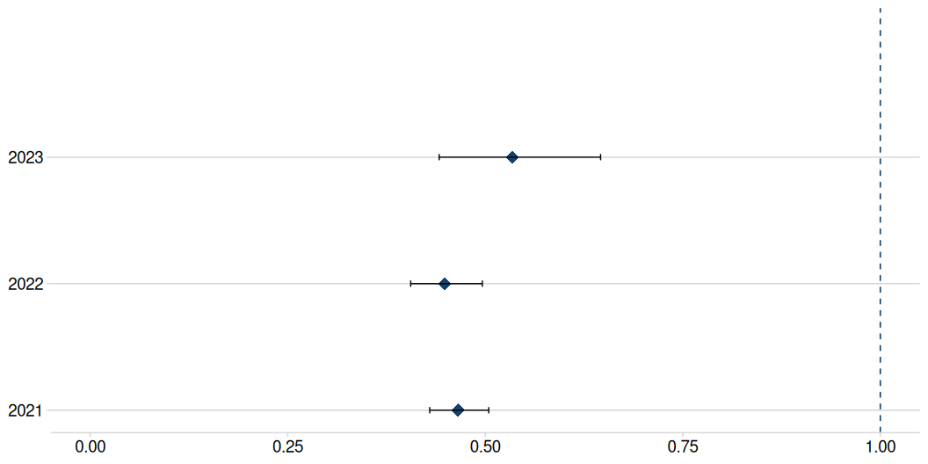
Relative risks: successful completion
Relative ‘risk’ of successful completion for those not receiving long-acting buprenorphine
Mean relative risk over four years: NA

