Slide 1
Deaths associated with substance use
Premature mortality and life-years lost due to drug and alcohol use OHID

Slide 2
Number of deaths associated with drug use
Year of death registration | All drug poisonings | Number of deaths without substance information | Percentage without substance information
2023 | 5,448 | 1,245 | 22.9
2022 | 4,907 | 1,239 | 25.2
2021 | 4,859 | 1,219 | 25.1
2020 | 4,561 | 1,050 | 23.0
The ONS classifies death related to drug poisoning according ICD-10 codes. Certain ICD-10 codes classify a death as a “drug misuse death”[^1]. Each of these requires a specific substance (e.g. heroin) or substance category (e.g. opioids) to be indicated either in the ICD-10 code or on the death certificate.
There are deaths each year where the ONS holds no information on the substance(s) involved.

Slide 3
Some of these will be classified as related to drug misuse where an ICD-10 code indicates mental and behavioural disorders due to drug use (excluding alcohol and tobacco) without a specific substance (e.g. F19 “multiple drug use and use of other psychoactive substances”).
Others, coded as accidental/intentional self-poisonings or self-poisonings of unknown intent, will not be classfified as related to drug misuse unless a controlled drug under Misuse of Drugs Act 1971 was mentioned on the death record.
The data linkage between ONS mortality and NDTMS allows some of those deaths to be identified indirectly as related to drug misuse where the person that died had had contact with the drug treatment.

Slide 4
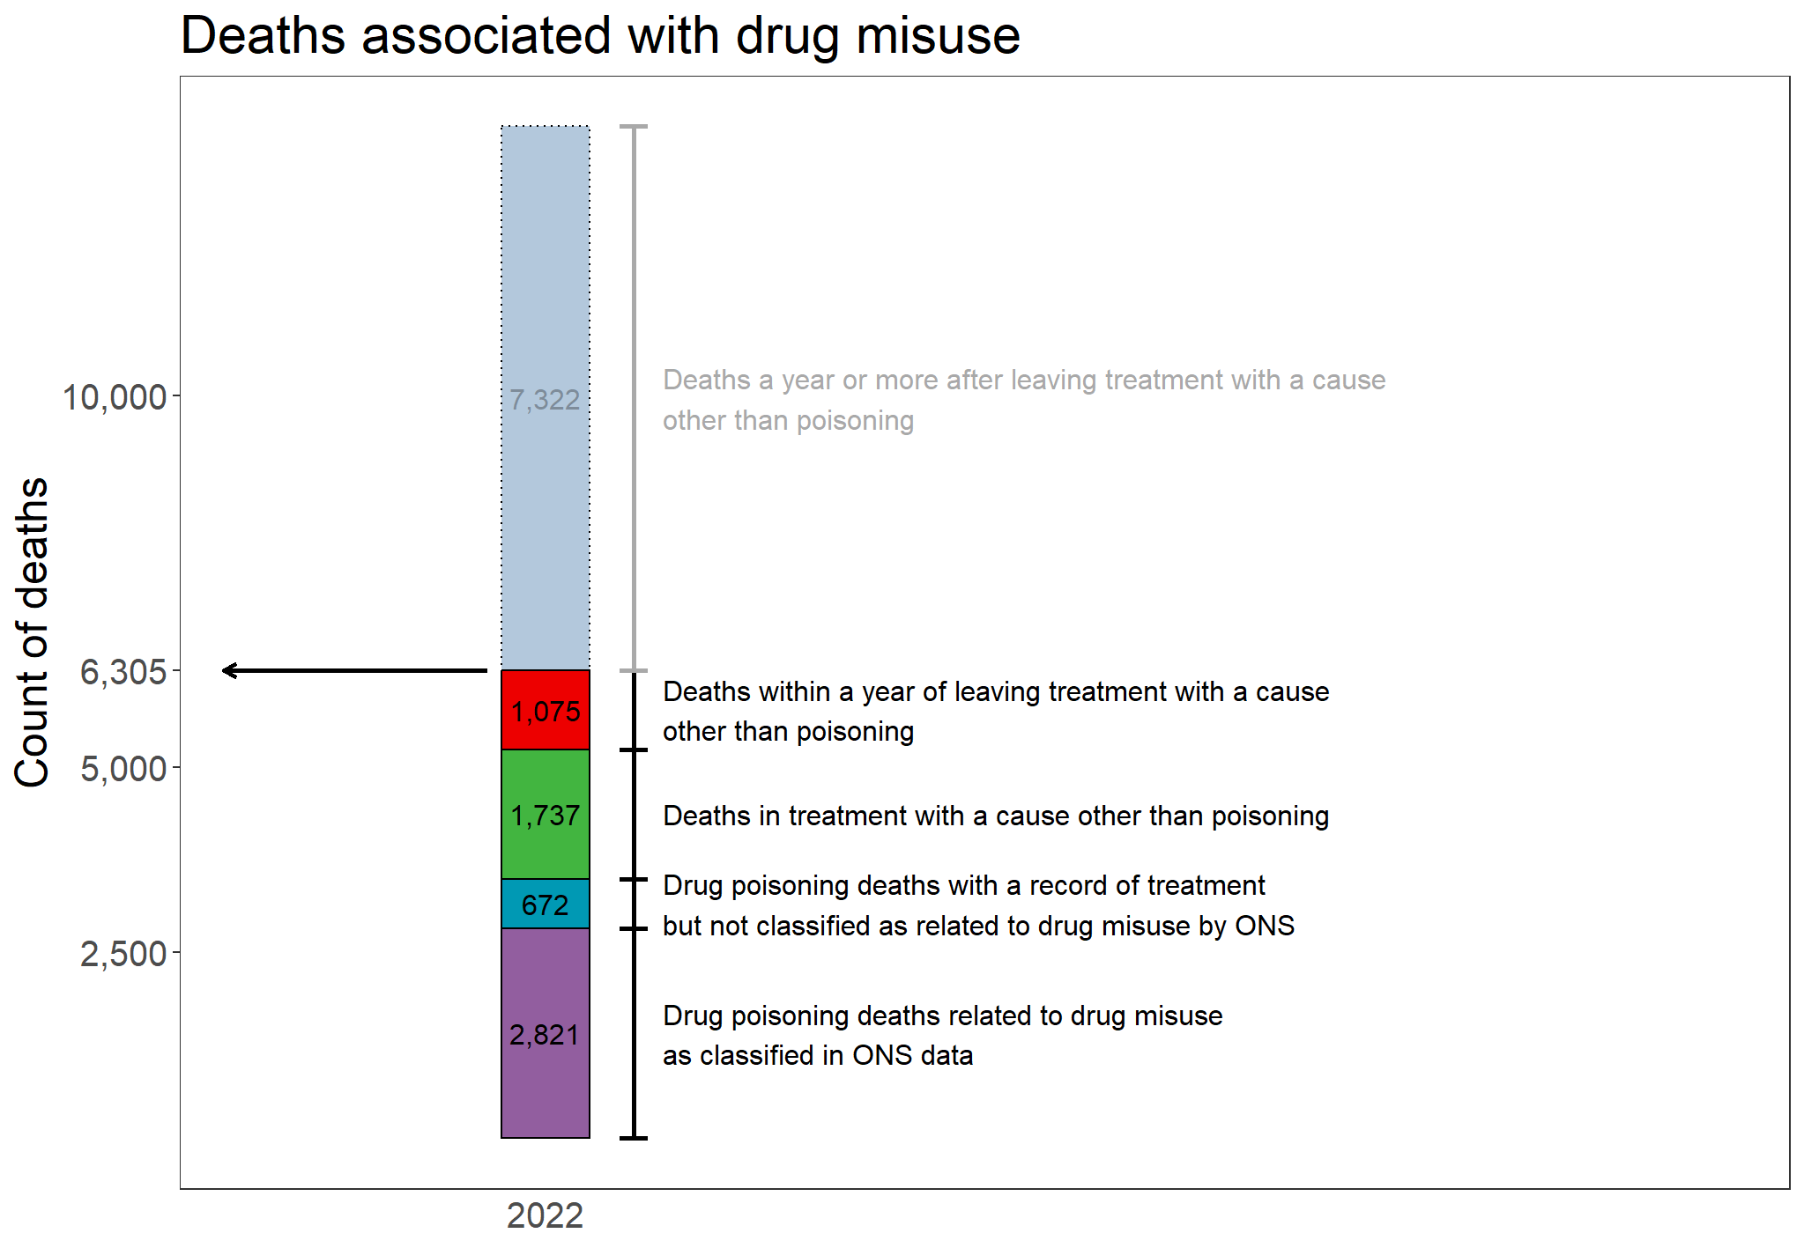

Slide 5
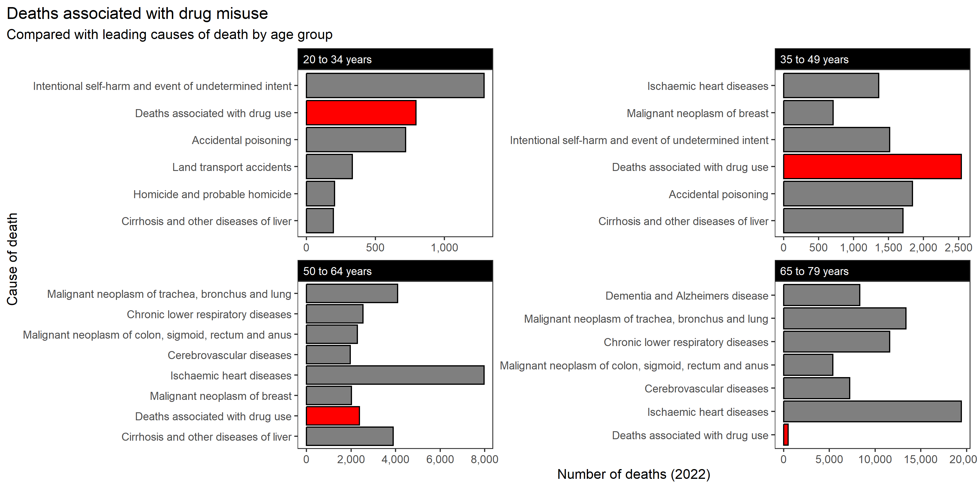

Slide 6
Cause of death | Died in treatment | Died within a year of discharge | Died one or more years following discharge
COVID-19 | 83 | 42 | 309
Accidental injury | 123 | 69 | 275
Intentional self-harm | 125 | 88 | 302
Diseases of the digestive system | 161 | 116 | 625
Neoplasms | 254 | 176 | 2,008
Diseases of the respiratory system | 309 | 127 | 945
Other causes | 312 | 186 | 1,042
Diseases of the circulatory system | 370 | 271 | 1,816

Slide 7
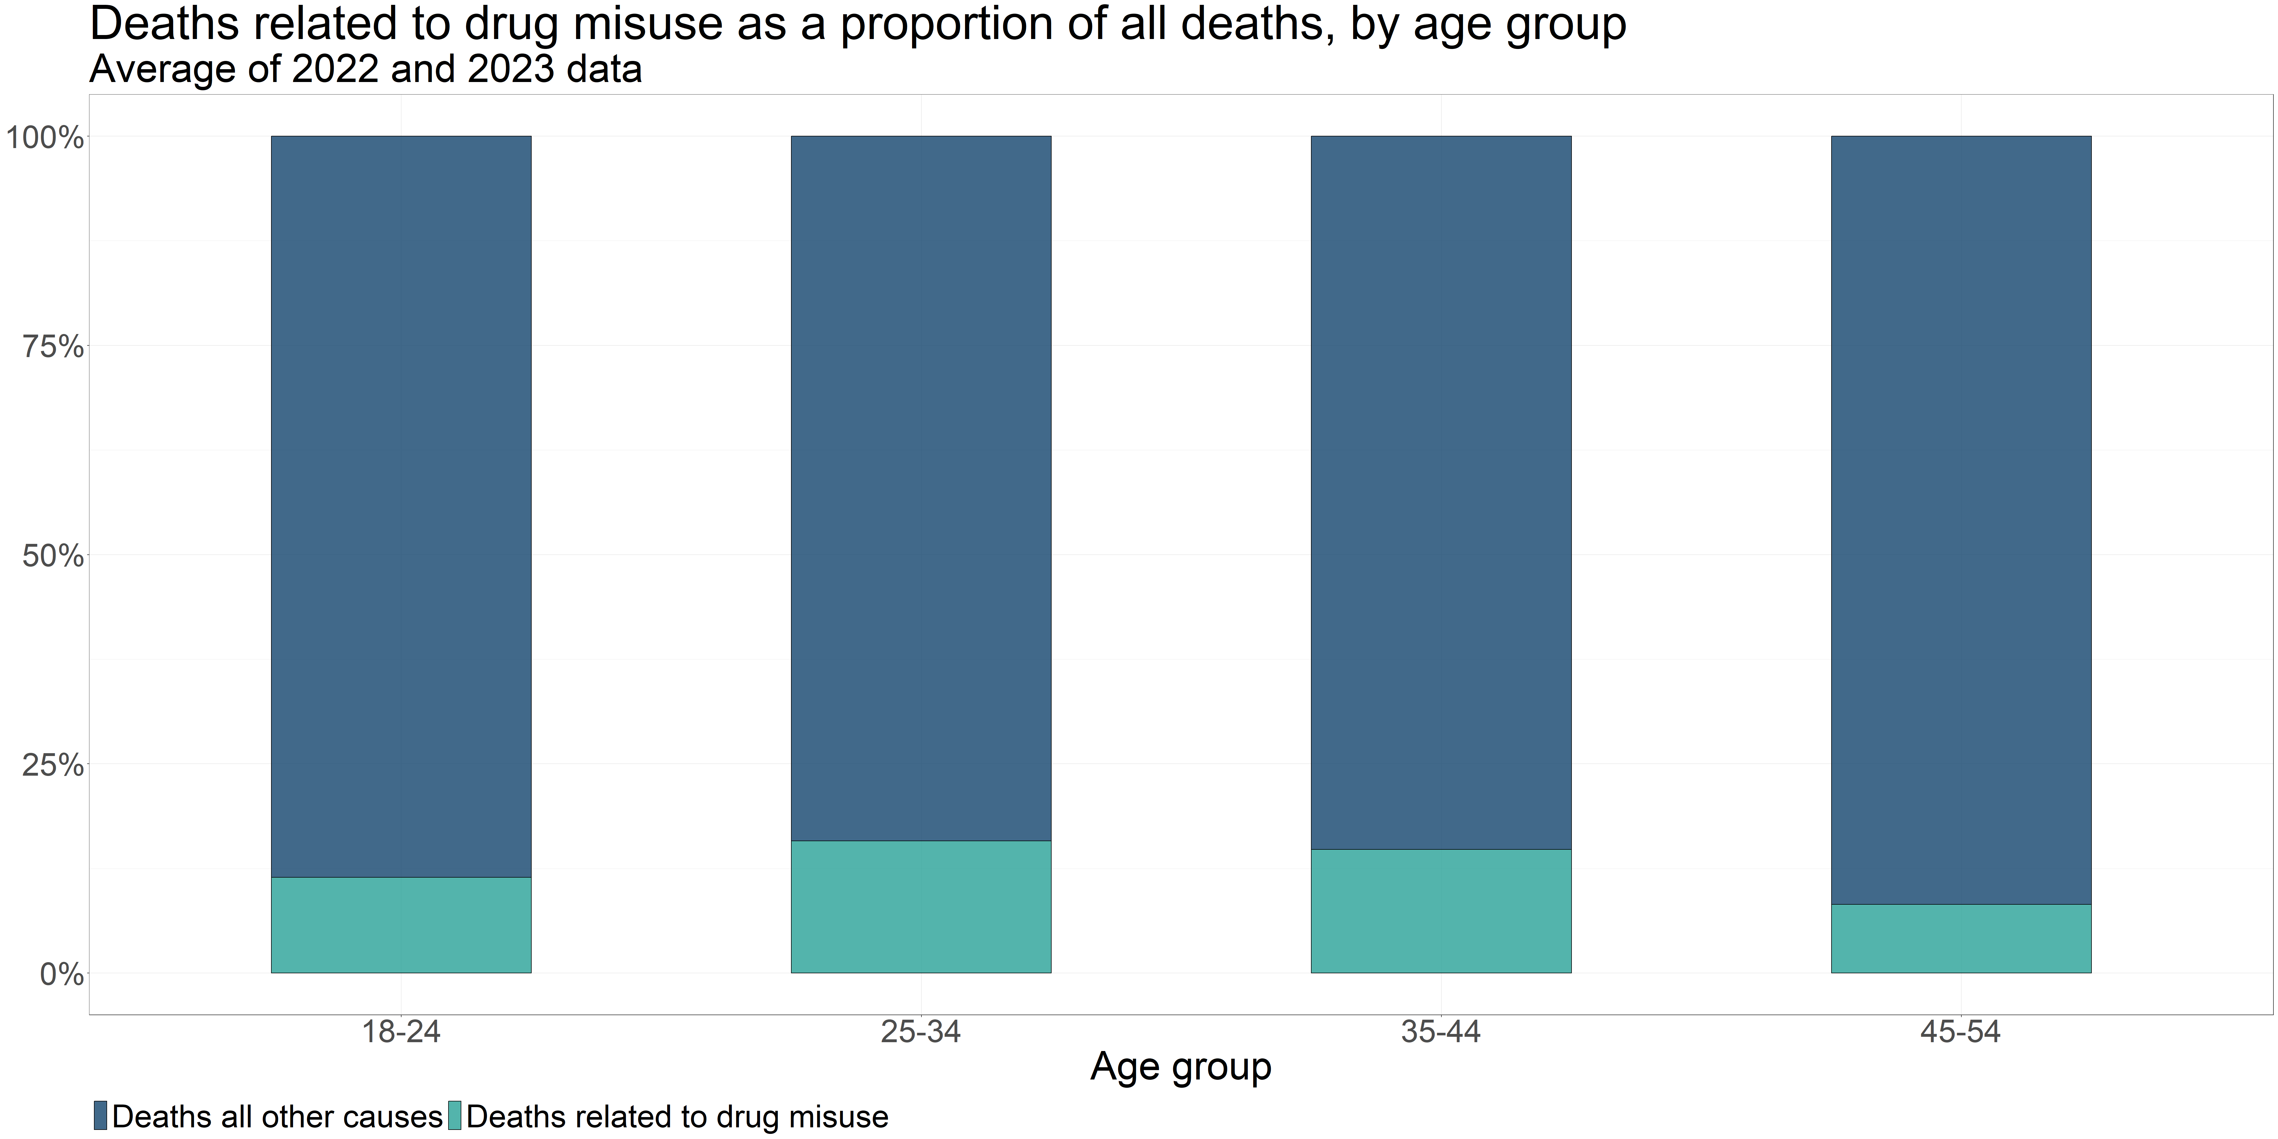

Slide 8
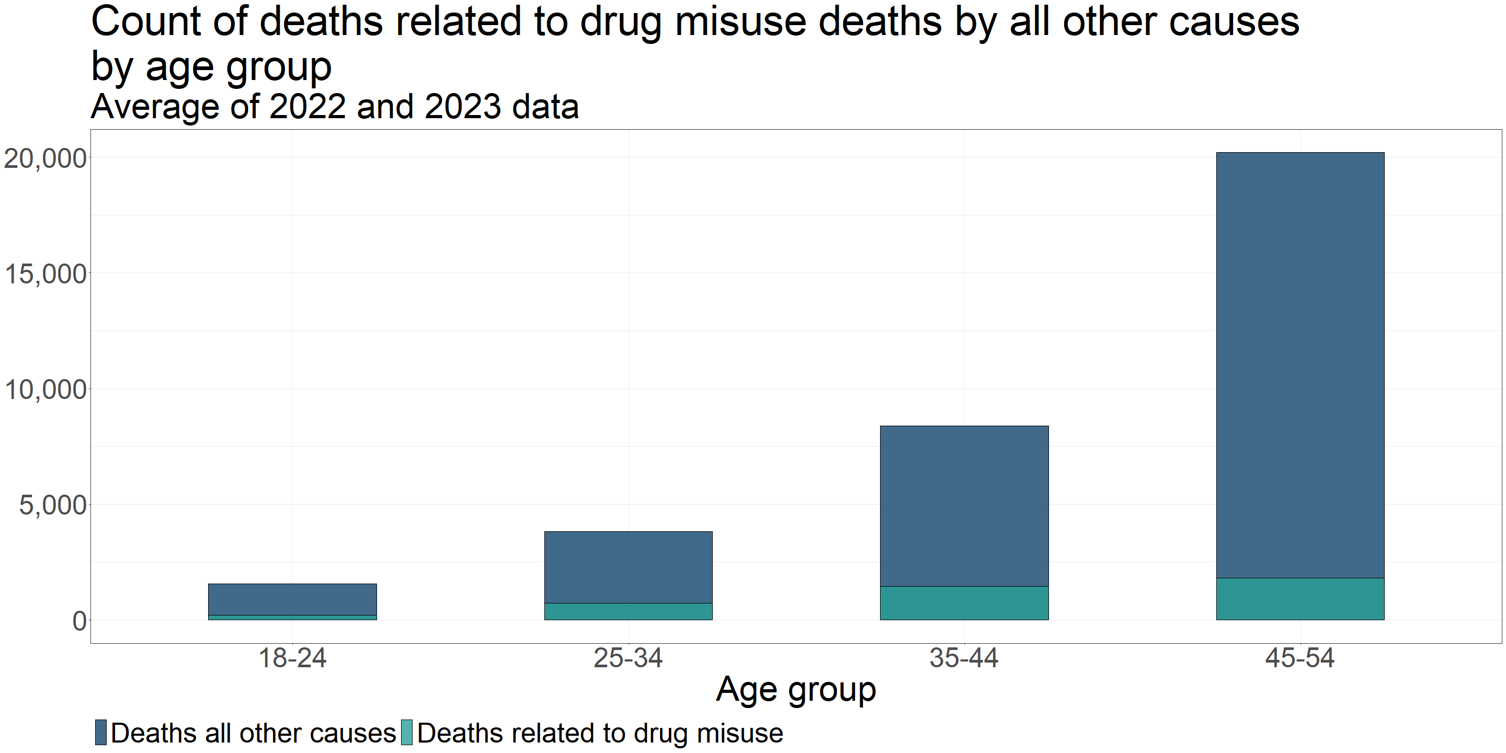

Slide 9
[^2]: This is the first four rows of Table 11 in the same release.

Slide 10
Years of life lost due to substance use
-Years of life lost (YLL) is a measure of the impact of premature mortality, helpfully defined by Public Health England here
-Chudasama et al. (2022) investigated five methods for estimating YLL[^2]. The first two methods are feasible with the available data for YLL from drug use and alcohol specific deaths. Only the drug-related YLL could be segmented by geographical estimates of deprivation.
-All five methods are detailed in the supplementary PDF here.

Slide 11
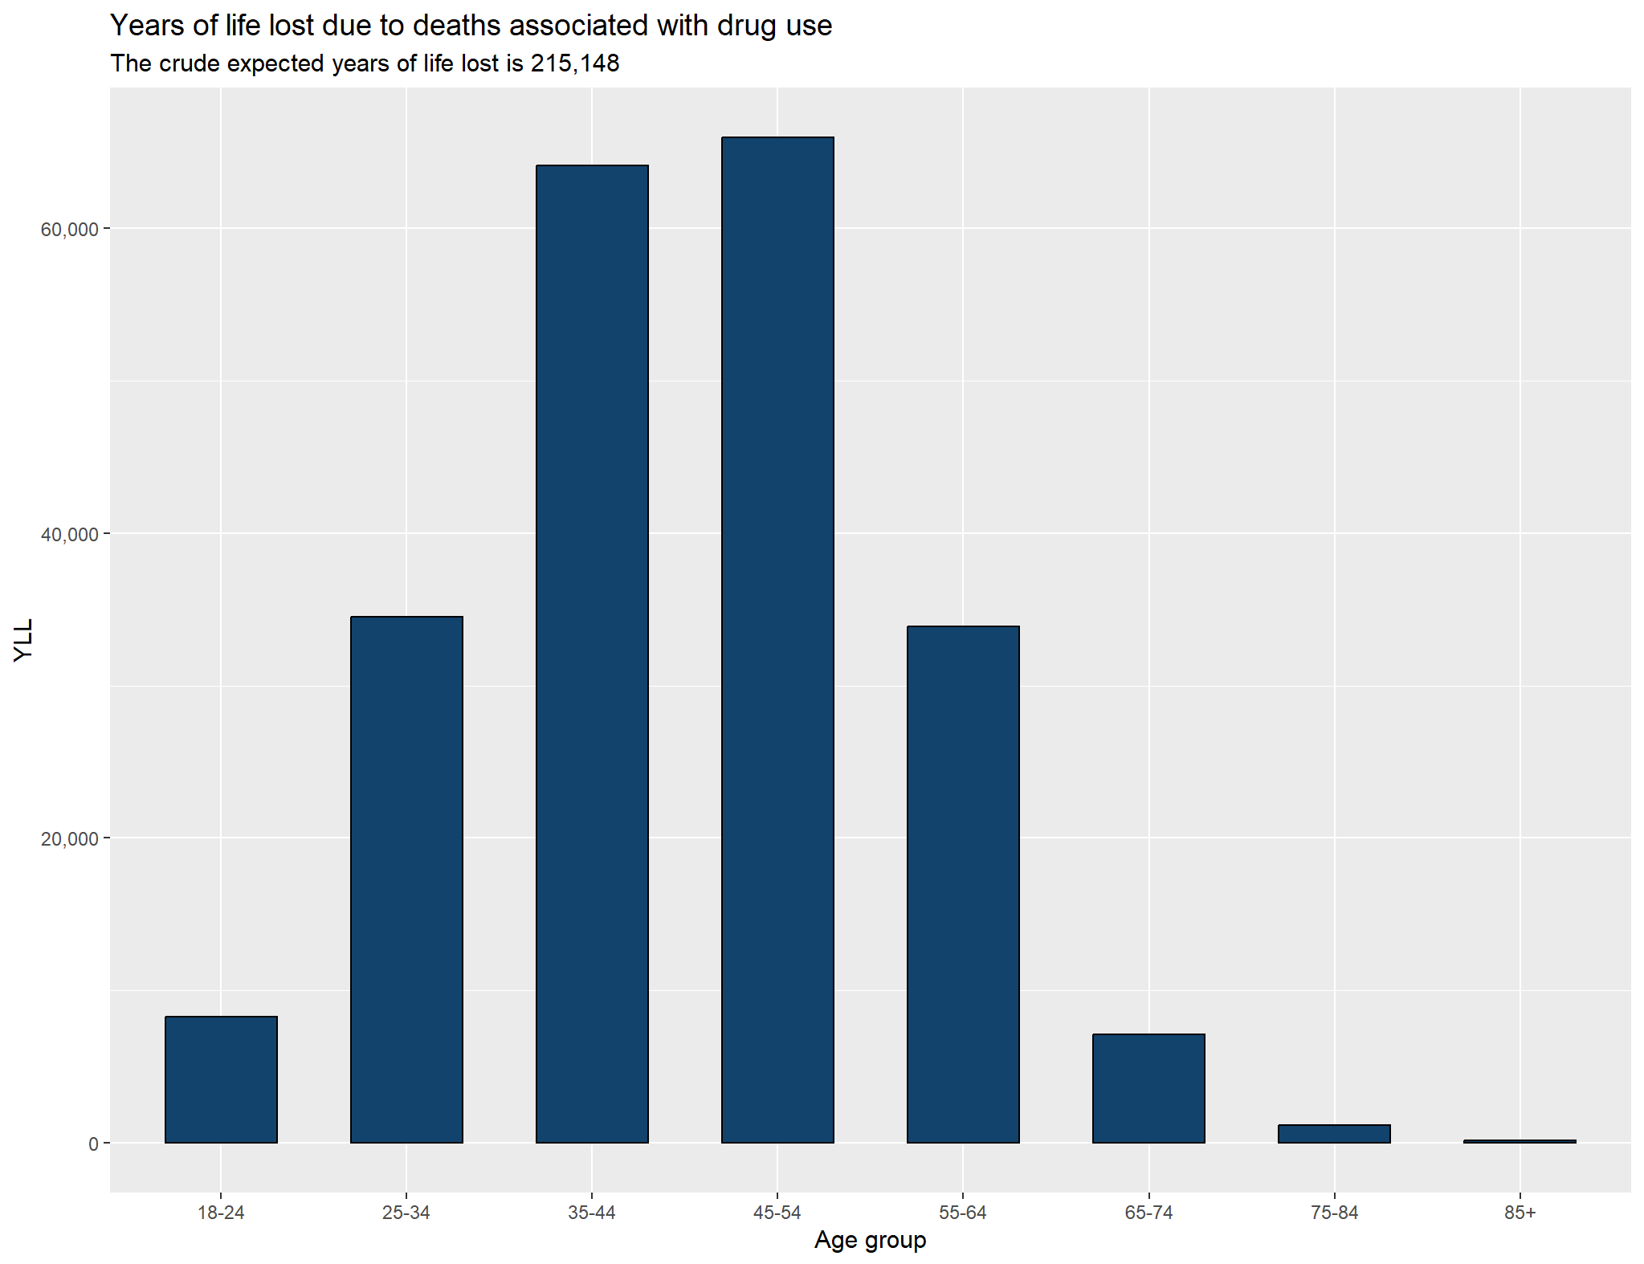
The crude expected years of life lost is:
$$YLL=\left(D_{x}\right)\left(e_{x}^{s}\right)$$
Where $D_{x}$ is the number of deaths and $e_{x}^{s}$ is the standard age of death from the external life expectancy.
Total YLL associated with drug use was 215,148.
For comparison Heald et al. (2024)[^3] estimated the impact of obesity on YLL in England at 791,689 in 2019.
Deaths at ages between 35 and 54 accounted for 60% of the YLL.

Slide 12
[^1]: The criteria for this classification are described in Box 2 of the Definition tab of the latest relese of Deaths related to drug poisoning, England and Wales available here. [^2]: Chudasama, Y.V., Khunti, K., Gillies, C.L., Dhalwani, N.N., Davies, M.J., Yates, T., & Zaccardi, F. (2022). Estimates of years of life lost depended on the method used: tutorial and comparative investigation. Journal of Clinical Epidemiology, 150, pp. 42-50. Available at: https://doi.org/10.1016/j.jclinepi.2022.06.012 [Accessed 6 Nov. 2024]. [^3]: Heald, A., Stedman, M., Fryer, A.A., Davies, M.B., Rutter, M.K., Gibson, J.M. and Whyte, M., 2024. Counting the lifetime cost of obesity: Analysis based on national England data. Diabetes, Obesity and Metabolism, 26(4), pp.1464-1478.

