Slide 1
Untitled

Slide 2
Ask 1: What proportion of premature deaths, given a cutoff point e.g. 55, are due to drugs and alcohol.
Ask 2: Years of life lost (YLL) as a measure of premature mortality
Ask 3: Add IMD

Slide 3
1. Proportion of deaths
Number of deaths associated with drug use
The ONS classifies death related to drug poisoning according ICD-10 codes. Certain ICD-10 codes classify a death as a “drug misuse death”¹. Each of these requires a specific substance (e.g. heroin) or substance category (e.g. opioids) to be indicated either in the ICD-10 code or on the death certificate.

Slide 4
Year of death registration | All drug poisonings | Number of deaths without substance information | Percentage without substance information
2023 | 5,448 | 1,245 | 22.9
2022 | 4,907 | 1,239 | 25.2
2021 | 4,859 | 1,219 | 25.1
2020 | 4,561 | 1,050 | 23.0
There are deaths each year where the ONS holds no information on the substance(s) involved:

Slide 5
Some of these will be classified as related to drug misuse where an ICD-10 code indicates mental and behavioural disorders due to drug use (excluding alcohol and tobacco) without a specific substance (e.g. F19 “multiple drug use and use of other psychoactive substances”). But others, broadly those coded as accidental/intentional self-poisonings or self-poisonings of unknown intent, will not be classfified as related to drug misuse unless a controlled drug under Misuse of Drugs Act 1971 was mentioned on the death record.
The data linkage between ONS mortality and NDTMS allows some of those deaths to be identified indirectly as related to drug misuse where the person that died had had contact with the drug treatment system within a year of their date of death.
National data, all ages

Slide 6
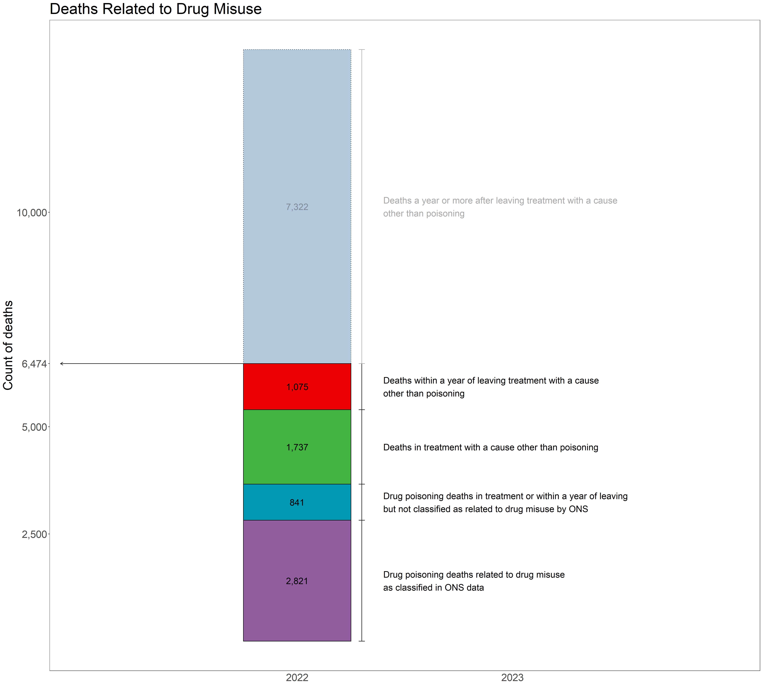

Slide 7
Cause of death | Died in treatment | Died within a year of discharge | Died one or more years following discharge
COVID-19 | 83 | 42 | 309
Accidental injury | 123 | 69 | 275
Intentional self-harm | 125 | 88 | 302
Diseases of the digestive system | 161 | 116 | 625
Neoplasms | 254 | 176 | 2,008
Diseases of the respiratory system | 309 | 127 | 945
Other causes | 312 | 186 | 1,042
Diseases of the circulatory system | 370 | 271 | 1,816

Slide 8
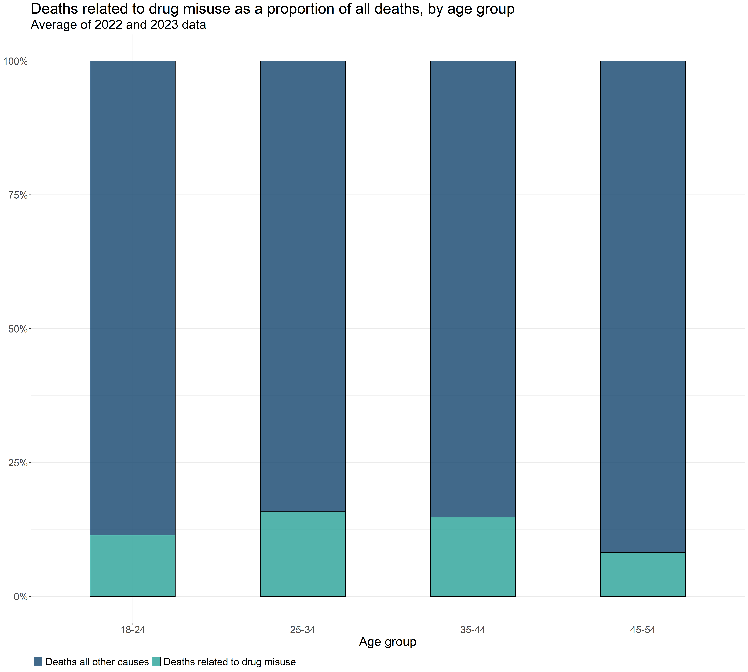
National data, by age group

Slide 9
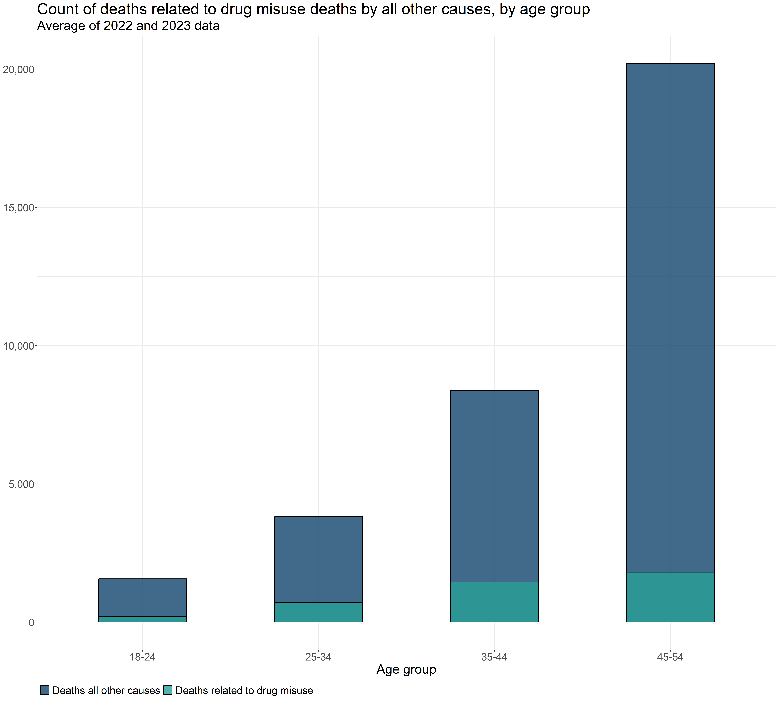

Slide 10
2. Years of life lost due to substance use
Years of life lost (YLL) is a measure of the impact of premature mortality, helpfully defined by Public Health England here
Chudasama et al. (2022) investigated five methods for estimating YLL². The first two methods are feasible with the available data for YLL from drug use and alcohol specific deaths. Only the drug-related YLL could be segmented by geographical estimates of deprivation.
All five methods are detailed in the supplementary PDF here.
Mortality data
Deaths related to drug misuse as defined by the ONS³.
Additional drugs related to drugs misuse that the ONS had insufficient data to classify, but can be inferred from the data linkage of ONS data with NDTMS data by Better Outcomes through Linked data (BOLD) ⁴.
Alcohol specific deaths

Slide 11
Notes
1. The criteria for this classification are described in Box 2 of the Definition tab of the latest relese of Deaths related to drug poisoning, England and Wales available here.
2. Chudasama, Y.V., Khunti, K., Gillies, C.L., Dhalwani, N.N., Davies, M.J., Yates, T., & Zaccardi, F. (2022). Estimates of years of life lost depended on the method used: tutorial and comparative investigation. Journal of Clinical Epidemiology, 150, pp. 42-50. Available at: https://doi.org/10.1016/j.jclinepi.2022.06.012 [Accessed 6 Nov. 2024].
3. Not publicly available
4. Not publicly available

