Slide 1

A Project Progress Presentation on Chatify
Department of Computer Science & Engineering
Goel Institute of Technology and Management
Presented to: Presented by:
Mr. Nitin Kumar Rao Sandeep Prajapati (1903600100047)
Prashant Pandey (1903600100039)
Anupam Mishra (1903600100014)

Slide 2
CONTENTS
Introduction
Technology
Hardware and Software Configuration
Feasibility
Data Flow Diagram
ER Diagram
Use Case Diagram
Project Snapshots
Future Scope
Bibliography

Slide 3
INTRODUCTION
Chatting app allows you to communicate.
It enables you to send and receive messages.
Chat applications allow you to stay connected with other people who may be using the application even on the other side of the world.
Chatting apps make it easier, simpler, and faster to connect with everyone and it is also easy to use.

Slide 4




TECHNOLOGY
4 Technologies used to make MERN Stack are:
M – Mongo DB
E – Express JS
R – React JS
N – Node JS

Slide 5
HARDWARE CONFIGURATION
The following hardware requirements are necessary for setting up the Project:
Processor: Intel Pentium 4 or later
RAM: 4GB
Storage: 5GB
Monitor: 15” Color Monitor

Slide 6
SOFTWARE CONFIGURATION
The following software requirements are necessary for setting up the Project:
Browser: Chrome 17+
Microsoft Visual Studio Code
Node JS (Version 8.x or higher)
NPM (Version 3.x.x or higher)
MongoDB

Slide 7
FEASIBILITY STUDY
Technical Feasibility: All the technologies which will use in the project are open source and easily available. Hence the project is technically feasible.
Economic Feasibility: There is no such need of funds or money in the early stage of the implementation of the project.
Operational Feasibility: With the help of the GitHub (GitHub is a code hosting platform for version control and collaboration) all the members of the team can easily work on the project.

Slide 8
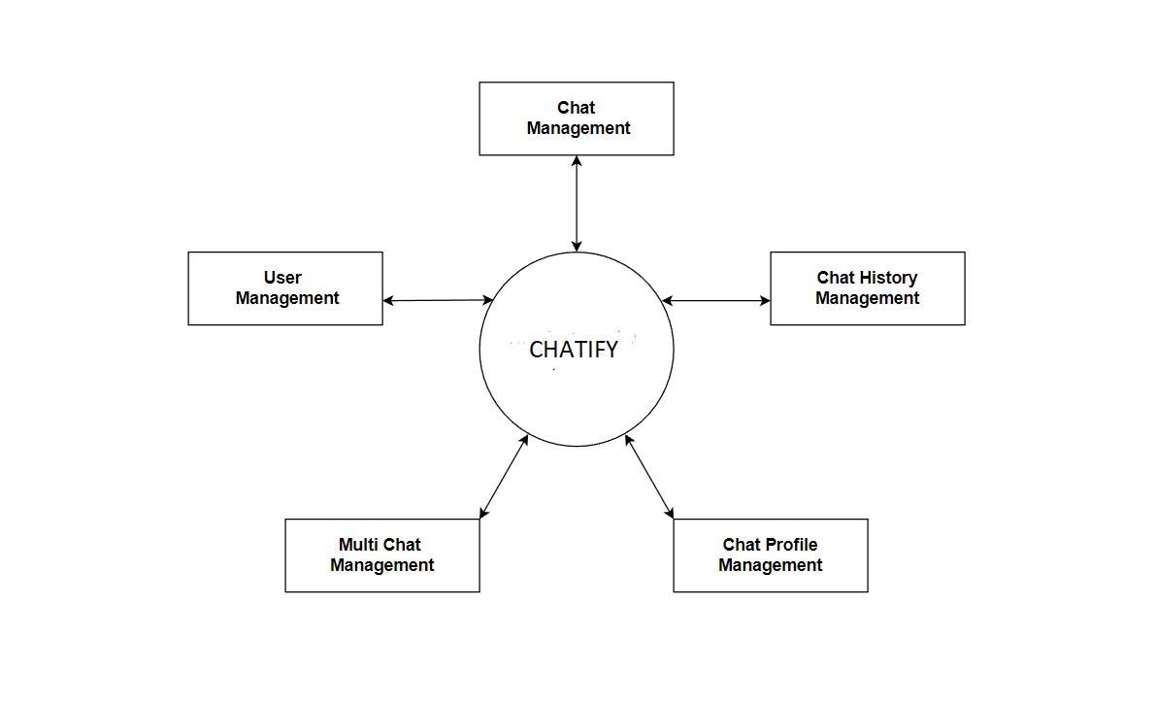
Data Flow Diagram
Level-0

Slide 9
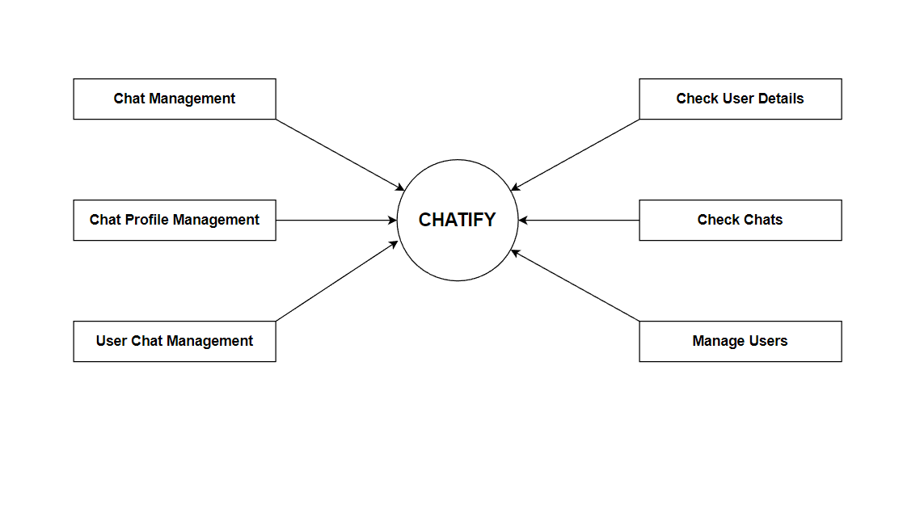
Level-1

Slide 10
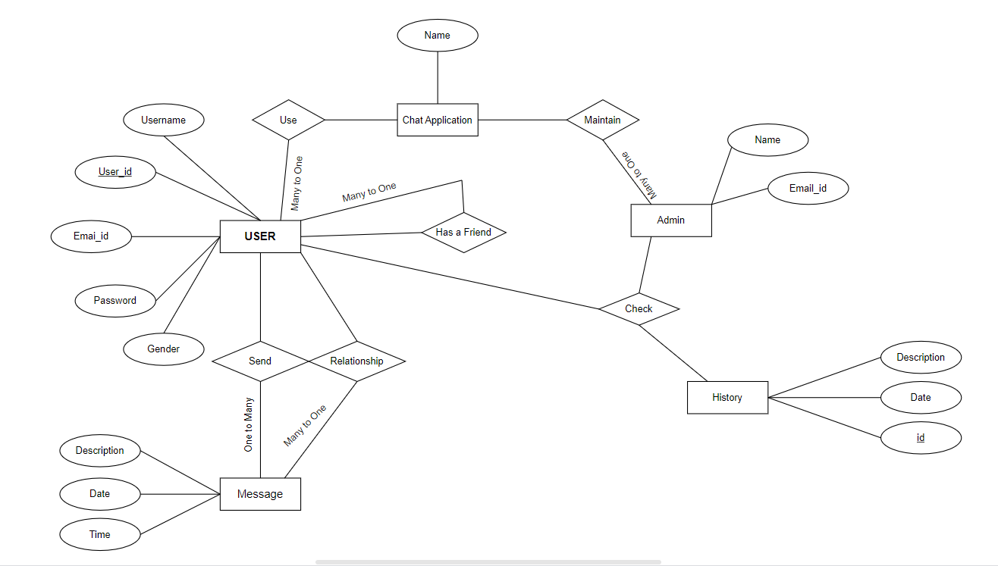
ENTITY RELATIONSHIP DIAGRAM

Slide 11
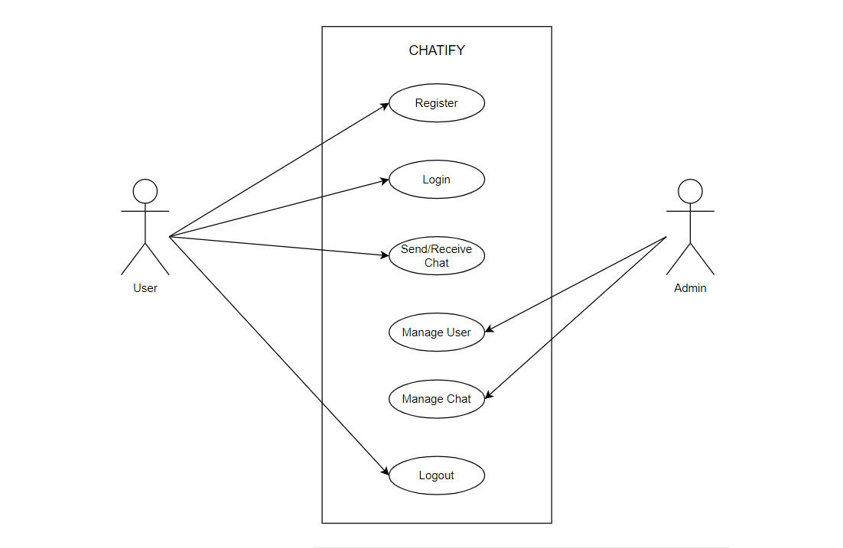
Use Case Diagram

Slide 12
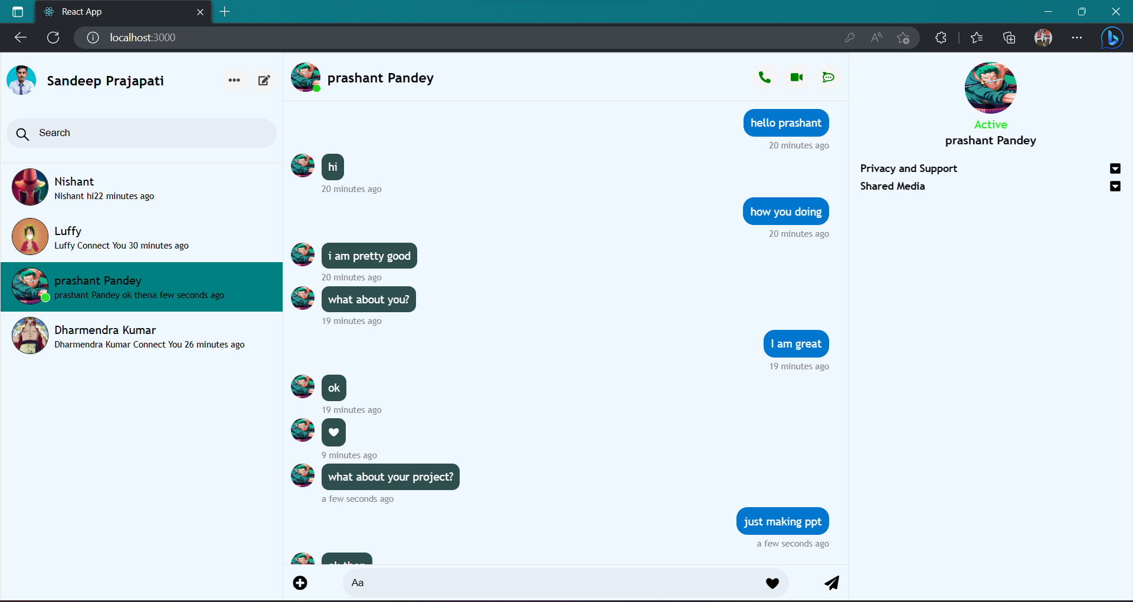
SNAPSHOT OF PROJECT

Slide 13
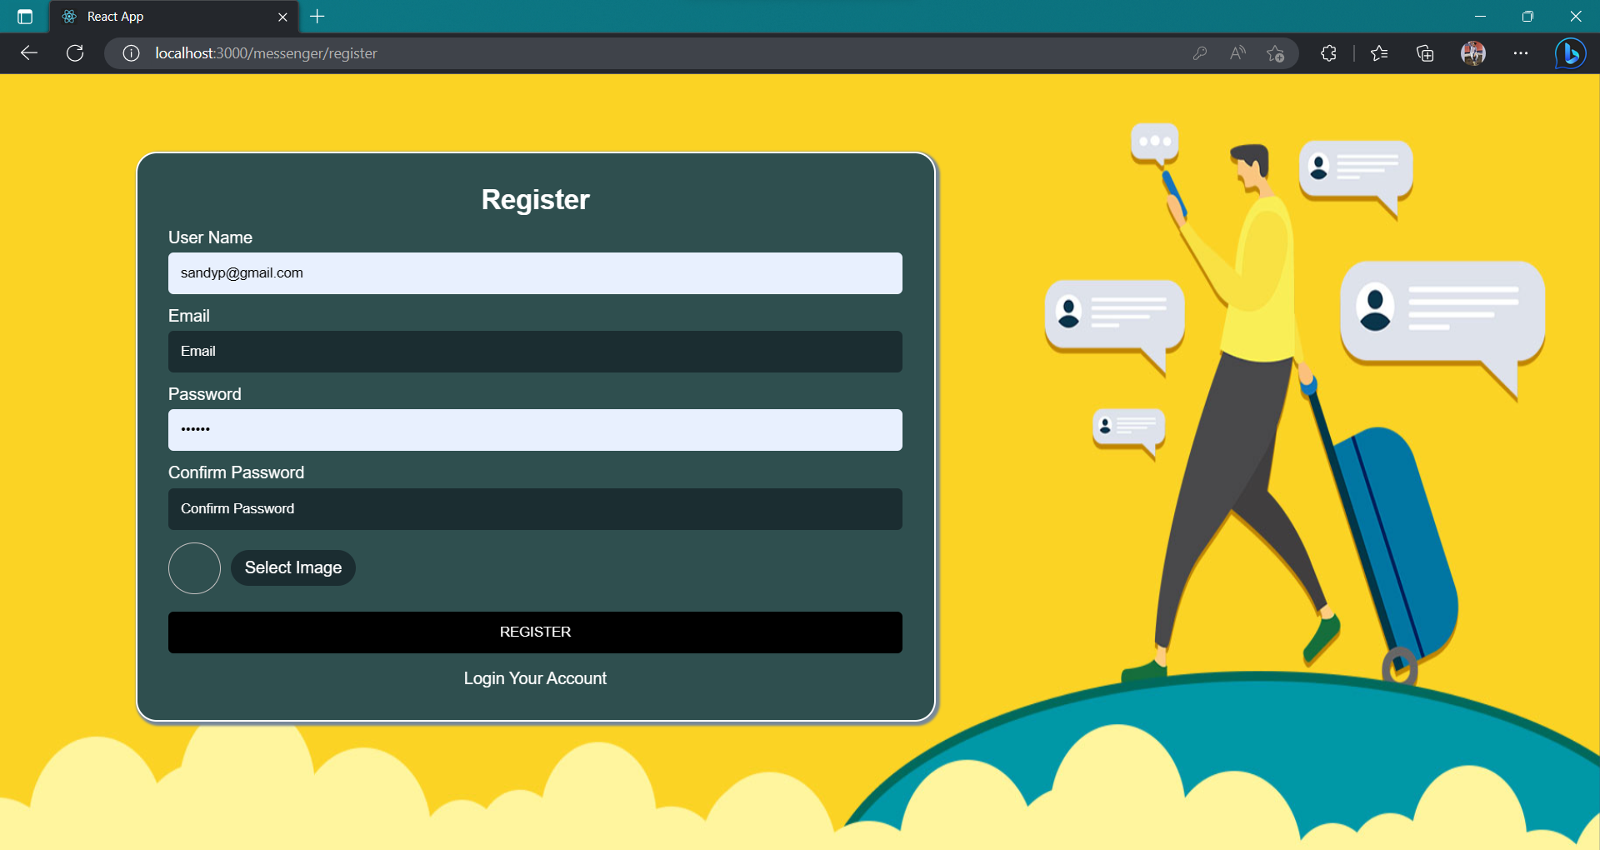
REGISTERATION PAGE

Slide 14
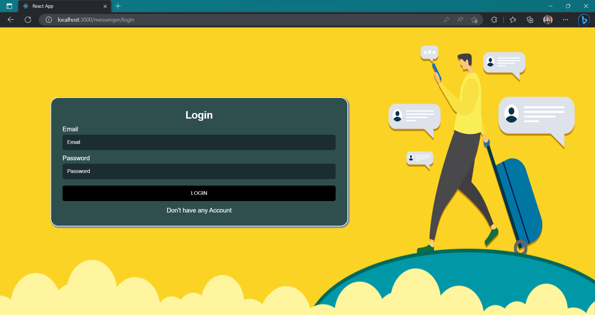
LOGIN PAGE

Slide 15
MAIN PAGE

Slide 16
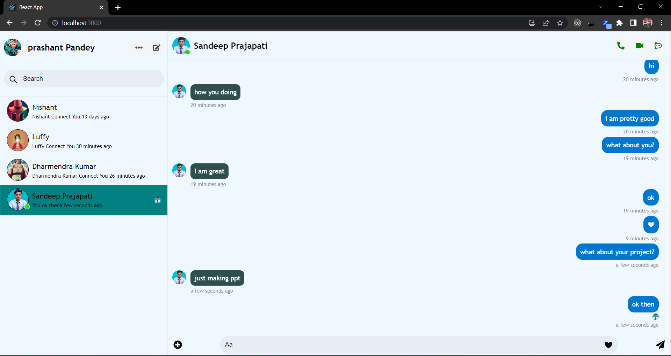
CHATS

Slide 17
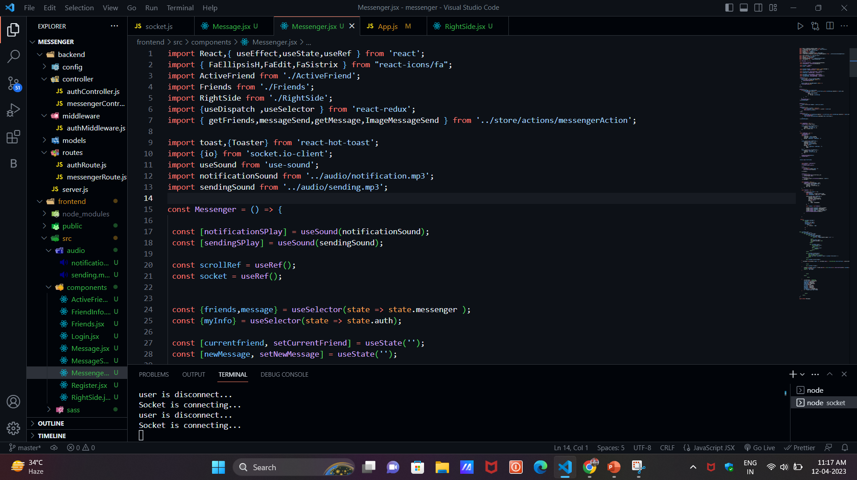
CODE

Slide 18
FUTURE SCOPE
File transfer: This will enable the user to send files of different formats to others via the chat application.
Video Call: This application can be enhanced to support large scale group video calling.
VR and AR:Virtual reality and augmented reality are other top-notch technologies, together with artificial intelligence.

Slide 19
Bibliography
MongoDB: https://www.mongodb.com/docs/drivers/
ExpressJS: https://expressjs.com/en/guide/routing.html
Npm: https://www.npmjs.com/
ReactJS: https://reactjs.org/docs/getting-started.html
NodeJS: https://nodejs.org/en/docs/
Javatpoint: https://www.javatpoint.com/expressjs-tutorial.
Tutorialspoint: https://www.tutorialspoint.com/reactjs/reactjs_overview.htm.
GeeksForGeeks: https://www.geeksforgeeks.org/

Slide 20


