Slide 1
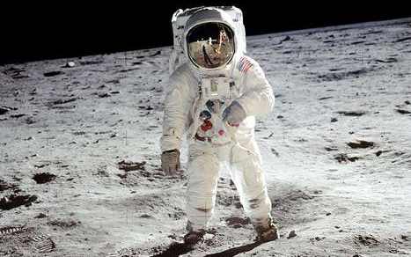
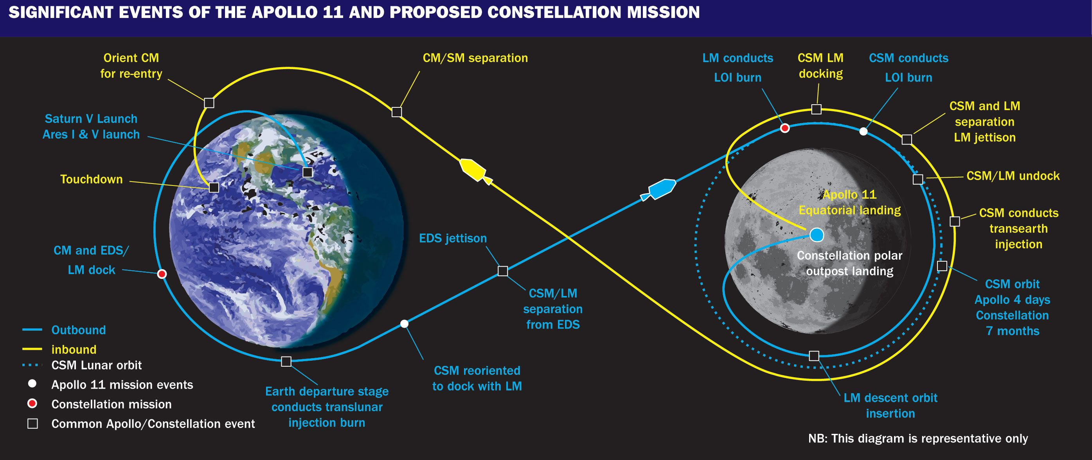
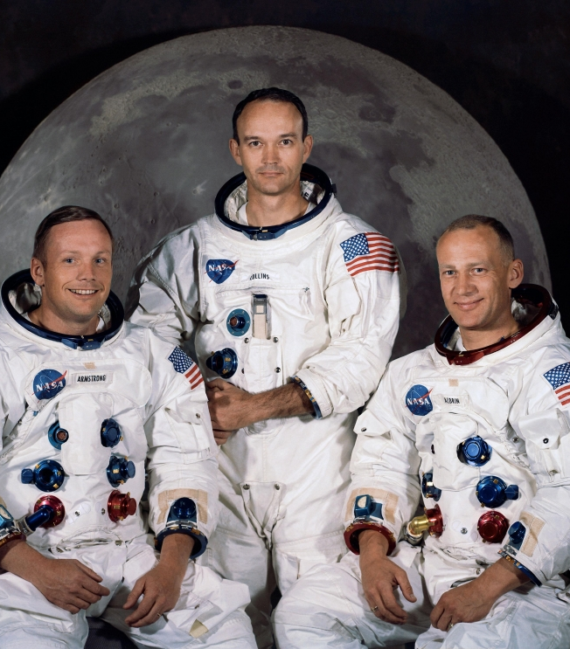
###
Apollo 11: 50th Anniversary
Apollo 11 Mission
This Summer marks the 50th anniversary of the Apollo 11 space mission, when Neil Armstrong and Buzz Aldrin took the first steps on the Moon
Technical Details
Saturn V, the rocket carrying the Apollo 11 team, launched on July 16th, 1969
Passed the Moon, the command and service module, Columbia, separated from the lunar module, Eagle.
The Eagle then descended to the surface of the Moon in the “Sea of Tranquility”, about 4 miles past the expected touch-down area.
109 hours, 42 minutes after launch, Neil Armstrong took the first steps on the Moon, with Buzz Aldrin following 20 minutes after.
During the Moon walk, the astronauts ventured up to 300 feet from the lunar lander during their 2 ½ hour walk
Many samples and pictures were taken, as well as leaving messages from Earth
Neil and Buzz then used Eagle to join back with Columbia to start the journey back to Earth
195 hours, 18 minutes, and 35 seconds after the initial launch, Apollo 11 splashed into the Pacific Ocean
The animation was programmed using OpenGL, an open source graphics library and C++
Computer graphics techniques used:
Key-Frame Animation
Texture Wrapping
Per-Fragment Lighting
Shaders
Bezier Curves
Bump-mapping?
Accurate depictions of the Earth/Moon position, axis, rotation, etc.
Overlay of astronaut’s helmet to give a first person perspective.
We have X different viewpoints throughout the animation with full ability to adjust the scene
We had to be cautious about ghosting and the fish eye effect that would occur when displaying in the planetarium
Will be screenshot of animation
Maybe our team posed like this
OMSI
The Apolloers
The Oregon Museum of Science and Industry (OMSI) requested this animation of the Apollo 11 Mission so that it could be displayed in their planetarium this summer to commemorate the 50th anniversary of the mission.
With direction from Jim Todd, the Director of Space Science Education, our team created the animation of the mission and integrated it into the Harry C. Kendall Planetarium’s system.
This project set out with a goal to educate and inspire viewers of all backgrounds. This has been done by (doing a thing).
Dean Akin – akind@oregonstate.edu
Jonathan Ropp – roppjo@oregonstate.edu
Shannon Sandy – sandys@oregonstate.edu
Mike Bailey – mjb@oregonstate.edu
Jim Todd – jtodd@omsi.edu
Flight path (From animation)
Sources
Lunar module, Saturn V, and Landing site models: NASA Github *insert URL*
Audio files and Apollo 11 recordings: www.nasa.gov
Other textures: *source any other textures we may use*

