Slide 1
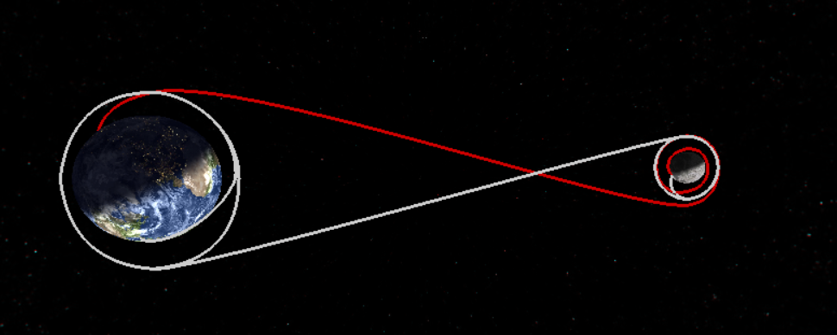
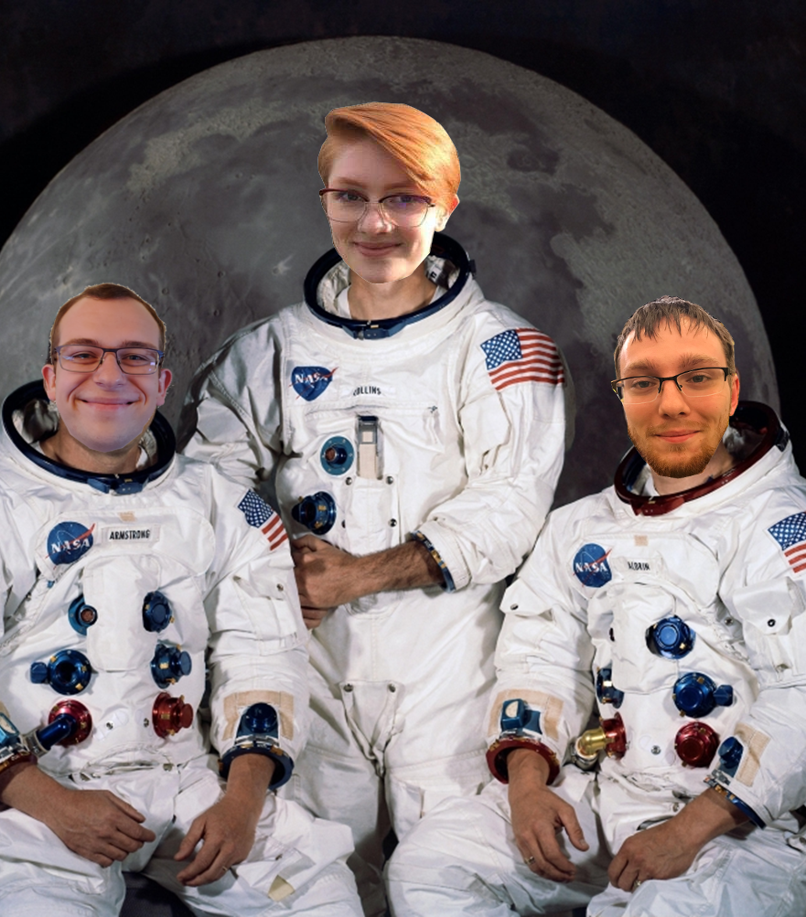
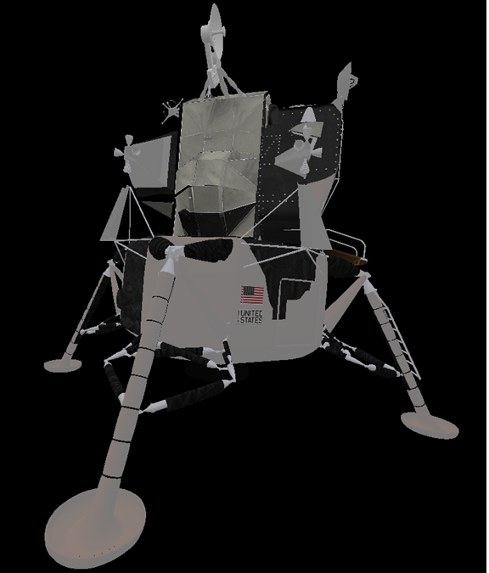
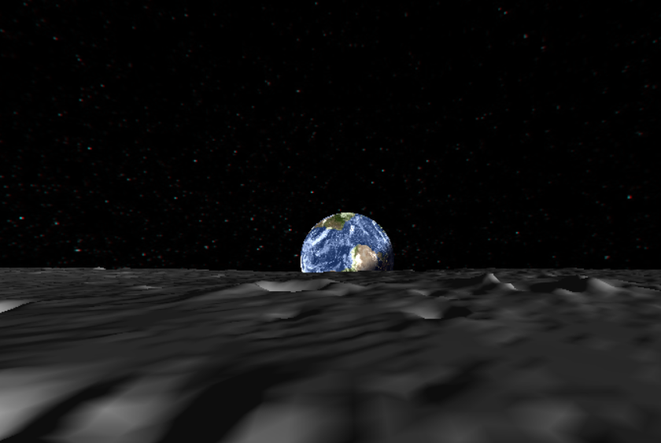
CS49
Apollo 11 Mission
Apollo 11: 50th Anniversary
Technical Details
Apollo 11 launched on July 16th, 1969 from the Kennedy Space Center in Florida
The Lunar Module descended to the surface of the Moon in the “Sea of Tranquility”, about 4 miles past the expected touch-down area
109 hours, 42 minutes after launch, Neil Armstrong took the first steps on the Moon
During the Moon walk, the astronauts ventured up to 300 feet from the lunar lander during their 2 ½ hour walk
195 hours, 18 minutes, and 35 seconds after the initial launch, Apollo 11 splashed into the Pacific Ocean
The animation was programmed using OpenGL, an open source graphics library, and C++
Computer graphics techniques used:
-Key-Frame Animation
-Texture Wrapping
-Per-Fragment Lighting
-Shaders
-Parametric Curves
Accurate depictions of the Earth/Moon position, axis, rotation, etc.
10 different viewpoints throughout the animation with full ability to adjust the scene
The objects were taken from different sources and had to be scaled, positioned, and textured individually to the correct proportions.
Recreating the historic mission that landed the first human on the Moon
OMSI
The Oregon Museum of Science and Industry (OMSI) requested this animation of the Apollo 11 Mission so that it could be displayed in the Harry C. Kendall Planetarium this Summer to commemorate the 50th anniversary of the mission. With direction from Jim Todd, the Director of Space Science Education, our team created the animation with the goal to educate and inspire viewers of all ages and backgrounds.
Apollo 11 Flight Path
Just like NASA, we had to determine the flight path based on the Moon’s position and orbit.
Our Goals
To educate and inspire various audiences about astronomy
Provide viewers with a realistic and interactive experience of the Apollo 11 Mission
Provide historical about the mission context through historic video/audio
Illustrate how large of an undertaking the Apollo 11 was, especially for its time
‘The Apolloers’
Student Team (Left to right):
Jonathan Ropp – roppjo@oregonstate.edu
Shannon Sandy – sandys@oregonstate.edu
Dean Akin – akind@oregonstate.edu
Client:
Jim Todd – jtodd@omsi.edu
OSU Mentor:
Professor Mike Bailey – mjb@oregonstate.edu
Lunar Module – “Eagle”
While we found the object for the Lunar Module, the textures had to be manually applied. Also, with many different objects used from many different sources, accurate scaling and positioning was key.
What a View
3D animation allows viewers to see what astronauts saw while they were on the Moon, as well as having more freedom to move a camera around the scene.

