Slide 1
JCL basic and SDSF
N.S.Manikandan
System Architect
TIFAC-CORE
VIT University
Vellore

Slide 2
What is JCL?
Job Control Language (JCL) is used to tell the system what program to execute, followed by a description of program inputs and outputs. It is possible to submit JCL for batch processing
Notes:
JCL is not a procedural language like COBOL, Assembler or C. It’s not an OO Language like C++, JAVA or SmallTalk.
2) JCL has uniquely identifying character of it’s own; it’s a JOB CONTROL LANGUAGE.
(A JOB is a unit of batch work and Sequential execution of programs)
3) JCL is a means of communication between a program that can be written in COBOL and the MVS operating system. If you write a program in COBOL which accesses files or writes output, then it will be the JCL that will identify to the OS the resources that your program expects to use.
4)Why JCL? Without JCL, programs can’t be run on an IBM mainframe environment.

Slide 3
Difference between batch & interactive processing
Batch processing
Jobs submitted are executed at later time
User can not interact
Performance measure is throughput
Interactive processing
Jobs submitted are executed immediately
User can interact
Performance measure is response time

Slide 4
Sample JCL
//UseridJ JOB ,,NOTIFY=&SYSUID,CLASS=D,
// MSGLEVEL=(1,1),MSGCLASS=X
//* SAMPLE JCL
//STEP1 EXEC PGM=SEQPROC
//STEPLIB DD DSN=OPERN.CICS3.LOADLIB,DISP=SHR
//SYSPRINT DD SYSOUT=*
//INFILE DD DSN=YourMainframeId.JCL.DAY2.FILE1,DISP=SHR
//OUTFILE DD DSN=YourMainframeId.JCL.DAY2.FILE2,
// DISP=(NEW,CATLG,DELETE),
// UNIT=SYSDA,SPACE=(TRK,(10,5),RLSE),
// DCB=(LRECL=80,BLKSIZE=8000,RECFM=FB)
Notes:
1) JCL statements are coded in 80 byte records –
Only 72 of the 80 chars available to code JCL. The last eight columns of each record reserved for an optional sequence number
2) Basic Format of a JCL : ...
Identifier [Name] [Operation] [Parameters] [Comments]
Identifier - Two slashes ( // ) starting in col 1. Exceptions are
For a delimiter statement, /* starting in col 1
For a comment statement , //* starting at col 1
Name – It can be from one to eight characters long, consisting of alphanumeric (A-Z and 0-9) & national (@,#,$) characters. Starting with a letter char. Must begin at col 3.
Operation – A valid operation code, such as JOB, EXEC or DD. Must be preceded and followed by a space.
Parameters – One or more parameters depending on the operation. Individual parameters are separated from one another by commas, no intervening spaces.
Comments – comments may follow parameters, preceded by one space and not extending beyond col 71
3) JCL parameters :
a) Positional parameters -
Must occur at a specific position within the parameters field
account for a missing parameter by a comma
b) Keyword parameters -
Keyword parameters to come only after all positional parameters have been coded, order of keyword parameters immaterial
4) JCL subparameters :
DCB=(DSORG=PO,LRECL=80,
BLKSIZE=6160)
DCB=(DSORG=PO)
DCB=DSORG=PO
DISP=(,DELETE)
Comma place holders are required only for missing positional sub-parameters.
5) Continuing JCL statements:
Break the parameter field in the first line, with a comma that follows a parameter or sub-parameter Slashes in column 1 & 2 of second line. Next parameter or sub parameter starting anywhere between columns 4 - 16, in the second line.

Slide 5
JCL statements:
JOB Provides a name (jobname) to the system for this batch workload. It
can optionally include accounting information and a few job-wide
parameters.
EXEC Provides the name of a program to execute. There can be multiple
EXEC statements in a job. Each EXEC statement within the same job
is a job step.
DD The Data Definition provides inputs and outputs to the execution
program on the EXEC statement. This statement links a data set or
other I/O device or function to a ddname coded in the program. DD
statements are associated with a particular job step.

Slide 6
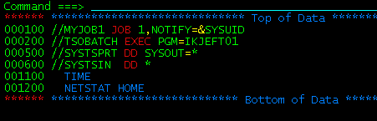
TSO command in JCL

Slide 7
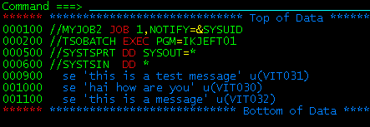
SEND command in JCL

Slide 8
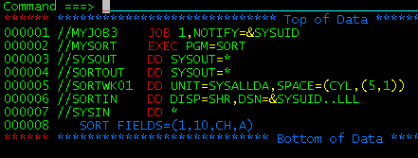
SORT program in JCL

Slide 9
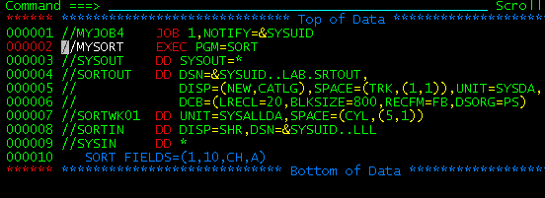
SORT program in JCL

Slide 10
Various stages of JCL execution
JES
interprets
JCL and
passes it
to
MVS
Determine
the
job
Create
the
JCL
Submit
the
JOB
MVS does
the work
System
Messages
MVS – Multiple Virtual Storage
JES
collects
the output
and information
about
the JOB
User
Views and
Interprets
output
Notes:
JES- Job Entry Subsystem.
To process a job, a Job Entry Subsystem, or JES is used. It keeps track of jobs that enter the system, presents them to OS for processing, and sends their spooled output to the correct destination.

Slide 11
Various stages of JCL execution
  Input
  Conversion
  Execution
  Output
  Hard copy
  Purge
Notes:
Various stages of JCL execution:
Input JES gives a unique job number
Conversion Check syntax errors & place in JES spool
Initiator Taking job from spool & sending it for execution
Output sends the output to printer
Purge After job is processed, it is purged

Slide 12
INPUT
MVS
INPUT
SPOOL
JES
JCL
SYSIN
Notes:
During input processing , the job is placed out on spool. At this point in time, a job consists of :
- Any JOB Control Language
- Any JOB Entry Control Language (JECL) in the Input Stream
- Any data SYSIN in the Input Stream
An entry is initialized in the Job queue and the job is assigned a JES Job Number as part of Input Processing

Slide 13
CONVERSION
MVS
SPOOL
JCL
SYSIN
JES
PROCLIB
PROC
Notes:
-Input to the conversion process consists of the Original JCL and any cataloged procedure referenced by it
-Full Syntax checking of the JCL is done at this time
-During conversion the JCL for a job is converted to its internal form, known as Converter/Interpreter text. All of the jobs that were marked awaiting conversion in the job Queue are converted
Note:- Procedures: Commonly used JCL statements can be grouped together into Procedures

Slide 14
CONVERSION
JOB INTERPRETER - JES2
PAY
JCL
INTERPRETER
PAY
CONTROL
BLOCKS
JES2
ADDRESS
SPACE
INITIATOR
ADDRESS
SPACE
Notes:
In JES2 during Conversion
JES2 gives job to idle initiator
Initiator attaches the interpreter to build control blocks
Interpreter examines job stream and creates a series of control blocks which describe all data sets required
Then the initiator
-invokes allocation routines
-builds user region and executes job in it
-invokes un-allocation routines after job is over
Note: Control blocks used to start job in initiator
Initiator:
A program that runs in system region of address space eligible for batch jobs
Examines JES spool, selects job, executes job in address space & returns to spool for next job
Each initiator has one or more job classes associated with it.
Can control number of jobs of each class & combinations there-of.
Within a class initiators select a job for execution based on priority ( 0 - 15 )
Initiator selects a job for execution and invokes the interpreter.
Each initiator can run only one program at a time, so the number of initiators running on a system reflects the number of programs being multi programmed.

Slide 15
EXECUTION, OUTPUT, HARDCOPY and PURGE
Execution:
  JES selects a job for execution , based upon job CLASS and job selection PRTY
  Ex: //ER5077 JOB ,,PRTY=8,CLASS=A
  Allocation of datasets
  SYSIN and SYSOUT
OUTPUT, HARDCOPY and PURGE
Notes:
Execution:
JES selects a job for execution , based upon job CLASS and job selection PRTY.
Allocation ( of data sets and devices necessary for execution ) is performed.
If the program reads any ‘ SYSIN’ data, a copy will be read from Spool and presented to the program.
If the program creates any ‘SYSOUT’ data, it will be ‘Spooled’, rather than sent directly to an output device.
Initiator Invokes a program called Interpreter which goes thru the
Job Input and creates a series of Control blocks in Scheduler
Work Area , a part of Address space Private Area.
2. It then invokes Allocation routines that decides on what resources
the Job step needs in terms of Units , Volumes and Data sets.
3. Initiator then builds a User region where the User’s program
is loaded , control is transferred to Program and the program gets
executed.
When the Program execution is over Initiator invokes deallocation
routines to release all the resources that are used.
OUTPUT:
After the job has terminated, the output created is analyzed and grouped according to SYSOUT class and output characteristics. Entries are then created in the Job Output Table (JOT) to reflect these various groupings
HARDCOPY:
During this phase, job output characteristics and the output is sent to the physical devices.
PURGE:
During Purge processing, all of the resources allocated to the job in earlier phases can be freed for re-use. These include : Spool Space, Job Queue Space, JES Job No

Slide 16
JCL PROCESSING
INPUT
STREAM
SPOOL
JES2 /
JES3
JCL
SYSIN
SYSOUT
PRINTER
JES2 /
JES3
INITIATOR1
INITIATOR3
INITIATOR2
Notes:
An example of how job classes are assigned to initiators
Initiator Eligible job classes
1 A
2 B,C,D,H,L
3 B,C
4 C

Slide 17
JCL execution
JCL INITIATION
STEP INITIATION
JCL
SYSIN
ALLOCATION
SYSOUT
PROGRAM EXECUTION
STEP TERMINATION
JOB TERMINATION

Slide 18
Basic Format of a JCL :
JCL FIELD NAMES
Identifier field
NAME field
OPERATION field
PARAMETER field
  Positional
  Keyword
COMMENT field

Slide 19
JCL STATEMENT FORMAT
//P123 JOB 1234,AMLAN,CLASS=E JOBSTATEMENT
Name
Parameters
Operation
Identifier Comment

Slide 20
Basic Format of a JCL : ...
Identifier [Name] [Operation] [Parameters] [Comments]
Identifier
    Two slashes ( // ) starting in col 1.
      Exceptions -
        1) For a delimiter statement, /* starting in col 1
        2) For a comment statement , //* starting at col 1
Name
    One to eight alphanumeric , starting with a letter char. Starts from col 3. Valid chars A-Z,0-9 or national characters ( # , @ , $ )

Slide 21
Basic Format of a JCL : ...
  Operation
    A valid operation code, such as JOB, EXEC or DD. Must be preceded and followed by a space.
  Parameters
    One or more parameters depending on the operation. Individual parameters are separated from one another by commas, no intervening spaces.
  Comments
    comments may follow parameters, preceded by one space and not extending beyond col 71

Slide 22
JCL parameters :
JCL parameters :
  1) Positional parameters -
    Must occur at a specific position within the parameters field
    account for a missing parameter by a comma
  2) Keyword parameters -
    UNIT=SYSDA ( no spaces )
      UNIT is a keyword parameter of value SYSDA
    Keyword parameters to come only after all positional parameters have been coded, order of keyword parameters immaterial

Slide 23
JCL subparameters :
DCB=(DSORG=PO,LRECL=80,
BLKSIZE=6160)
DCB=(DSORG=PO)
DCB=DSORG=PO
DISP=(,DELETE)
Comma place holders are required only for missing
positional subparameters.

Slide 24
Continuing JCL statements: ...
Break the parameter field with the comma that follows a parameter or sub-parameter
Slashes in column 1 & 2 of following line
Next parameter or sub parameter starting anywhere between columns 4 - 16
//SYSUT2 DD DSNAME=...,DISP=...,
// UNIT=SYSDA,VOL=SER=MPS800,
// SPACE=(CYL,(10,5,2)),
// DCB=DSORG=PO
( X ) Avoid continuing comments from line to line.

Slide 25
JOB STATEMENT
ACCT CLASS
NAME NOTIFY
MSGLEVEL
TYPRUN MSGCLASS
PRTY COND
RESTART USER
REGION PASSWORD
PERFORM TIME
Notes:
In JCL, a job can be considered as a unit of work that has to be executed.
The JOB STATEMENT is the first statement in any JCL segment. It identifies the beginning of a job to the OS. A name should be provided for a job, so that it can be differentiated from other jobs.
JOB Statement has several positional and keyword parameters (Listed above). Important parameters will be discussed in greater detail in the subsequent slides.
Note1: A JCL can not have more than one Job statement or Job card.
Note2: In INFOSYS mainframe, Job statement can be printed automatically by typing JOBCARD (or JC) command at the TSO command prompt.
//ER39978J JOB ,,NOTIFY=&SYSUID,CLASS=D,MSGLEVEL=(1,1),MSGCLASS=X
Here “ER39978J” Is Job name, and maximum length is 8 character.
As a standard on INFOSYS Mainframe Job name should be user mainframe ID suffixed with J.
For example if your user id is T100000, then the job name should be T100000J.

Slide 26
IMPORTANT JOB PARAMETERS
Positional Parameters
Account Information
Name
EX: //ER5077J JOB A123,NAME1
All these parameters are optional as far as JCL is concerned, they
are probably required by your installation.
Notes:
Accounting Information is used to bill any job that is run on the mainframe. The accounting information parameter identifies the account number which will be billed for CPU time utilized on the mainframe.
The name parameter follows the job accounting information parameter. Identifies the owner of the job. The name can be from one to 20 characters long, but it may not be required depending on the installation.
Ex: //ER5077J JOB A123,KRISHNA
The accounting parameter and Name parameter are positional parameters. The absence of these positional parameters is indicated via a comma.
Ex:
//ER5077J JOB ,KRISHNA or
//ER5077J JOB ,,

Slide 27
IMPORTANT JOB PARAMETERS
Keyword Parameters
CLASS
EX: //ER5077J JOB ,,CLASS=A
CLASS specifies the job class that is the nature of the job.
Installation will specify which of the 36 possible classes to use
which is from A to Z and 0 to 9 .
Installation establishes a default class that is in effect if CLASS
is omitted.
Notes:
In order to achieve a balanced processing load on a system, installations need t control the types of jobs that are executing at any given time. That’s why initiators select jobs for execution based on job classes. For example, an initiator that can process class A, B and C jobs will only select jobs with a class of A, B or C. By grouping jobs in this way, operators can start and stop whole classes to control the number of jobs processing on the system.
CLASS parameter specifies a single-character job class used to schedule the job. Job classes also help to determine the priority of the job. That means that jobs with the same job class are grouped together on the input queue to await execution.

Slide 28
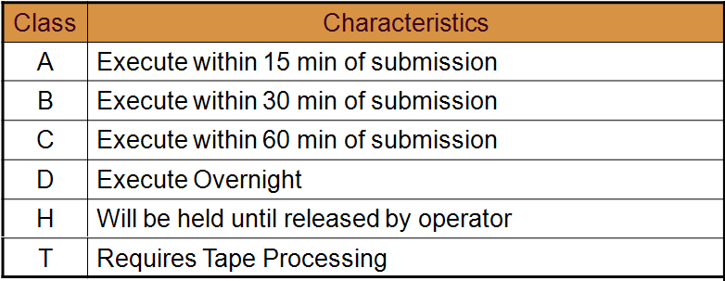
A typical JOB Class assignment

Slide 29
IMPORTANT JOB PARAMETERS
Keyword Parameters
MSGCLASS
EX: //ER5077J JOB ,,MSGCLASS=A
MSGCLASS specifies the job scheduler message output class.
Job scheduler messages include all messages not printed by the
job steps being executed but the JCL messages and system
messages
Installation establishes a default class that is in effect if
MSGCLASS is omitted.
Notes:
The MSGCLASS parameter allows you to assign an output class to your job log. The job log is a record of job-related information that you may find useful. The output classes you can use are defined by your installation.

Slide 30
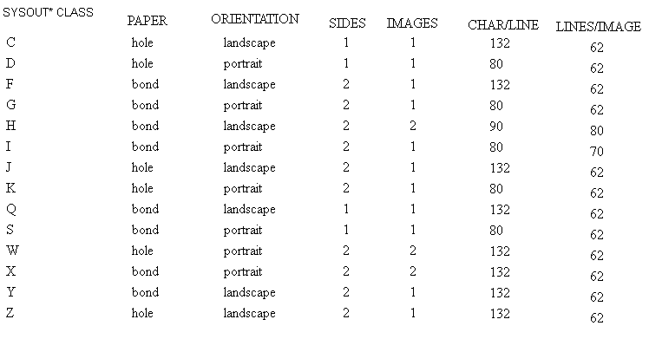
Notes:
MSGCLASS=A indicates output is to be written to a line printer or CMS virtual reader;
MSGCLASS=B indicates that output is to be written to a card punch or CMS virtual reader.
MSGCLASS=J indicates the output will be printed on 8 1/2" by 11" hole paper

Slide 31
IMPORTANT JOB PARAMETERS
Keyword Parameters
MSGLEVEL
EX: //ER5077J JOB ,,MSGLEVEL=(1,1)
MSGLEVEL(statements,messages) specifies the printing of JCL
statements and allocation messages.
EX: MSGLEVEL(0,1) will print only JOB statement, and all the
allocation, JES, SMS and operator messages
By default it is MSGLEVEL(1,1)
Notes:
The MSGLEVEL parameter is used to specify the JCL and allocation messages which will be recorded on the output device specified in MSGCLASS.
The Syntax of the MSGLEVEL parameter is as follows:
MSGCLASS=(statements,messages) or MSGCLASS=statements or MSGCLASS=(,messages)
Where statements may be number 0,1 or 2 and messages is a value which can be 0 or 1.
Statements = 0 --- only job statement is printed.
Statements = 1 --- Prints all JCL including Procedure statements and JES statements
Statements = 2 --- Prints only submitted JCL and JES Statements
Messages = 0 --- Prints allocation/termination messages only if the job terminates abnormally
Messages = 1 --- Prints all allocation/termination messages regardless of whether the job terminates normally or abnormally.

Slide 32
IMPORTANT JOB PARAMETERS
Keyword Parameters
NOTIFY
//ER5077J JOB ,,NOTIFY=&SYSUID
//ER5077J JOB ,,NOTIFY=ER5077
Requests the system sends a message to the TSO user id
specified when the job completes processing
Notes:
When NOTIFY=&SYSUID is specified, the message will be send to the user-id that was used to submit the job.
You cannot write NOTIFY=&&SYSUID.

Slide 33
IMPORTANT JOB PARAMETERS
Keyword Parameters
TYPRUN
EX: //ER5077J JOB ,,TYPRUN=SCAN
TYPRUN checks the JCL and holds the job in the input queue.
TYPRUN = SCAN checks the JCL for syntax errors and suppresses execution
of the job
TYPRUN = HOLD holds the JCL in the input queue for later execution.It is held
until the operator releases it.
TYPRUN = JCLHOLD(JES2 only) similar to HOLD but the difference is it is
checked while it is not with the HOLD option.
TYPRUN = COPY(JES2 only) lists or duplicates the lines placed in the JOB
statement to the class assigned in the MSGCLASS parameter and suppresses
execution.
Notes:
TYPRUN parameter modifies the way JES processes your Job.
TYPRUN parameter can be used to scan a job for syntax errors. When a job is submitted with the TYPRUN=SCAN parameter, the system checks the job for errors are reports any found in the job message output without executing the job. Although the system can’t detect any incorrect data set names or DCB data, it can catch misspelled parameters and incorrectly coded continuation lines.
A job can be placed in a hold status so it won’t execute until an operator issues a command that releases it. This can be useful if the operator needs to mount a tape or if the job needs to wait until another job has completed.

Slide 34
SOME OTHER Keyword JOB PARAMETERS
PRTY=Priority : is related to the CLASS parameter. It assigns
priority to jobs which belong to the same class.priority numbers
range from (0-14) or (0-15) depending on installations.
TIME=(min,sec) : signifies how much CPU time the JOB can take to
run.
RESTART=STEPNAME :Forces the JOB execution to start from a particular STEP.
Notes:
PRTY = priority is used by JES for queuing the job in the input queue. Comparing the PRTY parameter of two jobs belonging to different classes is meaningless.
TIME =The TIME parameter specifies the total amount of CPU time that all steps in a JOB can use collectively.
Syntax
TIME = {([minutes],[seconds])}
= {1440}
= {NOLIMIT}
= {MAXIMUM}
When there is a timeout, the abend is S322.
NOLIMIT indicates that the job can utilize the processor for an unlimited amount of time.
1440 also indicates that the job can use the processor for an unlimited amount of time.
MAXIMUM indicates that the processor can be used for the maximum amount of time i.e. 357912 min.
RESTART: Lets you restart a job when one of the job steps has failed. Normally you specify the job step name where you want to restart the job, but you can also specify a procedure step name if the job calls a procedure.
EX: If you want to start from step3 then
RESTART=STEP3

Slide 35
SOME OTHER keyword JOB PARAMETERS
ADDRSPC=REAL : It is used to specify whether the program is
to use REAL or VIRTual ADDRess SPaCe. Default is Virtual. If
Real is coded then the REGION parameter is also to be coded.
REGION=96K :To override the default amount of workspace
assigned for the job.
COND=(4,LT) :Permits the execution of a steps to depend on the
return code from the previous steps.
Notes:
The ADDRSPC parameter specifies whether the job will use real or virtual storage.
VIRT= the job will use the Virtual Storage
REAL = the job will use Real Storage
The default value is VIRTUAL. Good practice is to use the default value. If the parameter is coded in both EXEC and the JOB, the value in JOB will override.
REGION: Specifies the amount of storage in Megabytes and kilobytes for each of the steps in the Job within the job’s address space.

Slide 36
EXEC STATEMENTS
PGM COND
PROC PARM
ACCT REGION
ADDRSPC TIME
PERFORM
Notes:
All kinds of resources that will be required for execution of the job and program must be specified in a JCL.
EXEC statement is required to identify the program executed by each step in a job. Every EXEC statement is called as Step. Step name is of maximum 8 characters and it is optional, it’s a good practice to code a step name for each step.
Through EXEC statement, mainly program name or proc name is specified.
A job can be executing multiple steps and each step is identified by an EXEC statement and it must have a step name also.
The main parameters in EXEC statement are PGM and PROC and other parameters can be specified when ever it’s required.
In the next slides, each parameter is discussed in detail.

Slide 37
IMPORTANT EXEC PARAMETERS
positional parameters
PGM & PROC
EX: //STEP1 EXEC PGM=IEFBR14
EX: //STEP1 EXEC PROC=MYPROC
The PGM parameter identifies the name of the program that is to be executed.
The PROC parameter identifies the name of the procedure that is to be called.

Slide 38
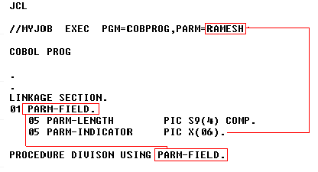
IMPORTANT EXEC PARAMETERS
keyword parameters
PARM
EX: //STEP1 EXEC PGM=IEBUPDT,PARM=‘LET,MAP,XREF’
The PARM parameter is used to supply information to a program as it executes.
Notes:
The PARM parameter is used to pass information that can be accessed by the program you specify in the PGM parameter. The information is usually used to influence the way the program works. For example, IBM programs like utilities, compilers, and the linkage editor use PARM information to set various processing options.
Any information coded into the PARM field is program-dependent. As a result, there are no special JCL rules to adhere to other than the rules of punctuation you must follow for any parameter value. If the PARM field contains special characters like commas, spaces, parentheses etc you should enclose the entire field in the apostrophes.

Slide 39
IMPORTANT EXEC PARAMETERS
keyword parameters
ADDRSPC
EX: //STEP1 EXEC PGM=IEBUPDT,ADDRSPC=VIRT
The ADDRSPC parameter is to indicate to the system that the job step is to use either VIRT (virtual) or REAL (real) storage.
By default it is virtual.

Slide 40
IMPORTANT EXEC PARAMETERS
keyword parameters
COND
EX: //STEP3 EXEC PGM=IEBUPDT,COND=(8,LE,STEP1)
The COND Permits the execution of steps to depend
on the return code from the previous steps.
The question should be is 8 less than the RC code of STEP1.
If Yes then Bypass STEP3
If No Execute STEP3
Notes:
The COND parameter allows you to specify the conditions that will allow a job step to execute. Specifically it allows you to check return codes from earlier steps so you can decide whether to execute the current step. You code this parameter on either the JOB or EXEC statement depending on whether you want to specify a condition that applies to each step in the job or only to a single step.

Slide 41
IMPORTANTEXECPARAMETERS
keyword parameters
(IF/THEN/ELSE/ENDIF)
EX: // IF STEPA.RC GE 4 THEN
//jcl statements
// ELSE
//jcl statements
// ENDIF
The IF/THEN/ELSE/ENDIF statement construct
provides a simple means of selectively executing job steps.
Notes:
It’s advisable to use IF statements than COND parameter to avoid any confusion.

Slide 42
DD STATEMENTS
ddname DD *
VOL DATA
DCB SYSOUT
DSN DUMMY
UNIT DLM
DISP SYSUDUMP
SYSMDUMP SYSABEND
REFERBACK JOBLIB
STEPLIB
Notes:
To describe the data sets that must be allocated for a job step, we code a DD statement for each data set after the EXEC statement. The DD statement provides the system with the information about a data set, such as its, storage requirements, organization & record length. DD statement parameter can be coded in various combinations, depending on whether the data set is new or old, temporary or permanent, and cataloged or uncataloged.
The DD statement (Data Definition), is used to identify the source of input and output files. There are several parameters for this statement and are discussed in detail in the next slides.

Slide 43
DSN
The name of the data set
Simple Name : 1 to 8 chars
Qualified Name : separated by periods
each name 1 to 8 chars
total 44 characters including periods
Temporary data sets : &&TEMP or do not
mention DSN parameter
Refer back : DSN=*.STEP1.DD1
Notes:
DSN Specifies the name of the existing data set or newly created data set. It specifies the name of the file to be used as input or output for the job. DSN is a KEYWORD parameter in the DD statements.
Always use Qualified names only as it’s not possible to allocate datasets with simple name of 8 characters.
A temporary dataset is created during job execution and deleted after a job complete. A Temporary dataset is recognized as such if the DSN parameter is omitted. In this case, system assigns a unique name to it and reference is made to it by referring stepname and ddname.
If the same dataset of previous steps is being used in a particular step, then we can refer back to the dataset by stepname and ddname of previous steps instead of coding the dataset name again.

Slide 44
DISP
NEW , CATLG , DELETE
OLD , KEEP , KEEP
DISP= SHR , UNCATLG , CATLG
MOD , DELETE , UNCATLG
PASS ,
DISP=(status,normal-disposition,abnormal-disposition)
Notes:
DISP plays an important part in the coding of datasets.
The status field indicates the current status of the dataset.
NEW means a new dataset (output) will be created.
OLD means an existing dataset and dataset becomes available exclusively to the step which it is referenced. If this file is being written to, then it’s old data will be lost and replaced by the new data.
SHR is identical to OLD except that SHR allows multiple jobs to read the same dataset.
MOD does different things under different circumstances. If the dataset already exists, use of the MOD subparameter in the status field results in the reader/writer of the device positioning itself just after the last record.
If the sequential dataset does not exist, then system replaces MOD with NEW and creates new dataset.
Normal disposition subparameter tells the operating system how to dispose of the dataset when the job step is done
CATLG, KEEP, UNCATLG and DELETE are self explanatory.
PASS: Where is this parameter seen??????
Temporary datasets can be PASSed.
PASS indicates that an entry for the dataset that contains DSN,VOL and UNIT parameter be placed on a table in storage, the passed dataset queue. This entry is to be used in subsequent step to receive the passed dataset.
There is a third subparameter on DISP that can control what happens to datasets during an ABEND. PASS is not allowed at this position.
If a step fails a PASSed data set is handled by the abend subparameter.
However, if NO Abend subparameter is coded, a PASSed dataset is handled by the Abend disposition specified the last time it was passed.
If no Abend disposition is coded, in the current step or in previous steps, a PASSed data set is deleted
Example to Explain PASS subparameter.
//STEP1 DD DSN=PAY,DISP=(NEW,PASS)
//STEP2 DD DSN=PAY,DISP=(OLD,PASS,KEEP)
//STEP3 DD DSN=PAY,DISP=(OLD,DELETE)
If a job fails in Step1, data set will be deleted.
--no Abend Disposition coded on step 1
--no Abend Disposition coded on previous step
If the job fails in Step2,data set will be kept
--Abend Disposition coded on Step2 says KEEP
If the job fails in Step3,data set will be kept
--no Abend Disposition on Step3
--the Abend Disposition coded on Step2 says Keep

Slide 45
DCB
LRECL=n (VALUE IN BYTES)
RECFM=(F/FB/V/VB/U)
BLKSIZE= multiple of LRECL
DSORG=(PS/PO/DA)
Notes:
DCB Parameters describe the physical characteristics of a Data Set
Must be coded for newly created data set. For existing Datasets, OS retains DCB info when Dataset was created
RECFM specifies the record format of the Dataset
RECFM=( FB/ F/VB/V/VBS )
FB = Fixed length and Blocked
F = Fixed length and Unblocked
VB = Variable length and Blocked
V = Variable length and Unblocked
VBS= Variable length and Block Spanned
Logical record Length LRECL: is used to specify Max length of fixed/variable length records in a data set
length of fixed length record(F/FB) = length of record
length of variable length record (V/VB) = length of longest record + 4 bytes
e.g. If longest record is 300 Bytes then code LECL = 304
NOTE : If 4 bytes not allocated
- data is lost by truncation
- Job might abend
Block Size BLKSIZE:
It is used to specify the size of the block of records in a dataset with FB.
BLKSIZE = even multiple of LRECL
e.g. DCB=(RECFM=FB,LECL=240,BLKSIZE=720)
with V/VB
BLKSIZE = 8 bytes greater than longest record
e.g. If longest record = 120 bytes
LECL= 124 Bytes
BLKSIZE = 128 Bytes
Dataset Organization DSORG: It identifies the organization of the data set .
DSORG ( PS/PO/DA )
PS : specifies a physical Sequential Organization
PO : specifies a partitioned Organization
DA : specifies a direct organization

Slide 46
SPACE
SPACE=(space units,(primary,secondary,dir),RLSE)
space unit - TRK(tracks)/CYL(cylinders)/BLOCKSIZE in bytes
EX:
SPACE=(TRK,(100,200))
SPACE=(TRK,(10,5))
- allocate 10 tracks primarily and if required as secondary allocation 5 tracks
Notes:
SPACE parameter is used to request DASD storage space for newly created data sets.
SPACE=(space units,(primary,secondary,dir),RLSE)
space unit - TRK (tracks) / CYL (cylinders) / BLOCKSIZE in bytes
e.g.:
SPACE=(TRK,(10,5)) - allocate 10 tracks primarily and if required as secondary allocation 5 tracks
SPACE=(CYL,(10,2))
ALL THE SUB PARAMETERS ARE POSITIONAL

Slide 47
UNIT
Hardware address
Type
Group
// UNIT=0320
OR
// UNIT=3390
OR
// UNIT=SYSDA
OR
// UNIT=DISK
To use the same unit that has been used by prior DD statement
// UNIT=AFF=ddname
Notes:
The UNIT parameter indicates the information about input or output device that will be used by the dataset. It specifies a group name, device type, or device number that identifies the device where the file resides.
The syntax of the UNIT parameter:
UNIT= group-name/device-type/device number
group-name: specifies a group name that identifies devices that belong to categories set up by the installation. SYSDA & TAPE are commonly used group names. SYSDA typically refers to any DASD unit, TAPE refers to any available tape drive.
device-type: specifies a device by its machine type or model. Ex: UNIT=3390, a 3390 device is used.
device-number: specifies a device by a three or four digit hex address. Four digit number must be precede by a slash(/), as in UNIT=/2301

Slide 48
VOL
It is used to specify a disk volume or specific tapes.
// VOL=SER=INUSR2,UNIT=SYSDA
To referback a volume used by some prior DD statement use:
// VOL=REF=ddname
Notes:
VOL=SER specifies the six-character volume serial number of the volume that contains the file. The UNIT and VOLUME parameters are used to create new data sets or to retrieve existing uncataloged data sets. For cataloged data sets no need to code the UNIT and VOL parameters because UNIT & VOL information is stored in the catlog.

Slide 49
SYSOUT
SYSOUT is used to route output to a device.
// DDNAME DD SYSOUT=CLASS
// DDNAME DD SYSOUT=A
If you want to send the output to the same device
described by MSGCLASS of the job use:
// DDNAME DD SYSOUT=*
Notes:
Programs that produce reports typically use the SYSOUT parameter in their DD statements. JES2 & JES3 allow a program to produce SYSOUT data sets that are collected in JES spool space before they are actually printed. By using the SYSOUT parameter in DD statement, you are indicating that the data set should be processed by JES2/JES3.
The SYSOUT parameter specifies an output class associated with the data set. If you code asterisk(*) instead of an output class in the SYSOUT parameter, the output class specified in the MSGCLASS parameter of the JOB statement is used.

Slide 50
JOBLIB STATEMENTS
EX
//ER5077A JOB ,,CLASS=A
//JOBLIB DD DSN=OPERN.CICS3.LOADLIB,
// DISP = (what should be the disposition)
// DISP = SHR
//STEP1 EXEC PGM=INHOUSE
The JOBLIB statement specifies the library (PDS) where the program is residing. It is placed after the JOB statement and is effective for every JOB steps.
Notes:
To execute programs that don’t reside in the system libraries, you code a DD statement in your job that specifies a private library to be searched. You can specify your private library as a job library or a step library.
To specify a job library that applies to an entire job , you code DD statement using JOBLIB as the ddname. It must be the first JCL statement after the Jobcard.
Note: OPERN.CICS3.LOADLIB is the system library (PDS) which contains program load module.

Slide 51
STEPLIB STATEMENTS
EX.
//STEP1 EXEC PGM=INHOUSE
//STEPLIB DD DSN=OPERN.CICS3.LOADLIB,
// DISP = (what should be the disposition)
// DISP = SHR
The STEPLIB statement defines the library where the program is residing. It is placed after the EXEC statement and is effective for that particular step and overrides any JOBLIB statement.
Notes:
To specify a step library that applies to only one step in a job, you code a DD statement named STEPLIB after the EXEC statement for the step. When JOBLIB and STEPLIB are coded in a JCL STEPLIB will override JOBLIB. First it searches the PDS mentioned in STEPLIB followed by the system libraries.

Slide 52
SDSF - System Display and Search Facility – an ISPF application
SDSF allows users to:
  View and search the system log
  Enter system commands
  Hold, release, cancel, and purge jobs
  Monitor jobs while they are processed
  Display job output before deciding to print it
  Control the order in which jobs are processed
  Control the order in which output is printed
  Control printers and initiators
After submitting a job, z/OS users use SDSF to review the job output for successful completion or JCL errors.
Notes:
SDSF is a software product whose primary purpose is to display printed output held in the JES
spool area. Much of the printed output sent to JES by batch jobs (and other jobs) is never
actually printed. Instead it is inspected using SDSF and deleted or used as needed.

Slide 53
Log - display system log da - display active users of system
I - display jobs in the jes2 input queue o - display jobs in output queue h - display jobs in the jes2 held o/p queue st - display status of the jobs in jes2 queue pr - display jes2 printers on this system init - display jes2 initiators on this system mas - display jes2 members in mas input - allow display of sysin data sets ulog - display user session log who - display user id, logon proc name end - to terminate sdsf

Slide 54
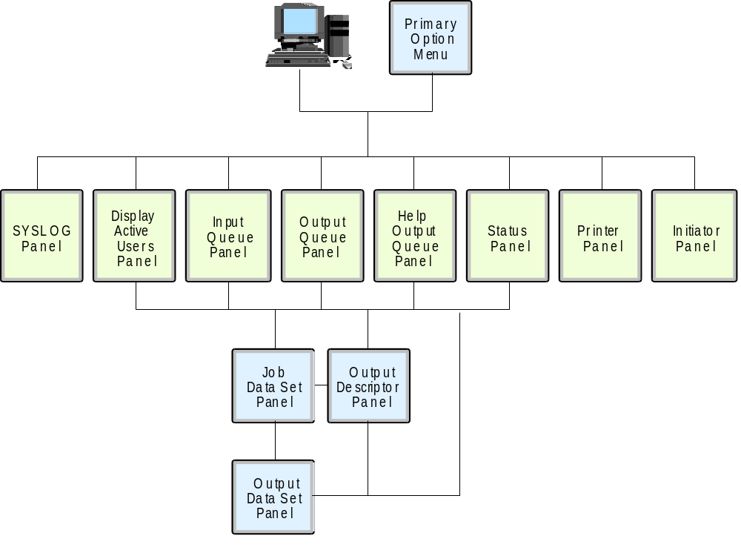
SDSF panel hierarchy

Slide 55
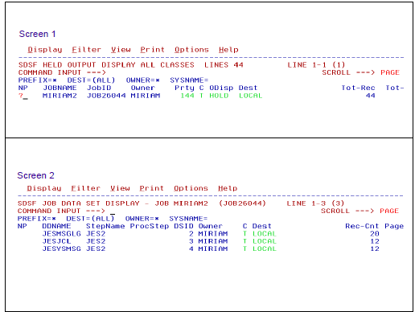

SDSF: Viewing the JES2 output files
Notes:
Issuing a question mark (?) command in the NP column displays the output files generated by
job 26044. The second screen shown in Figure displays three ddnames: JES2 messages
log file, JES2 JCL file, and JES2 system messages file. This option is useful when you are
seeing jobs with many files directed to SYSOUT and you want to display one associated with
a specific step. You issue an S in the NP column to select a file you want.

Slide 56
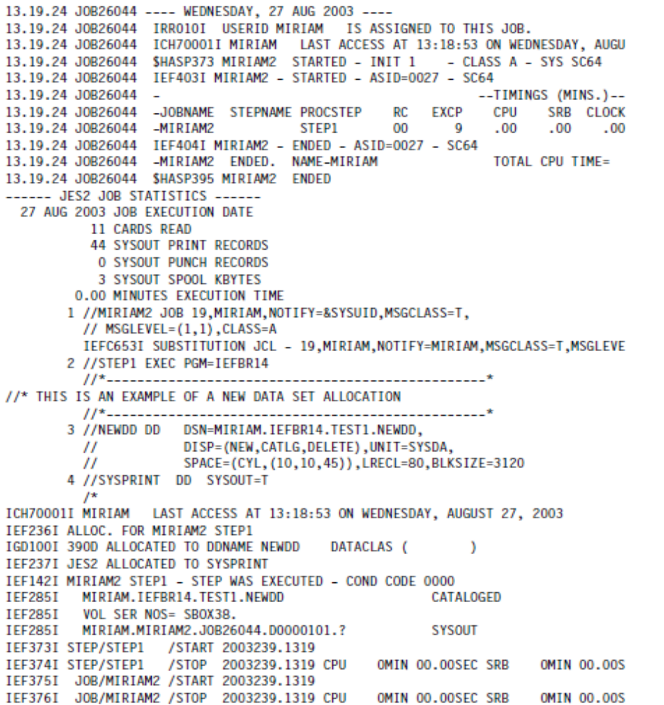
Notes:
1. The RC or Return Code value is 00 which indicates a successful completion of the step.
2. The COND CODE or Condition Code is 0000 which indicates a successful completion of the
job.
3. The following messages show that the data set MIRIAM.IEFBR14.TEST.NEWDD was
allocated on disk volume SBOXA7, and was cataloged.
IEF2851 MIRIAM.IEFBR14.TEST.NEWDD CATALOGED
IEF2851 VOL SER NOS= SBOXA7

Slide 57
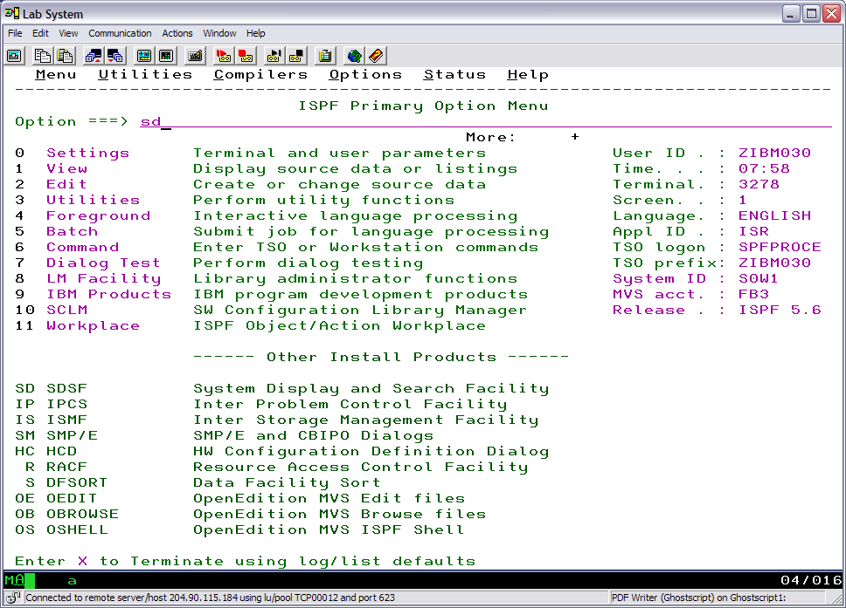
SDSF – an ISPF option (sd)

Slide 58
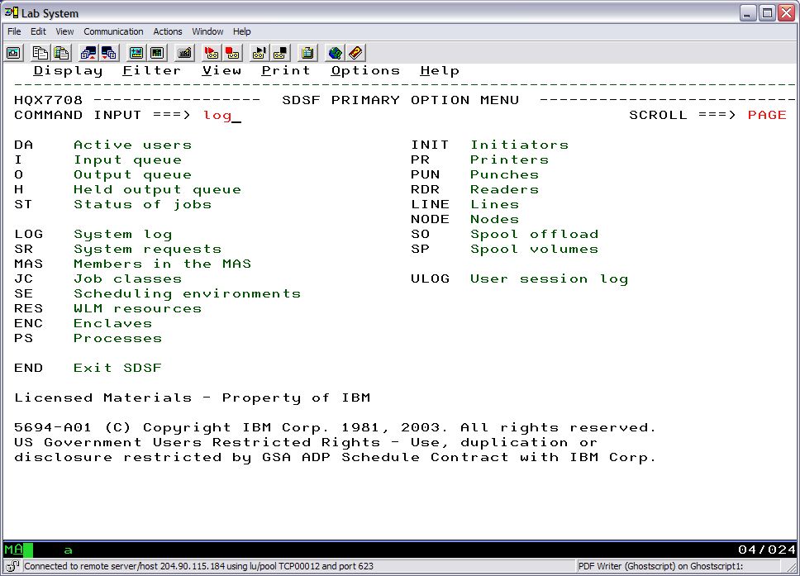
SDSF – enter log to view the system log (LOG )

Slide 59
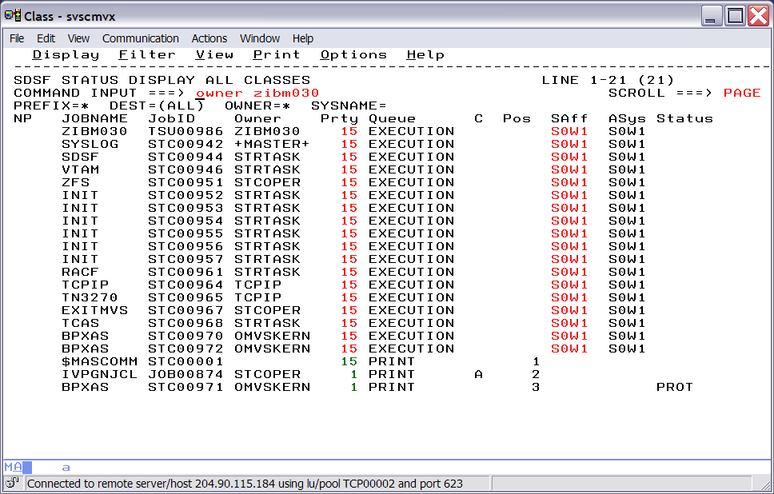
SDSF – status panel use of owner filter

Slide 60
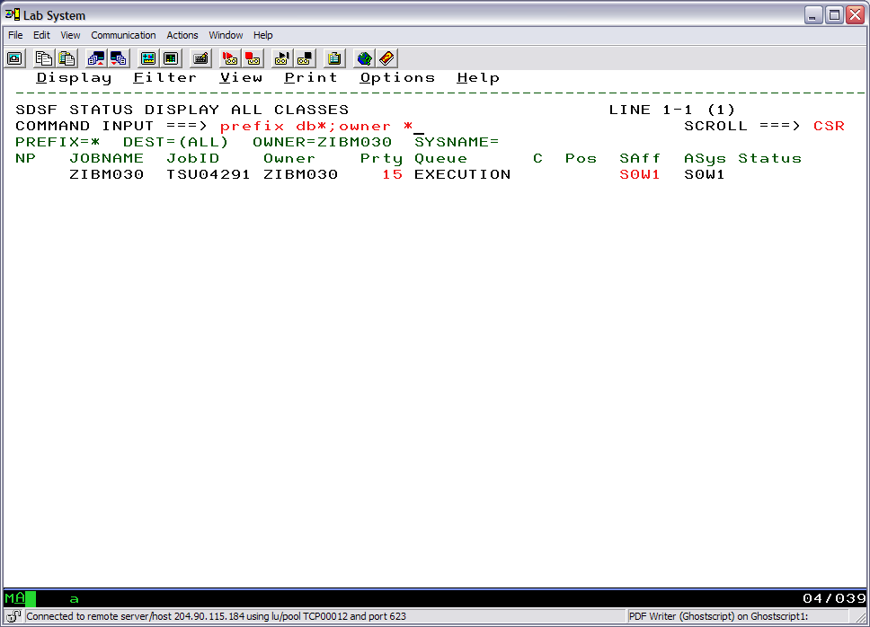
SDSF – owner panel use of prefix filter

Slide 61
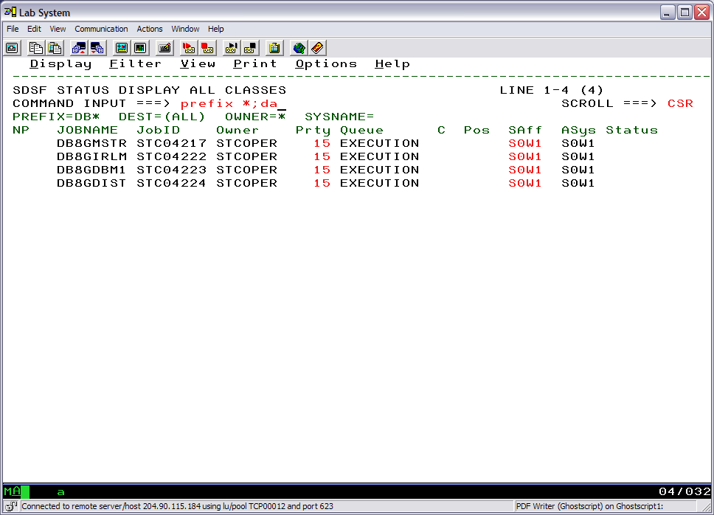
SDSF – prefix filter set display active panel

Slide 62
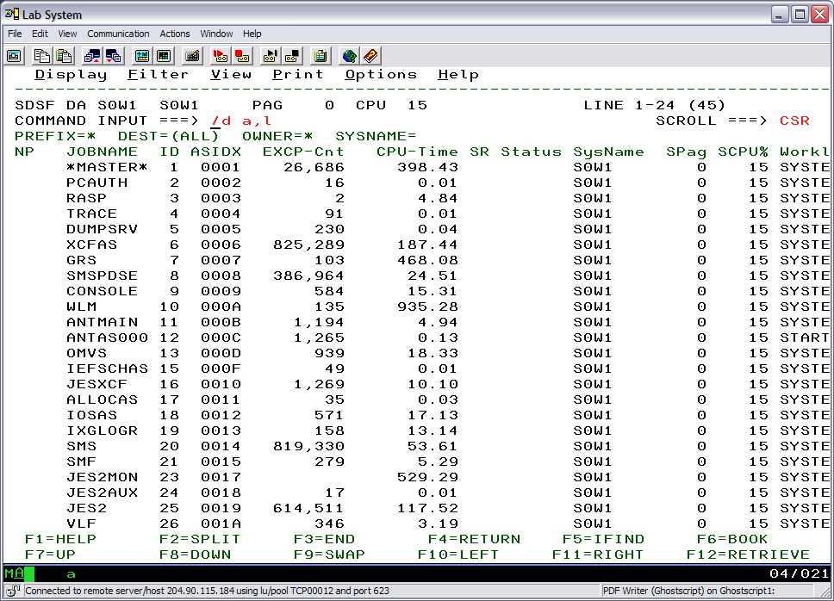
SDSF – shift right on display active panel MVS display active

Slide 63
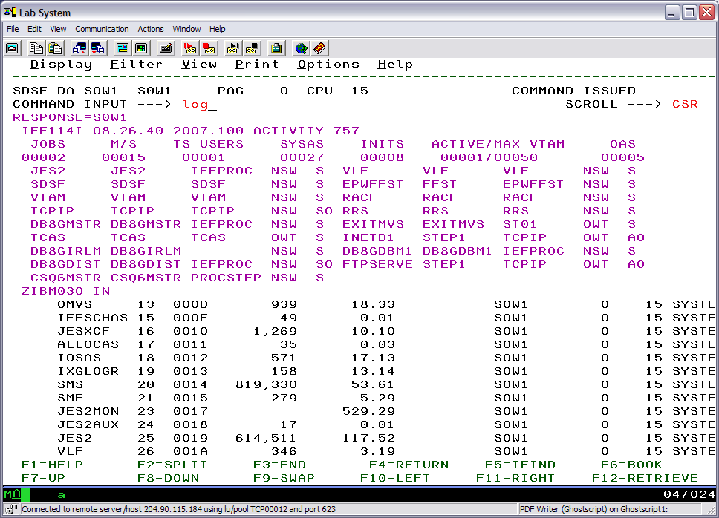
SDSF – output of MVS display active command view log output

Slide 64
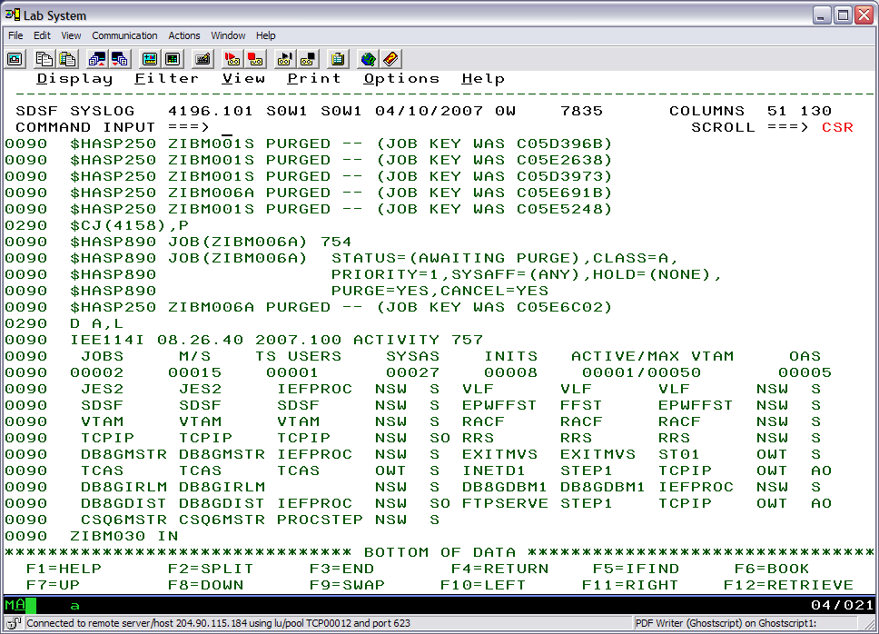
SDSF – output of MVS display active command

Slide 65
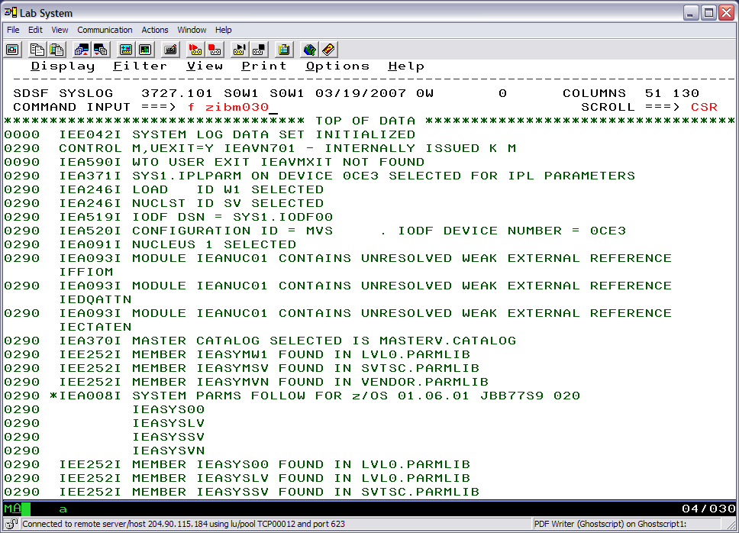
SDSF – using find (f) command

Slide 66
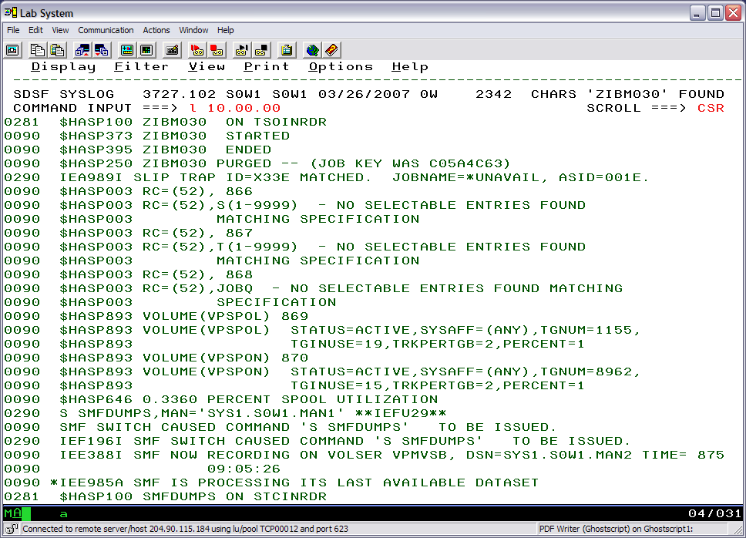
SDSF – using locate (l) command

Slide 67
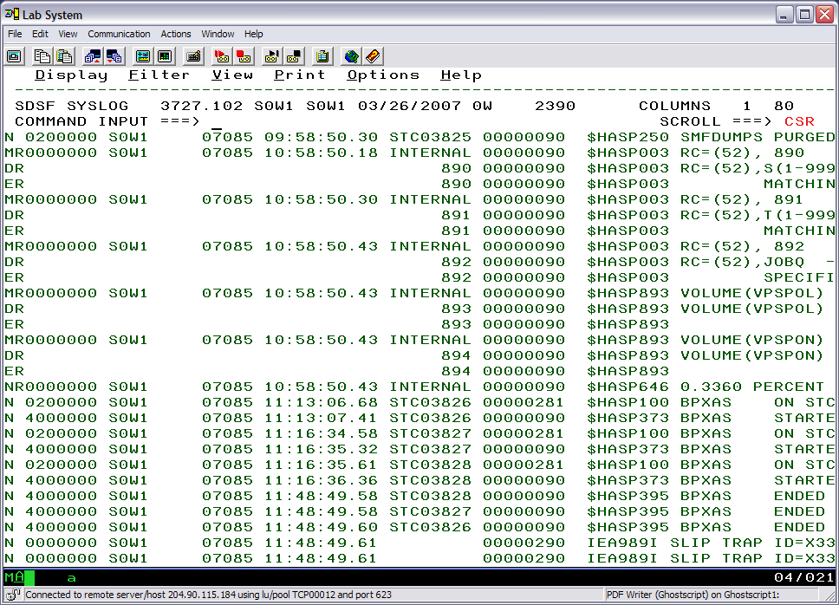
SDSF – located 10.00.00 time in system log

