Slide 1

R
N.S.Manikandan
System Architect
TIFAC-CORE

Slide 2
R Language

Slide 3
R Session
After R is started, there is a console awaiting for input. At the prompt (>), you can enter numbers and perform calculations.
> 1 + 2
[1] 3
Variable Assignment
We assign values to variables with the assignment operator "=". Just typing the variable by itself at the prompt will print out the value. We should note that another form of assignment operator "<-" is also in use.
> x = 1
> x
[1] 1
Functions
R functions are invoked by its name, then followed by the parenthesis, and zero or more arguments. The following apply the function c to combine three numeric values into a vector.
> c(1, 2, 3)
[1] 1 2 3

Slide 4
Comments
All text after the pound sign "#" within the same line is considered a comment.
> 1 + 1 # this is a comment
[1] 2
Extension Package
Sometimes we need additional functionality beyond those offered by the core R library. In order to install an extension package, you should invoke the install.packages function at the prompt and follow the instruction.
> install.packages()
Getting Help
R provides extensive documentation. For example, entering ?c or help(c) at the prompt gives documentation of the function c in R. Please give it a try.
> help(c)

Slide 5
R data types

Slide 6
Numeric
Decimal values are called numerics in R. It is the default computational data type. If we assign a decimal value to a variable x as follows, x will be of numeric type.
> x = 10.5 # assign a decimal value
> x # print the value of x
[1] 10.5
> class(x) # print the class name of x
[1] "numeric“
Furthermore, even if we assign an integer to a variable k, it is still being saved as a numeric value.
> k = 1
> k # print the value of k
[1] 1
> class(k) # print the class name of k
[1] "numeric"

Slide 7
Integer
In order to create an integer variable in R, we invoke the as.integer function. We can be assured that y is indeed an integer by applying the is.integer function.
> y = as.integer(3)
> y # print the value of y
[1] 3
> class(y) # print the class name of y
[1] "integer"
> is.integer(y) # is y an integer?
[1] TRUE
Incidentally, we can coerce a numeric value into an integer with the same as.integerfunction.
> as.integer(3.14) # coerce a numeric value
[1] 3
And we can parse a string for decimal values in much the same way.
> as.integer("5.27") # coerce a decimal string
[1] 5
In the other hand, it is erroneous trying to parse a non-decimal string.
> as.integer("Joe")
[1] NA
Like the C language, TRUE has the value 1, while FALSE has value 0.
> as.integer(TRUE) # the numeric value of TRUE
[1] 1
> as.integer(FALSE) # the numeric value of FALSE
[1] 0

Slide 8
Logical
A logical value is often created via comparison between variables.
> x = 1; y = 2 # sample values
> z = x > y # is x larger than y?
> z # print the logical value
[1] FALSE
> class(z) # print the class name of z
[1] "logical“
Standard logical operations are "&" (and), "|" (or), and "!" (negation).
> u = TRUE; v = FALSE
> u & v # u AND v
[1] FALSE
> u | v # u OR v
[1] TRUE
> !u # negation of u
[1] FALSE

Slide 9
Character
A character object is used to represent string values in R. We convert objects into character values with the as.character() function:
> x = as.character(3.14)
> x # print the character string
[1] "3.14"
> class(x) # print the class name of x
[1] "character“
Two character values can be concatenated with the paste function.
> fname = "Joe"; lname ="Smith"
> paste(fname, lname)
[1] "Joe Smith“
However, it is often more convenient to create a readable string with the sprintf function, which has a C language syntax.
> sprintf("%s has %d dollars", "Sam", 100)
[1] "Sam has 100 dollars"

Slide 10
To extract a substring, we apply the substr function. Here is an example showing how to extract the substring between the third and twelfth positions in a string.
> substr("Mary has a little lamb.", start=3, stop=12)
[1] "ry has a l“
And to replace the first occurrence of the word "little" by another word "big" in the string, we apply the sub function.
> sub("little", "big", "Mary has a little lamb.")
[1] "Mary has a big lamb.“
More functions for string manipulation can be found in the R documentation.
> help("sub")

Slide 11
R data structures

Slide 12
Vector
A vector is a sequence of data elements of the same basic type. Members in a vector are officially called components.
Here is a vector containing three numeric values 2, 3 and 5.
> c(2, 3, 5)
[1] 2 3 5
And here is a vector of logical values.
> c(TRUE, FALSE, TRUE, FALSE, FALSE)
[1] TRUE FALSE TRUE FALSE FALSE
A vector can contain character strings.
> c("aa", "bb", "cc", "dd", "ee")
[1] "aa" "bb" "cc" "dd" "ee“
Incidentally, the number of members in a vector is given by the length function.
> length(c("aa", "bb", "cc", "dd", "ee"))
[1] 5

Slide 13
Combining Vectors
Vectors can be combined via the function c. For examples, the following two vectors n ands are combined into a new vector containing elements from both vectors.
> n = c(2, 3, 5)
> s = c("aa", "bb", "cc", "dd", "ee")
> c(n, s)
[1] "2" "3" "5" "aa" "bb" "cc" "dd" "ee“
Value Coercion
In the code snippet above, notice how the numeric values are being coerced into character strings when the two vectors are combined. This is necessary so as to maintain the same primitive data type for members in the same vector.
Vector Arithmetics
Arithmetic operations of vectors are performed member-by-memberFor example, suppose we have two vectors a and b.
> a = c(1, 3, 5, 7)
> b = c(1, 2, 4, 8)
Then, if we multiply a by 5, we would get a vector with each of its members multiplied by 5.
> 5 * a
[1] 5 15 25 35

Slide 14
And if we add a and b together, the sum would be a vector whose members are the sum of the corresponding members from a and b.
> a + b
[1] 2 5 9 15
Similarly for subtraction, multiplication and division, we get new vectors via memberwise operations.
> a - b
[1] 0 1 1 -1
> a * b
[1] 1 6 20 56
> a / b
[1] 1.000 1.500 1.250 0.875
Recycling Rule
If two vectors are of unequal length, the shorter one will be recycled in order to match the longer vector. For example, the following vectors u and v have different lengths, and their sum is computed by recycling values of the shorter vector u.
> u = c(10, 20, 30)
> v = c(1, 2, 3, 4, 5, 6, 7, 8, 9)
> u + v
[1] 11 22 33 14 25 36 17 28 39

Slide 15
Vector Index
Vector Index
We retrieve values in a vector by declaring an index inside a single square bracket "[]"operator.
For example, the following shows how to retrieve a vector member. Since the vector index is 1-based, we use the index position 3 for retrieving the third member.
> s = c("aa", "bb", "cc", "dd", "ee")
> s[3]
[1] "cc"
Negative Index
If the index is negative, it would strip the member whose position has the same absolute value as the negative index. For example, the following creates a vector slice with the third member removed.
> s[-3]
[1] "aa" "bb" "dd" "ee“
Out-of-Range Index
If an index is out-of-range, a missing value will be reported via the symbol NA.
> s[10]
[1] NA

Slide 16
Logical Index Vector
A new vector can be sliced from a given vector with a logical index vector, which has the same length as the original vector. Its members are TRUE if the corresponding members in the original vector are to be included in the slice, and FALSE if otherwise.
For example, consider the following vector s of length 5.
> s = c("aa", "bb", "cc", "dd", "ee")
To retrieve the the second and fourth members of s, we define a logical vector L of the same length, and have its second and fourth members set as TRUE.
> L = c(FALSE, TRUE, FALSE, TRUE, FALSE)
> s[L]
[1] "bb" "dd“
The code can be abbreviated into a single line.
> s[c(FALSE, TRUE, FALSE, TRUE, FALSE)]
[1] "bb" "dd"

Slide 17
Numeric Index Vector
A new vector can be sliced from a given vector with a numeric index vector, which consists of member positions of the original vector to be retrieved.
Here it shows how to retrieve a vector slice containing the second and third members of a given vector s.
> s = c("aa", "bb", "cc", "dd", "ee")
> s[c(2, 3)]
[1] "bb" "cc"
Duplicate Indexes
The index vector allows duplicate values. Hence the following retrieves a member twice in one operation.
> s[c(2, 3, 3)]
[1] "bb" "cc" "cc"
Out-of-Order Indexes
The index vector can even be out-of-order. Here is a vector slice with the order of first and second members reversed.
> s[c(2, 1, 3)]
[1] "bb" "aa" "cc"
Range Index
To produce a vector slice between two indexes, we can use the colon operator ":". This can be convenient for situations involving large vectors.
> s[2:4]
[1] "bb" "cc" "dd"

Slide 18
Named Vector Members
We can assign names to vector members.
For example, the following variable v is a character string vector with two members.
> v = c("Mary", "Sue")
> v
[1] "Mary" "Sue“
We now name the first member as First, and the second as Last.
> names(v) = c("First", "Last")
> v
First Last
"Mary" "Sue“
Then we can retrieve the first member by its name.
> v["First"]
[1] "Mary“
Furthermore, we can reverse the order with a character string index vector.
> v[c("Last", "First")]
Last First
"Sue" "Mary"

Slide 19
List
A list is a generic vector containing other objects.
For example, the following variable x is a list containing copies of three vectors n, s, b, and a numeric value 3.
> n = c(2, 3, 5)
> s = c("aa", "bb", "cc", "dd", "ee")
> b = c(TRUE, FALSE, TRUE, FALSE, FALSE)
> x = list(n, s, b, 3) # x contains copies of n, s, b
List Slicing
We retrieve a list slice with the single square bracket "[]" operator. The following is a slice containing the second member of x, which is a copy of s.
> x[2]
[[1]]
[1] "aa" "bb" "cc" "dd" "ee"
With an index vector, we can retrieve a slice with multiple members. Here a slice containing the second and fourth members of x.
> x[c(2, 4)]
[[1]]
[1] "aa" "bb" "cc" "dd" "ee"
[[2]]
[1] 3

Slide 20
Data Frame
A data frame is used for storing data tables. It is a list of vectors of equal length. For example, the following variable df is a data frame containing three vectors n, s, b.
> n = c(2, 3, 5)
> s = c("aa", "bb", "cc")
> b = c(TRUE, FALSE, TRUE)
> df = data.frame(n, s, b)
Build-in Data Frame
We use built-in data frames in R for our tutorials. For example, here is a built-in data frame in R, called mtcars.
> mtcars
mpg cyl disp hp drat wt ...
Mazda RX4 21.0 6 160 110 3.90 2.62 ...
Mazda RX4 Wag 21.0 6 160 110 3.90 2.88 ...
Datsun 710 22.8 4 108 93 3.85 2.32 ...
............
The top line of the table, called the header, contains the column names. Each horizontal line afterward denotes a data row, which begins with the name of the row, and then followed by the actual data. Each data member of a row is called a cell.
To retrieve data in a cell, we would enter its row and column coordinates in the single square bracket "[]" operator.

Slide 21
the cell value from the first row, second column of mtcars.
> mtcars[1, 2]
[1] 6
Moreover, we can use the row and column names instead of the numeric coordinates.
> mtcars["Mazda RX4", "cyl"]
[1] 6
Lastly, the number of data rows in the data frame is given by the nrow function.
> nrow(mtcars) # number of data rows
[1] 32
And the number of columns of a data frame is given by the ncol function.
> ncol(mtcars) # number of columns
[1] 11
Preview
Instead of printing out the entire data frame, it is often desirable to preview it with the head function beforehand.
> head(mtcars)
mpg cyl disp hp drat wt ...
Mazda RX4 21.0 6 160 110 3.90 2.62 ... ..........

Slide 22
Data Frame Column Vector
We reference a data frame column with the double square bracket "[[]]" operator.
For example, to retrieve the ninth column vector of the built-in data set mtcars, we write mtcars[[9]].
> mtcars[[9]]
[1] 1 1 1 0 0 0 0 0 0 0 0 ...
We can retrieve the same column vector by its name.
> mtcars[["am"]]
[1] 1 1 1 0 0 0 0 0 0 0 0 ...
We can also retrieve with the "$" operator in lieu of the double square bracket operator.
> mtcars$am
[1] 1 1 1 0 0 0 0 0 0 0 0 ...
Yet another way to retrieve the same column vector is to use the single square bracket "[]"operator. We prepend the column name with a comma character, which signals a wildcard match for the row position.
> mtcars[,"am"]
[1] 1 1 1 0 0 0 0 0 0 0 0 ...

Slide 23
Data Frame Column Slice
Numeric Indexing
The following is a slice containing the first column of the built-in data set mtcars.
> mtcars[1]
mpg
Mazda RX4 21.0
Mazda RX4 Wag 21.0
Datsun 710 22.8
............
Name Indexing
We can retrieve the same column slice by its name.
> mtcars["mpg"]
mpg
Mazda RX4 21.0
Mazda RX4 Wag 21.0
Datsun 710 22.8
............
To retrieve a data frame slice with the two columns mpg and hp, we pack the column names in an index vector inside the single square bracket operator.
> mtcars[c("mpg", "hp")]
mpg hp
Mazda RX4 21.0 110
Mazda RX4 Wag 21.0 110
Datsun 710 22.8 93

Slide 24
Data Frame Row Slice
Numeric Indexing
For example, the following retrieves a row record of the built-in data set mtcars. Please notice the extra comma in the square bracket operator, and it is not a typo. It states that the 1974 Camaro Z28 has a gas mileage of 13.3 miles per gallon, and an eight cylinder 245 horse power engine, ..., etc.
> mtcars[24,]
mpg cyl disp hp drat wt ...
Camaro Z28 13.3 8 350 245 3.73 3.84 ...
To retrieve more than one rows, we use a numeric index vector.
> mtcars[c(3, 24),]
mpg cyl disp hp drat wt ...
Datsun 710 22.8 4 108 93 3.85 2.32 ...
Camaro Z28 13.3 8 350 245 3.73 3.84 ...

Slide 25
Data Import
Excel File
> library(gdata) # load gdata package
> mydata = read.xls("mydata.xls") # read from first sheet
Table File
> mydata = read.table("mydata.txt") # read text file
> mydata # print data frame
V1 V2 V3
1 100 a1 b1
2 200 a2 b2
3 300 a3 b3
4 400 a4 b4
CSV File
> mydata = read.csv("mydata.csv") # read csv file
To save a data frame to a CSV file, use the write.csv() function. If your data frame is named pt_data, simply enter:
> write.csv(pt_data, file = "pt_data.csv")

Slide 26

Matrix
A matrix is a collection of data elements arranged in a two-dimensional rectangular layout. The following is an example of a matrix with 2 rows and 3 columns.
> A = matrix(
+ c(2, 4, 3, 1, 5, 7), # the data elements
+ nrow=2, # number of rows
+ ncol=3, # number of columns
+ byrow = TRUE) # fill matrix by rows
> A # print the matrix
[,1] [,2] [,3]
[1,] 2 4 3
[2,] 1 5 7
An element at the m^{th} row, n^{th} column of A can be accessed by the expression A[m, n].
> A[2, 3] # element at 2nd row, 3rd column
[1] 7
The entire m^{th} row A can be extracted as A[m, ].
> A[2, ] # the 2nd row
[1] 1 5 7

Slide 27
Similarly, the entire n^{th} column A can be extracted as A[ ,n].
> A[ ,3] # the 3rd column
[1] 3 7
We can also extract more than one rows or columns at a time.
> A[ ,c(1,3)] # the 1st and 3rd columns
[,1] [,2]
[1,] 2 3
[2,] 1 7
#Creating mat8 and mat9
mat8 <- matrix(1:6, 2)
mat8
[,1] [,2] [,3]
[1,] 1 3 5
[2,] 2 4 6
mat9 <- matrix(c(rep(1, 3), rep(2, 3)), 2, byrow = T)
mat9
[,1] [,2] [,3]
[1,] 1 1 1
[2,] 2 2 2

Slide 28
#transpose
t(mat9)
[,1] [,2]
[1,] 1 2
[2,] 1 2
[3,] 1 2
mat8 * mat9
[,1] [,2] [,3]
[1,] 1 3 5
[2,] 4 8 12
mat8 * 4
[,1] [,2] [,3]
[1,] 4 12 20
[2,] 8 16 24
#division
mat8/mat9
[,1] [,2] [,3]
[1,] 1 3 5
[2,] 1 2 3
mat9/2
[,1] [,2] [,3]
[1,] 0.5 0.5 0.5
[2,] 1.0 1.0 1.0
#addition
mat9 + mat8
[,1] [,2] [,3]
[1,] 2 4 6
[2,] 4 6 8
mat9 + 3
[,1] [,2] [,3]
[1,] 4 4 4
[2,] 5 5 5
#subtraction
mat8 - mat9
[,1] [,2] [,3]
[1,] 0 2 4
[2,] 0 2 4
#multiplication
#we transpose mat8 since the dimension of the matrices have to match
#dim(2, 3) times dim(3, 2)
mat8 %*% t(mat9)
[,1] [,2]
[1,] 9 18
[2,] 12 24

Slide 29
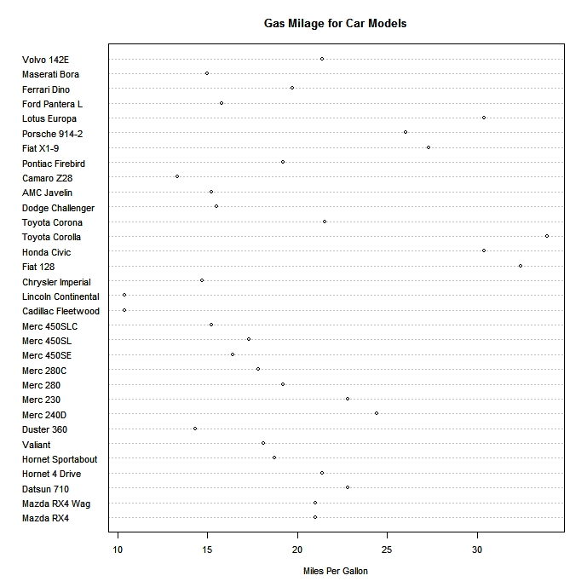
Dot Plots
Create dotplots with the dotchart(x, labels=) function, where x is a numeric vector and labels is a vector of labels for each point. You can add a groups= option to designate a factor specifying how the elements of x are grouped. If so, the option gcolor= controls the color of the groups label. cex controls the size of the labels.
# Simple Dotplot
dotchart(mtcars$mpg, labels=row.names(mtcars), cex=.7,
main="Gas Milage for Car Models",
xlab="Miles Per Gallon")

Slide 30
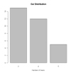
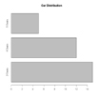
Bar Plots
Create barplots with the barplot(height) function, where height is a vector or matrix. If height is a vector, the values determine the heights of the bars in the plot. If height is a matrix and the option beside=FALSE then each bar of the plot corresponds to a column of height, with the values in the column giving the heights of stacked “sub-bars”. If height is a matrix and beside=TRUE, then the values in each column are juxtaposed rather than stacked. Include option names.arg=(character vector) to label the bars. The option horiz=TRUE to createa a horizontal barplot.
counts <- table(mtcars$gear)
barplot(counts, main="Car Distribution",
xlab="Number of Gears")
counts <- table(mtcars$gear)
barplot(counts, main="Car Distribution", horiz=TRUE,
names.arg=c("3 Gears", "4 Gears", "5 Gears"))

Slide 31
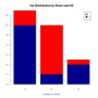
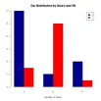
Stacked Bar Plot
# Stacked Bar Plot with Colors and Legend
counts <- table(mtcars$vs, mtcars$gear)
barplot(counts, main="Car Distribution by Gears and VS",
xlab="Number of Gears", col=c("darkblue","red"),
legend = rownames(counts))
Grouped Bar Plot
# Grouped Bar Plot
counts <- table(mtcars$vs, mtcars$gear)
barplot(counts, main="Car Distribution by Gears and VS",
xlab="Number of Gears", col=c("darkblue","red"),
legend = rownames(counts), beside=TRUE)

Slide 32
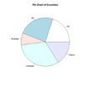
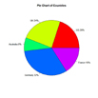
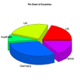
Pie Charts
Pie charts are created with the function pie(x, labels=) where x is a non-negative numeric vector indicating the area of each slice and labels= notes a character vector of names for the slices.
slices <- c(10, 12,4, 16, 8)
lbls <- c("US", "UK", "Australia", "Germany", "France")
pie(slices, labels = lbls, main="Pie Chart of Countries")
# Pie Chart with Percentages
slices <- c(10, 12, 4, 16, 8)
lbls <- c("US", "UK", "Australia", "Germany", "France")
pct <- round(slices/sum(slices)*100)
lbls <- paste(lbls, pct) # add percents to labels
lbls <- paste(lbls,"%",sep="") # ad % to labels
pie(slices,labels = lbls, col=rainbow(length(lbls)),
main="Pie Chart of Countries")
# 3D Exploded Pie Chart
library(plotrix)
slices <- c(10, 12, 4, 16, 8)
lbls <- c("US", "UK", "Australia", "Germany", "France")
pie3D(slices,labels=lbls,explode=0.1,
main="Pie Chart of Countries ")

Slide 33
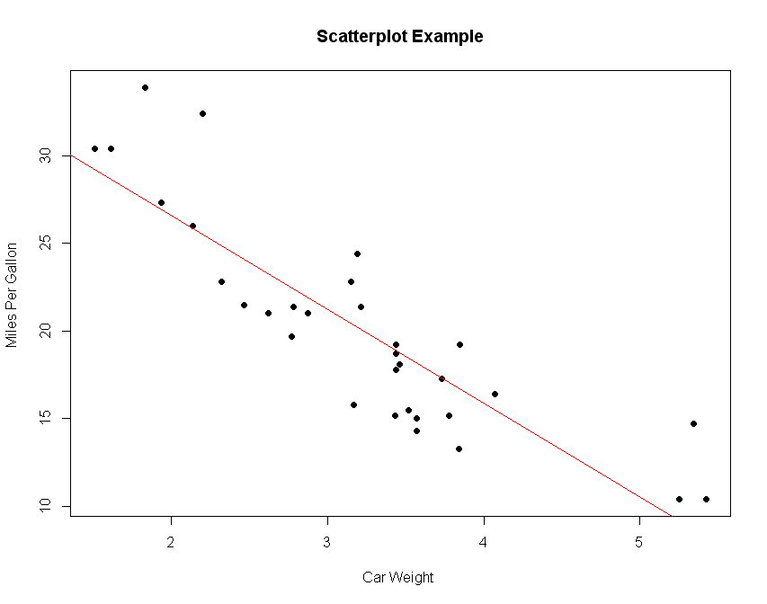
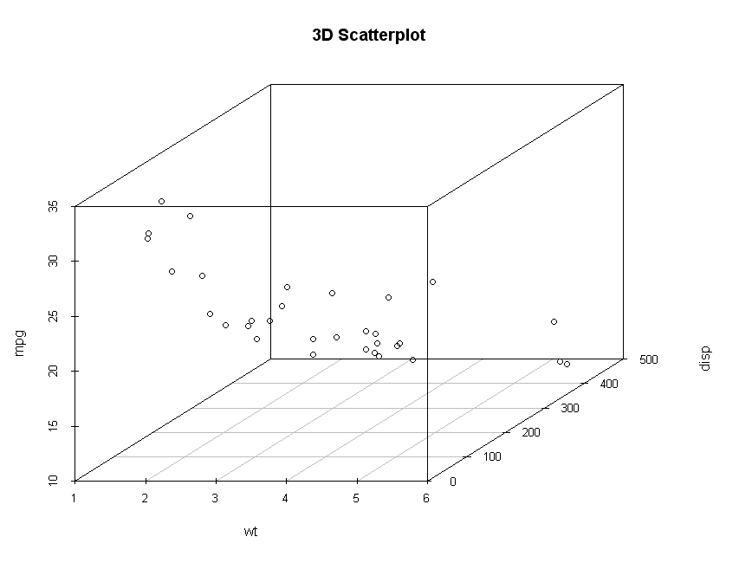
Simple Scatterplot
There are many ways to create a scatterplot in R. The basic function is plot(x, y), where x and y are numeric vectors denoting the (x,y) points to plot.
attach(mtcars)
plot(wt, mpg, main="Scatterplot Example",
xlab="Car Weight ", ylab="Miles Per Gallon ", pch=19)
# Add fit lines
abline(lm(mpg~wt), col="red") # regression line (y~x)
3D Scatterplots
create a 3D scatterplot with the scatterplot3d package. Use the function scatterplot3d(x, y, z)
library(scatterplot3d)
attach(mtcars)
scatterplot3d(wt,disp,mpg, main="3D Scatterplot")

Slide 34
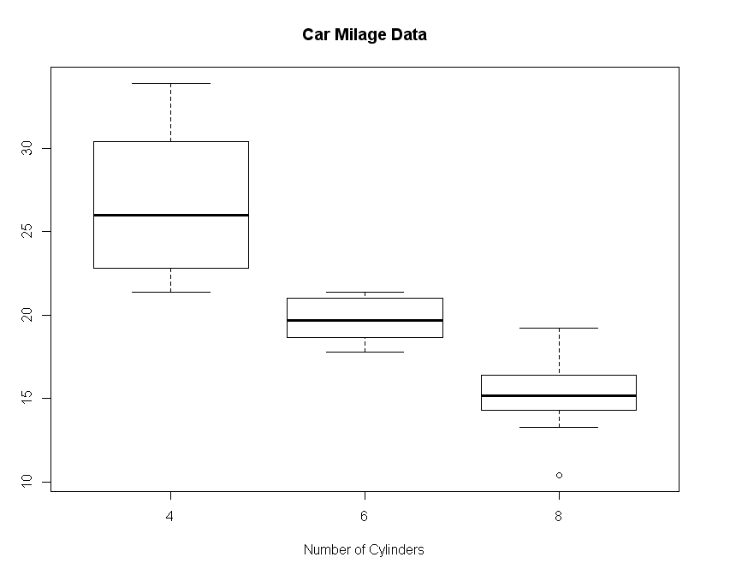
Boxplots
Boxplots can be created for individual variables or for variables by group. The format is boxplot(x, data=), where x is a formula and data= denotes the data frame providing the data. An example of a formula is y~group where a separate boxplot for numeric variable y is generated for each value of group.
boxplot(mpg~cyl,data=mtcars, main="Car Milage Data",
xlab="Number of Cylinders", ylab="Miles Per Gallon")

