Slide 1

Population growth, health spending and tuberculosis in both Germany and Turkey
Group_1

Slide 2
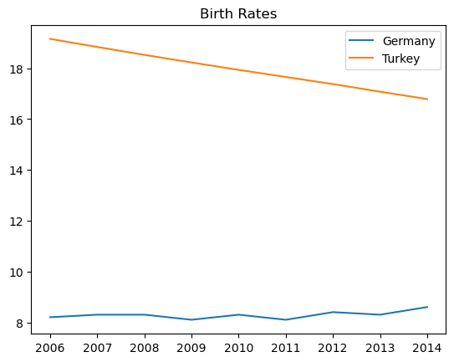
Birth rate per 1000 people
Based on this data, it can be deduced that birth rate in Germany between 2006 -2015 remained stagnant
- downward trends in economy,
- less family planning,
- more migration out of Germany
- Turkey’s birth rate from 2006 to 2015 has gradually decreased
Birth rate/1000 people
Years

Slide 3
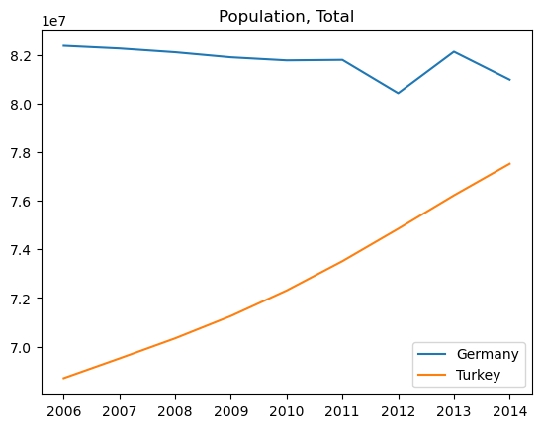
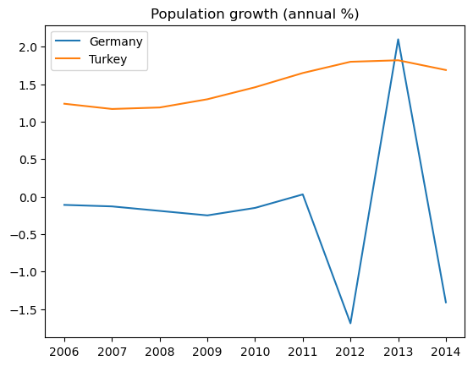
Total Population and Annual Percent growth
Population by million
% population growth
Turkey’s population grew exponentially from ~7.0 mil to ~7.8 mil
- improved healthcare
- decreased infant mortality
- immigration into the country
- dating apps
- Germany’s population from 2006 to 2011 remained consistent, followed by fluctuations in the later years

Slide 4
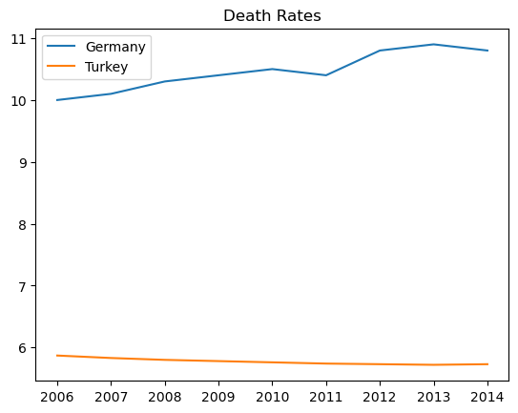
Death rate per 1000 people
Death rate in Turkey shows no fluctuations and remained at 6 /1000 (0.06%) people for a decade
whereas in Germany it is relatively higher at 10/1000 (0.10) people
Death rate/ 1000 people

Slide 5
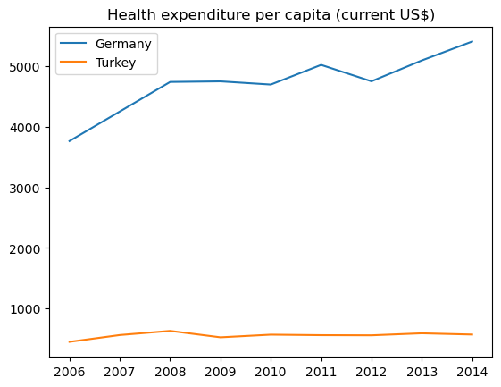
Health expenditure per capita
Per Capita USD
Germany health expenditure per capita in 2006 was $3,698 and in 2014 it increased to $5,207
Germany looks to have maintained good funding allocation towards healthcare as represented in population growth
Turkey health expenditure per capita in 2006 was $300 and 2014 it increased to $524
Turkey has been consistent with their funding throughout the decade, which is shown in increased population graph
Keep up with the annual growth rate
Provide sufficient funds for general healthcare needs (birth/death)

Slide 6
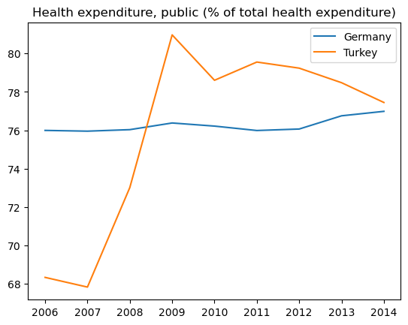
Total public Health expenditure
Germany health care system shows no fluctuation/is steady
Total health expenditure increased in Turkey around 2007
Tuberculosis Control Department budget increased
Economic stability
% Total Health Expenditure

Slide 7
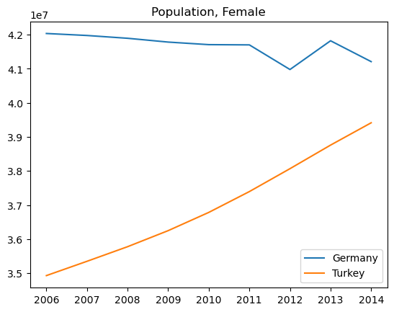
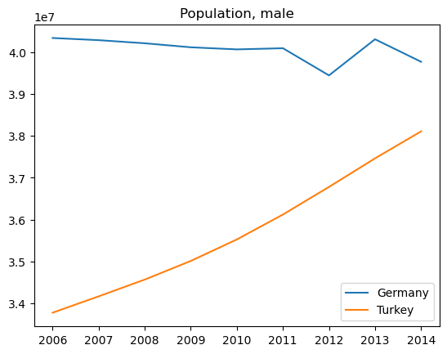
Population by gender
Population Growth:
Germany's population has been relatively stable with a low population growth rate in these years. The country has faced challenges related to an aging population and low birth rates, which have impacted population growth.
During the 2006-2014 period, Germany continued to allocate a significant portion of its GDP to healthcare.
Tuberculosis is considered a relatively low burden in Germany compared to some other countries. Germany has implemented comprehensive TB control measures.
Turkey experienced significant population growth during the 2006-2014 period.
During the 2006-2014 period, Turkey invested in healthcare infrastructure, expanded health insurance coverage, and aimed to enhance access to healthcare services.
Turkey has had a higher burden of tuberculosis compared to Germany. During the 2006-2014 period, Turkey focused on improving diagnosis and treatment services for tuberculosis.

Slide 8
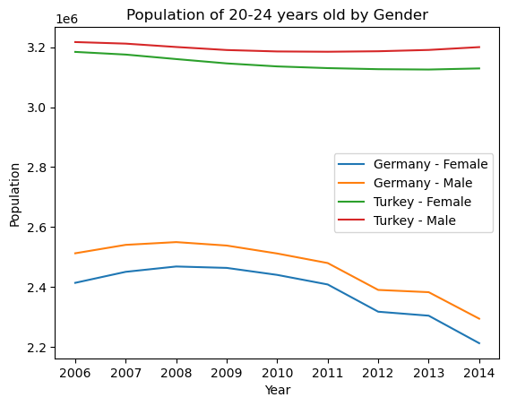
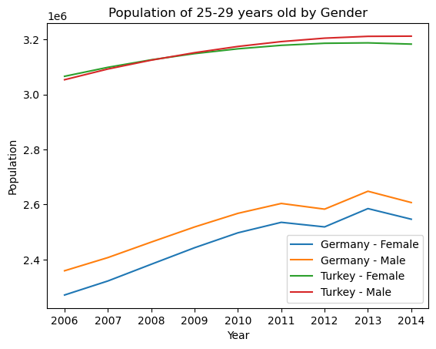
Ages 20-29
Germany’s age group from 20- 29 based on gender stayed parallel throughout the years with higher cases in early 2000s
Population by age group and gender in Turkey varied over the years;
20-24 female population was lower than male
25-29 both gender population overlap
Benefitted from improved healthcare

Slide 9
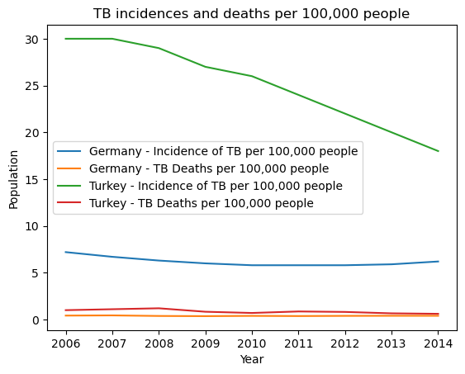
TB cases and associated deaths
Incidence rate in Germany remained around an annual TB incidence of 7.3 cases per 100,000 population
A total of 105 patients died of tuberculosis in 2015 (2014: 109 deaths). This corresponded to a mortality of 0.13 cases per 100,000 population
TB incidence rate began to decrease around 2006 due to Turkey’s initiative on Health Transformation Program (HTP)
Tuberculosis control department (TCD) funding went up
Strengthen/improve public health services
Prioritize illness prevention methods
Higher number of health professionals
Proper registration of patients with TB
Economic and governmental stability

