Slide 1

Population growth, health spending and tuberculosis in both Germany and Turkey
Group_1

Slide 2
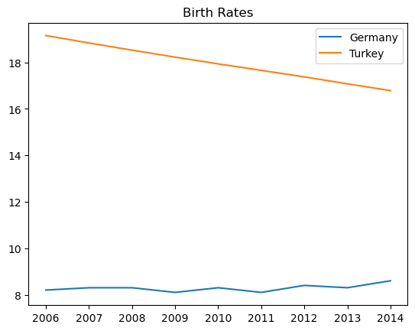
Birth rate per 1000 people

Slide 3
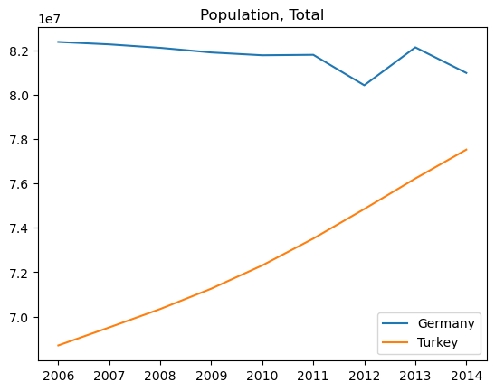
Population total by millions

Slide 4
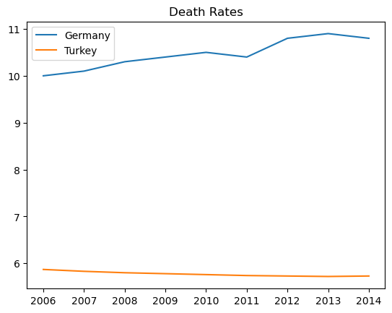
Death rate per 1000 people

Slide 5
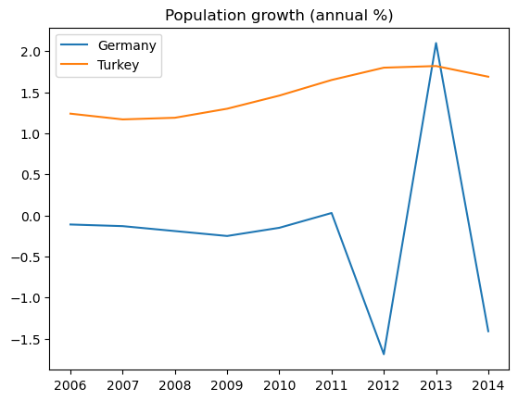
Population growth by percent

Slide 6
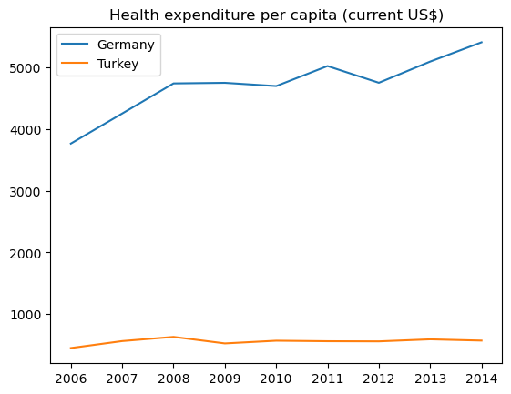
Health expenditure per capita

Slide 7
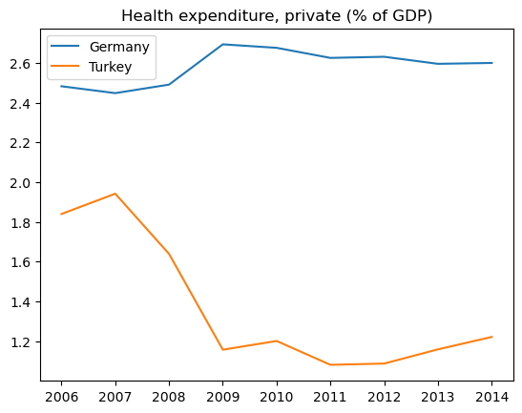
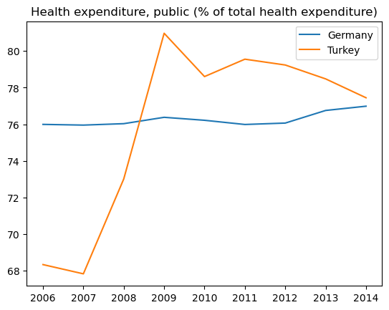
Health expenditure private vs public

Slide 8
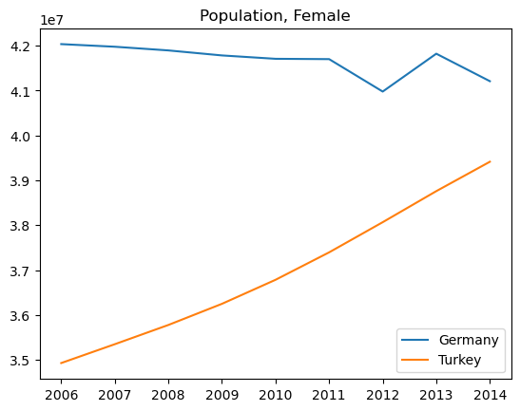
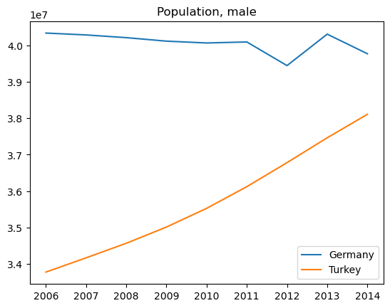
Population by gender

Slide 9
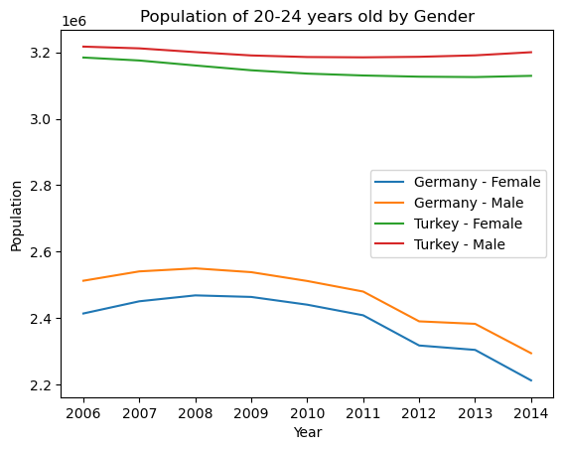
Ages 20-24

Slide 10
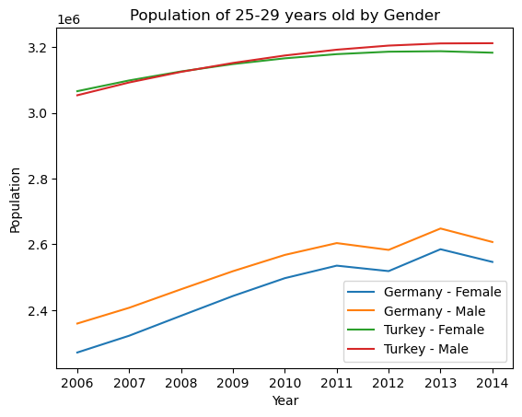
Ages 25-29

Slide 11
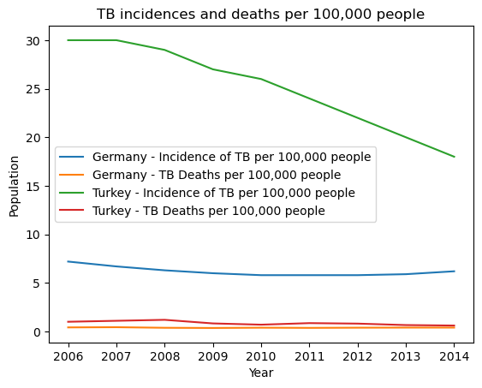
TB cases and associated deaths

