Slide 1

BANKING Portal
Mini project
(java web application)

Slide 2
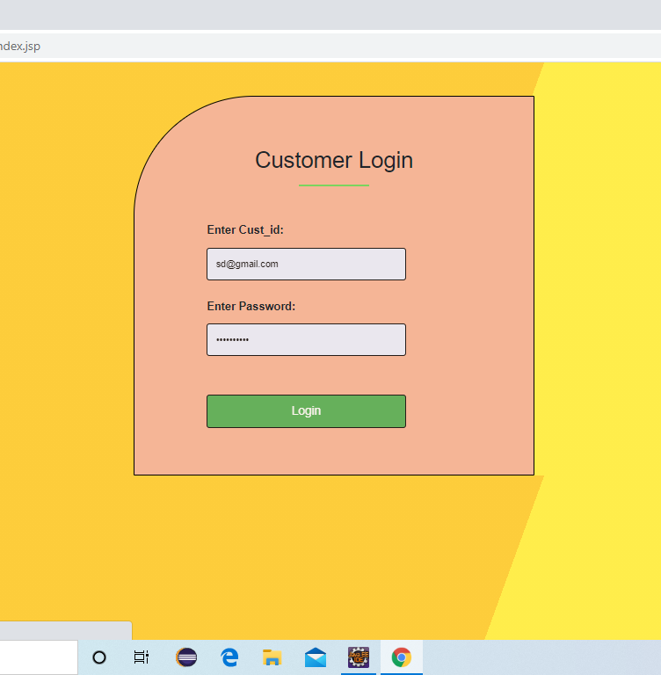
Login page
Customer can login by using cust_id and password.

Slide 3
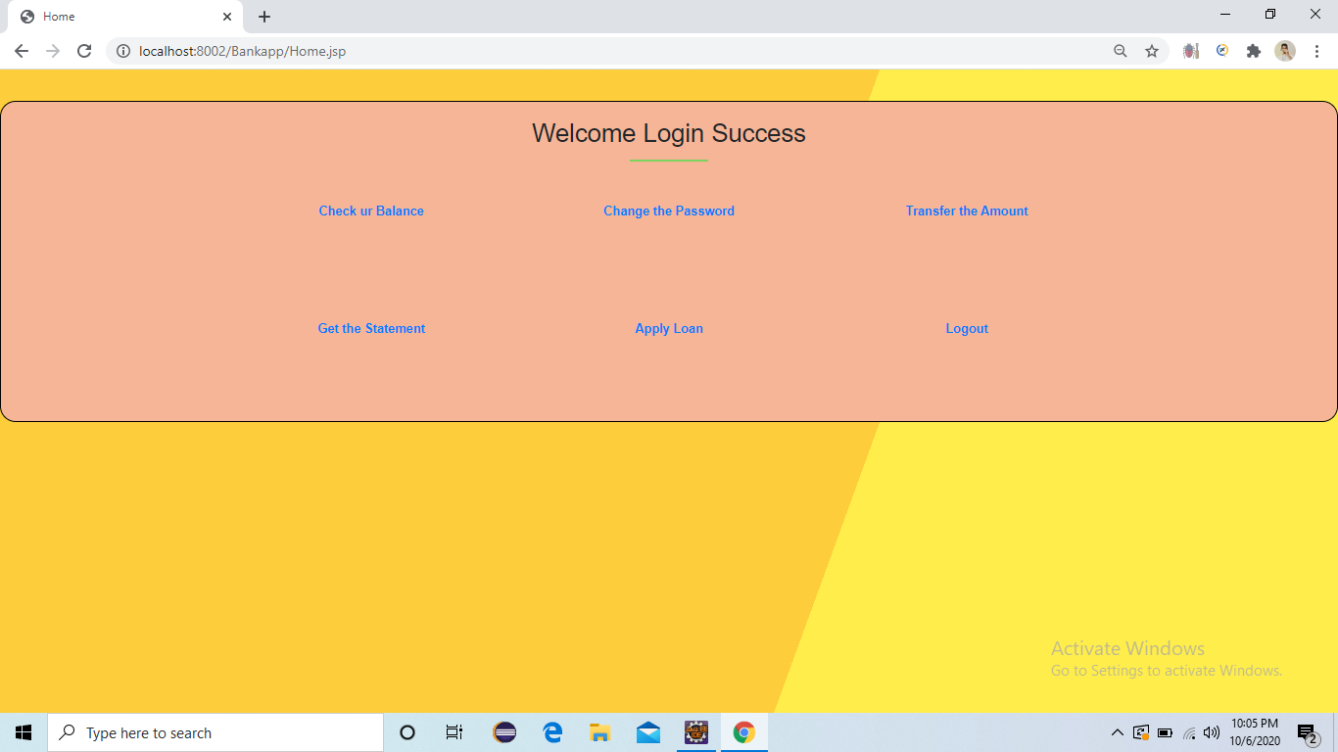
Home page
After successful Login.
Customer can view their balance.
Customer can change the password.
Customer can transfer the amount.
Customer can view their statement.
Customer can apply loan.

Slide 4
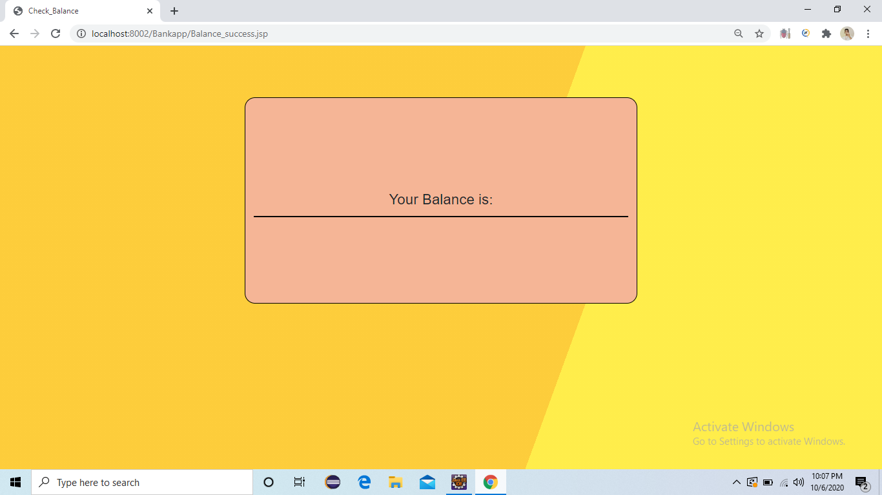
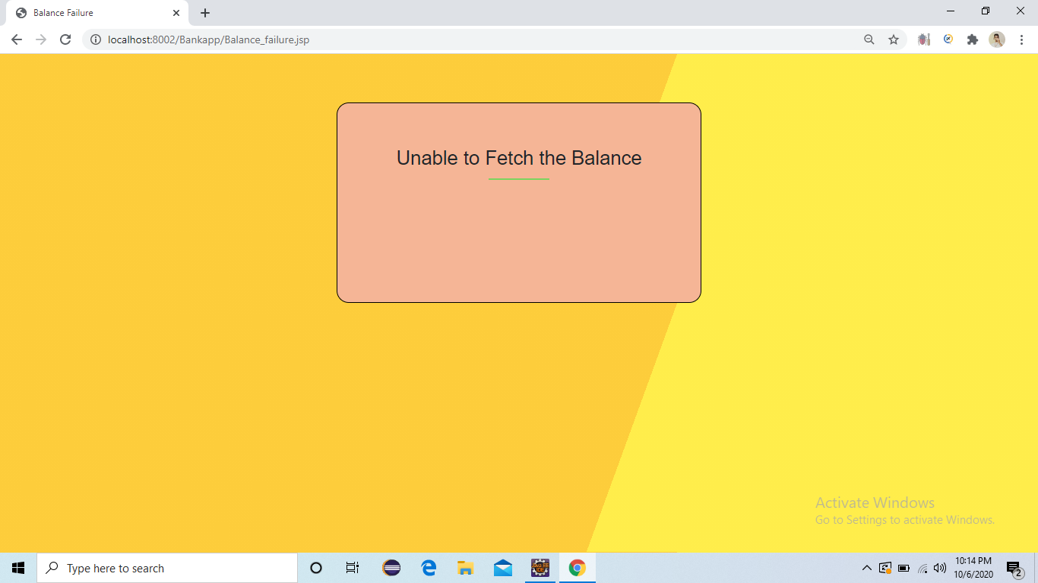
Check balance page:
Here user can view the Balance.
If something went wrong means will get unable to fetch balance message.

Slide 5
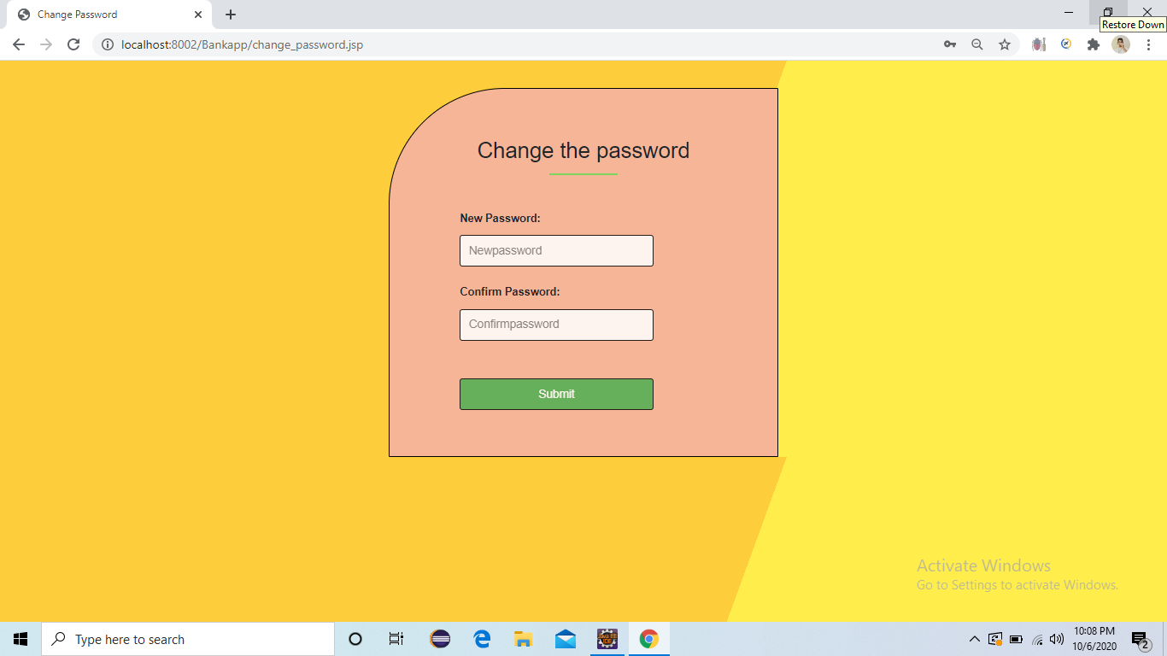
Change password page:
Here user can change the password.

Slide 6
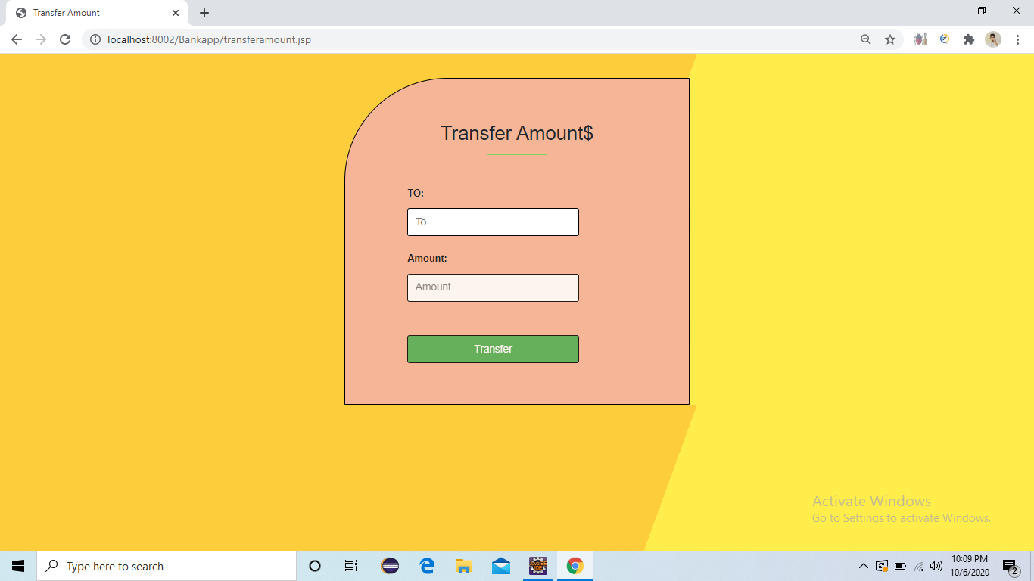
Amount transfer page:
Here user can transfer the amount to another customer.

Slide 7
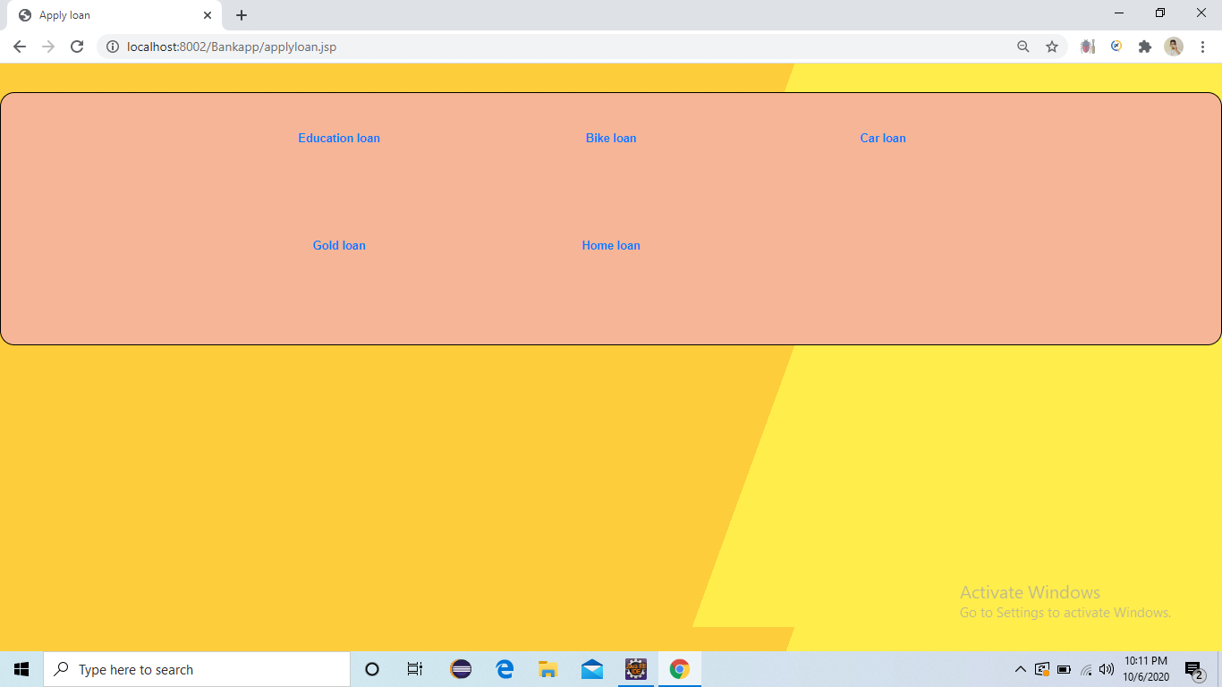
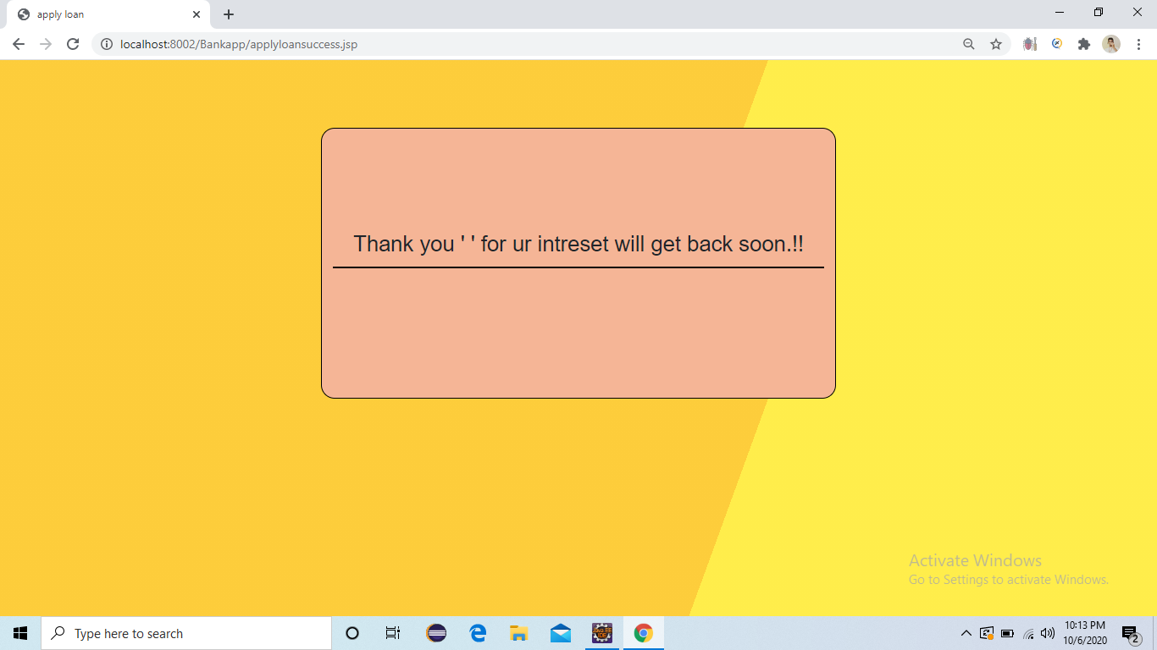
Loan page:
Here user can view and apply various types of loans.
After submitting will get message.

Slide 8
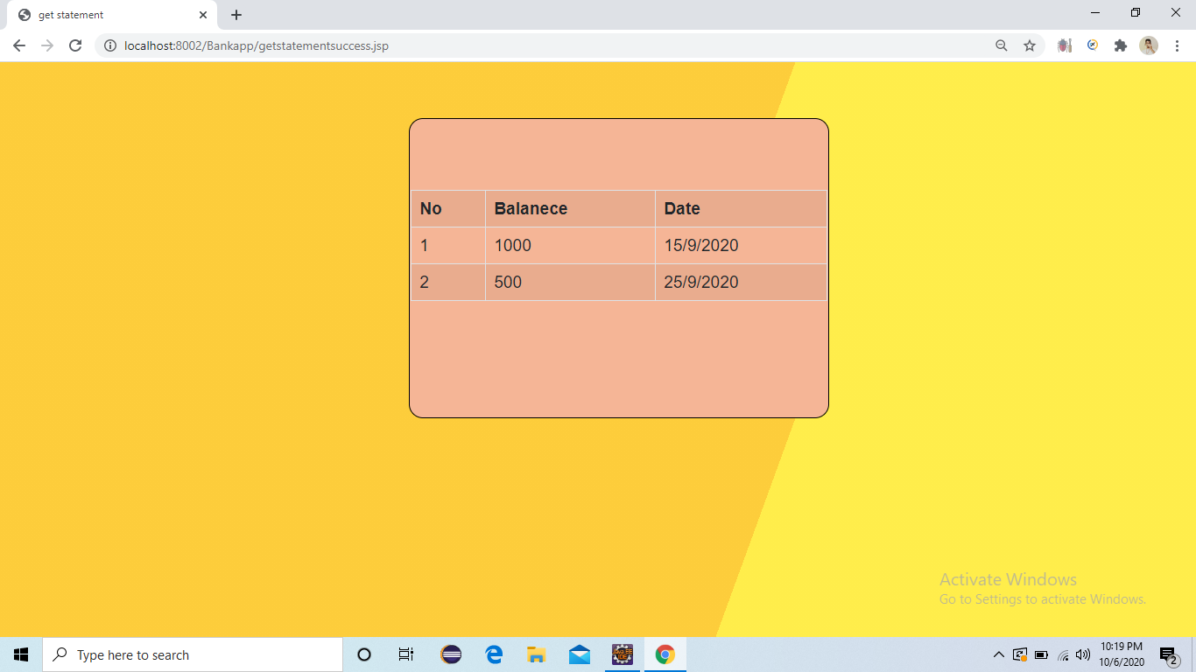
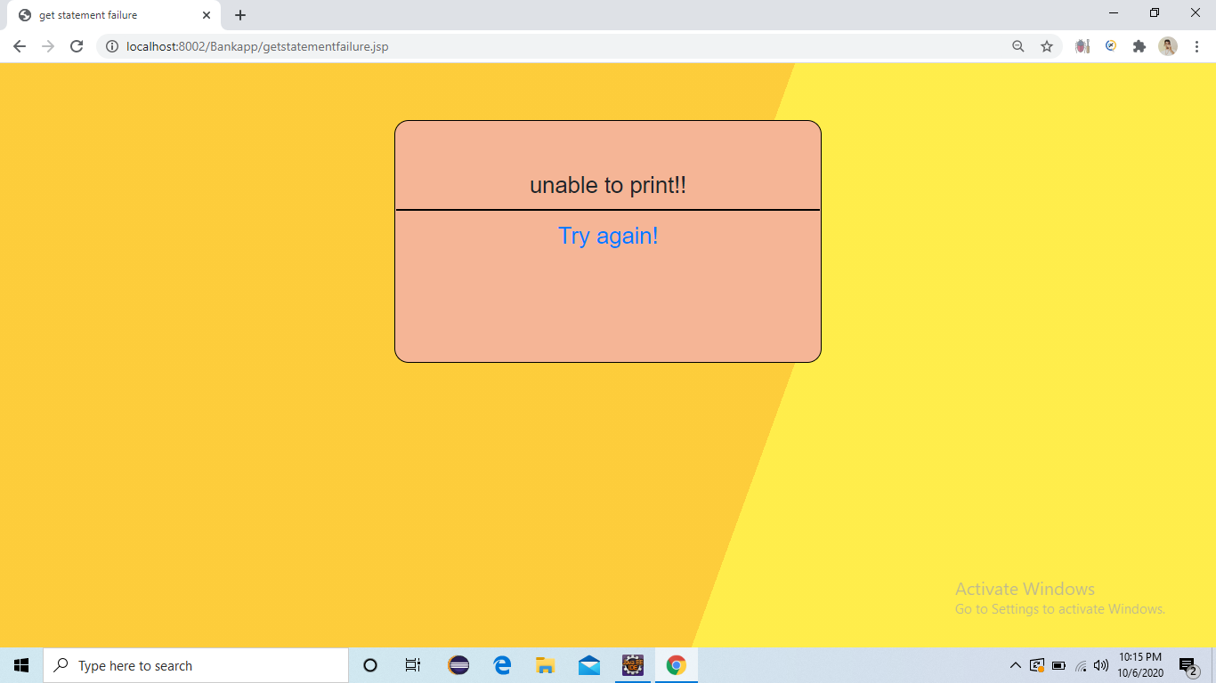
Statement page:
Here user can view the previous transaction details.
If something went wrong means will get unable to print message.

