Slide 1
Student Portal
Mini Project
(Java Web Application)

Slide 2
ADMIN LOGIN.
FACULTY LOGIN.
STUDENT LOGIN.

Slide 3

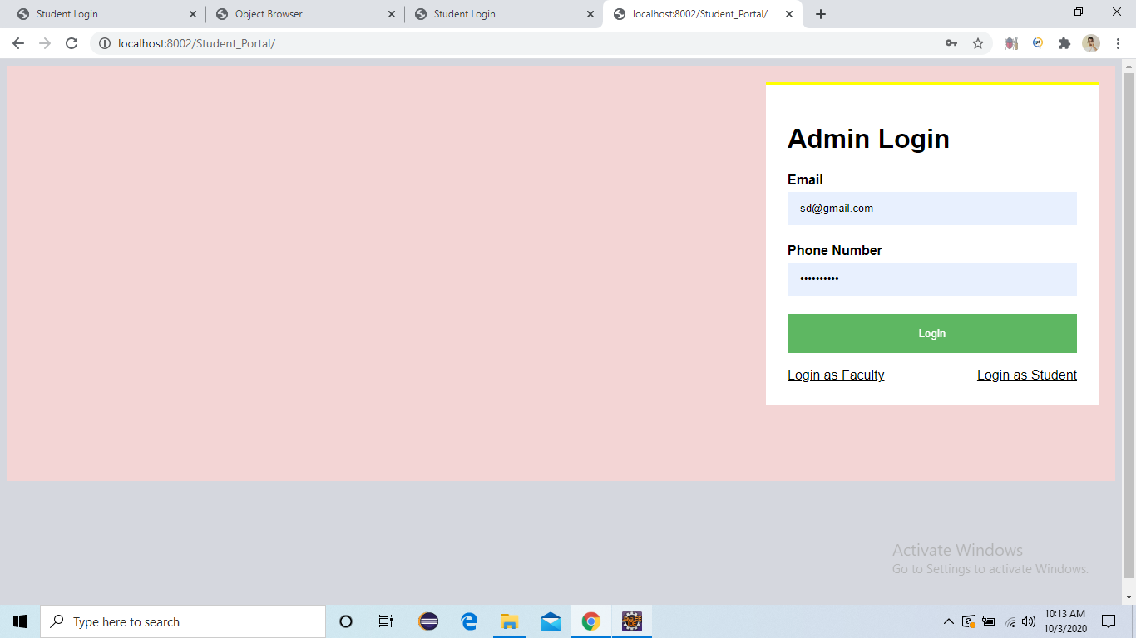
Index
Admin can Login using email and Phone number.

Slide 4
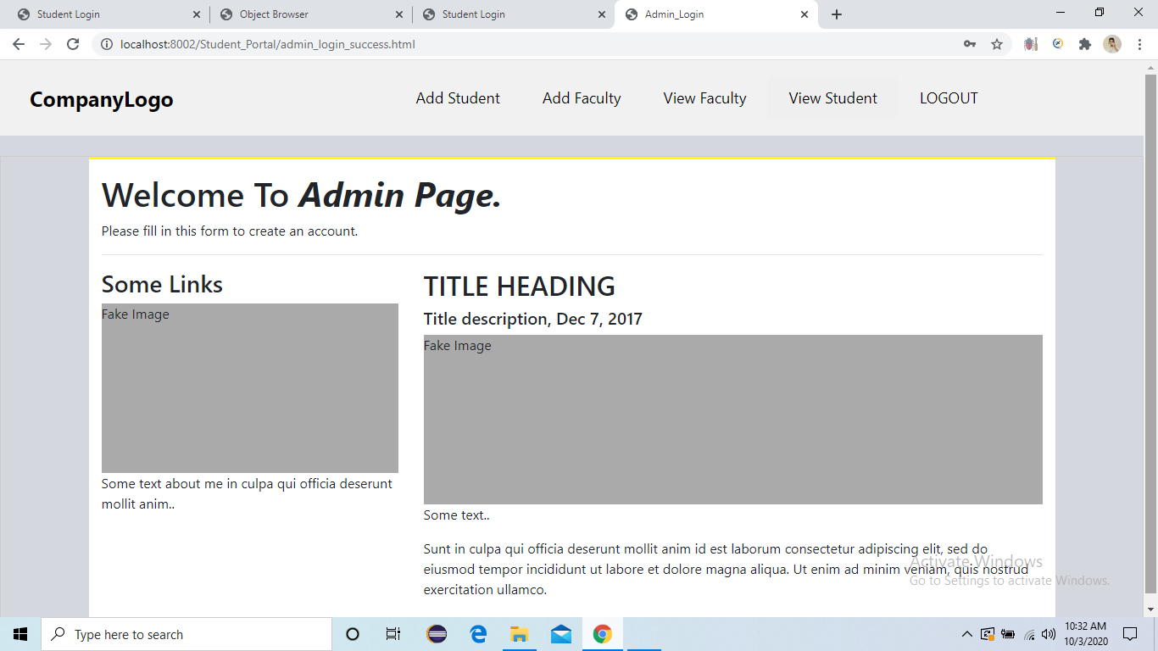
Admin_Login Success.
After Admin Login Success.

Slide 5
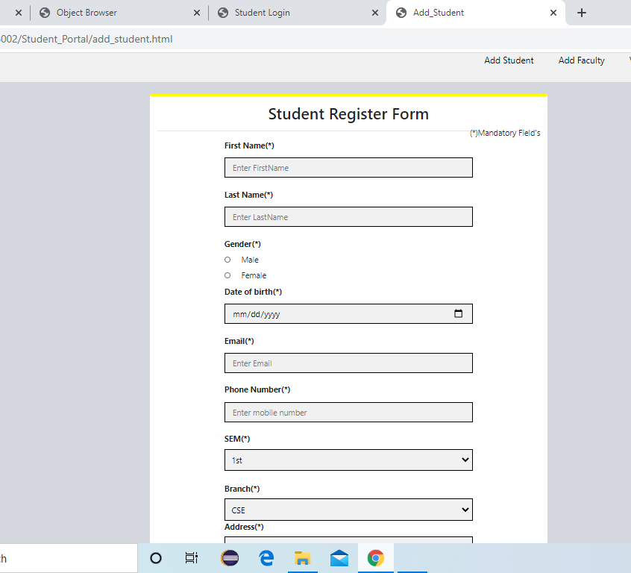
Student Registration Page.
Admin can add Student Details Here.

Slide 6
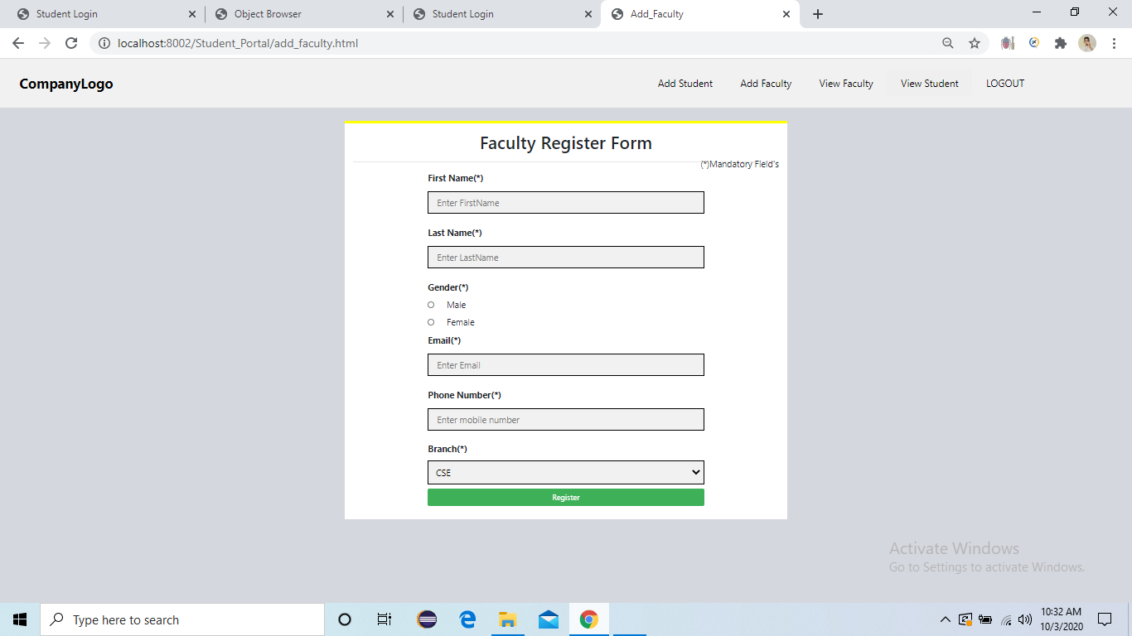
Faculty Registration Page.
Admin can add Faculty Details Here.

Slide 7
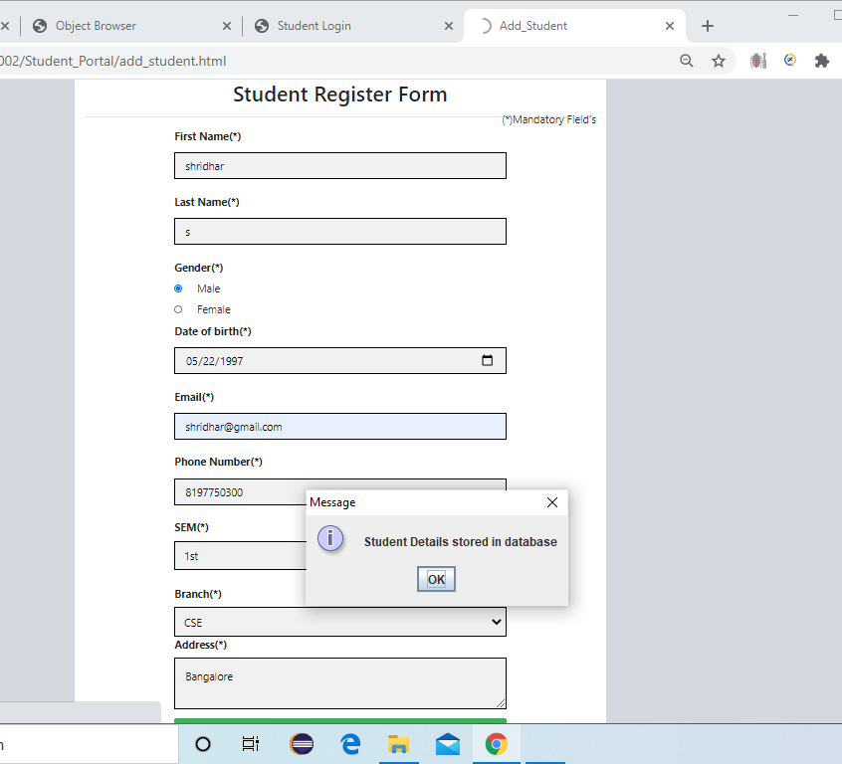
you will Get one pop up message after Successful insertion.

Slide 8
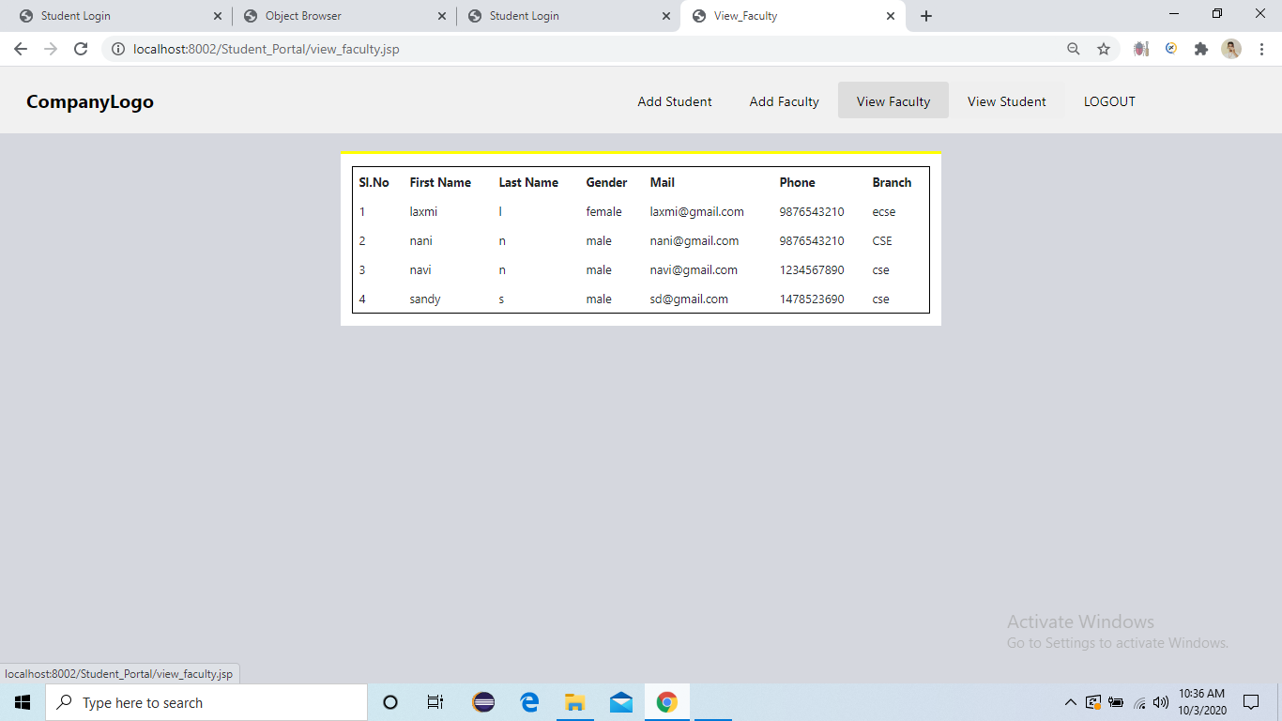
View Faculty
Admin can view the faculty details.

Slide 9
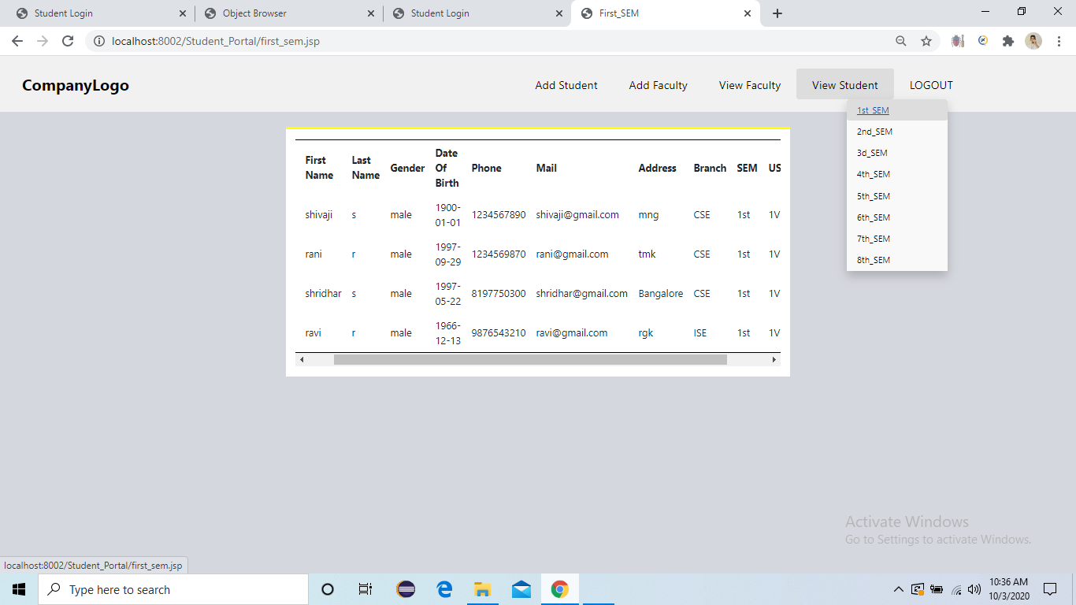
View Student
Admin can view the Student details.

Slide 10
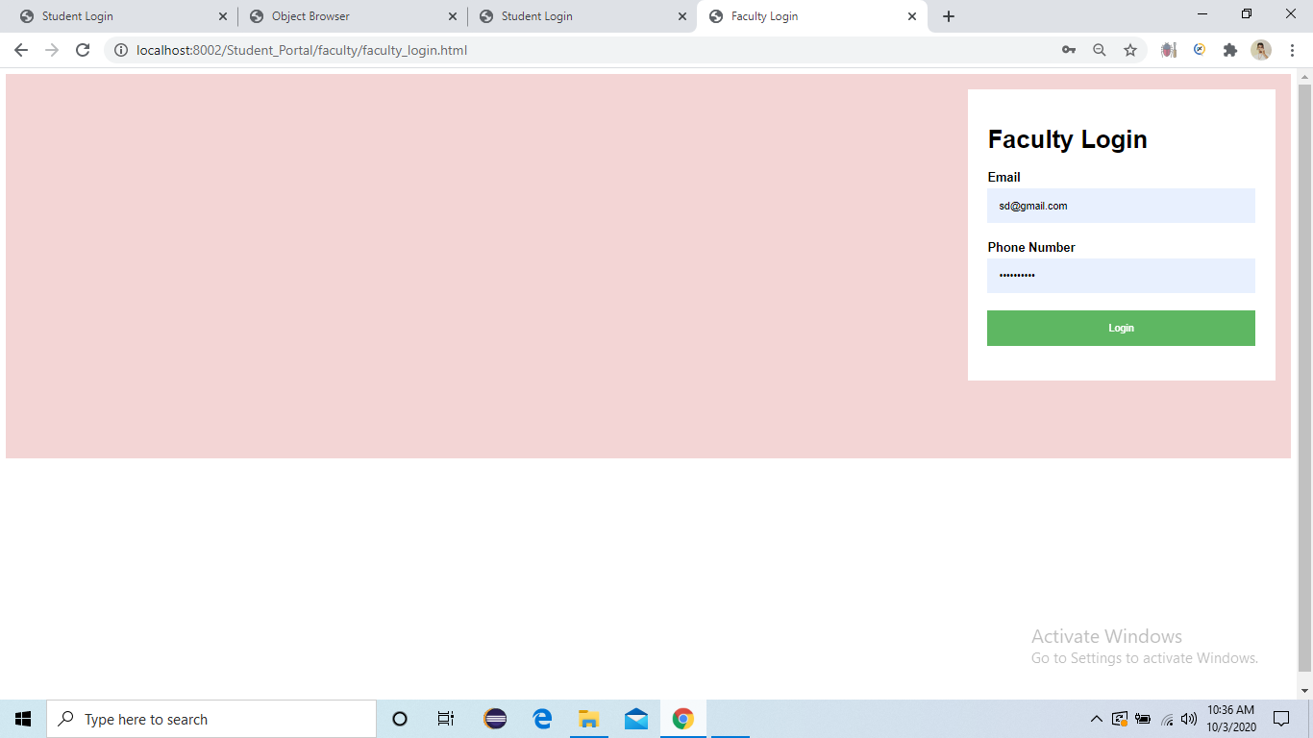
Faculty Login
Faculty can Login by using email and Password.

Slide 11
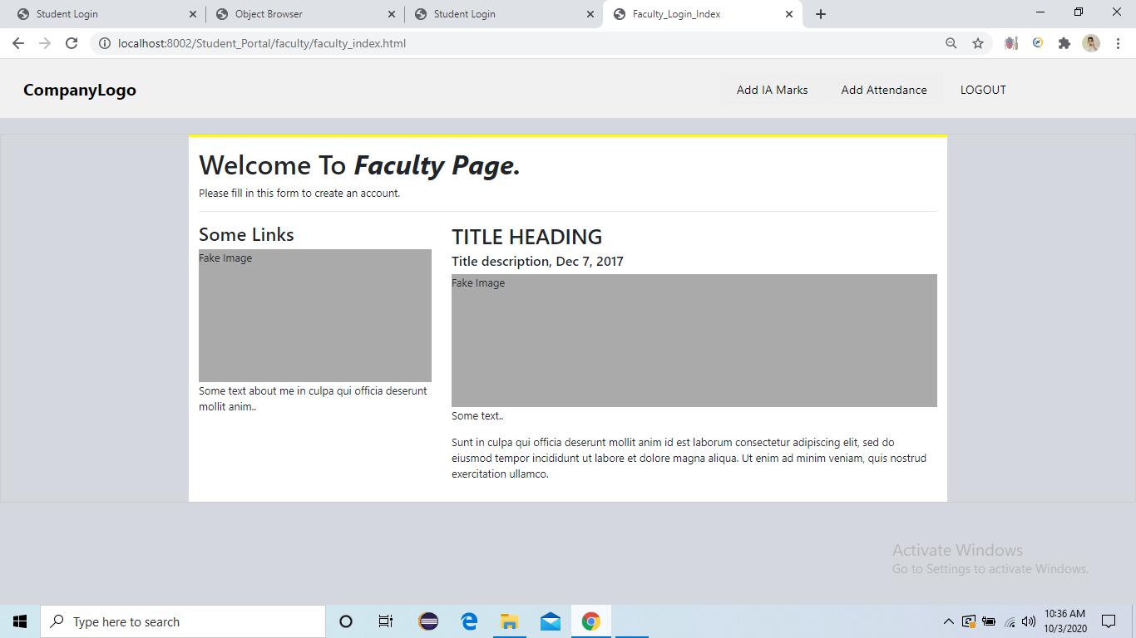
Faculty_login Success.
Index page of Faculty.

Slide 12
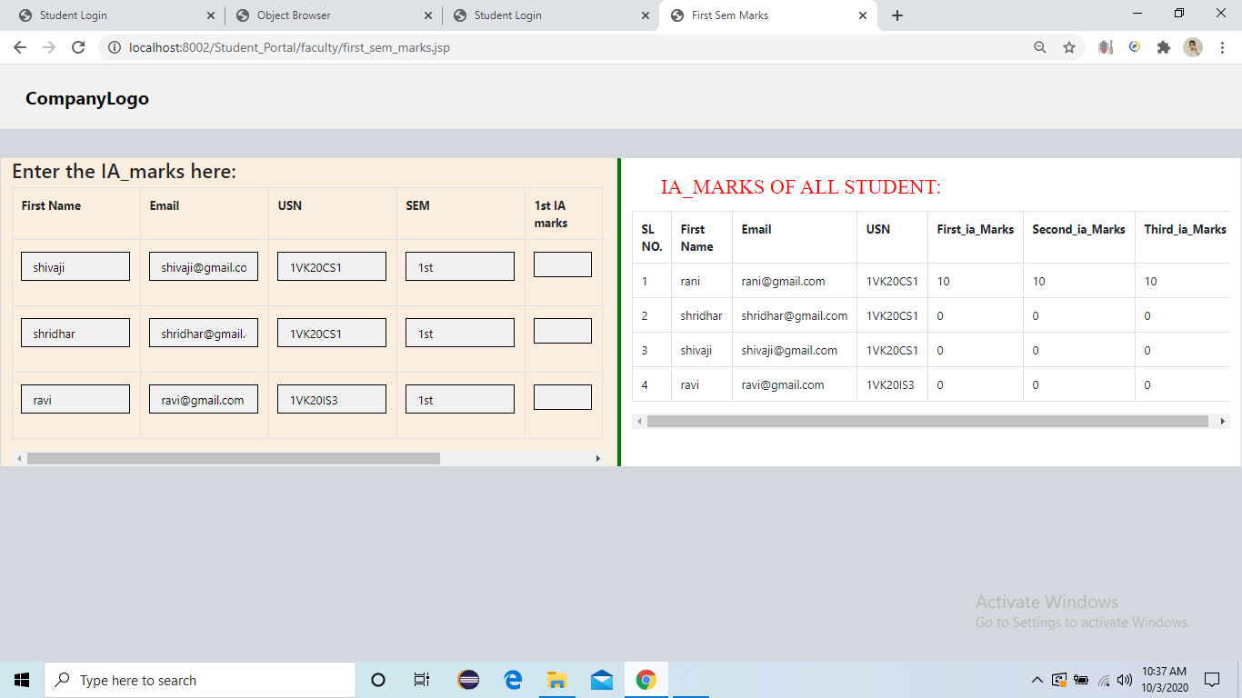
IA_MARKS of each Student
Faculty add the IA_marks of each Student.

Slide 13
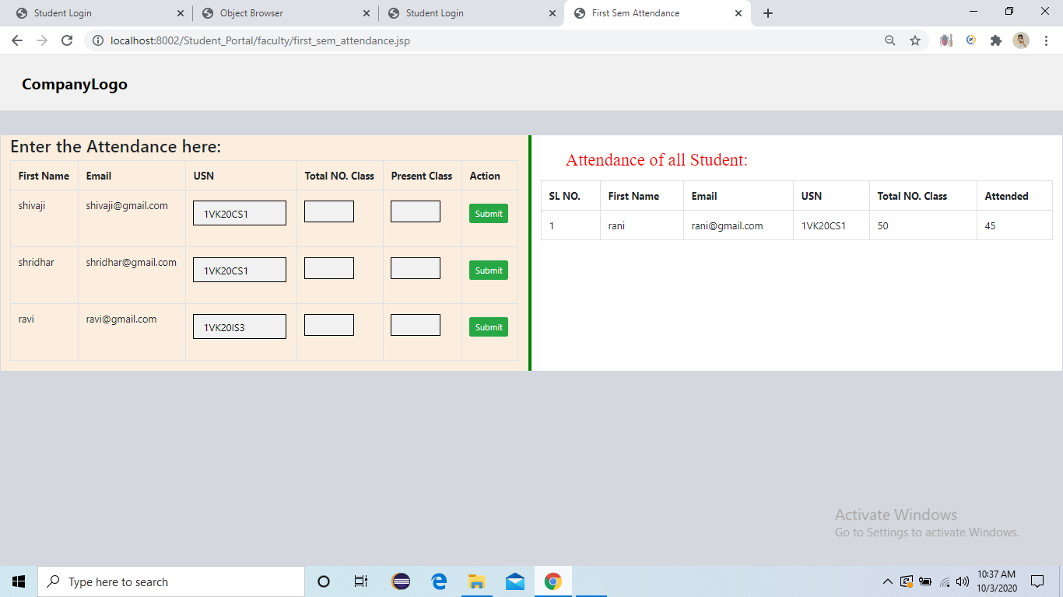
Attendance of each Student
Faculty add the attendance of each Student.

Slide 14
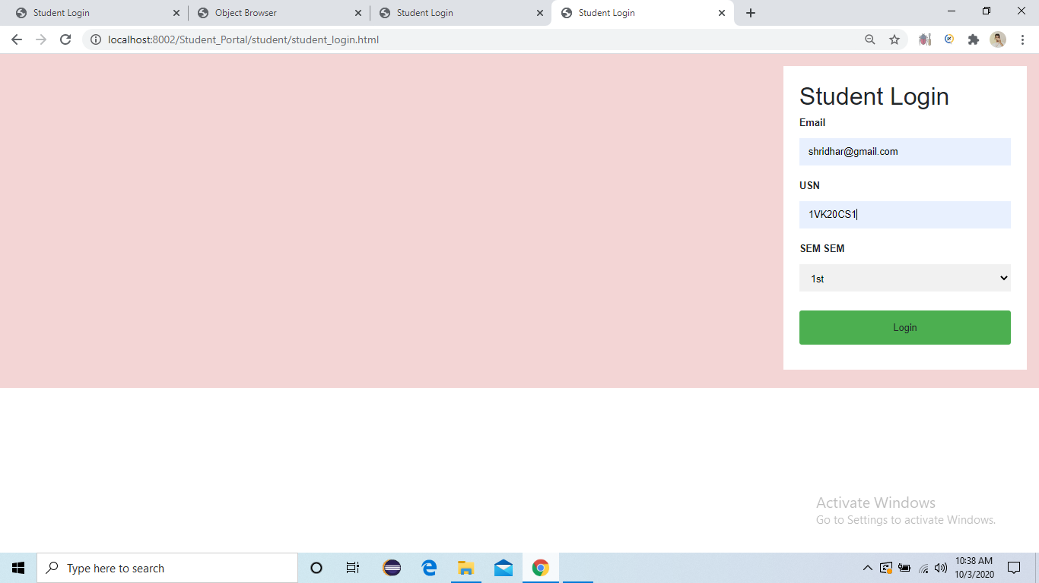
Student Login.
Student can Login by using email, usn, sem.

Slide 15
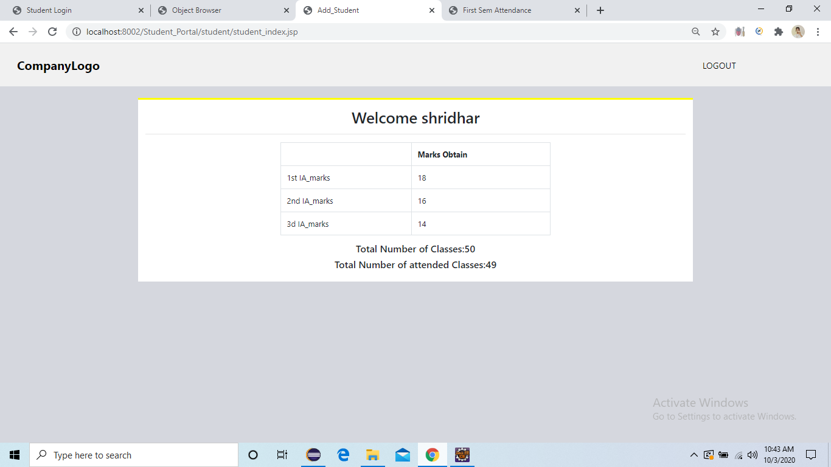
Student Portal
Student can view their Marks and Attendance.

