Slide 1
SLEEP TRACKING APP
By jinx

Slide 2
Discription
Sleep Data Monitoring
Tracks parameters like body movement, heart rate, and sleep duration using sensors.
Monitors environmental factors such as room temperature, humidity, and noise levels.
Data Analysis
Analyzes sleep stages (light, deep, and REM sleep).
Generates reports and visualizations to help users understand their sleep patterns.
User-Friendly Interface
Mobile app or web dashboard for real-time sleep data viewing.
Personalized tips and recommendations based on data trends.
Custom Alerts
Smart alarms that wake users during light sleep stages for better restfulness.
Notifications about potential sleep issues, such as irregular sleep cycles.
Cloud Integration
Synchronizes data with the cloud for secure storage and access across devices.
Enables long-term tracking and comparison of sleep trends.

Slide 3
package com.example.projectone
import android.content.Context
import android.content.Intent
import android.icu.text.SimpleDateFormat
import android.os.Bundle
import androidx.activity.ComponentActivity
import androidx.activity.compose.setContent
import androidx.compose.foundation.Image
import androidx.compose.foundation.layout.*
import androidx.compose.material.Button
import androidx.compose.material.MaterialTheme
import androidx.compose.material.Surface
import androidx.compose.material.Text
import androidx.compose.runtime.*
import androidx.compose.ui.Alignment
import androidx.compose.ui.Modifier
import androidx.compose.ui.draw.alpha
import androidx.compose.ui.layout.ContentScale
import androidx.compose.ui.res.painterResource
import androidx.compose.ui.unit.dp
import androidx.core.content.ContextCompat
import com.example.projectone.ui.theme.ProjectOneTheme
import java.util.*

Slide 4
class MainActivity : ComponentActivity() {
private lateinit var databaseHelper: TimeLogDatabaseHelper
override fun onCreate(savedInstanceState: Bundle?) {
super.onCreate(savedInstanceState)
databaseHelper = TimeLogDatabaseHelper(this)
databaseHelper.deleteAllData()
setContent {
ProjectOneTheme {
// A surface container using the 'background' color from the theme
Surface(
modifier = Modifier.fillMaxSize(),
color = MaterialTheme.colors.background
) {
MyScreen(this,databaseHelper)
}
}
}

Slide 5
}
}
@Composable
fun MyScreen(context: Context, databaseHelper: TimeLogDatabaseHelper) {
var startTime by remember { mutableStateOf(0L) }
var elapsedTime by remember { mutableStateOf(0L) }
var isRunning by remember { mutableStateOf(false) }
val imageModifier = Modifier
Image(
painterResource(id = R.drawable.sleeptracking),
contentScale = ContentScale.FillHeight,
contentDescription = "",
modifier = imageModifier
.alpha(0.3F),
)
Column(
modifier = Modifier.fillMaxSize(),
horizontalAlignment = Alignment.CenterHorizontally,
verticalArrangement = Arrangement.Center
) {
if (!isRunning) {
Button(onClick = {
startTime = System.currentTimeMillis()

Slide 6
isRunning = true
}) {
Text("Start")
//databaseHelper.addTimeLog(startTime)
}
} else {
Button(onClick = {
elapsedTime = System.currentTimeMillis()
isRunning = false
}) {
Text("Stop")
databaseHelper.addTimeLog(elapsedTime,startTime)
}
}
Spacer(modifier = Modifier.height(16.dp))
Text(text = "Elapsed Time: ${formatTime(elapsedTime - startTime)}")
Spacer(modifier = Modifier.height(16.dp))
Button(onClick = { context.startActivity(
Intent(
context,

Slide 7
TrackActivity::class.java
)
) }) {
Text(text = "Track Sleep")
}
}
}
private fun startTrackActivity(context: Context) {
val intent = Intent(context, TrackActivity::class.java)
ContextCompat.startActivity(context, intent, null)
}
fun getCurrentDateTime(): String {
val dateFormat = SimpleDateFormat("yyyy-MM-dd HH:mm:ss", Locale.getDefault())
val currentTime = System.currentTimeMillis()
return dateFormat.format(Date(currentTime))
}
fun formatTime(timeInMillis: Long): String {
val hours = (timeInMillis / (1000 * 60 * 60)) % 24
val minutes = (timeInMillis / (1000 * 60)) % 60
val seconds = (timeInMillis / 1000) % 60
return String.format("%02d:%02d:%02d", hours, minutes, seconds)
}

Slide 8
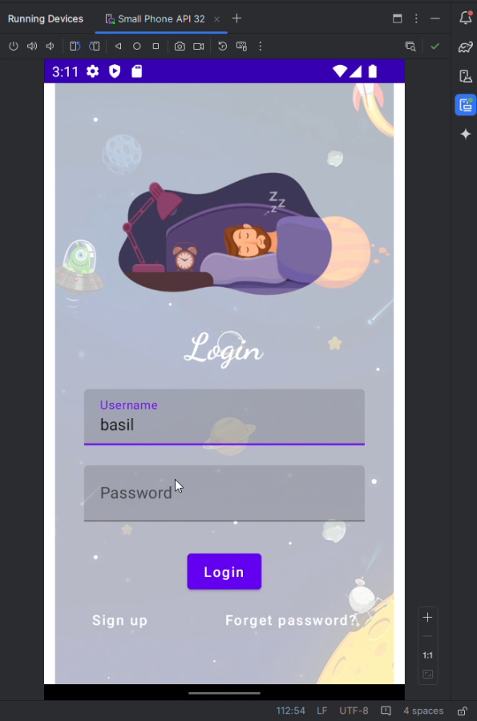
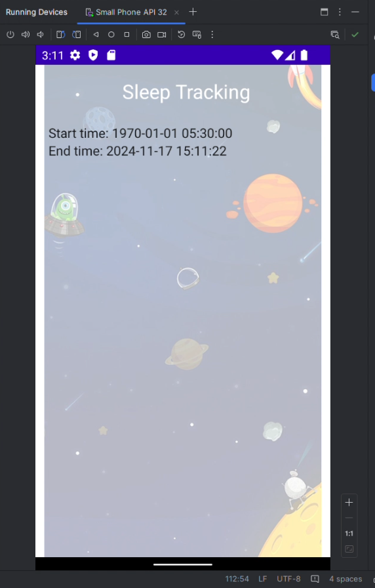
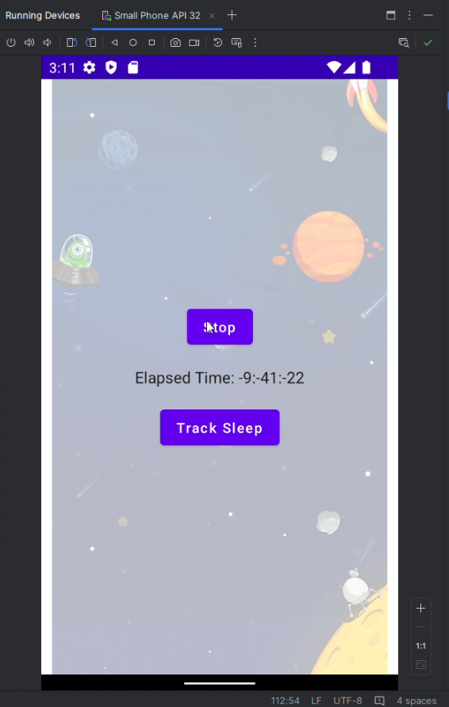
Output

