Slide 1
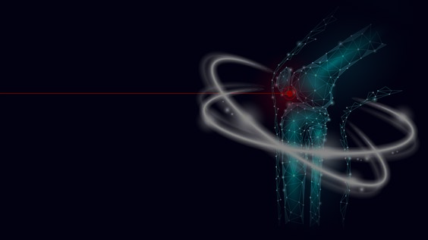
Osteoporosis
prediction

Slide 2
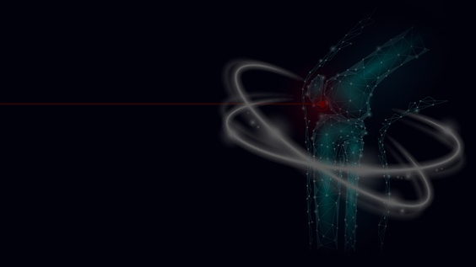
Objective:
The aim of this project is to predict the likelihood of osteoporosis in individuals based on their bone density and other relevant factors

Slide 3

Problem Statement:
Despite being a leading pathological disorder affecting millions worldwide, osteoporosis diagnosis via Dual Energy X-ray Absorptiometry (DXA) is costly and not readily available. Additionally, treatment costs are high.

Slide 4

Expected Outcome:
Development of machine learning algorithms capable of accurately detecting osteoporosis based on the provided data.

Slide 5
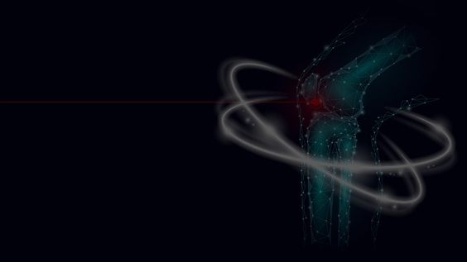
Stakeholders
Healthcare Providers
Patients
Policy Makers
Researchers

Slide 6

Feature Enhancement
To develop a predictive model that utilizes “GEN AI” to analyze X-ray images of individuals' bones and classify them as normal, osteopenia, or osteoporosis. This will involve comparing the features extracted from the X-ray images

Slide 7

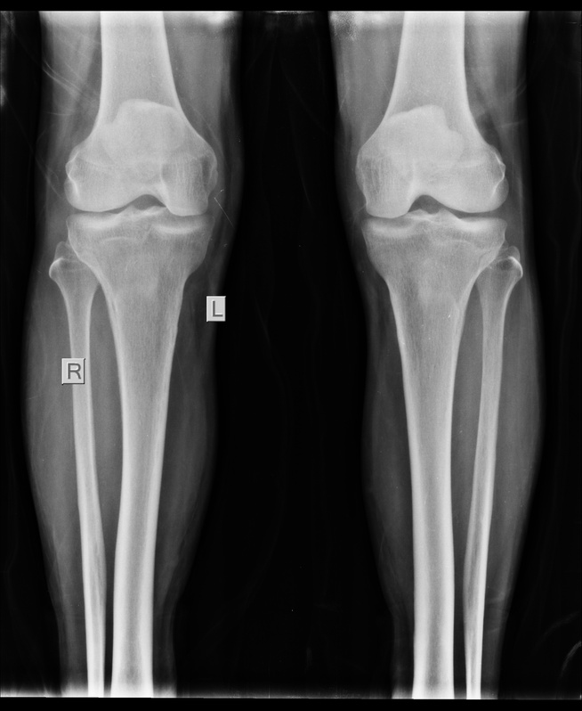
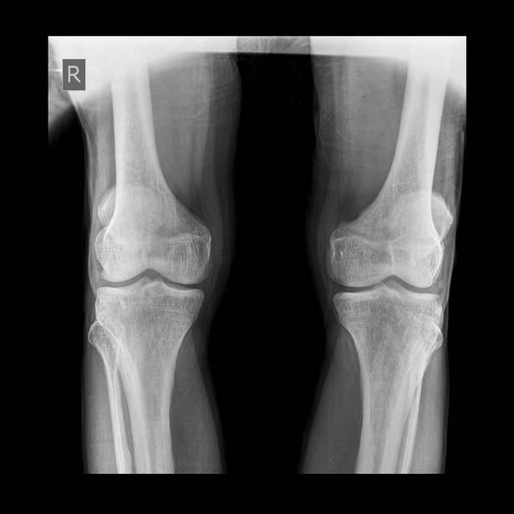
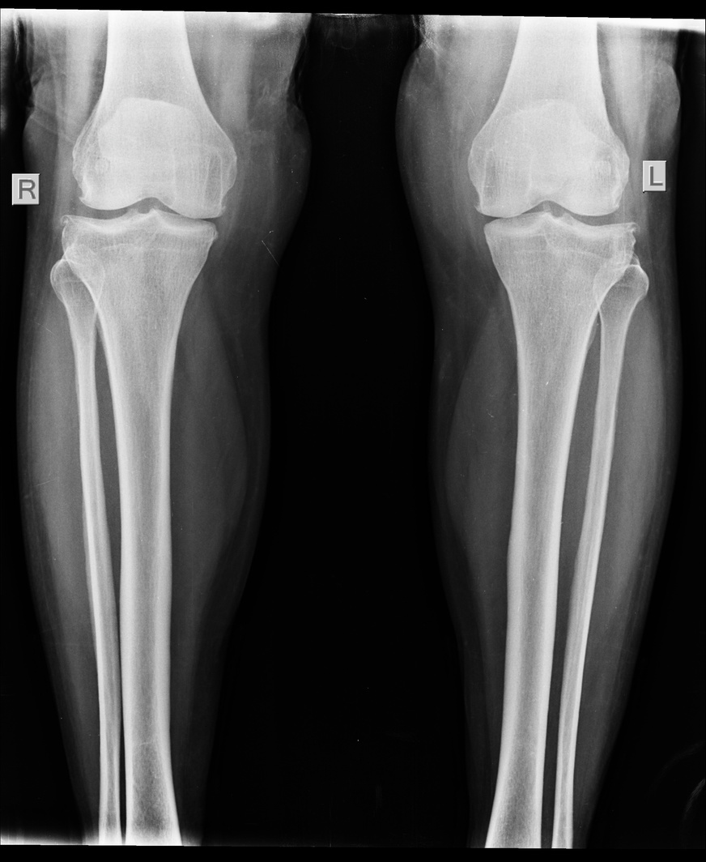
Normal
Osteopenia
Osteoporosis

