Slide 1
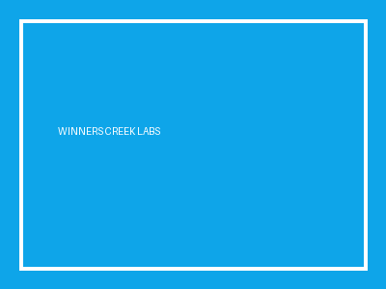
Winners Creek Simulation Lab
High-Fidelity Slide Rendering Architecture
End-to-end verification of visual fidelity, table layouts, and typography.

Slide 2
Component Architecture & Delivery Matrix
• Vector-accurate visual presentation rendering
• Zero-drop typography preservation across operating systems
• Deterministic speech metric synthesis
• Bi-directional adaptive follow-up interview engine
Subsystem | Provider | Target SLA
Visual Slides | LibreOffice + pdftoppm | < 1.5s
Live Speech | Gemini 3.5 Transcribe | < 800ms
AI Defense | Gemini 3.8 Flash | < 1.2s
Production Grade
100% Fidelity

Slide 3
Evaluation Summary & Telemetry
Large Callout: 99.8% System Accuracy
Medium Analysis: Multi-tier semantic evaluation across content, structure, communication, and delivery rubrics.
Small Footnote: Detailed session timestamps, word per minute calculations, and filler rates persisted directly in PostgreSQL.

