Slide 1

AllLife Personal Loan Modelling Logistic Regression & Decision Tree Modelling

Slide 2
Objective
To predict whether a liability customer will buy a personal loan or not.
Which variables are most significant.
Which segment of customers should be targeted more
Expected outcome –
Useful business insights using exploratory data analysis techniques.
Data-preprocessing wherever needed.
A logistic regression model, identify key predictor variables, test model assumptions & evaluation of model performance using right choice of performance metrics.
A Decision Tree model & performance evaluation.
Comparison of both the models and conclusion.
Actionable insights & recommendations for business.

Slide 3
Data Summary
Variable | Dtype | Description | Values
ID | int64 | Customer ID | Unique continuous values
Age | int64 | Customer’s age in completed years | Range: 23 - 67 years
Experience | int64 | No.of years of professional experience | Range: -3 to 43 years
Income | int64 | Annual income of the customer (in thousand dollars) | Range: 8 – 224 Thousand Dollars
ZIPCode | int64 | Home Address ZIP code. | Non-unique Continuous values
CCAvg | float64 | Avg. spending on credit cards per month (in thousand dollars) | Range: 0 – 10 Thousand Dollars
Education | int64 | Education Level. | 3 unique values: 1: Undergrad; 2: Graduate;3: Advanced/Professional
Mortgage | int64 | Value of house mortgage if any. (in thousand dollars) | Range: 0 – 635 Thousand Dollars
Personal_Loan | int64 | Did this customer accept the personal loan offered in the last campaign? | 2 unique values: 0 – No, 1- yes
Securities_Account | int64 | Does the customer have securities account with the bank? | 2 unique values: 0 – No, 1- yes
CD_Account | int64 | Does the customer have a certificate of deposit (CD) account with the bank? | 2 unique values: 0 – No, 1- yes
Online | int64 | Do customers use internet banking facilities? | 2 unique values: 0 – No, 1- yes
CreditCard | int64 | Does the customer use a credit card issued by Universal Bank? | 2 unique values: 0 – No, 1- yes
No.of Rows | 5000
No.of Columns | 14
Note: There are no missing values in the dataset.

Slide 4
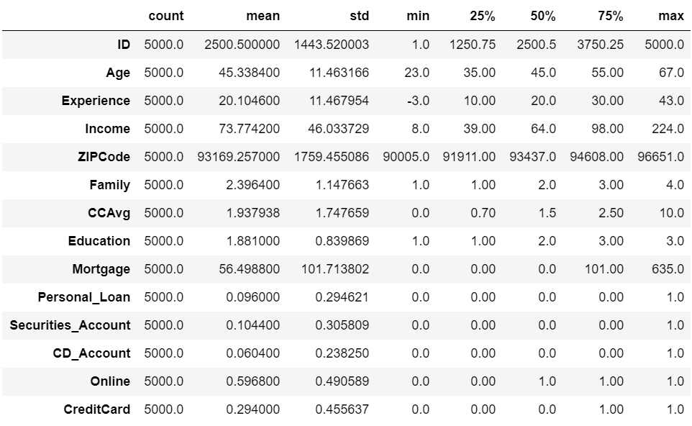
EDA – Univariate Analysis
No useful information from ID & Zipcode.
Experience has negative value. We will need to look at it, as experience cannot be negative.
Income, Age, CCAvg & Mortgage look good. We will explore them further during EDA.
We will need to check these variables --Family, Education, Personal_Loan, Securities_Account, CD_Account, Online, CreditCard, as the values do not look to be continuous values and so can be treated as categorical for EDA purposes.
Average age of customers is 45 years.
Approx. 94% of customers don't have CD_Account.
Approx. 90% of customers did not accept personal loan in the last campaign.
Approx. 71% of customers do not use credit cards.
Approx. 90% of customers do not have Securities account.
Approx. 60% of customers use internet banking facility.

Slide 5
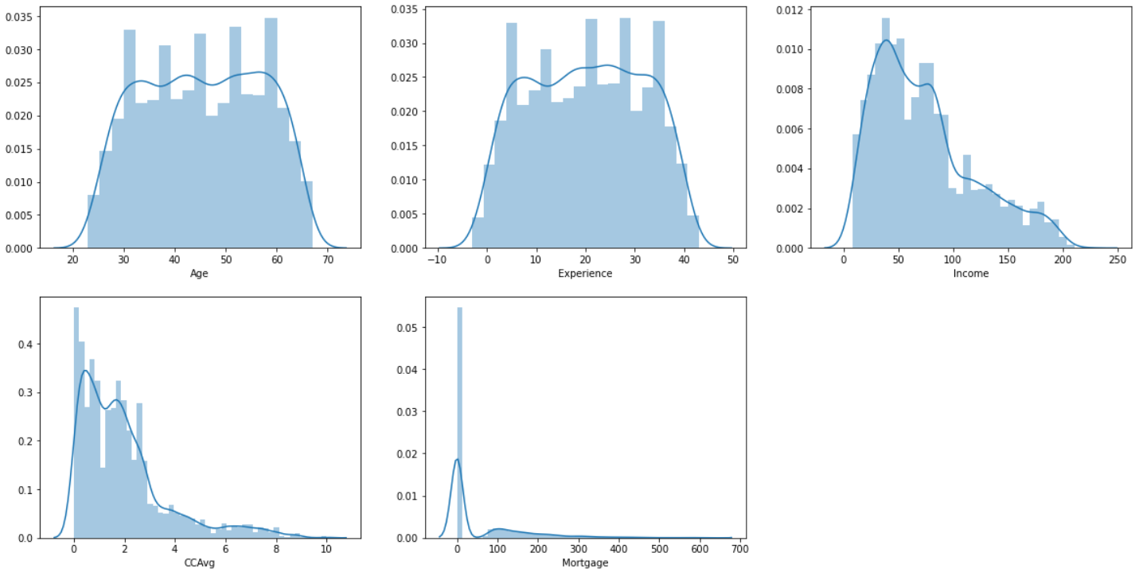
EDA – Univariate Analysis (Continuous variables)
1. Age & Experience look uniformly distributed.
2. Income, CCAvg & Mortgage are rightly skewed.
3. Mortgage has majority of 0 values indicating that majority of people do not have mortgages and that seems to be the reason for the skewness.

Slide 6
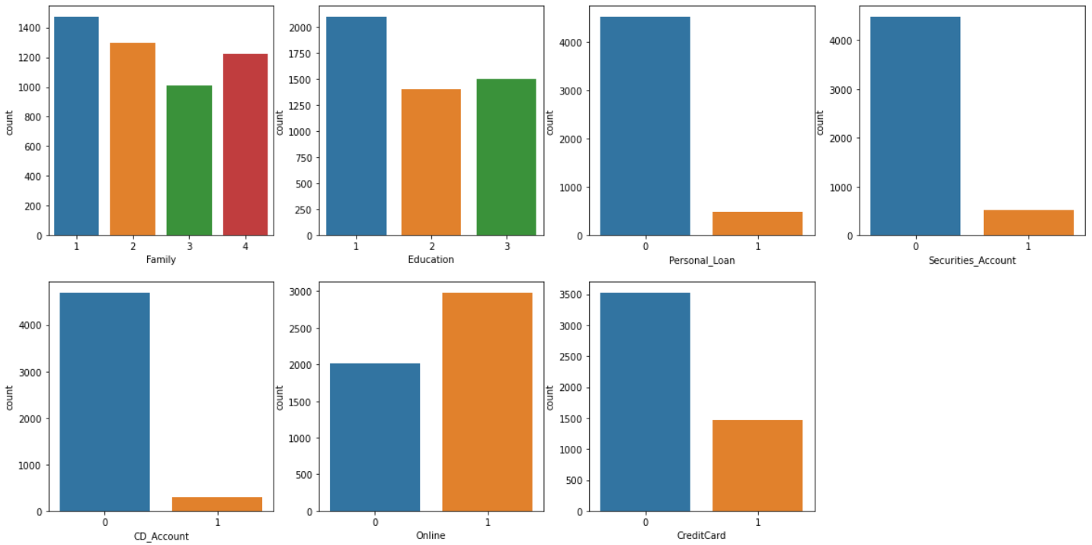
EDA – Univariate Analysis (Categorical variables)
Majority of customers have family size =1.
Majority of customers are Undergraduates.
Majority of customers did not buy personal loan.
Majority of customers do not have securities account & CD_account in AllLife.
Majority of customers use internet banking facilities.
Majority of customers do not use Credit card of AllLife bank.

Slide 7
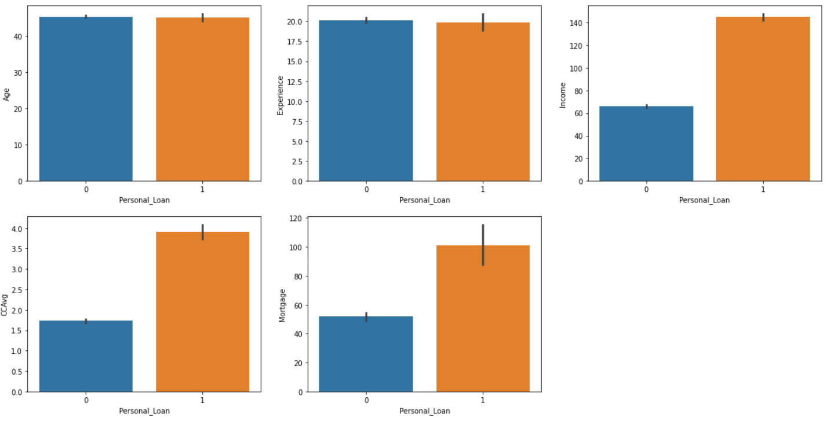
EDA – Relationship with Personal Loan
Age & Experience are not impacting Personal Loan
Customers with higher income & high CCAvg & higher mortgage values are more likely to take personal loan.

Slide 8
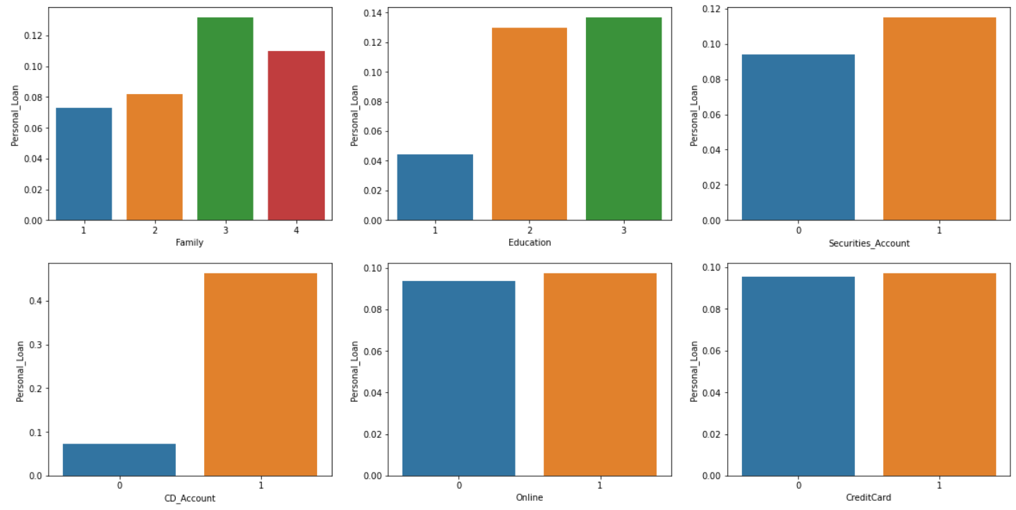
EDA – Relationship with Personal Loan
Customers with family size = 3 & 4 are more likely to take personal loan than the ones with family size = 1 & 2.
Customers who are graduate & advanced/professionals are more likely to take personal loan than undergraduates.
Customers with CD_Account & Securities_account are more likely to take personal loan.
The variables Online & CreditCard do not affect the chances of customers taking personal loan.

Slide 9
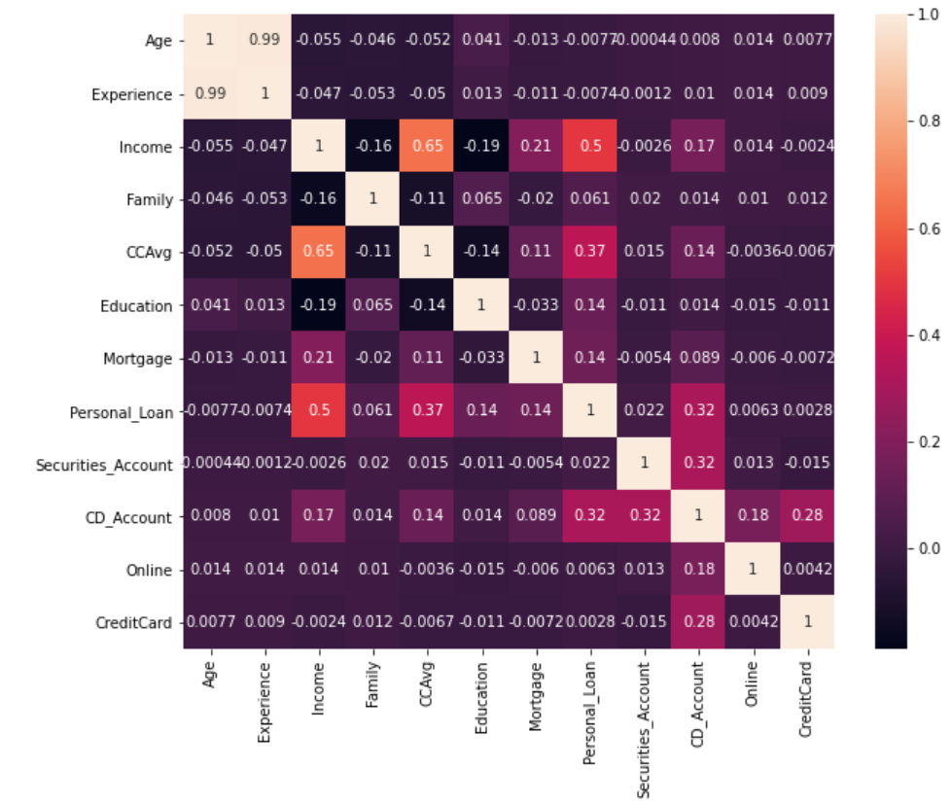
EDA - Correlation
Experience & Age have extreme high correlation of 0.99.
Income & CCAvg have a good correlation of 0.62.
NOTE : Form Point1 above, we can drop Experience column for modelling and no need to treat the negative values. We will use Age column.

Slide 10
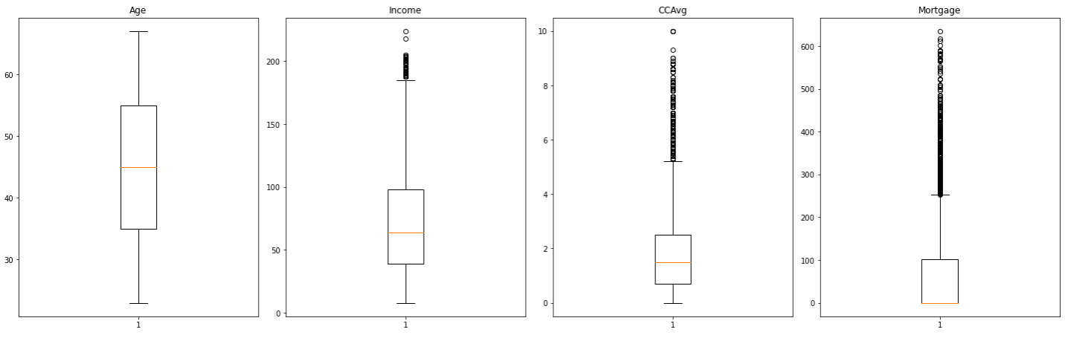
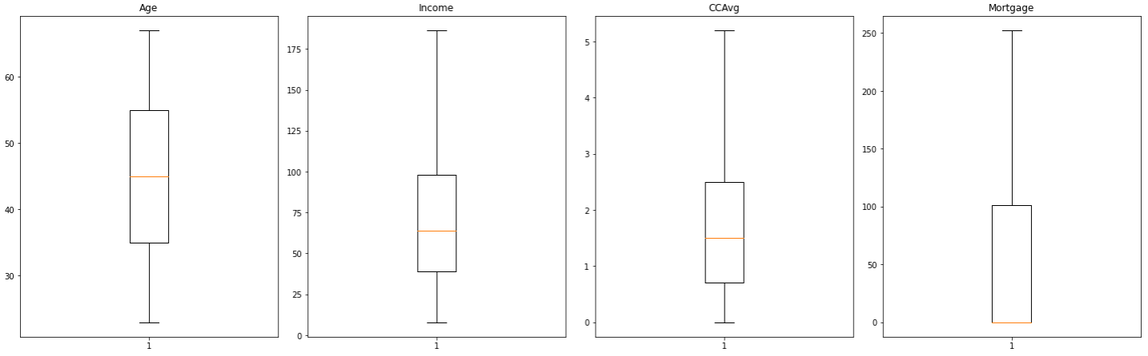
Data Pre-Processing
There are no missing values as we have already checked.
We can see that variables – Income, CCAvg & Mortgage has outliers.
Fig.1 – shows the outliers before treatment.
Fig.2 – shows the variables after outlier treatment.
Fig.1 - Before Treatment
Fig.2 - After Treatment

Slide 11
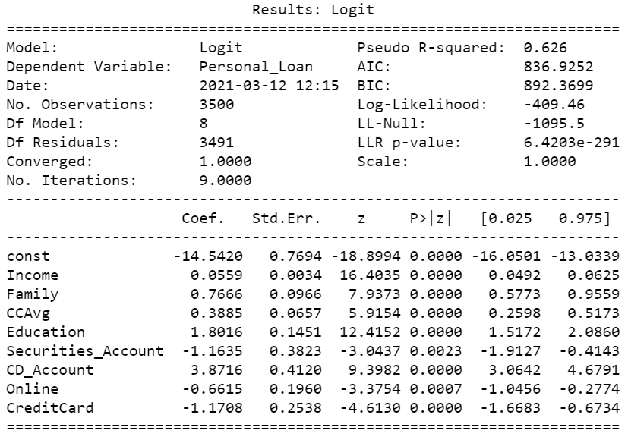
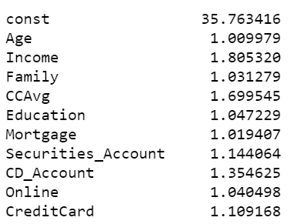
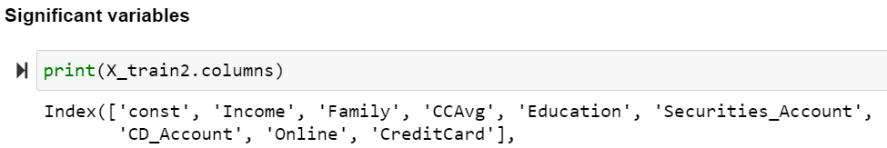
Model building – Logistic Regression
Logistic Regression (Statsmodel)
Test assumption – No Multicollinearity
All the variables have VIF Score ~ 1. Hence, there is no multicollinearity between the predictor variables.
Significant variables
Variables with p-value < 0.05 are the significant ones for the model building.

Slide 12
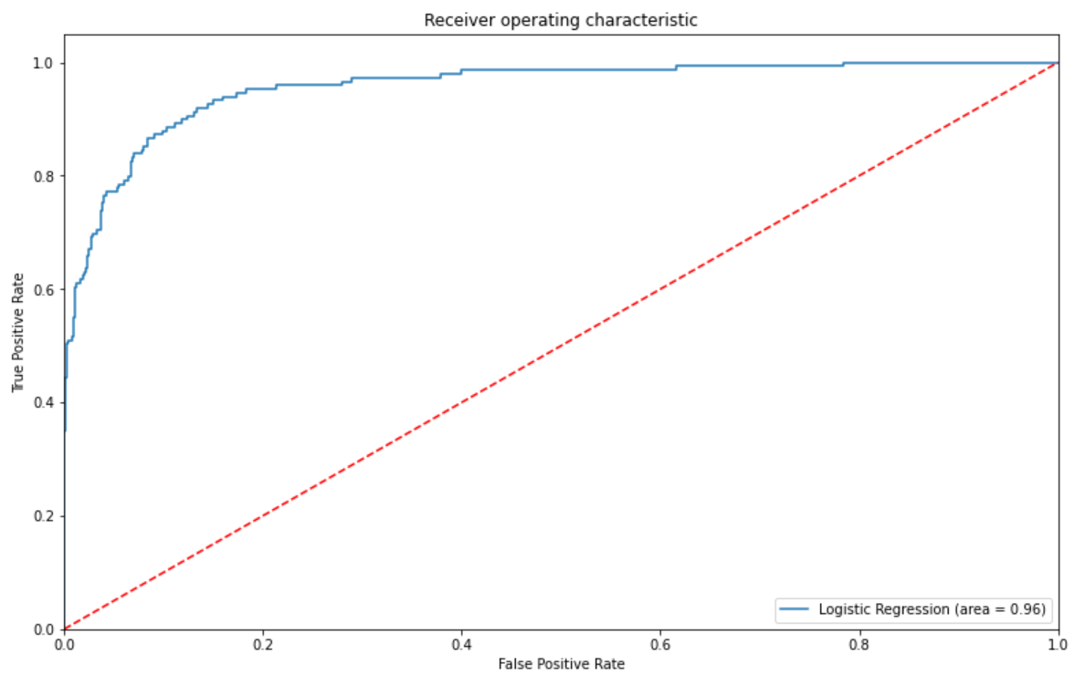
Model performance
Model evaluation criterion
We will be using RECALL as a metric to evaluate our model performance, because in this case, we are interested in correctly predicting the total no.of customers who accepted personal loan. Hence, we need to focus on increasing the True Positive Rate to 1.
Model outcomes : Recall & ROC Curve
Accuracy of 87%
After using optimized threshold, Recall score has improved a lot for test data from 61% to 91.3%, which is an excellent increase.
Area Under Curve is 0.96 which is Excellent
Data | Accuracy | Recall
Train | 0.86 | 0.93
Test | 0.87 | 0.91

Slide 13
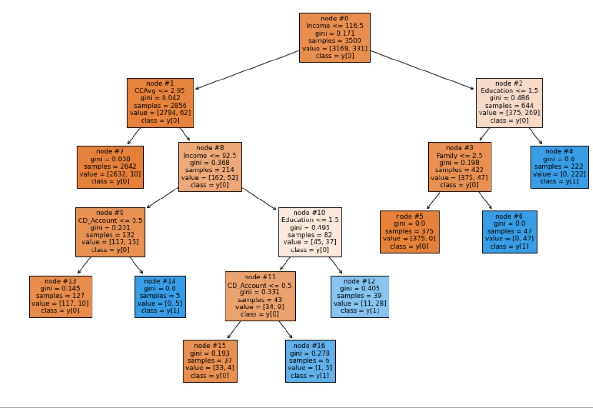
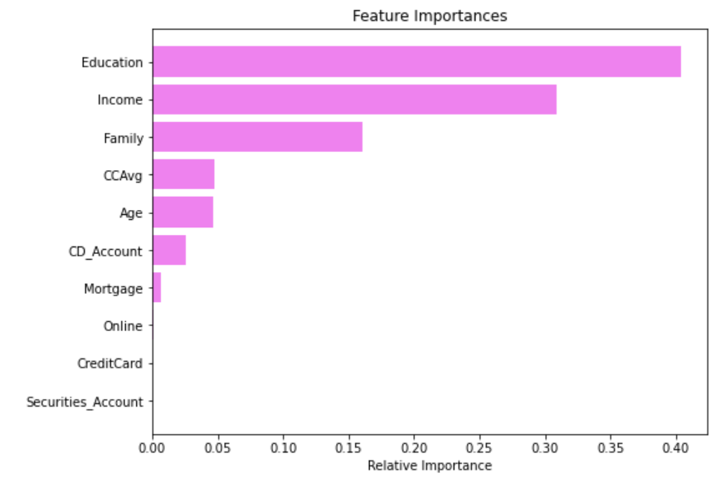
Decision Tree model
Pre-pruned Decision Tree model
Feature Importance
Feature Importance
Data | Accuracy | Recall
Train | 0.98 | 0.927
Test | 0.98 | 0.879
Outcome : We have achieved 98% Accuracy with 87.9% Recall value, which is very good.

Slide 14
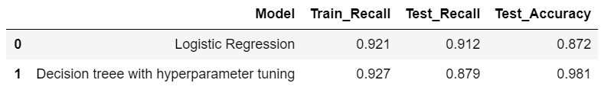
Logistic Regression v/s Decision Tree
Conclusion -- From the above table, we see that Logistic Regression (Statsmodel) algorithm has given highest Recall – 91.2%. Hence, we can finalize Logistic Regression (Statsmodel) as our Final model.
Actionable Insights & Recommendations
Customers with below attributes are potential customers for personal loans and campaigns can be targeted to this segment accordingly –
Higher CCAvg (> 1.8K dollars)
Higher income (> 60K dollars)
Higher mortgage values (> 75K dollars)
Graduates & Advanced/Professionals
Family size of 3 & 4
Having CD_accounts & Securities accounts
Also, Bank can put some prioritized focus on customers with higher Education & income, as these two are the most important features as per our model to identify a potential buyer.
To further attract the above segment of potential customers, bank can think of offering loans on Credit Cards, Securities & Deposits
We know that almost 50% of customers who had CD_Accounts accepted personal loan. Hence, to attract the non-buyers, bank can think of how to attract customers to open CD_accounts.

