Slide 1
EDA & Statistical Analysis Axis Insurance

Slide 2
Project Description & Objective
Expected outcome –
Useful business insights using exploratory data analysis techniques.
Hypothesis formulation and testing with statistical evidences.
Test of proportions and variances of specific attributes within dataset, to understand the effect of a given attribute to the insurance business.
The objective is to explore the insurance dataset using EDA techniques, perform statistical analysis and extract insights from the data.
Key Steps needed:
Explore the dataset and extract insights using Exploratory Data Analysis.
Prove (or disprove) that the medical claims made by the people who smoke is greater than those who don’t?
Prove (or disprove) with statistical evidence that the BMI of females is different from that of males.
Is the proportion of smokers significantly different across different regions?
Is the mean BMI of women with no children, one child, and two children the same? Explain your answer with statistical evidence

Slide 3
Data Summarization
Variable | Datatype | Description | Values
age | int64 | The age of the primary beneficiary (excluding those above 64 years, since they are generally covered by the government) | Range : 18 to 64 years
sex | object | This is the policy holder's gender. | 2 unique values : male, female
bmi | float64 | This is the body mass index (BMI), which provides a sense of how over or under-weight a person is relative to their height. BMI is equal to weight (in kilograms) divided by height (in meters) squared. An ideal BMI is within the range of 18.5 to 24.9. | Range : 15.96 to 53.13
children | int64 | The number of children / dependents covered by the insurance plan. | 6 unique values : 0,1,2,3,4,5
smoker | object | This is yes or no depending on whether the insured regularly smokes tobacco. | 2 unique values : yes, no
region | object | This is the beneficiary's place of residence in the U.S., divided into four geographic regions. | 4 unique values : southwest, southeast, northeast, northwest.
charges | float64 | Individual medical costs billed to health insurance | Range : 1121.87 to 63770.4
No.of Rows | 1338
No.of Columns | 7
Note: There are no missing or garbage values in the dataset.

Slide 4
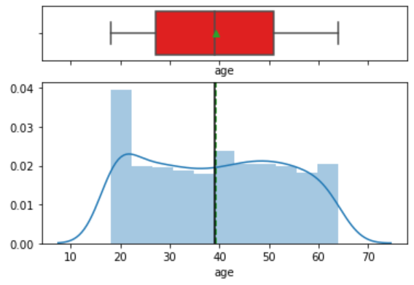
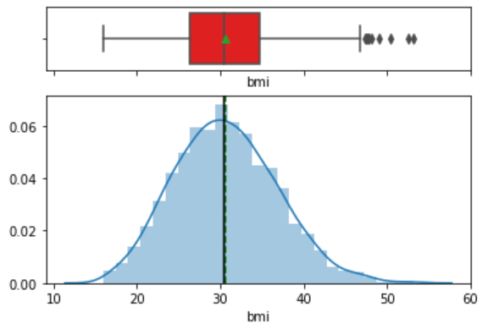
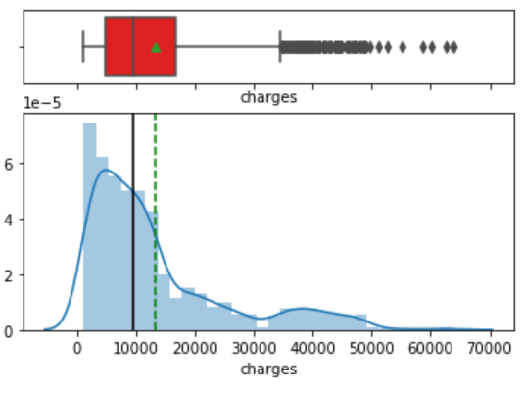
EDA – Univariate Analysis
Age : Age looks to be distributed uniformly with average of 39 years and no outliers. However, people around 18-21 years of age are twice in number compared to other age ranges.
BMI : BMI looks normally distributed, but with few outliers with higher BMIs. Also, there are very less people with lower BMI range < 18.
Charges : Charges is highly skewed with lots of outliers. 75% of people have billed charges less than 17000.

Slide 5
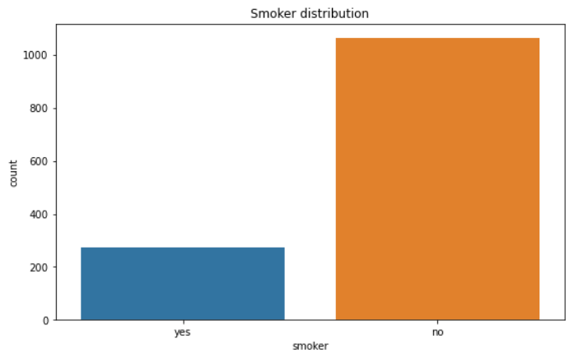
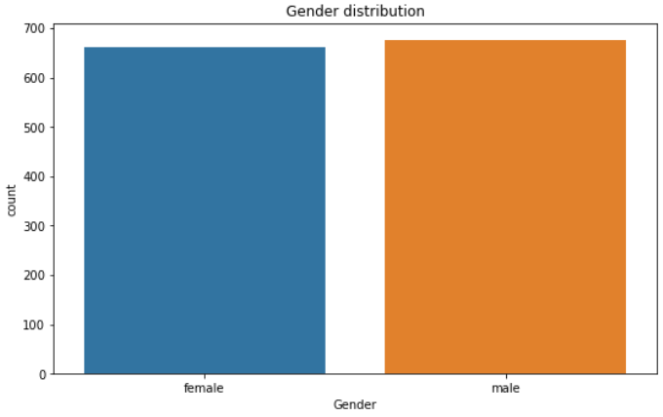
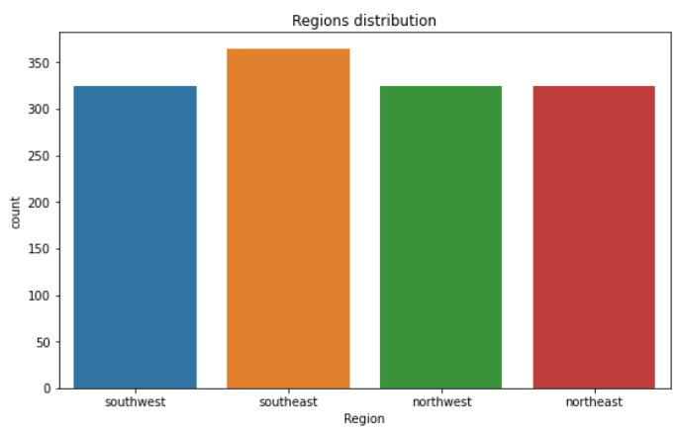
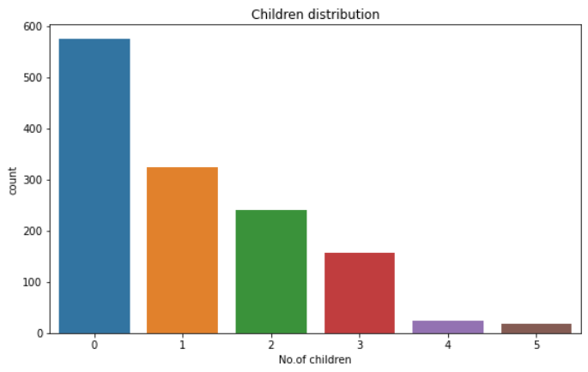
EDA – Univariate Analysis
Smoker: There are lot more non-smokers than smokers.
Gender: There is not much difference in males & females.
Region: Distribution of region is almost uniform across all the regions, with a slight higher count from Southeast region.
Children: Majority of people have less than 2 children and very few have more than 3. Also, people with no children are highest in count in this dataset.

Slide 6
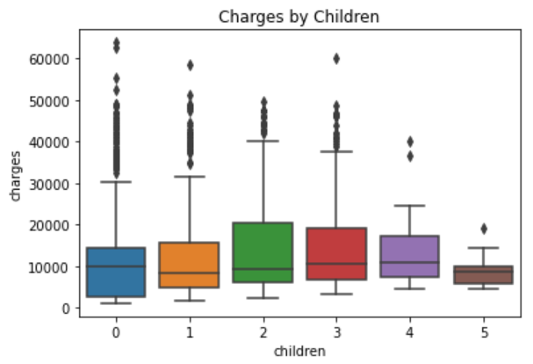
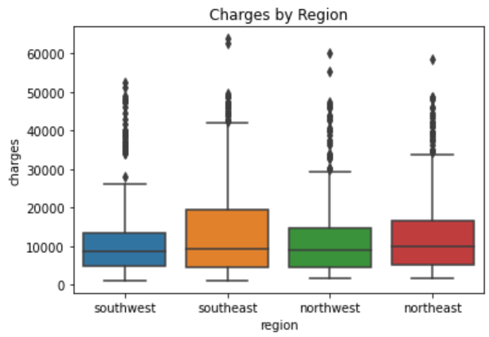
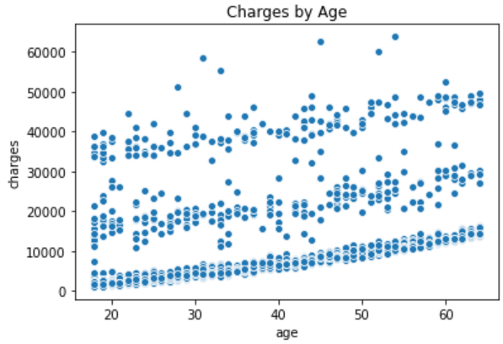
EDA – Multivariate Analysis
Charges by Children : People with no children have billed high charges whereas people with 5 children have billed the least charges.
Charges by Region : There are outliers in every location, however, Southeast customers have billed higher charges compared to other regions.
Charges by Age : There is a noticeable pattern between "age" and "charges". Older people have charges higher than younger ones..

Slide 7
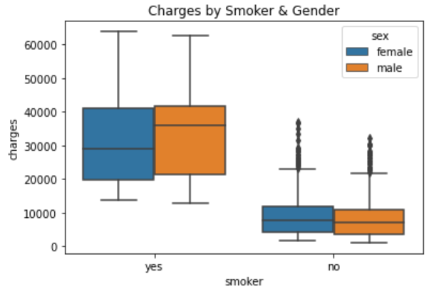
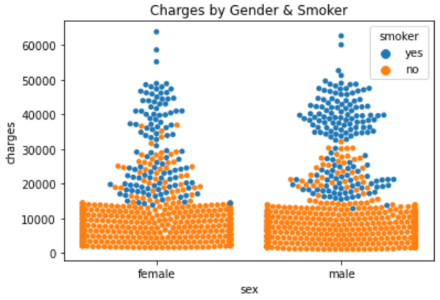
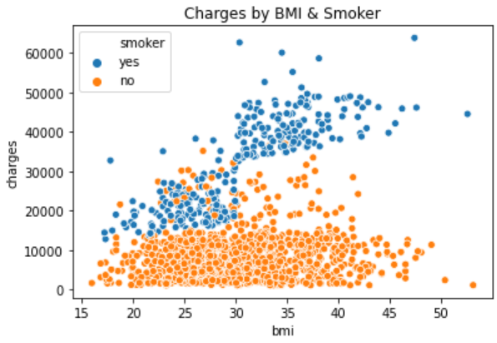
EDA – Multivariate Analysis
Charges by Smoker & Gender :
Smokers have billed significantly higher charges than the non-smokers.
However, we can see few outliers in non-smokers charging higher amount.
Also, gender is not a differentiating factor for smoking habit.
There are more male smokers than female smokers who have billed higher charges > 30000, whereas charges for males & females who do not smoke, looks uniformly distributed.
Charges by BMI & Smoker : Smokers with BMI > 30, tend to incur higher charges above 30000, whereas, non-smoker even with BMI > 30 have incurred charges below 30000.

Slide 8
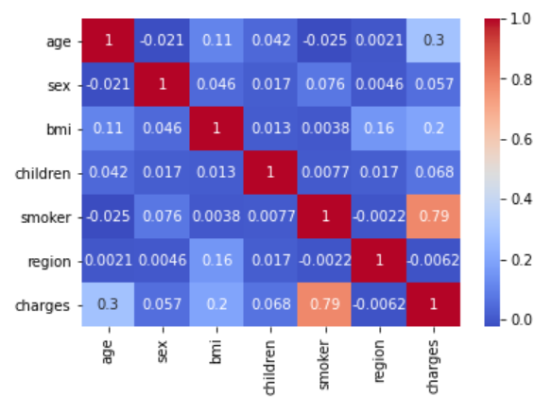
EDA – Correlation Heatmap
Observations
Majority of the variables are not correlated with each other except for few.
Smoker & charges are highly correlated.
There is a mild positive correlation between "age" and "charges“, indicating that charges increase as the age increases.
There is a slight positive correlation between "bmi" and "charges".

Slide 9
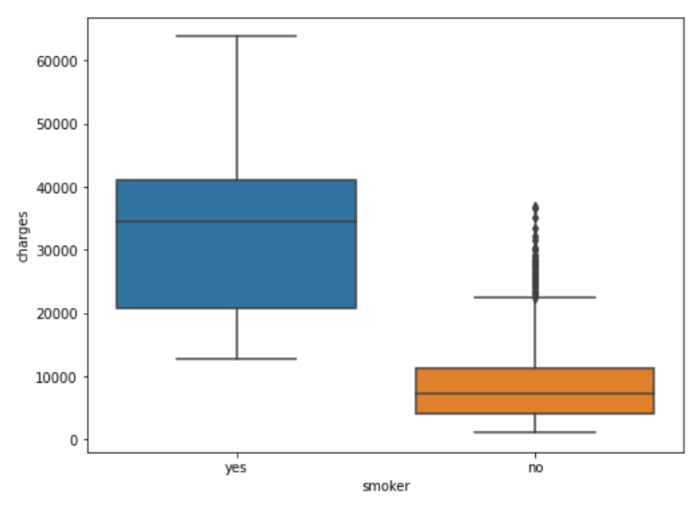
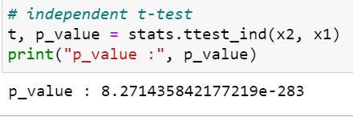
Hypothesis Testing – Analysis of effect of smoking on medical charges.
Conclusion: Since, p_value < 0.05 (alpha), we REJECT the null hypothesis and conclude that there is a significant difference between medical claims made by smokers and by non-smokers. “Medical claims made by people who smoke is greater than those who don’t.”

Slide 10
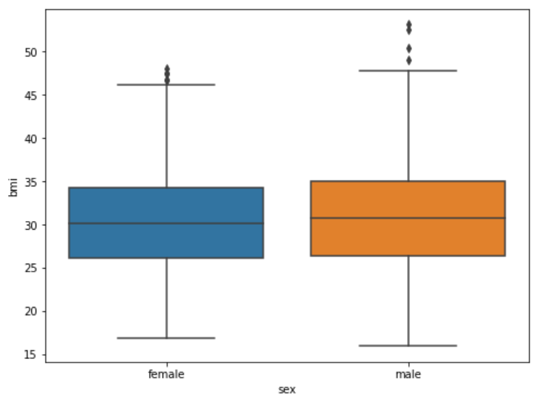
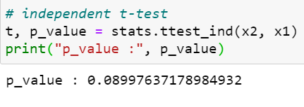

Hypothesis Testing – Analysis of effect of Gender over BMI.
Conclusion : Since, p_value > 0.05 (alpha), we "Fail to reject" the null hypothesis and conclude that “There is no difference between BMIs of females and BMIs of males.”

Slide 11
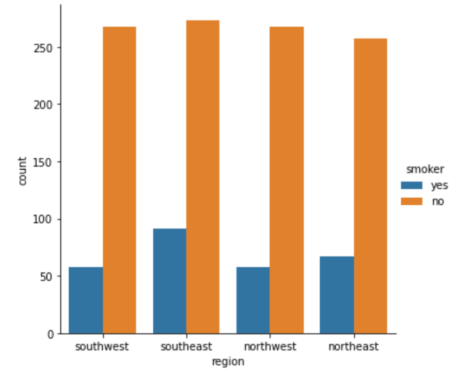
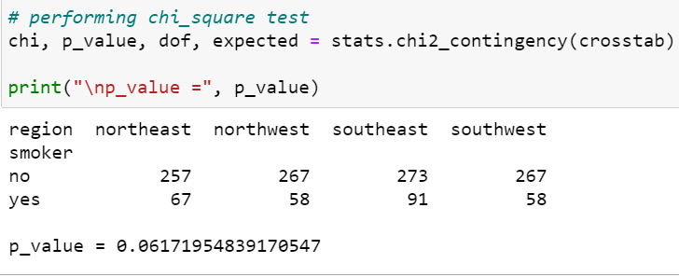
Test of Proportion – Proportion of Smokers across regions.
Conclusion : Since p_value (0.062) > 0.05, we "Fail to reject" the null hypothesis and conclude that – “There is no difference in proportion of smokers across different regions.”

Slide 12
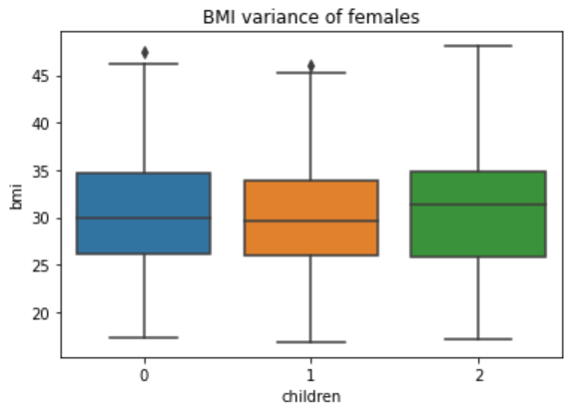
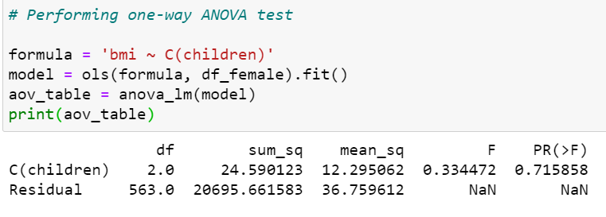
Test of Variance – Variance of BMI of women with no children, 1 child & 2 children. (Using ANOVA technique)
Conclusion : Considering both factors(bmi & children) and since the p_value (0.715858) > 0.05, we "Fail to reject" the null hypothesis and conclude that – “The mean BMI of women with no children, 1 child and two children are the same.”

