Slide 1
Title: Portfolio
Presented By:
Tanmay Sane
MSEE,
UNC-Charlotte, Charlotte, NC, USA

Slide 2
Overview
Education
Focus / Background
Related Experience
Projects
Case Study
2

Slide 3


Education
Masters in Electrical and Electronics Engineering, Fall 2014
GPA: 3.61
University of North Carolina Charlotte, USA
Bachelors in Electronics Engineering, Spring 2011
GPA: 3.4
Mumbai University, India
Fig 1: UNCC Logo [1]
Fig 2: Mumbai Uni. Logo [2]
3

Slide 4
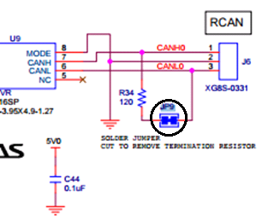
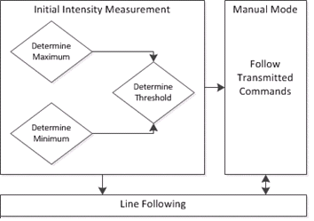
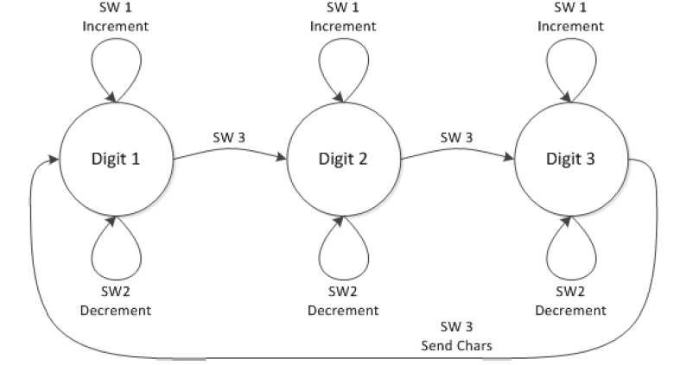
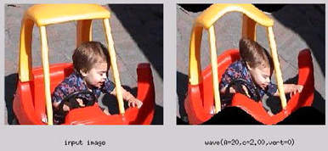
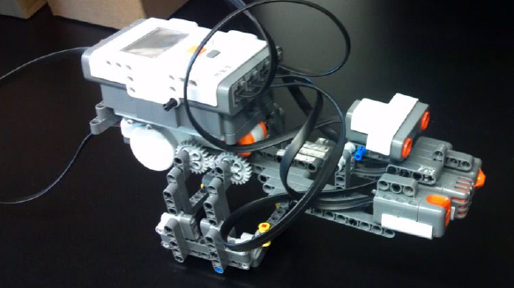
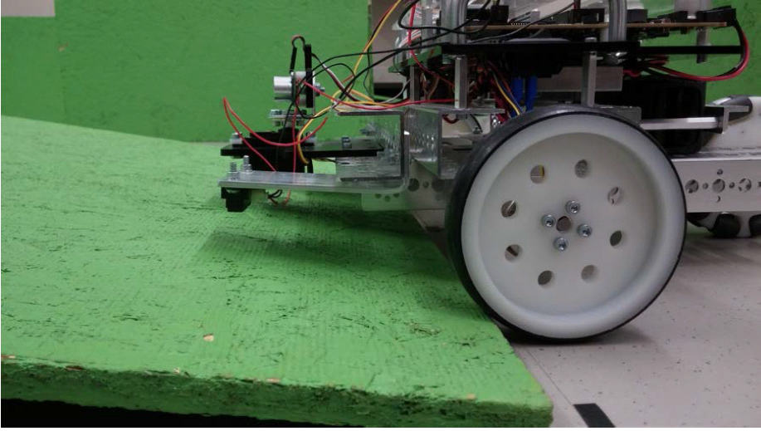
Focus
Software Development for embedded systems, robotic maneuvering & image processing.
Fig 3. CAN Schematic
Fig 4. Switch States
Fig 5. Line Follower Logic
Fig 6. Sine wave Transformation
Fig 7. Biped Robot
Fig 8. Edge Sensing
4

Slide 5
Related Experience
Software Developer, Caterpillar (EASi LLC), March 2015- Present
Providing support for new target platforms
Testing and validation of applications
Performing CAN based ECU diagnostics
Graduate Research Assistant, UNCC-ECE, Jan 2014- Feb 2015
Developed Embedded C based networking library for a wireless development platform.
Developed website for IEEE Conference HONET 2014 .
Introduced LEGO NXT based programming to middle school students.
Graduate Research Assistant, UNCC-Civil & Environmental Engg. Dec 2013- Jan 2014
Developed WordPress based faculty & (NSF funded) project website in a short duration.
Engineering Intern ECIL, India, Jun 2009- July 2009
Tested C graphics software modules, assisted in PCB assembly, soldering & testing.
5

Slide 6
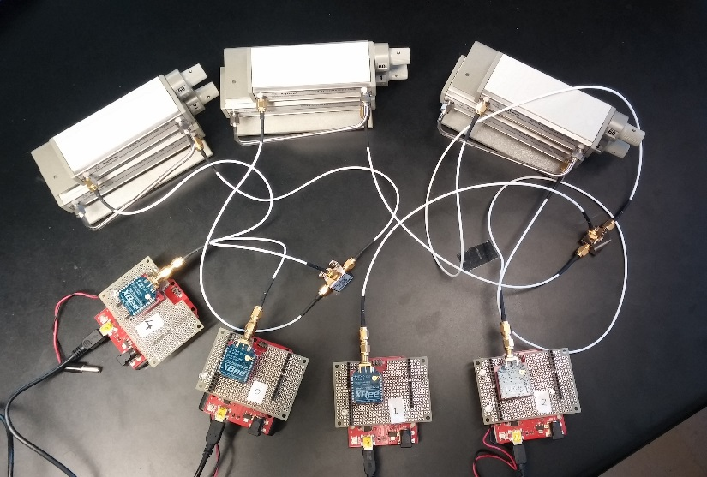
Academic Projects
Master’s Project
Implementation of Dynamic Source Routing Protocol on 802.15.4 using Series 1 XBee.
Developed Embedded C interface, to perform Dynamic Source Routing.
Designed test environment for testing & debugging modules.
Presented at IEEE South East Con 2015.[11]
Fig 9: DSR Test Environment
6

Slide 7
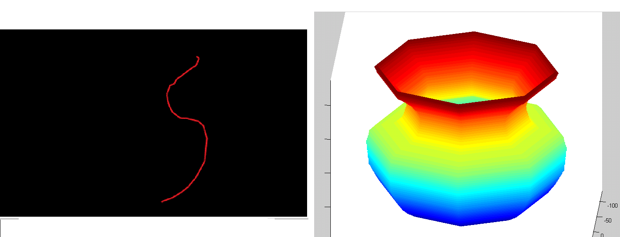
Academic Projects
Bachelor’s Project
A prototype low cost 3D Scanner.
Developed Simulink Image Acquisition model, MATLAB based scanning algorithm.
2nd prize in an IEEE-CRCE competition (Branch Code: #60351).
Fig 10: 3D Scanner Output
7

Slide 8
Coursework Projects
Embedded Systems
Implemented CAN based data communication using two Renesas RX63N boards.
Deciphered a hidden cypher by XBee wireless communication.
Task Creation and scheduling using FreeRTOS on Renesas RX63N board.
Designed a UART based control system using TI MSP430.
Robotics
Developed an XBee configurable, line following robot using Arduino.
Implemented a maze solving logic (LabVIEW)on DaNI2 robot, using ping and infrared sensors.
Designed an obstacle avoiding biped robot, using LEGO MINDSTORMS & LabVIEW NXT.
A* path planning based, maze solving logic, implementation on DaNI2 robot .
Image Processing
Constructed a color image of Abell 1689 using data at Hubble Archive.
Sine wave and noise based spatial image transformations.
8

Slide 9
Case Study
Implementation of Dynamic Source Routing on 802.15.4 using XBee Series 1 modules

Slide 10
Introduction
Role: Graduate Research Assistant, Embedded Software Developer
Under: Project Manager & Software Architect
Contributions:
Routing Protocol Selection
Software Implementation (Concept to code implementation )
Test Environment Creation
Testing of XBee Interface Library
Testing of developed functionality
10

Slide 11
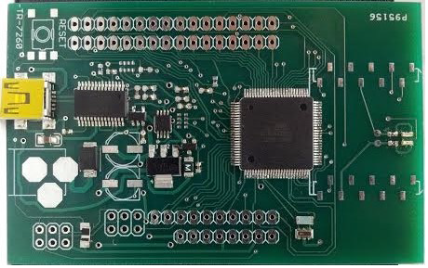
Topic Introduction
Increasing trend in the use of Wireless Sensor Networks for data collection & monitoring.
But most development platforms have an integrated OS or propriety software .
Example: MICAz, OS -Tiny OS, TelosB, OS- Contiki (IoT), Imote- Tiny OS
Proprietary software makes interfacing unsupported hardware very difficult.[7]
Writing drivers, utilizing micro controller peripherals is work intensive.[7]
Background
To resolve this issue, an open source development platform which employs commonly used and widely supported open source hardware and software was developed. [7]
Fig11. Motesquito (Stiquimote) Board [7]
11

Slide 12
Platform Introduction
Hardware Features: Atmega 2560
Existing Software Features:
Hardware Abstraction Layer
Support for microcontroller peripherals, configurations
XBee Interface Layer [16]
XBee Transmit, Receive and configuration API’s
Required Feature
Need for a means to route packets.
Fig12. Software Layer Organization
12

Slide 13
Problem Statement
To implement a wireless routing protocol which utilizes the underlying software layers.
Requirements
Selection of Routing Protocol & Trans-receiver
Design & Implementation
Protocol Selection:
Protocols Considered: Adhoc On demand Distance (AODV), Dynamic Source Routing (DSR)
Selected Protocol: DSR
Table 1. Selection of Protocol
Selection Criteria | AODV | DSR
Proactive v/s On demand routing | On Demand | On Demand
Route advertisement | Yes (Periodic) | No
Source Routing | No | Yes
Updating of neighbor routing table | Yes | No
Inconsistent Routes | Yes | No
Packet Overhead | Less | More
13

Slide 14
Problem Statement
Transreceiver Selection
Radios : XBeeSeries1 & 2
Selected Transreceiver: XBee Series 1
Table 2. Radio Selection
Selection Criteria | Xbee S2 | Xbee S1
Portability | Yes | Yes
Community Support [7] | Yes | Yes
Single Hop Functionality | No | Yes
Existing Networking Firmware | AODV Mesh | No
Feasibility of different networking approaches [14] | No | Feasible
Transmit Power [6] | 2mW | 1mW
14

Slide 15
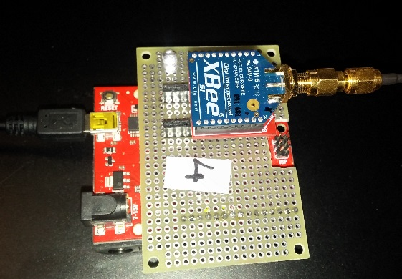
Design
Hardware Description
The wireless nodes used, consisted of a microcontroller and a radio.
Microcontroller : ATmega328P [11]
Transreceiver : XBee S1
XBee Series 1 Interfacing : Tx –DIN, Rx –DOUT
LED Indicator : PORTD Pin 7
Fig13. Wireless Module used
15

Slide 16
Design
Software Design
Software Organization
Creation of DSR Packet
Route Cache
Recent Request List
Networking API
Software Organization
Fig14. Packet Handling
16

Slide 17
Design
Software Design
Creation of DSR Packet
Fig15. XBee Packet Structure
Fig16. DSR Packet Structure
17

Slide 18
Design
Software Design
Route Cache
Fig17. Route Cache Element
Recent Request List
Fig18. Seen List / Heard List
18

Slide 19
Design
Software Design
Networking API
int Tranmsit_DSR
(int dest_n, char* msg,int msg_siz );
Fig19. Transmit DSR Flowchart
19

Slide 20
Code Organization
Table 3. Code Org.
Files | Functions | Layer
Xbee_DSR.c | Function Calls Networking Interface DSR Initializations Motesquito (Board) Initializations | User Layer
DSR.c, DSR.h | Declaration of DSR Data Types and parameters DSR initialization and packet handler functions DSR packet manipulation functions Route Cache Functions, Seen List Functions Route Discovery and Ack. Status Check Functions | Networking Layer
Xbee.c, Xbee.h XBeeConfig.h | XBee Initializations Receive functions 16 bit transmit request Network ID functions Transmit functions Display function XBee Pan ID setup functions | XBee Interface Layer
XbeeHAL.c DSRHAL.h Motesquito.c Motesquito.h | Receive Interrupt, USART Initialization Timer Initializations and Interrupt Board Configurations Serial Port Initializations | Hardware Abstraction Layer
20

Slide 21
Design
Functional Design
Fig 20. Functional Design
User Layer
motesquitoInit()
Transmit_DSR()
initDSR()
Seen List
Functions
Cache Functions
Timer Validity
Msg_status
Network Layer
Request
Transmit Msg
newPkt
XbeeUSART_init()
*cbFunPtr()
setNewPktcb(newPkt)
set16bitadress()
get16bitadress()
XBee Interface
Layer
XbeeInit()
Transmit_16 bit
XbeeSetup()
rxISR()
HAL
USART0_init()
USART_INIT( )
sendByte()
ISR(USART_RX_vect)
initTimer()
21

Slide 22
Implementation
Background: A XBee can be configured to transmit at the following power levels. [Table 1]
A received XBee signal is valid if it is in the range of -40dB to -92 dB (receiver sensitivity).
One hop audibility and two hop signal isolation, is required to confirm working of the protocol.
Such isolation is difficult to achieve with the existing signal strength and environmental interference.
Serial monitoring (Cool Term) of multiple spatially spaced nodes is not feasible (long cables).
Problem Statement: Creation of a closely spaced, hardware test environment which enables one hop signal reception and two hop signal isolation.
Power Level | dB Value
0 | -10 dB
1 | -6 dB
2 | -4 dB
3 | -2 dB
4 | 0 dB
Table 4. XBee Power levels [12]
22

Slide 23

Implementation
Solution: Creation of a test environment.
Approach 1: Use of multiple SMA connectors for per hop attenuation
Drawbacks : Lack for portability, difficult to alter attenuation
Fig 21. Test Bed Block Diagram
Fig 22. SMA Attenuator
23

Slide 24
Implementation
Solution: Creation of a test environment.
Approach 2 : Single variable value attenuator.
Benefits : Easier to handle, variable attenuation (-10 dB - 64 dB=74 dB )
Fig 23. Test Bed Block Diagram
Fig 24. Test Bed Implementation
24

Slide 25
Software Implementation
Route Discovery (Source Node)
Fig 25. Route Discovery Implementation
25

Slide 26
Software Implementation
Route Discovery (Intermediate / Target Node)
Fig 26. Route Discovery Implementation
26

Slide 27
Software Implementation
Route Reply (Target, Intermediate, Source Node)
Fig 27. Route Reply Implementation
27

Slide 28
Software Implementation
Message Forwarding
Fig 28. Transmission and Acknowledgement Phase
28

Slide 29
Software Implementation
Acknowledgement Forwarding
Fig 29. Transmission and Acknowledgement Phase
29

Slide 30
Software Implementation
Route Maintenance
Route Discovery Failure during Route Request
Fig 30. Route Discovery Failure during Route Request
30

Slide 31
Software Implementation
Route Maintenance
Route Discovery Failure during Reply
Fig 31. Route Discovery Failure during Route Reply
31

Slide 32
Software Implementation
Route Maintenance
Transmission Failure
Fig 32. Transmission Failure
32

Slide 33
Demonstration
//Driver script
int main(void)
{
motesquitoInit();//Set up communications
initDSR(); // Setup DSR functionality
char message[]={‘M',‘O',‘T',‘E',‘S',‘Q',‘U‘,‘I‘,‘T',‘O'};
int msg_status= Transmit_DSR(4,message,10); // target node, data, data_size
if (msg_status==1) //Success
{//Indicator on for 5sec}
if (msg_status==2) //Route Discovery failure
{/*Indicator toggled with 100ms interval*/}
if (msg_status==3) // Acknowledgement failure
{/*Indicator toggled with 1s interval*/}
while(1)
{}
}
Implementation
Functioning
33

Slide 34
Testing
Testing of the existing and developed software layers is crucial to ensure proper functionality.
The software modules were tested mainly in an interactive manner.
The testing was carried out by conducting unit, integration and system testing.
The scripts and internal modules were subjected to white box testing and black box testing.
Aspects of code coverage and branch coverage proved effective in ensuring expected code flow.
Few Issues
Successive char data bytes were type-casted into an int variable in reverse order than expected.
Fix: The order of the char data bytes was passed in a reverse manner to the respective function.
Since the same port was used for communication and printing debug values, small size debug indicators/ messages were used. Thus, one debug window was used per node.
User Level API Testing
The Transmit_DSR API would return status values for route discovery failure, transmission failure and
transmission success.
These values were used for black box testing.
34

Slide 35
A Brief Analysis of Design Choices
Layered architecture -> module testing is feasible, hardware portability
Use of call back function -> Import DSR functionality (software portability of network layer)
User of variable attenuator-> in range / out of range
Use of #ifdef preprocessors-> real time debugging. (print packet contents, states etc. )
Use of #define to define max. no of hops, max. cached routes-> scalability
Classification of error types -> better control of recovery strategy
35

Slide 36
Conclusion & Future Work
Conclusion
The implementation functions as designed & is a good fit for Atmega 2560 (Motesquito)
DSR based user interface to forward messages from one node to another
Huge scope for developing customized user interfaces
Networking using single hop of feature of XBee Series 1 (802.15.4)
Demonstrated self healing capability
Unseen Issues
Debugger firmware
Concept Implementation
Future Work
Motesquito (Target board) based testing
Aspect of self-organizing
36

Slide 37
References
http://advancement.uncc.edu
http://www.mu.ac.in/
Poor, R. and Auburn, Charlotte B. and Bowman, C. (2003), Self-healing networks, QUEUE, May 2003, 52-59
D. Johnson and D. Maltz, "Dynamic Source Routing in Ad Hoc Wireless Networks", in Mobile Computing, edited by Tomasz Imielinski and Hank Korth, Chapter 5, pp. 153-181, Kluwer Academic Publishers, 1996.
J. Broch, D. A. Maltz, D. B. Johnson, Y.-C. Hu, and J. Jetcheva. A Performance Comparison of Multi-Hop Wireless Ad-Hoc Network Routing Protocols. In In Proceedings of the Fourth Annual ACM/IEEE Inter-national Conference on Mobile Computing and Net-working, Oct. 1998.
XBee®/XBee-PRO® RF Modules, Product Manual v1.xEx - 802.15.4 Protocol.
Sultana Alimi, Samuel Shue and James M. Conrad,Design and Implementation of an Open-Source Wireless Sensor Network Development Platform, SOUTHEASTCON 2014, IEEE
XBee™ ZNet 2.5/XBee-PRO™ ZNet 2.5 OEM RF Modules, Product Manual v1.x.4x - ZigBee Protocol
ATMEL, AVR micro-controller ATmega 328P datasheet, Oct. 2009 .
ATMEL, AVR micro-controller ATmega 2650 datasheet, Feb. 2014 .
Tanmay Sane, Sam Shue and James M. Conard, Implementation of Dynamic Source Routing on 802.15.4, using Xbee Series 1 modules, SOUTHEASTCON 2015, IEEE
http://www.science.smith.edu/~jcardell/Courses/EGR328/Readings/XBeeCookbook.pdf
http://www.hkaco.com/gongye/scope/scope_9000s_accessories.asp
XBee®/XBee-PRO® ZB RF Modules User Manual, 2012 Pg 58
An Introduction to IEEE STD 802.15.4, Jon T Adams, Freescale Semiconductor, Inc
Development of a portable XBee C library and RSSI triangulation localization framework, Sam Shue, James Conard, Honet 14. 125,128.
37

