Slide 1
Fault-tolerant key-value server client using RPC
Nguyen Duc Anh (BI9-041)
• Doan Minh Long (BI9-145)
• Tran Khanh Duong (BI9-078)
• Vu Long Dung (BI9-070)
• Tran Ngoc Diep (BI7-033)

Slide 2
Problem description
Continue operating in the event of the failure of (or one or more faults within) some of its components.
Able to continues its intended operation, possibly at a reduced level, rather than failing completely, when some part of the system fails.

Slide 3
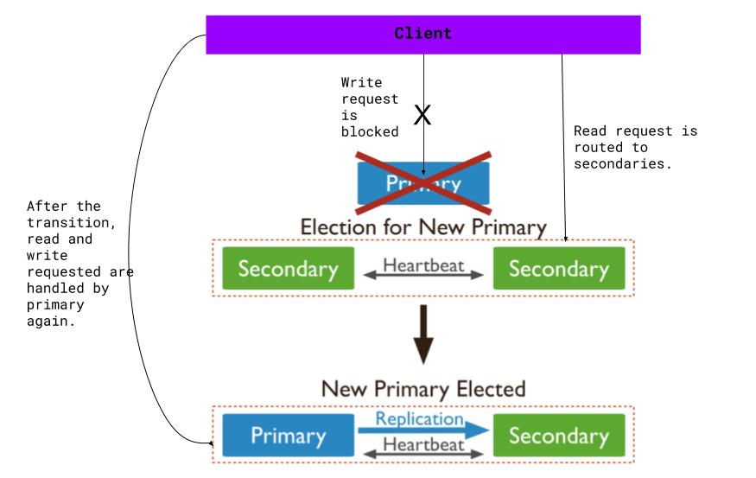
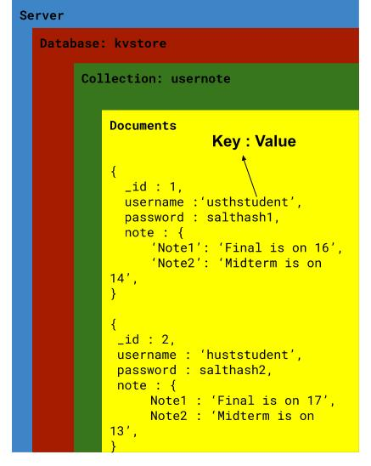
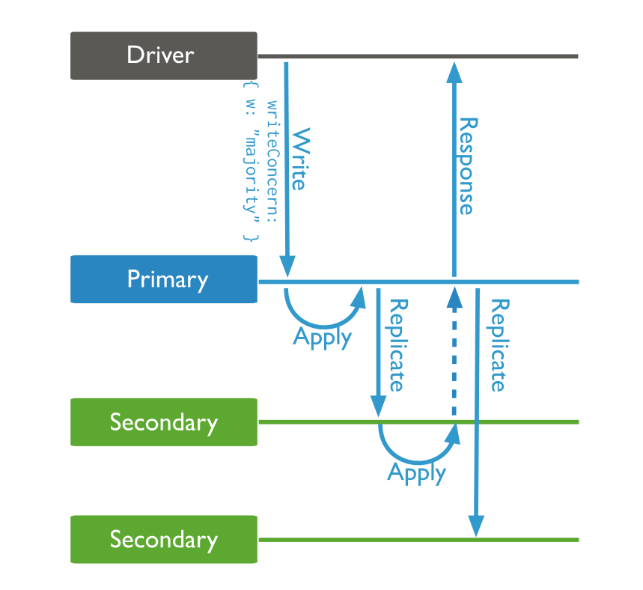

Requirements | Design
maintains a database of key/value pairs | Key-value store
fault-tolerant solution must be software-based, not hardware based | a software solution
During failure, the service should use a backup system immediately | MongoDB has a concept of replication
backup servers may return data that does not reflect the state of the data on the primary | MongoDB has a rollback functionality
always maintain a log with a specified max size in case the backup server goes offline | Each members has an oplog. Backups copy oplog from primary
always be a small curtain of time between the transition. Have to figure out a way to deal with client incoming requests | Block all WRITE requests. READ request can be routed
implement Remote Procedure Call | Python has the package XMLRPC

Slide 4
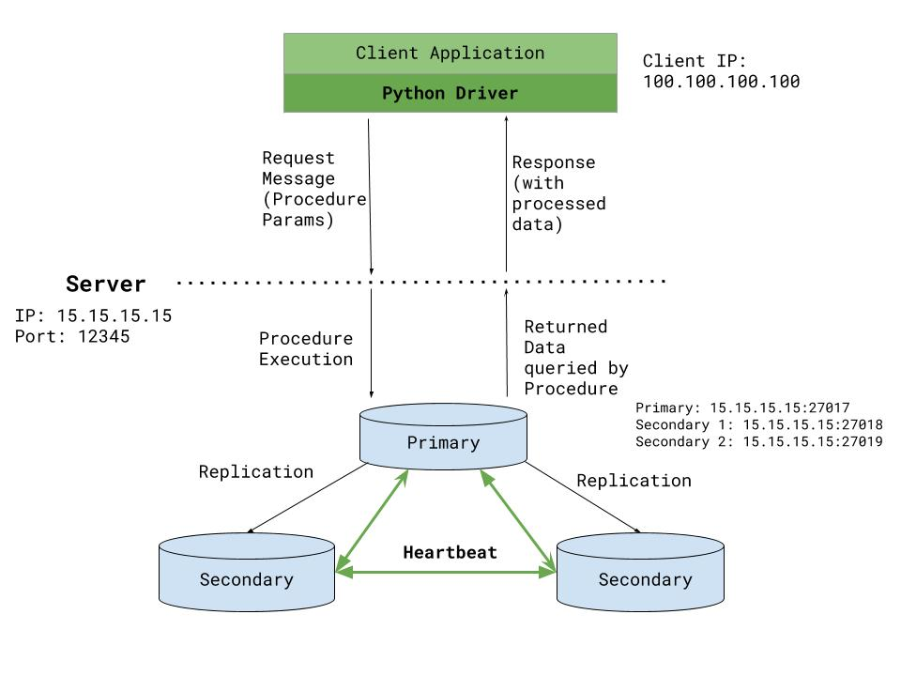
System organization

Slide 5
Implemetation
- In the XMLRPC server, three functions – controller.
Register
setNote
getNote

Slide 6
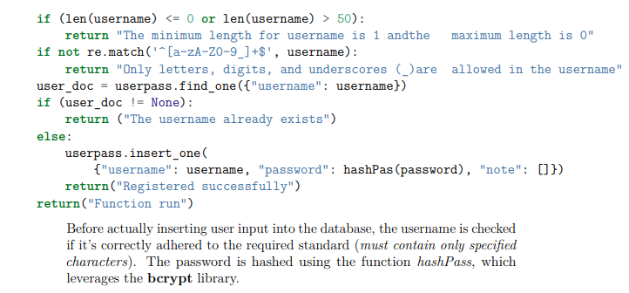
Register
Two parameter:
Username
Password
Has a connecting client -> call a function

Slide 7
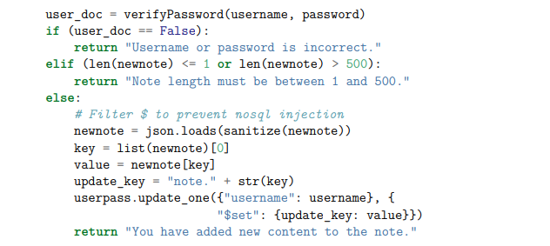
setNote
Four parameters from client:
Username
Password
Title
Content
Title and content – Json format.

Slide 8
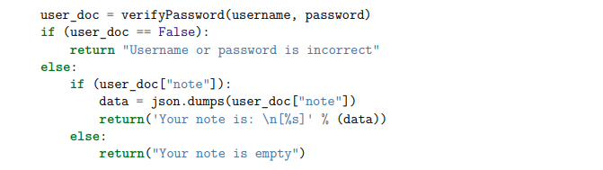
getNote
Two parameters:
Username
Password

Slide 9


