Slide 1
Solving the Mazes using Stacks
Also known as Rat in a Maze Problem

Slide 2
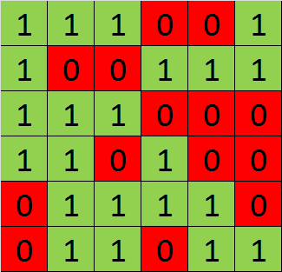
Start
Right
Down
Up
Left
Destination
1 = movement allowed
0 = blockage (movement not allowed)

Slide 3
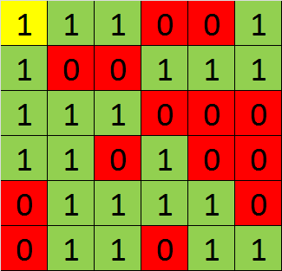
R
D
U
L
Stack: <R>

Slide 4
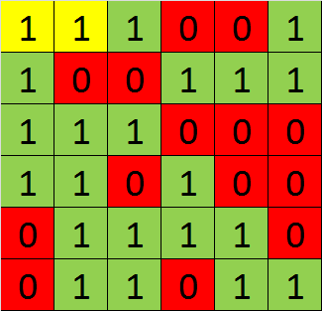
R
D
U
L
Stack: <R, R>

Slide 5
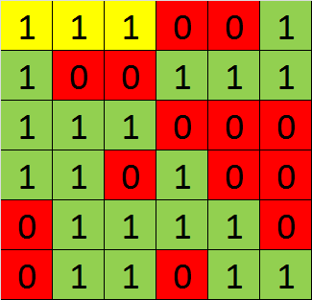
R
D
U
L
Stack: <R, R, R>
Moving to Right, Up and Down not possible
Now, backtrack (POP) and move in reverse direction

Slide 6
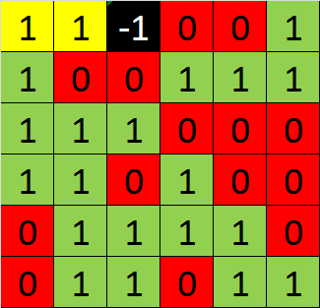
Stack: <R, R>
Note that moved in Left Direction
Blocked that position to avoid re-visit

Slide 7
Stack: <R, R>
Moving to Right, Up and Down not possible
Now, backtrack (POP) and move in reverse direction

Slide 8
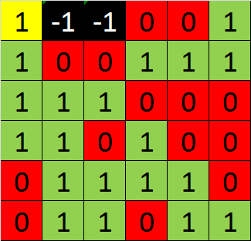
Stack: <R>
Note that moved in Left Direction
Blocked that position to avoid re-visit

Slide 9
R
D
U
L
Stack: <R>
Note that now moving Right not possible
Move Down Now

Slide 10
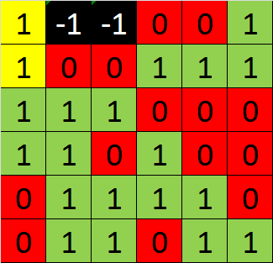
R
D
U
L
Stack: <R, D>

Slide 11
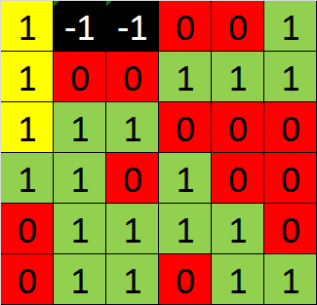
R
D
U
L
Stack: <R, D, D>

Slide 12
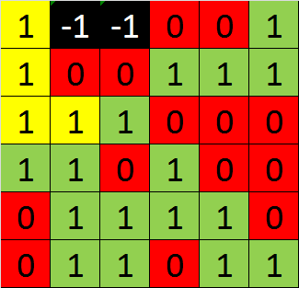
R
D
U
L
Stack: <R, D, D, R>

Slide 13
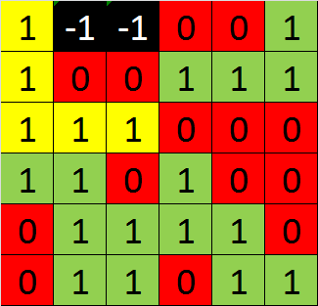
R
D
U
L
Stack: <R, D, D, R, R>

Slide 14
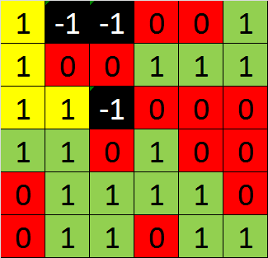
Stack: <R, D, D, R>

Slide 15
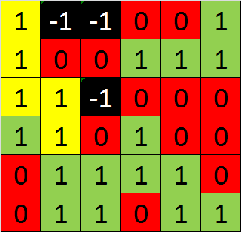
R
D
U
L
Stack: <R, D, D, R, D>

Slide 16
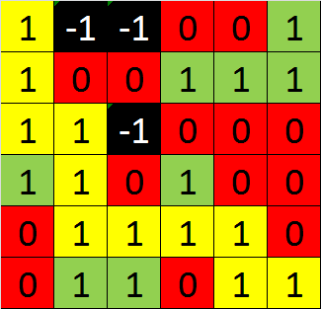
Stack: <R, D, D, R, D, D, R, R, R, D, R>

