Slide 1
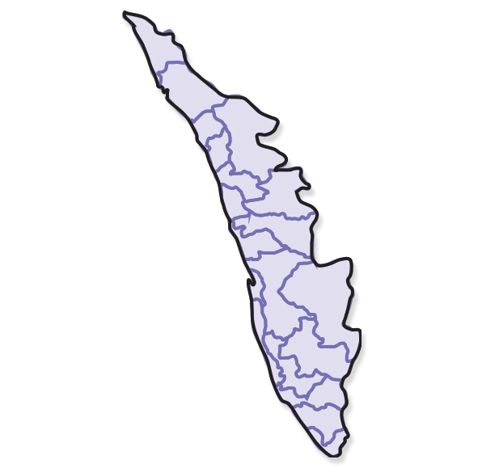
Electoral Trends Analysis
Analyzes Kerala legislative assembly election data to understand voting patterns, party dominance, and competition

Slide 2
project overview – electoral trends analysis
What this Project is
The project analyzes election data to understand trends in voting, party dominance, and competition.
Objective
To analyze election data and understand trends in competition, party dominance, and voter behavior.

Slide 3
TOOLS USED PYTHON PANDAS FOR DATA HANDLING MATPLOTLIB / SEABORN / PLOTLY FOR VISUALIZATION
APPROACH
CLEANED DATASET (MISSING VALUES, FORMATTING)
FILTERED RELEVANT YEARS (LIKE 2011, 2016, ETC.)
CREATED MULTIPLE VISUALIZATIONS:
TREND CHARTS
COMPARISONS
DISTRIBUTIONS

Slide 4
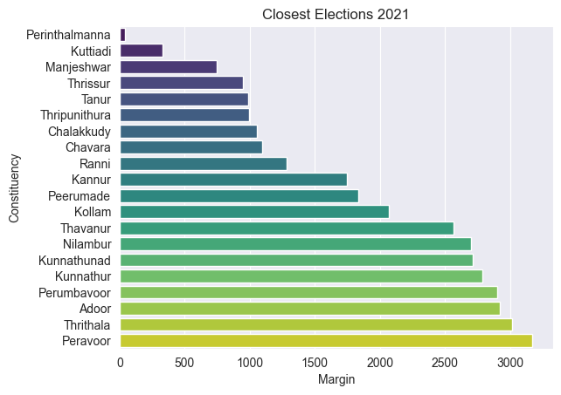
Closest Elections 2021
Shows constituencies with smallest winning margins.
These seats had the most competitive contests.

Slide 5
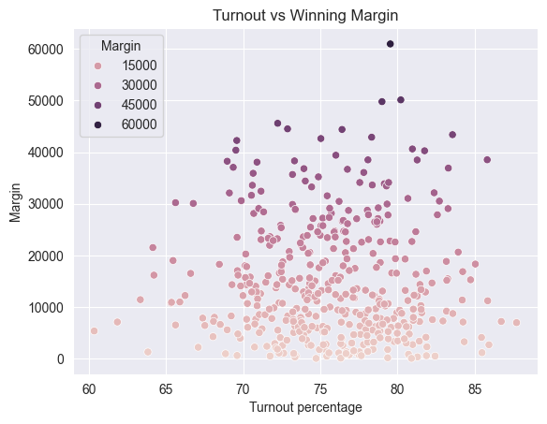
Turnout and Winning margin
Shows relationship between voter turnout and winning margin.
No clear pattern suggests turnout has limited impact on margins.

Slide 6
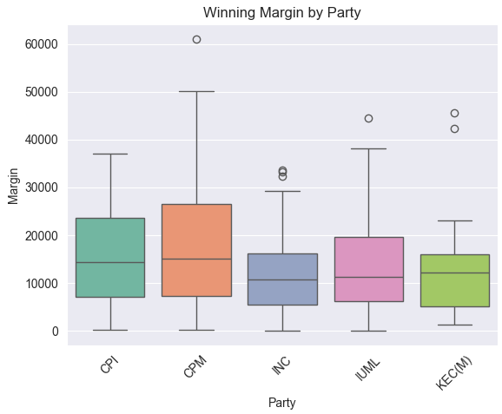
Winning Margin By Party
Shows average winning margin for major parties.
Higher values indicate stronger and more comfortable victories.

Slide 7
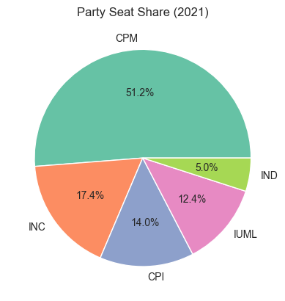
Party Seat Share- 2021
Shows proportion of seats won by top parties in 2021.
Larger segments indicate stronger political presence.

Slide 8
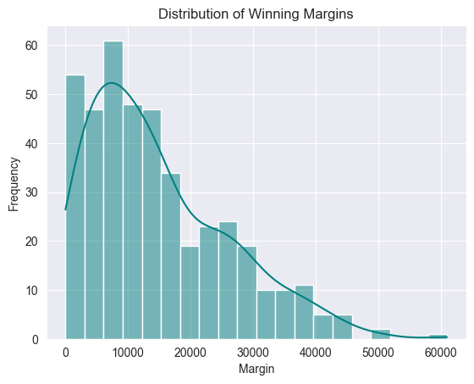
Margin Distribution
Shows how winning margins are spread across constituencies.
Most values in lower range indicate moderate competition.

Slide 9
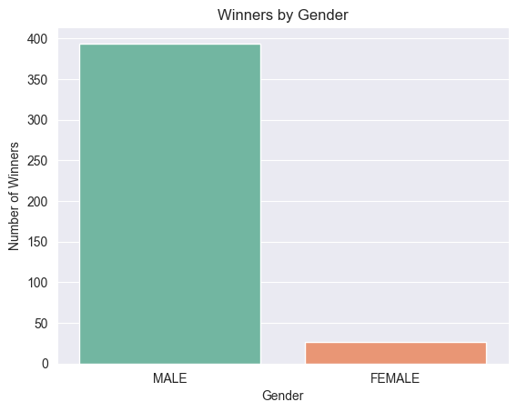
Gender of Winners
Shows distribution of winners by gender.
Highlights imbalance in representation

Slide 10
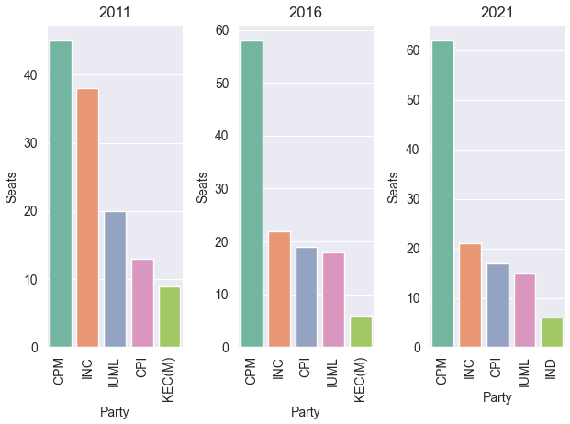
Party Wins (Year Wise)
Compares seats won by top parties across election years.
compare party performance across 2011, 2016, and 2021
Highlights consistency and shifts in party dominance

Slide 11
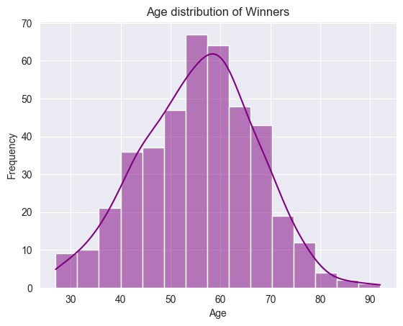
Age Distribution of Winners
Shows age range of winning candidates.
Most winners fall within a specific middle age group

Slide 12
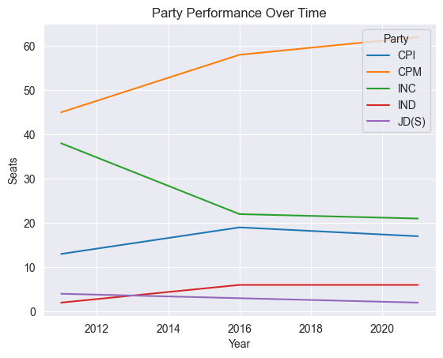
Election Trend Over Time
Shows how values change across election years
Helps identify increasing or decreasing trends over time

Slide 13
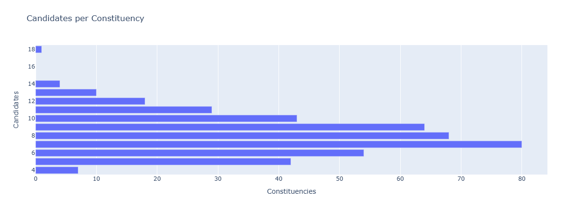
Candidates per Constituency
Shows how many candidates contest in each seat
Higher numbers indicate more competition.

Slide 14
Conclusion
Elections show moderate competition with several close contests
A few parties consistently dominate across years
Turnout has limited effect on winning margins
Competition varies across constituencies

