Slide 1
Exploratory Data Analysis (EDA)
& Business Intelligence
Comprehensive Sales & Revenue Analysis
Chipotle Dataset

Slide 2
Project Overview
• Data Cleaning & Preparation
• Descriptive Statistics
• Sales & Revenue Analysis
• Business Insights & KPIs
• Dashboard Recommendations

Slide 3
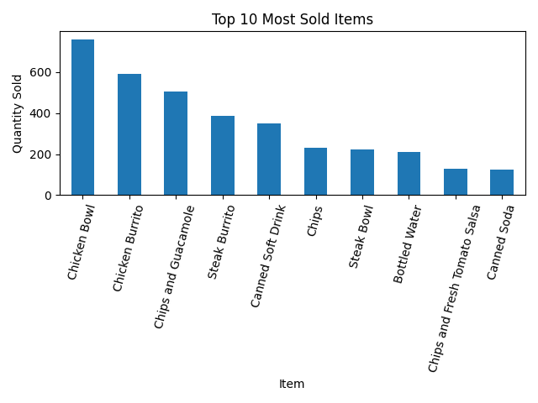
Top 10 Most Sold Items

Slide 4
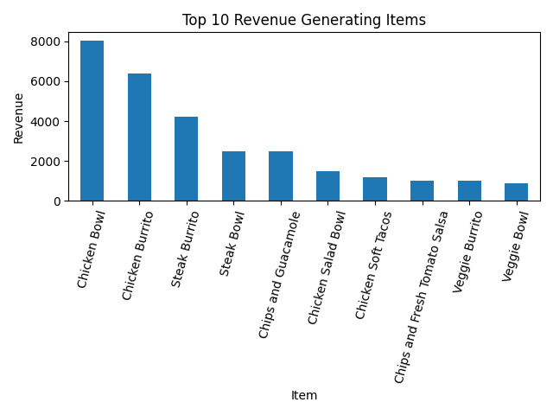
Top 10 Revenue Generating Items

Slide 5
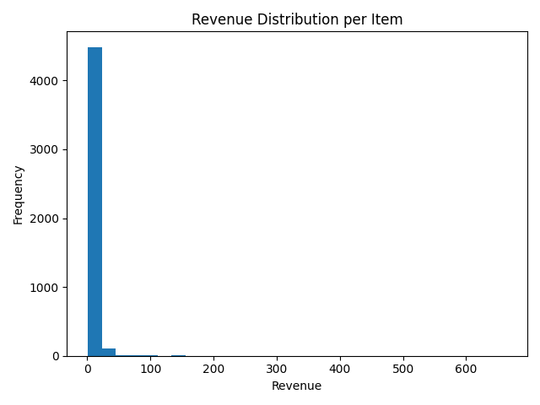
Revenue Distribution

Slide 6
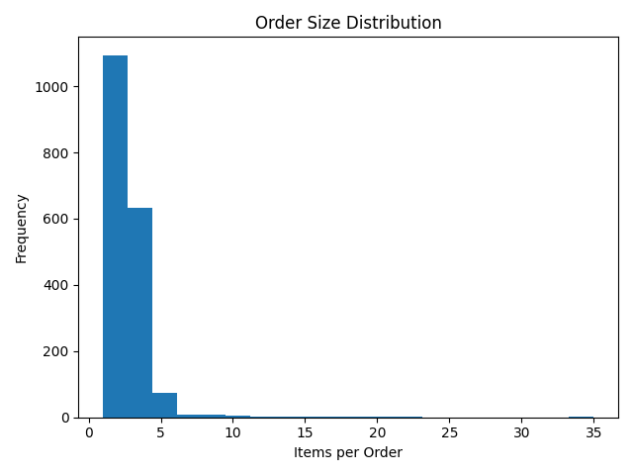
Order Size Distribution

Slide 7
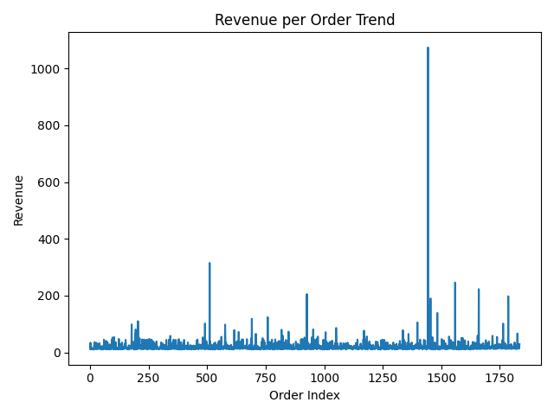
Revenue per Order Trend

Slide 8
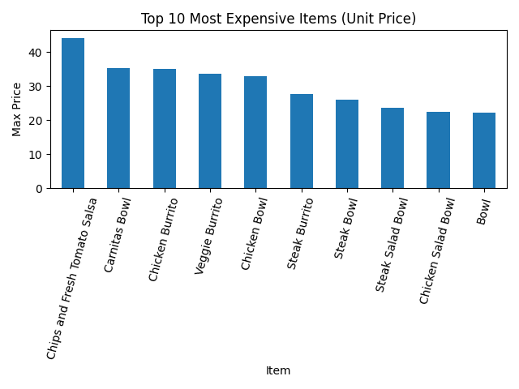
Top 10 Most Expensive Items

Slide 9
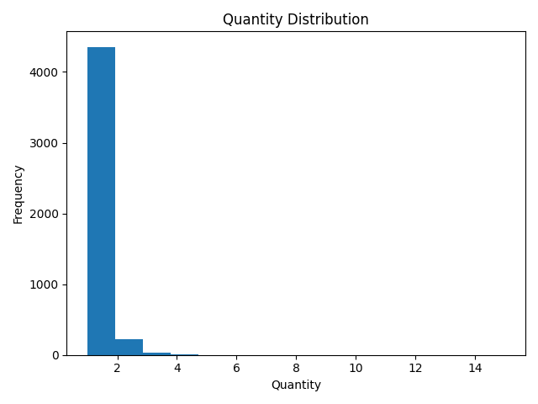
Quantity Distribution

Slide 10
Key Business Insights
• Revenue highly concentrated among top products
• Majority of orders contain small item counts
• High-value items significantly impact total revenue
• Opportunity for upselling in low-quantity orders
• Data suitable for dashboard & BI reporting

