Slide 1

Overview!
Diabetes Classification using Machine Learning Algorithms
Presented By :
Sanei Nessrine
Yousfi Mohamed Ali

Slide 2
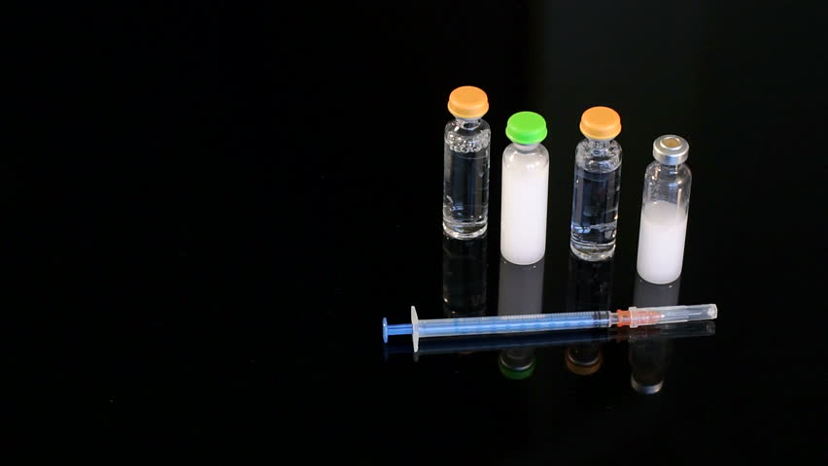
PLan
Overview
Database - Pima Indians Diabetes Dataset
Methodology
Algorithms Comparison & Results Interpretation
Conclusion

Slide 3

Overview
The Pima indians (Akimel Oodham) of Arizona have the highest rate of diabetes of any population in the world.

Slide 4
Database - Pima Indians Diabetes Dataset
Attribute | Description | Value
Pregnancies | Number of pregnancies | [0-17]
Glucose | Plasma glucose concentration | [0-199]
Blood Pressure | Diastolic blood pressure | [0-122]
SkinThickness | Triceps skin fold thickness | [0-99]
Insulin | 2-Hour serum insulin | [0-846]
Body Mass | Body mass index | [0-67]
Pedigree | Diabetes pedigree function | [0-2.45]
Age | Age of an individual | [21-81]
Outcome | Tested +/- | {0,1}
This dataset is originally from the National Institute of Diabetes and Digestive and Kidney Diseases.
Pima Indian Diabetes dataset has 9 attributes in total.
All the person in records are females.

Slide 5
Methodology
Used 3 algorithms of supervised Learning :
* Decision Tree
* Random Forest
* K nearest neighbors

Slide 6
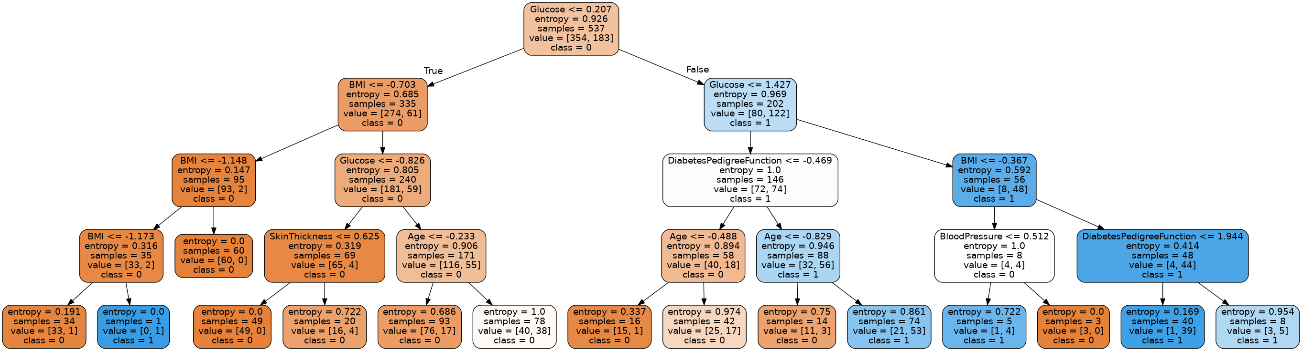
Decision Tree
A decision tree is a decision support tool that uses a tree-like graph or model of decisions and their possible consequences, including chance event outcomes, resource costs, and utility.
The attribute/feature best for set is taken as root “Glucose”

Slide 7
Random Forest
Random Forest is a tree-based machine learning algorithm that leverages the power of multiple decision trees for making decisions
Each node in the decision tree works on a random subset of features to calculate the output. The random forest then combines the output of individual decision trees to generate the final output.

Slide 8

K Nearest Neighbor
KNN algorithms use data and classify new data points based on similarity measures (e.g. distance function). Classification is done by a majority vote to its neighbors. The data is assigned to the class which has the nearest K neighbors.

Slide 9
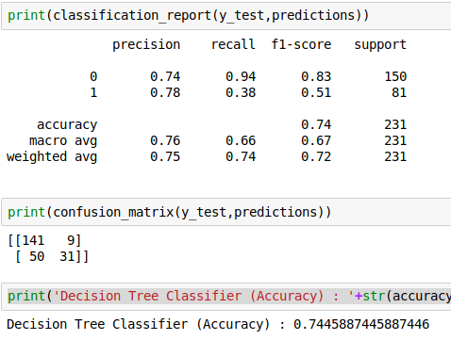
Algorithms Comparison & Results interpretation
DECISION TREE

Slide 10
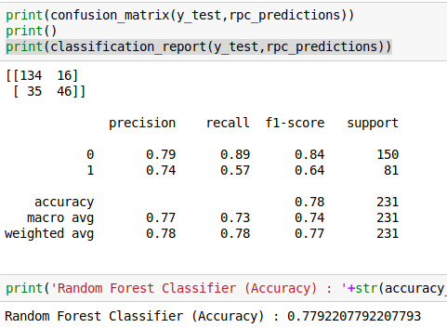
RANDOM FOREST

Slide 11
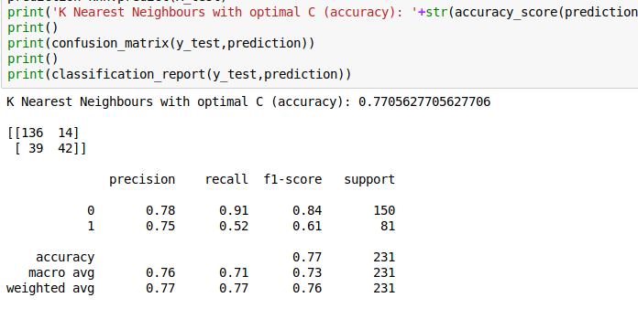
K-NN

Slide 12


Slide 13
Conclusion
77,92% accuracy rate provided with Random Forest .
Random Forest (at the right parameters) can be a good choice and practical to classify a medical data .

Slide 14


