Slide 1

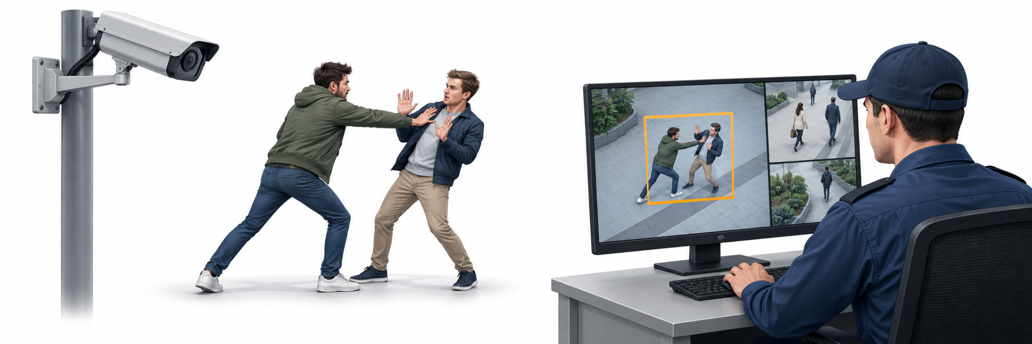
PRIS 2026
A Lightweight ConvLSTM Architecture for Abnormal Human
Activity Recognition in Surveillance Videos
By Sanele Hlabisa & Prof. Jules-Raymond Tapamo
^{PRIS 2026}
^{28 & 29} ^{October 2026}
Coastlands Hotel, Musgrave, Durban
THEME: International Year of Rangelands and Pastoralists
^{pris.ukzn.ac.za}

Slide 2


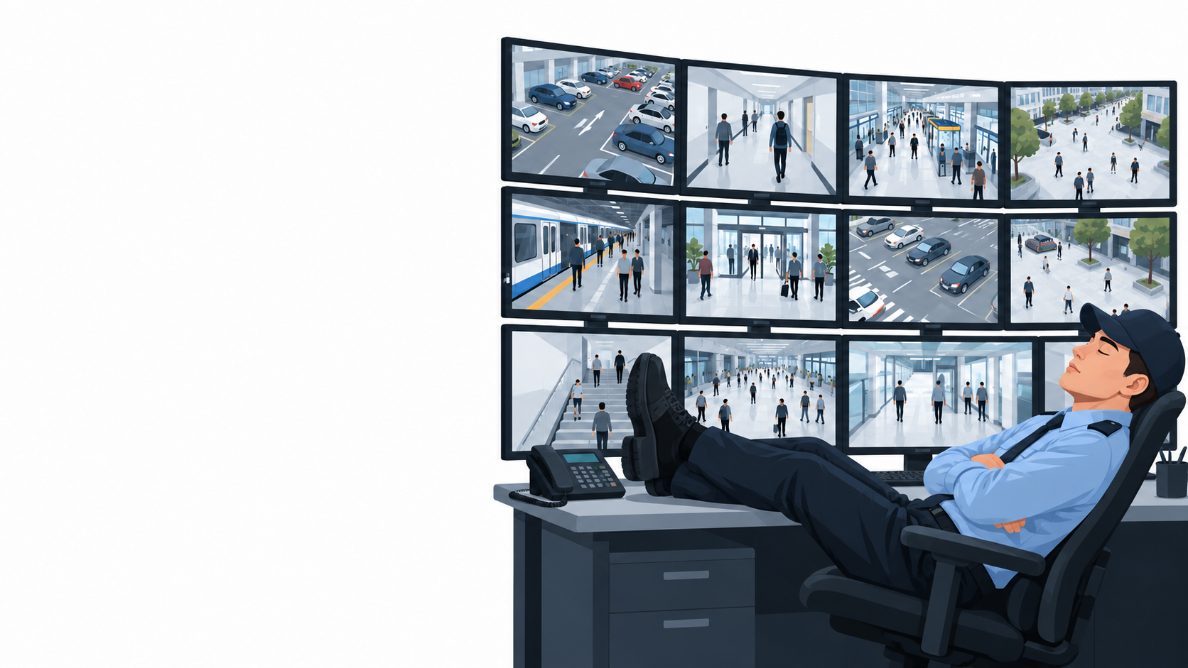

Why This Problem Matters
Problem Statement
  Cameras record more than people can monitor
  Fatigue and divided attention can lead to missed events
  This creates a need for automated activity recognition
Existing approaches
  3D CNN: Learns appearance and motion, but is often large
  ViT: Captures long-range patterns, but is compute-intensive
  ConvLSTM: Combines spatial features with temporal memory
Research question
  Can a compact ConvLSTM maintain strong recognition performance with fewer parameters?
^{PRIS 2026}
^{28 & 29} ^{October 2026}
Coastlands Hotel, Musgrave, Durban
THEME: International Year of Rangelands and Pastoralists
^{pris.ukzn.ac.za}

Slide 3
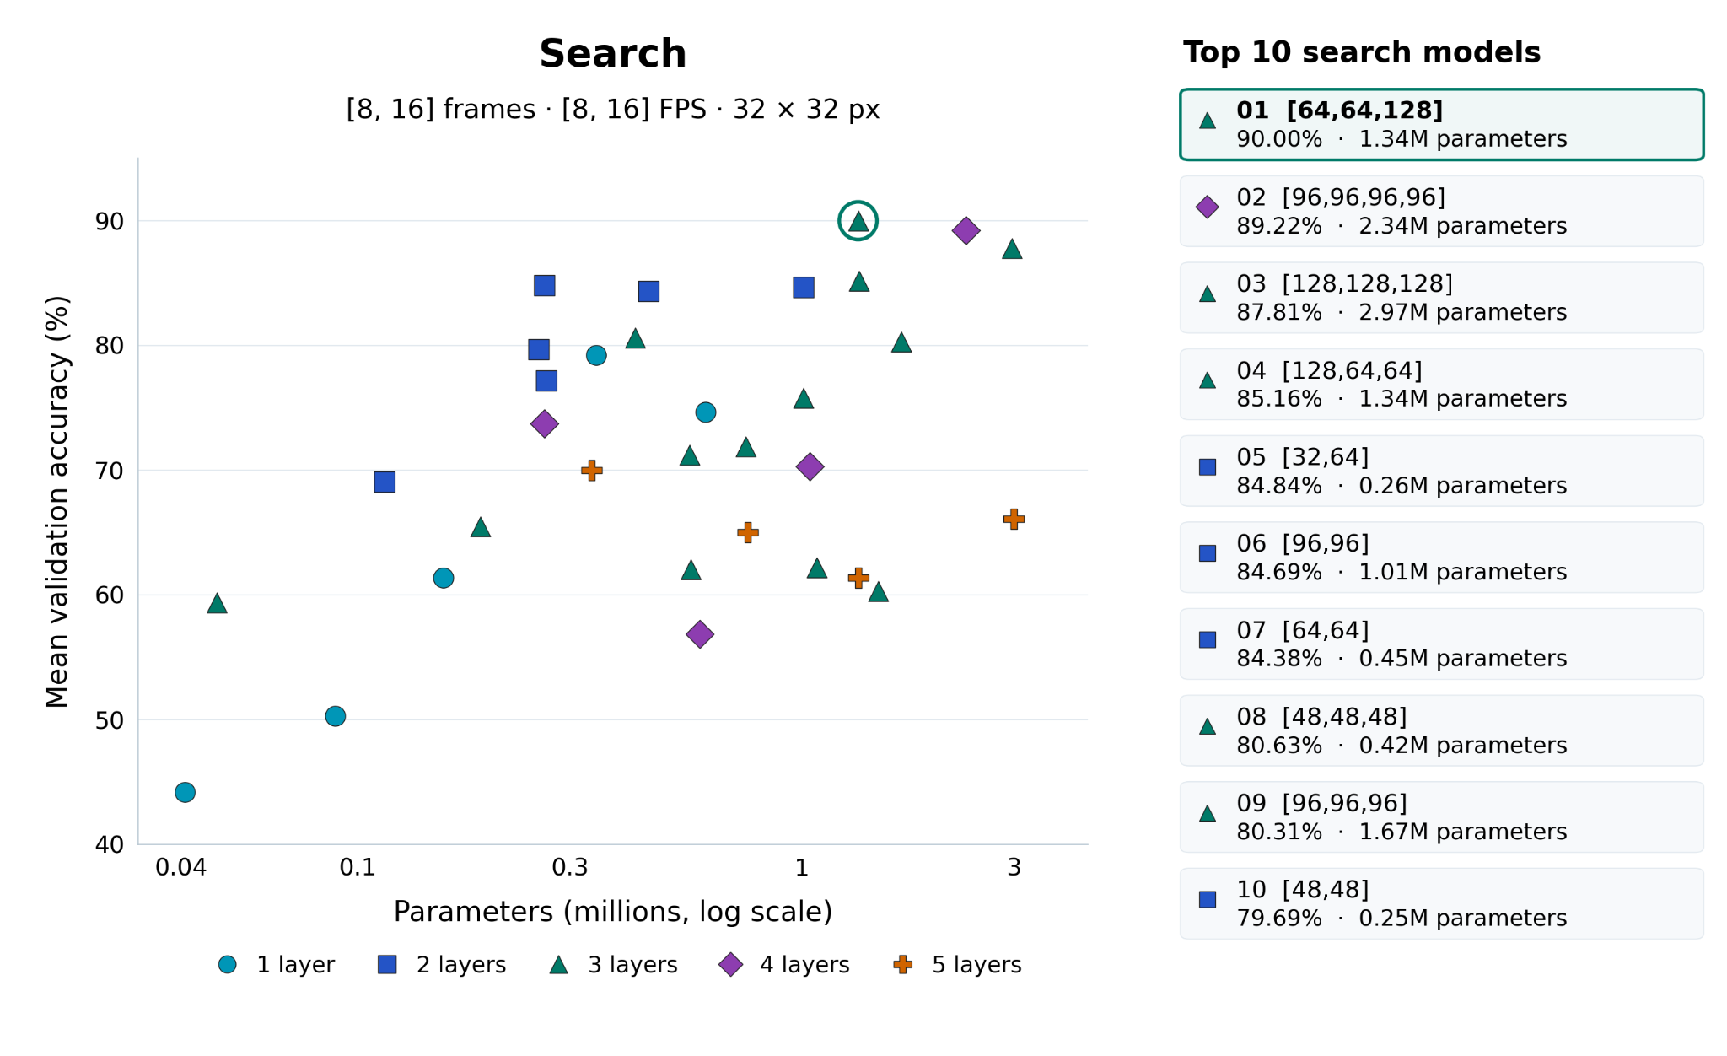
Proposed Solution and Architecture Search
Configurable Architecture
  Flat: ConvLSTM[8,8,8]
  Expanding: ConvLSTM[4,8,16]
  Contracting: ConvLSTM[16,8,4]
Abnormal Activities Dataset
  1,069 video clips
  11 activity classes
Controlled Search
  32 architectures
  4 temporal settings
  128 search runs
^{PRIS 2026}
^{28 & 29} ^{October 2026}
Coastlands Hotel, Musgrave, Durban
THEME: International Year of Rangelands and Pastoralists
^{pris.ukzn.ac.za}

Slide 4
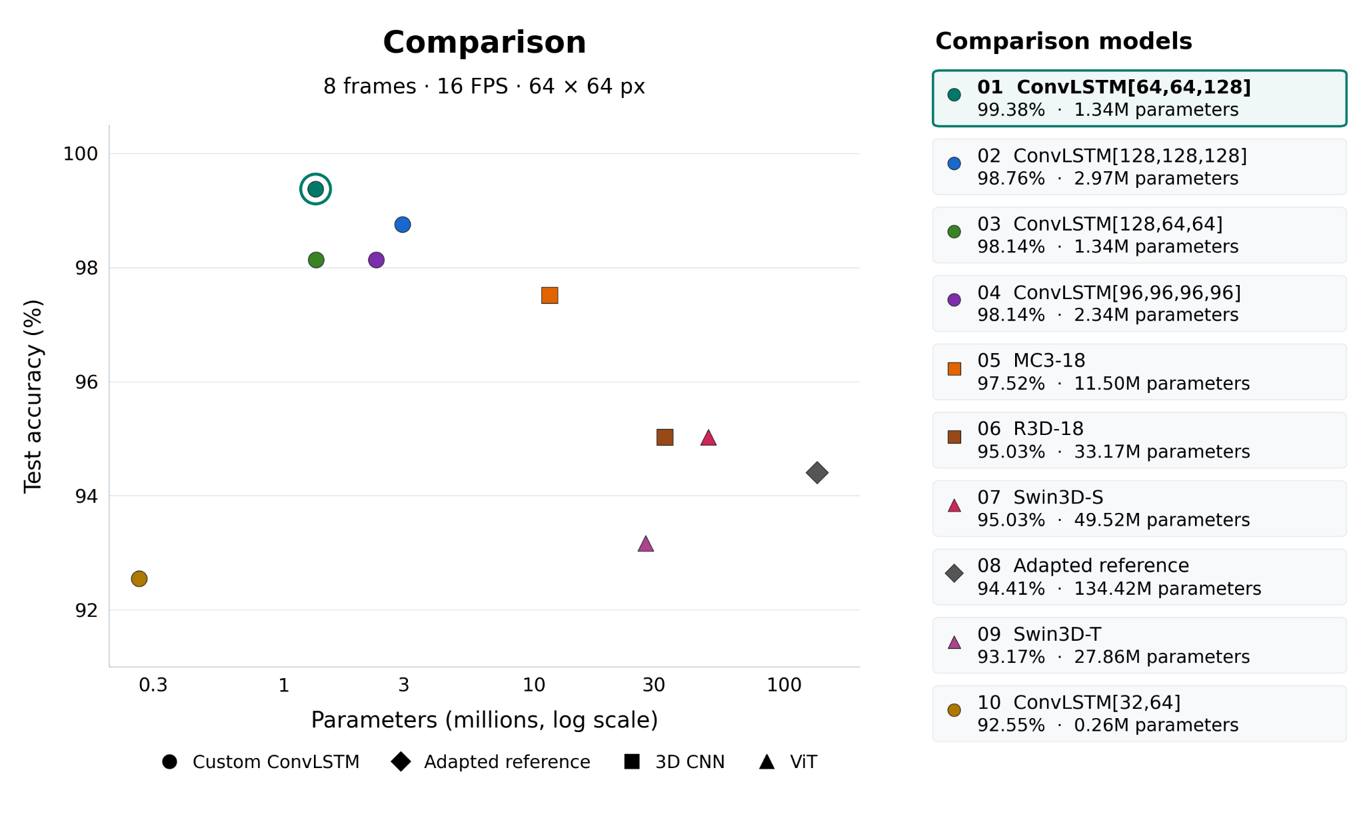
Comparison and Future Work
Final comparison
  Six ConvLSTM models
  Two 3D CNNs
  Two ViTs
Best Result
  99.38% accuracy, 1.34M params
Deployment
  Gradio application
Future work
  Multi-label recognition
  Continuous overlapping windows
^{PRIS 2026}
^{28 & 29} ^{October 2026}
Coastlands Hotel, Musgrave, Durban
THEME: International Year of Rangelands and Pastoralists
^{pris.ukzn.ac.za}

