Slide 1
LENDING CLUB CASE STUDY SUBMISSION
Group Assignment
Ashutosh Kulkarni
Kamal Mehta
Peeyush Singhal
Sayan Banerjee

Slide 2
Introduction and Purpose
Introduction: Lending Club is the largest online loan marketplace, facilitating personal loans, business loans, and financing of medical procedures. Like most other lending companies, lending loans to ‘risky’ applicants is the largest source of financial loss (called credit loss). Lending club is interested to understand the ‘risky’ applicants via the historical data to minimize its financial loss.
Purpose: The company wants to understand the driving factors (or driver variables) behind loan default, i.e. the variables which are strong indicators of default. The company can utilise this knowledge for its portfolio and risk assessment. The purpose of this Exploratory Data Analysis (EDA) is to understand
consumer attributes and
loan attributes
influence the tendency of default.

Slide 3
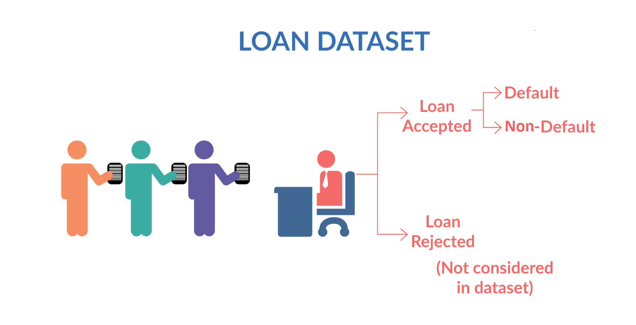
Data Understanding
Loan Variables
Pre-Loan Variables
Loan Variables (Company Intrinsic)
Post-Loan Variable
Included
Included
Excluded
These are customer profile variables which are available during loan application phase.
Some of these might indicate whether a customer is likely to default or not. These are the variables which we are going to identify and focus on during this EDA case study.
These are the variables which typically lender controls and can adjust based on the profile of loan applicant. These variables are loan amount (that is finally approved), interest rate, term and monthly repayment amount.
These are variables which are generated after the loan has been granted to loan applicant and when loan cycle has started.
These typically include payments, payments missed, payment due date etc. It is clear from business understanding that these variables should not be considered as driver variables for default as these cannot indicate the likelihood of default at loan application stage.
Loan Accepted – Non-Default (Fully Paid)
Included
Loan Accepted – Current**
Excluded
Loan Accepted – Default (Charged Off)
Included
**Loan Accepted – (loan_status=)Current, an intermediate state, is excluded from analysis because these customers do not participate to show propensity to default or non-default. The propensity can be understood only for completed loans

Slide 4
Data Cleaning and Manipulation
Sanity Check
Cleaning
Manipulation
Removing Rows
Finding percentage of missing values in each column
Imputation for missing values
Having 100% missing values or same values (zero standard deviation)
Loan status == Current **
Unique / Duplicate values in columns
Where every row has a different value
Cleaning
Leading & Lagging spaces
Converting String to Integer (example : months)
Remove signs (example % in interest rates)
Emp_length = NA
Revol_util = 0
mths_since_last_record = -1
pub_rec_bankruptcies = 0
Loan Variables and Post-Loan Variables **
Removing Columns
** see Data Understanding

Slide 5
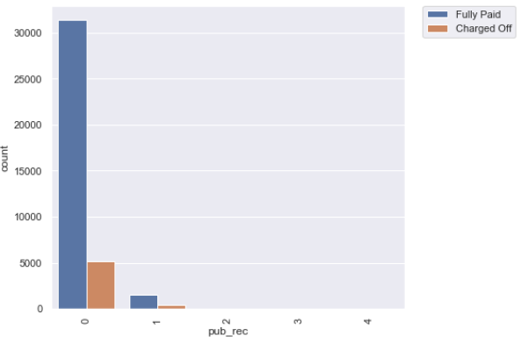
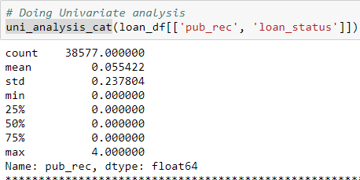
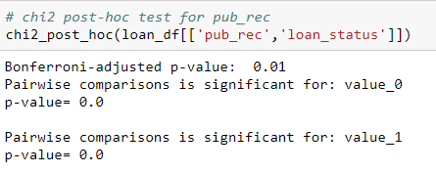
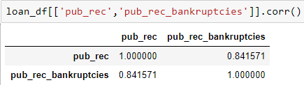
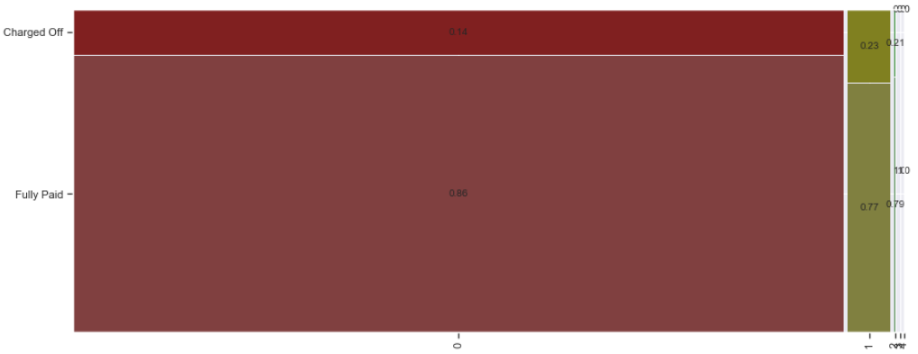
Data Analysis : Insight into establishing Impacting variables : Customer Variable – pub_rec/pub_rec_bankruptcies
Example
annual_inc
emp_length
pub_rec / pub_rec_bankruptcies
earliest_cr_line - charged off proportion increasing from 2004
pub_rec: Number of derogatory public records;
pub_rec_bankruptcies: Number of public record bankruptcies
These variables have got values like 0, 1, 2, 3, 4, so we have used categorical analysis here, though the values are numeric
Customer
2
Count plot
1
Univariate Analysis
4
χ² post-hoc test
pub_rec & pub_rec_bankruptcies are statistically significant when looked against loan_status
pub_rec and pub_rec_bankruptcies have got high correlation
3
Mosaic plot
5
Correlation analysis

Slide 6
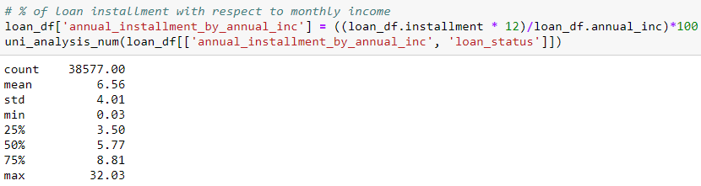
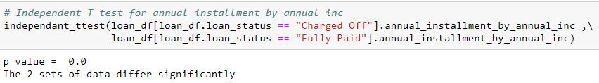
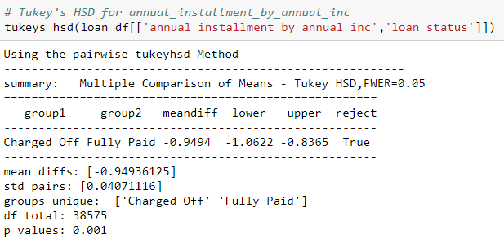
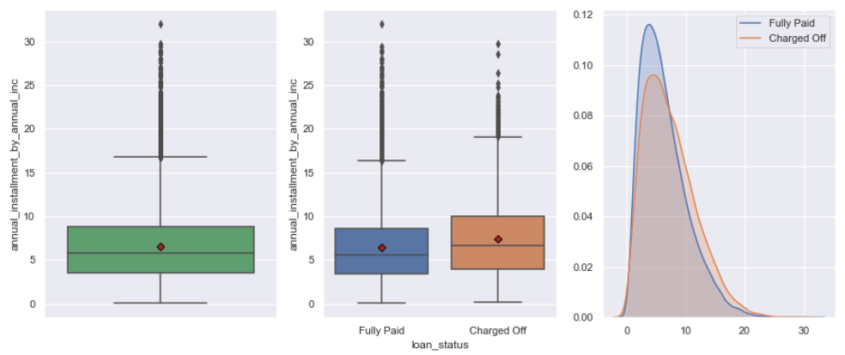
Data Analysis : Insight into establishing Impacting variables : Derived Variable – annual_installment over annual_income
Example
annual_installment as percent of annual_income
Derived
Univariate Analysis –quantitative
1
5
Independent t-test
2
Box plot - Univariate
3
Box plot-segmented
6
Tukey HSD test
4
Distribution plot
Rejection of null hyposthesis that annual_installment as a percentage of annual income does not have impact on sub categories of loan_status i.e charged off and fully paid

Slide 7
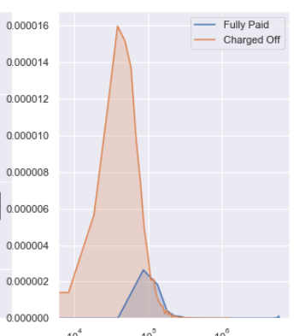
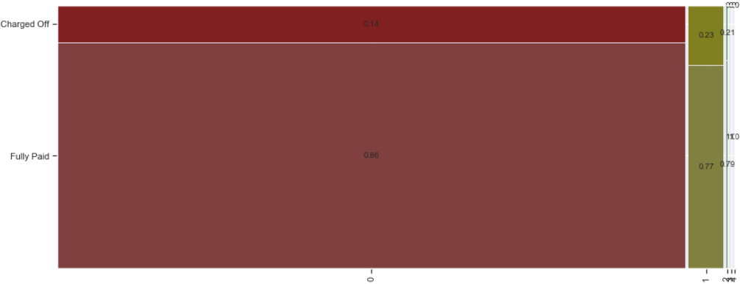
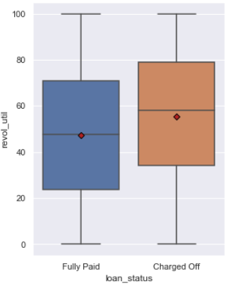
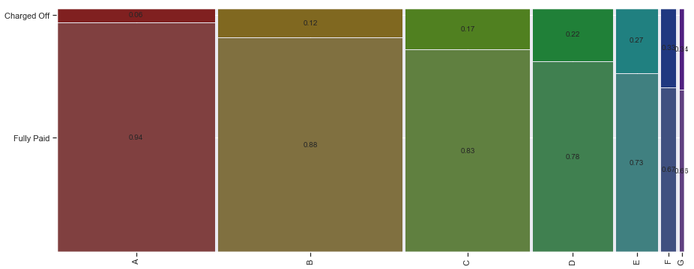
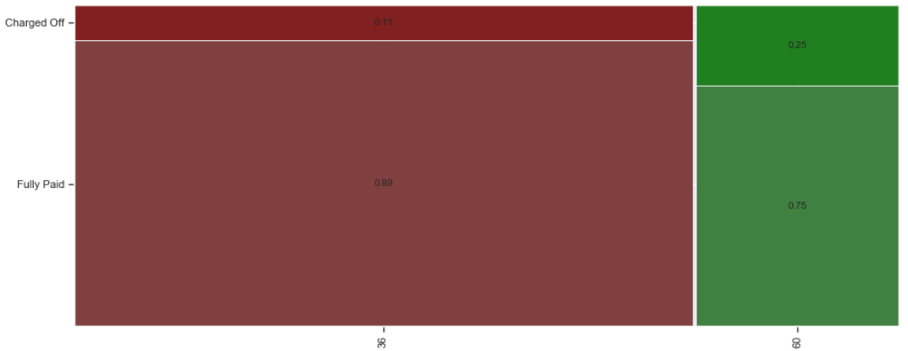
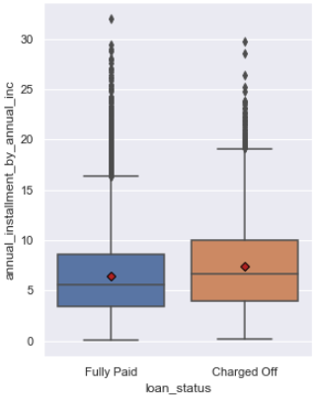
Conclusion & Recommendation
We believe the following variables impact the loan status (Charged off/Fully paid) the most
annual_inc : Lesser annual income leads to more defaults
pub_rec / pub_rec_bankruptcies :Number of derogatory public records: we found that if there is a record of derogatory public records present for a loan applicant that substantially increases the tendency for default.
Term : The number of payments on the loan: higher terms lead to more defaults.
revol_util : Revolving line utilization rate, or the amount of credit the borrower is using relative to all available revolving credit: We found that there is an increase in tendency to default in case the revol_util increased
Grade / sub_grade: Grade / sub_grade is assigned by the lending club as per the loan / customer attributes. As grade moves from A to G, the propensity of default increases.
annual_installment over annual_income : This refers to the capacity of an individual to pay for the loan, we see that if the value when less gives rises to defaults
Customer
Loan
Derived
annual_inc : The distribution of charged off loans is more for lesser annual income
pub_rec / pub_rec_bankruptcies : As the number of pub_rec/bankruptcies increase, there is an increase in charged off loans, proportionally
Grade / sub_grade: As grade moves from A to G, the propensity of default increases
annual_installment over annual_income : The mean + median for Fully paid and charged off loans is very different in this derived matrix
Term : The number of payments on the loan: higher terms lead to more defaults. For 60 months the charged off proportion is high
revol_util: there is difference between mean + median for charged off and fully paid loans when revol_util is segmented, this if further proven statistically
Recommendation : increase the interest rate /lower the funded amount /reduce loan term for above cases

Slide 8
Data Analysis: Other Impacting Variables
Below variables also impact the loan status (Charged off/Fully paid) the most.
These can be looked upon at lower priority but needs attention.
Employee Length [emp_length]: There is a possibility of default where the customer is not employed (‘NA’) or have experience >10 years
Earliest credit line [earliest_cr_line]: The month the borrower's earliest reported credit line was opened : charged off proportion increasing from 2004
Customer
Purpose [purpose]: Few purposes for loan have a higher tendency for default like small business, renewable energy, education and others. This might be due to risk associated with these ventures.
inq_last_6mths : The number of inquiries in past 6 months (excluding auto and mortgage inquiries) : The number of inquiries in past 6 months: we found that tendency to default increases as number of inquiries in past 6 months increases beyond 2, this suggests an evidence of 'credit seeking behavior' on part of loan applicant.
Loan
loan_amount_by_annual_inc : We can conclude higher the ration between loan_amount and annual_inc higher the chances for customer to default
surplus_amount_per_month : As the surplus amount reduces , the propensity to default increases
Issue Month / Year : We observe that there is a spike in the % of Charged Off loan which are issued towards ed of the yearly cycle (Dec) and whenever the volume increases. The process of loan approval could be made better even while chasing volume . This is not controlled by approver and hence not a significant variable.
Credit Line issue year: A significant drop is seen in quality of loans for customers who were given credit line after 2004. The company may want to review the process and the credit line.
Derived

