Slide 1
Exam Review
Networking
CS 3470, Section 1
Sarah Diesburg

Slide 2
Coverage
Total: 80 raw points
  Based on lectures, assignments, and projects
  Based on your ability to apply various principles learned in the class
Multiple choice, short answer, and problem solving questions
Percentage of points earned will be multiplied to percentage of 200 points as stated on syllabus

Slide 3
Coverage
Two parts
  Chapters 5-6 (last third of class)
    Roughly 2/3 of test
  Cumulative (over first 2/3 of class, exams 1-2)
    Roughly 1/3 of test

Slide 4
Chapters 5-6
Review

Slide 5
Transport Layer
Definitions
  Transport layer
    What is the primary function?
    Why is it necessary (say on top of IP)?
  Packet Encapsulation
    Layer headers are added or taken away
  Multiplexing/demultiplexing

Slide 6
Transport Layer
Definitions
  TCP socket
    Identified by 4-tuple (IP src, IP dest, port src, port dest)
  UDP socket
    Identified by 2-tuple (IP dst, IP port)
  Pseudoheader
  Flow control
  Congestion control

Slide 7
Transport Layer
  Segments
    Packets exchanged between TCP peers
  TCP flags
    SYN, ACK, FIN, RST

Slide 8
Transport Layer
Short answer / problem solving
  UDP advantages over TCP
  TCP advantages over UDP
  Checksum with 1’s compliment
  Byzantine Generals’ problem

Slide 9
DNS
Definitions
  What is DNS?
  Host aliasing
    Multiple names for one server
  MX records
  Load balancing
    Many IP addresses associated with a hostname
  Canonical name

Slide 10
DNS
Short answers / problem solving
  Role of a root DNS server
  Role of a top-level domain (TLD) server
  Be able to create and identify iterative and recursive DNS queries
  Role of DHCP and DNS

Slide 11
TCP Control Flow
Definitions
  Sequence number field (often called SequenceNum)
  Passive open
  Active open
  Maximum Segment Lifetime (TCP)

Slide 12
TCP Control Flow
Short answers / problem solving
  TCP 3-way handshake
  Goals of TCP sliding window
  AdvertisedWindow/EffectiveWindow (see next slide)
  TCP tear down sequence

Slide 13
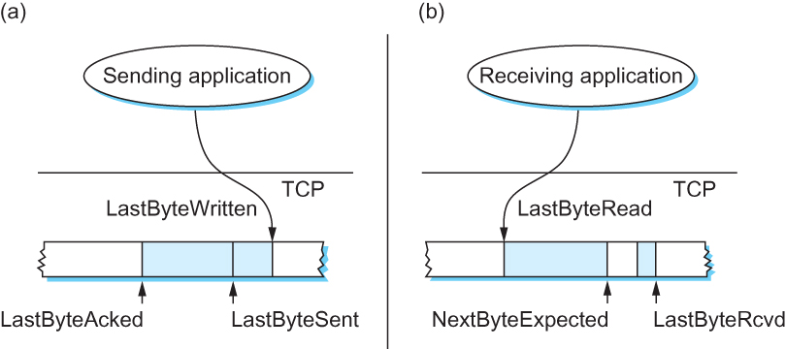
Sliding Window Revisited
Sender
Receiver
Be able to look at a sliding window diagram and show me the AdvertisedWindow (on receiver) and EffectiveWindow (on sender)

Slide 14
TCP Transmission Control
Definitions
  Silly window syndrome
  Fast retransmit (3 duplicate ACKs)
  Nagle’s Algorithm
    Generally, what does it do?
  Adaptive Retransmission
    Generally, what does it do?

Slide 15
TCP Transmission Control
Short answer / problem solving
  3 ways TCP triggers a transmission
    MSS
    Explicit send
    Timer
  TCP cumulative ACKs

Slide 16
TCP Congestion Control
Definitions
  Congestion window (or CongWin)
  TCP loss event
    Why do we care about losses?
    Timeout or 3 duplicate ACKs
  Additive Increase/Multiplicative Decrease (AIMD)
  Slow Start
  Fast Recovery

Slide 17
TCP Congestion Control
Short answers / problem solving
  Explain how AIMD and slow start work
  Explain how fast recovery works
  Explain how TCP is fair
    Is all traffic fair?
  Homework 8-9, questions 5-6

Slide 18
Summary: TCP Congestion Control
When CongWin is below Threshold, sender in slow-start phase, window grows exponentially.
When CongWin is above Threshold, sender is in congestion-avoidance phase, window grows linearly.
When a triple duplicate ACK occurs, Threshold set to CongWin/2 and CongWin set to Threshold.
When timeout occurs, Threshold set to CongWin/2 and CongWin is set to 1 MSS.

Slide 19
Programming Project
What does a pipe (“|”) and redirection (“>” or “<“) do?

Slide 20
Putting it all together
Review

Slide 21
Putting it all together
Wireshark
  I may paste a screenshot of a Wireshark trace and ask you a few questions about it
  Review project 5 to prepare

Slide 22
Putting it all together
Definitions
  Review definitions and general concepts from previous reviews and old tests

Slide 23
Putting it all together
The following problem-solving questions may show up on the final from previous tests:
  Calculate the total time required to transfer a file (recall the definition of latency)
  NRZ, Manchester, and NRZI encodings
  2-Dimensional Parity

Slide 24
Putting it all together
  Drawing windows in the sliding window protocol
  ISO/OSI vs Internet Model
  Determining next hop for a CIDR network
  Dijkstra's algorithm
  Spanning tree
  Creating subnets and/or determining the next hop (CIDR forwarding)

