Slide 1
daRIEUnaruto
Bùi Thế Sáng – ITITIU19046
Trương Công Trung – ITITIU19059

Slide 2
About
Game rules
Game play
Networking
UML Diagrams

Slide 3
Game rules
This is a type-based 1v1 street fighting game in which players will have to type a combination of keys in order to use skills. Each skill has its own graphics, element type, and a set of combination of keys.
The game will end when one of the players being taken down (out of blood)

Slide 4
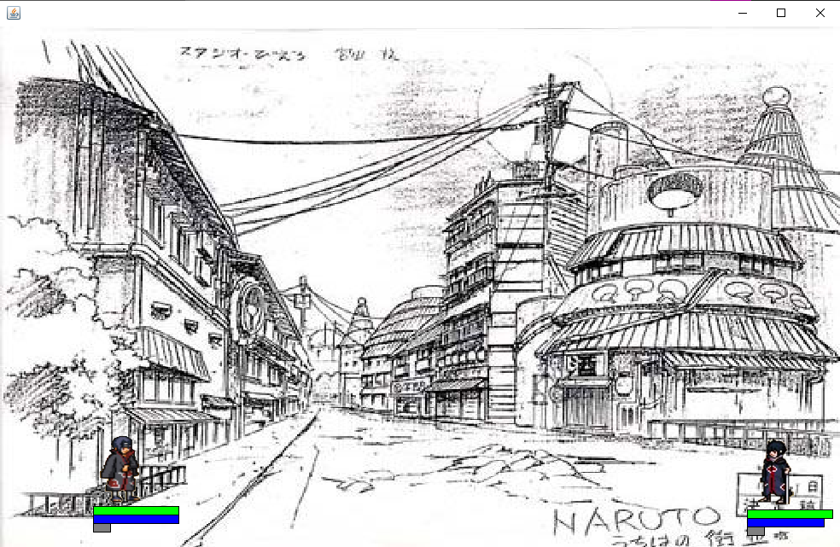
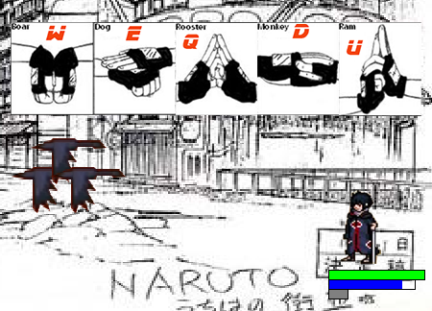
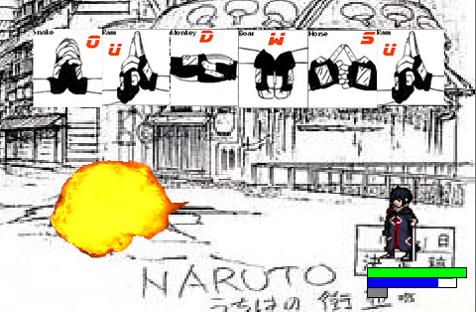
Game play
Notes:
White chess will be Trapped between the new and old black chess

Slide 5
Networking

Slide 6
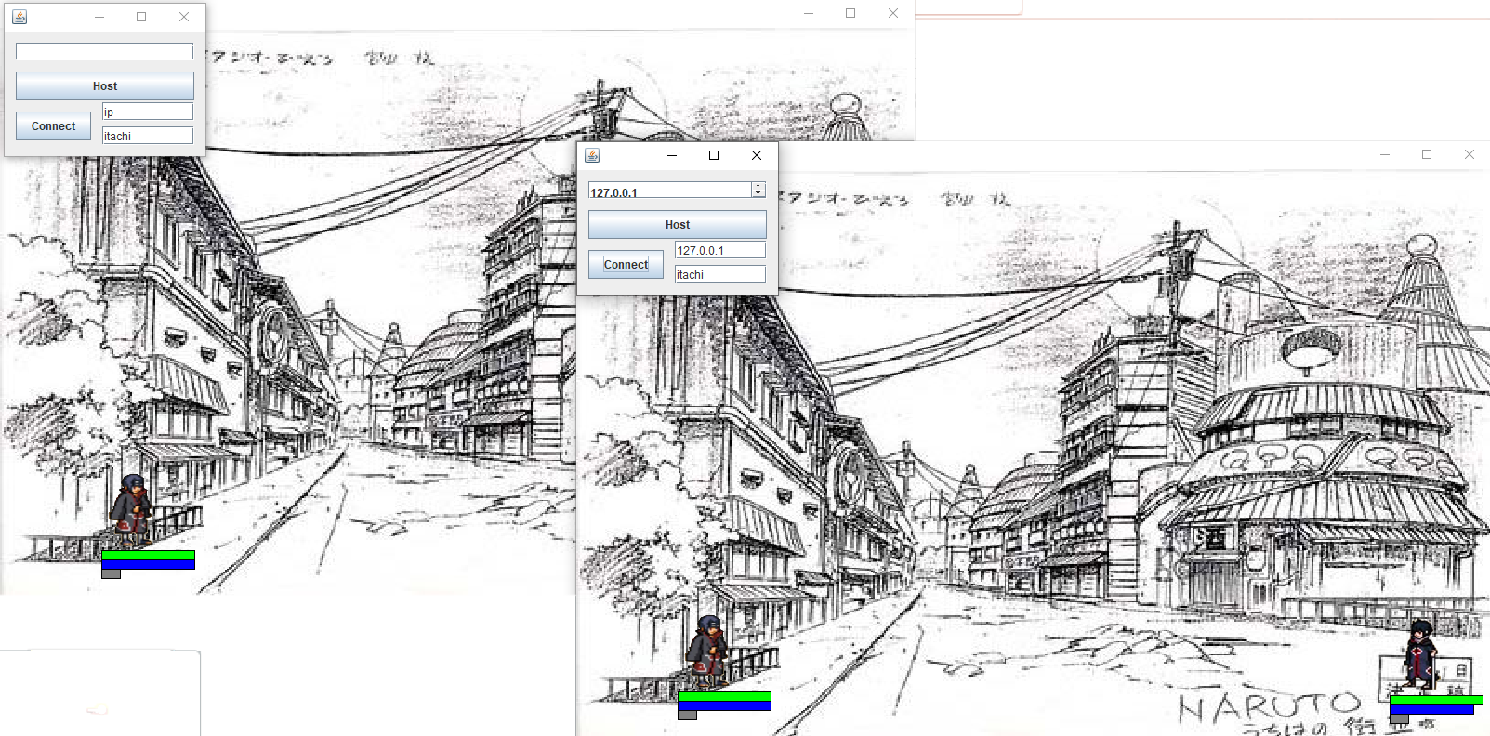

Slide 7
Publish
&
Subscribe
Technology used in the project
Swing
AWT

Slide 8
Library and Package
Painting on the Frame, Panel:
import javax.swing.JFrame;
import javax.swing.JPanel;
import javax.imageio.ImageIO;
import java.awt.image.BufferedImage;
For Exception:
import java.io.IOException;
For Handling Game action and Keyboard
import java.awt.event.ActionEvent;
import java.awt.event.ActionListener;
import java.awt.event.KeyEvent;
import java.awt.event.KeyListener;
For calling threat by time :
import javax.swing.Timer;

Slide 9
UML Diagrams

Slide 10
Lessons from this project
Difficulty
Future Features

