Slide 1
적록색약

Slide 2
import sys
sys.setrecursionlimit(100000)
N = int(sys.stdin.readline())
grid = [list(sys.stdin.readline()) for _ in range(N)]
visited = [[False for col in range(N)] for row in range(N)]

Slide 3
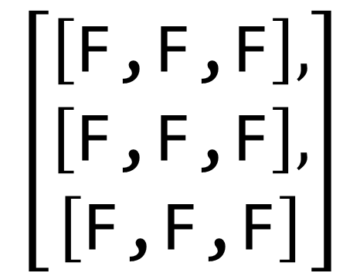
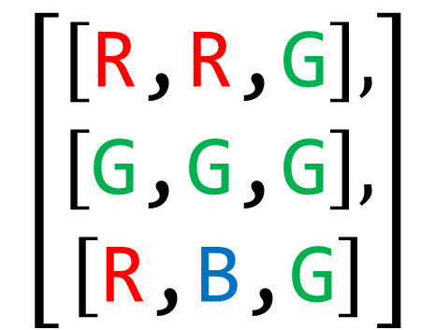
# 상하좌우
dx = [0,0,1,-1]
dy = [1,-1,0,0]
# dfs : 같은 색으로 이루어진 구역을 다 visit
def dfs(x, y, color):
visited[x][y] = True
for i in range(4):
nx = x+dx[i]
ny = y+dy[i]
if (0<=nx<N) and (0<=ny<N) and not visited[nx][ny] and grid[nx][ny]==color:
dfs(nx, ny, color)
$$\left[\begin{aligned}\left[\text{F}\text{,}\text{F}\text{,}\text{F}\right], \\ \left[\text{F}\text{,}\text{F}\text{,}\text{F}\right], \\ \left[\text{F}\text{,}\text{F}\text{,}\text{F}\right]\end{aligned}\right]$$
$$\left[\begin{aligned}\left[\text{R}\text{,}\text{R}\text{,}\text{G}\right], \\ \left[\text{G}\text{,}\text{G}\text{,}\text{G}\right], \\ \left[\text{R}\text{,}\text{B}\text{,}\text{G}\right]\end{aligned}\right]$$
i=0, j=0, dfs(0,0,grid[0][0]) -> cnt =1
i=0, j=2, dfs(0,2,grid[0][2]) -> cnt =2
i=2, j=0, dfs(2,1,grid[2][1]) -> cnt =3
i=2, j=1, dfs(2,1,grid[2][1]) -> cnt =4
# 정상인
cnt = 0
for i in range(N):
for j in range(N):
if not visited[i][j]:
dfs(i,j, grid[i][j])
cnt += 1
print(cnt, end=' ')

Slide 4
# 적록색약
# R과 G의 색이 같으므로 G -> R로 변경
for i in range(N):
for j in range(N):
if grid[i][j] == 'G':
grid[i][j] = 'R'
cnt = 0
visited = [[0 for col in range(N)] for row in range(N)]
for i in range(N):
for j in range(N):
if not visited[i][j]:
dfs(i,j, grid[i][j])
cnt += 1
print(cnt)

