Slide 1
Programming using Python
File I/O

Slide 2
File I/O
Files are persistent storage
Allow data to be stored beyond program lifetime
The basic operations on files are
open, close, read, write
Python treat files as sequence of lines
sequence operations work for the data read from files

Slide 3
File I/O: open and close
open(filename, mode)
While opening a file, you need to supply
The name of the file, including the path
The mode in which you want to open a file
Common modes are r (read), w (write), a (append)
Mode is optional, defaults to r
open(..) returns a file object
close() on the file object closes the file
finishes any buffered operations

Slide 4
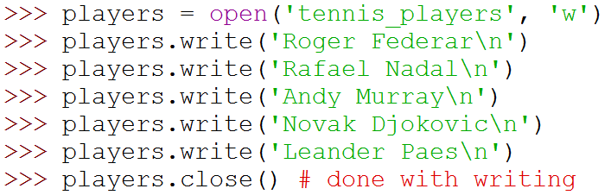
File I/O: Example
Do some writing
How to do it?
see the next few slides

Slide 5
File I/O: read, write and append
Reading from an open file returns the contents of the file
as sequence of lines in the program
Writing to a file
IMPORTANT: If opened with mode 'w', clears the existing contents of the file
Use append mode ('a') to preserve the contents
Writing happens at the end

Slide 6
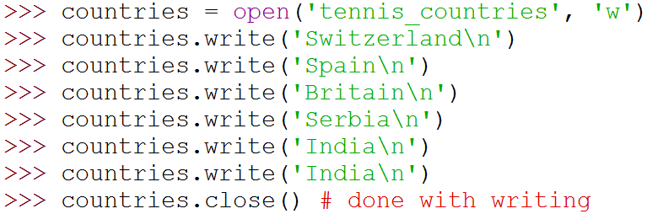
File I/O: Examples

Slide 7
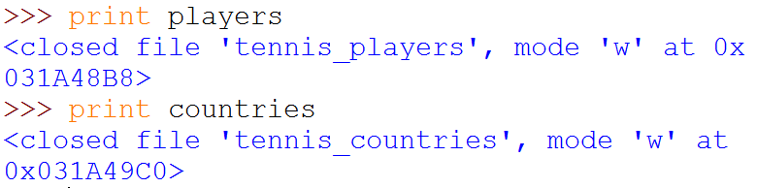
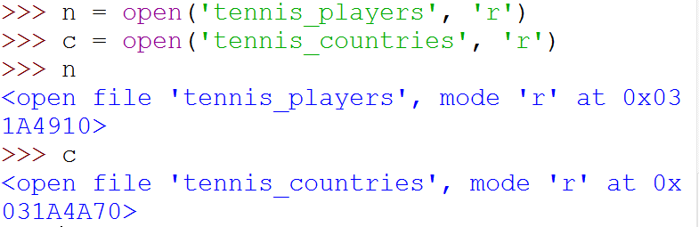
File I/O: Examples
(
)
(
)

Slide 8
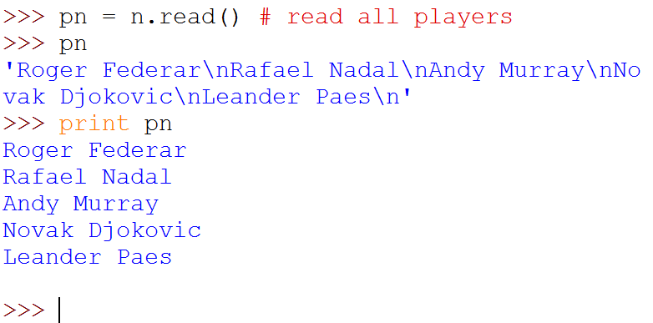

File I/O: Examples
(
)
Note empty line due to '\n'

Slide 9
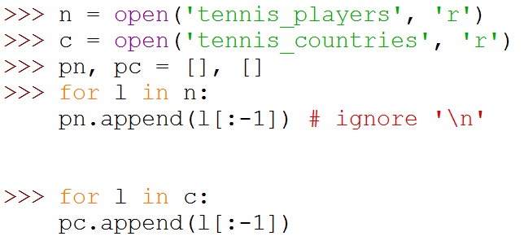

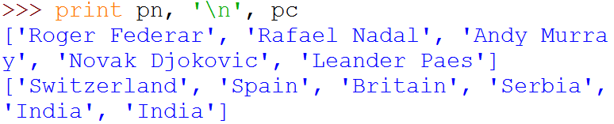
File I/O: Examples
Note the use of for ... in
for sequence
(
)
]

Slide 10
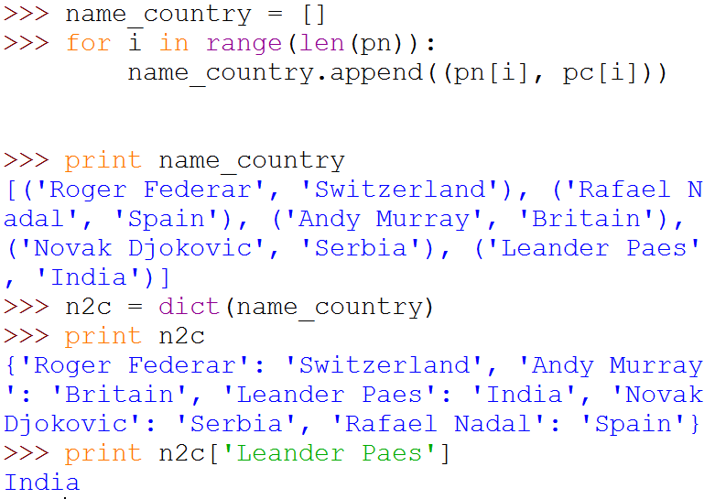
File I/O: Examples
(
)
(
)
(
)

Slide 11
Programming using Python
Modules and Packages

Slide 12
Modules
As program gets longer, need to organize them for easier access and easier maintenance.
Reuse same functions across programs without copying its definition into each program.
Python allows putting definitions in a file
use them in a script or in an interactive instance of the interpreter
Such a file is called a module
definitions from a module can be imported into other modules or into the main module

Slide 13
Modules
A module is a file containing Python definitions and statements.
The file name is the module name with the suffix .py appended.
Within a module, the module’s name is available in the global variable __name__.

Slide 14
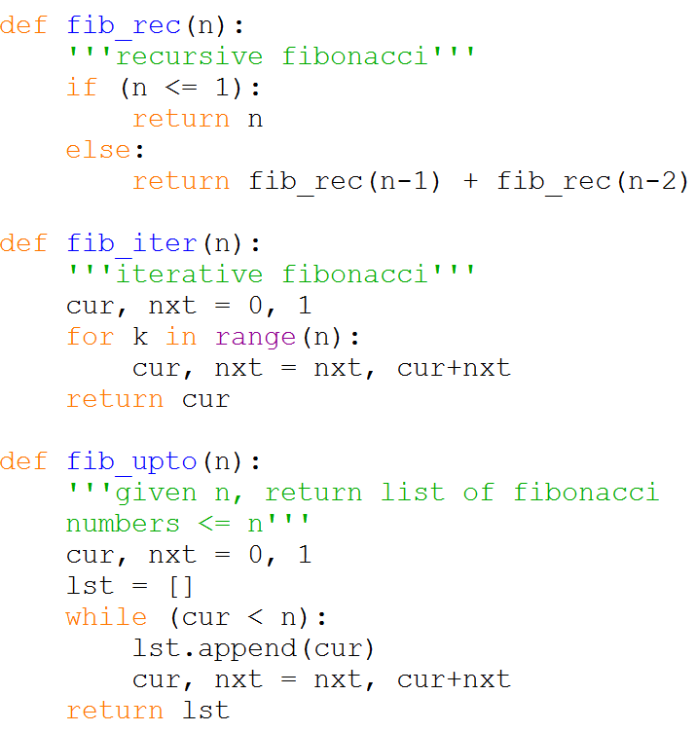
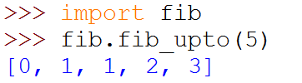
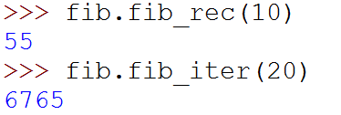

Modules Example
Within a module, the module’s name is available as the value of the global variable __name__.

Slide 15
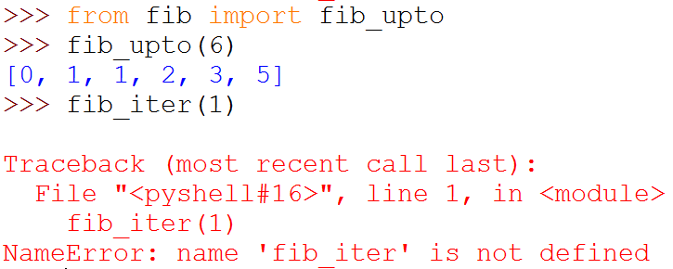
Importing Specific Functions
To import specific functions from a module
This brings only the imported functions in the current symbol table
No need of modulename. (absence of fib. in the example)

Slide 16
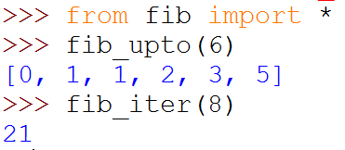
Importing ALL Functions
To import all functions from a module, in the current symbol table
This imports all names except those beginning with an underscore (_).

Slide 17
__main__ in Modules
When you run a module on the command line with
python fib.py <arguments>
the code in the module will be executed, just as if you imported it, but with the __name__ set to
"__main__".
By adding this code at the end of your module
if __name__ == "__main__":
... # Some code here
you can make the file usable as a script as well as an importable module

Slide 18
__main__ in Modules
if __name__ == "__main__":
import sys
print(fib_iter(int(sys.argv[1])))
This code parses the command line only if the module is executed as the “main” file:
$ python fib.py 10
55
If the module is imported, the code is not run:
>>> import fib
>>>

Slide 19
Package
A Python package is a collection of Python modules.
Another level of organization.
Packages are a way of structuring Python’s module namespace by using dotted module names.
The module name A.B designates a submodule named B in a package named A.
The use of dotted module names saves the authors of multi-module packages like NumPy or Pillow from having to worry about each other’s module names.

Slide 20
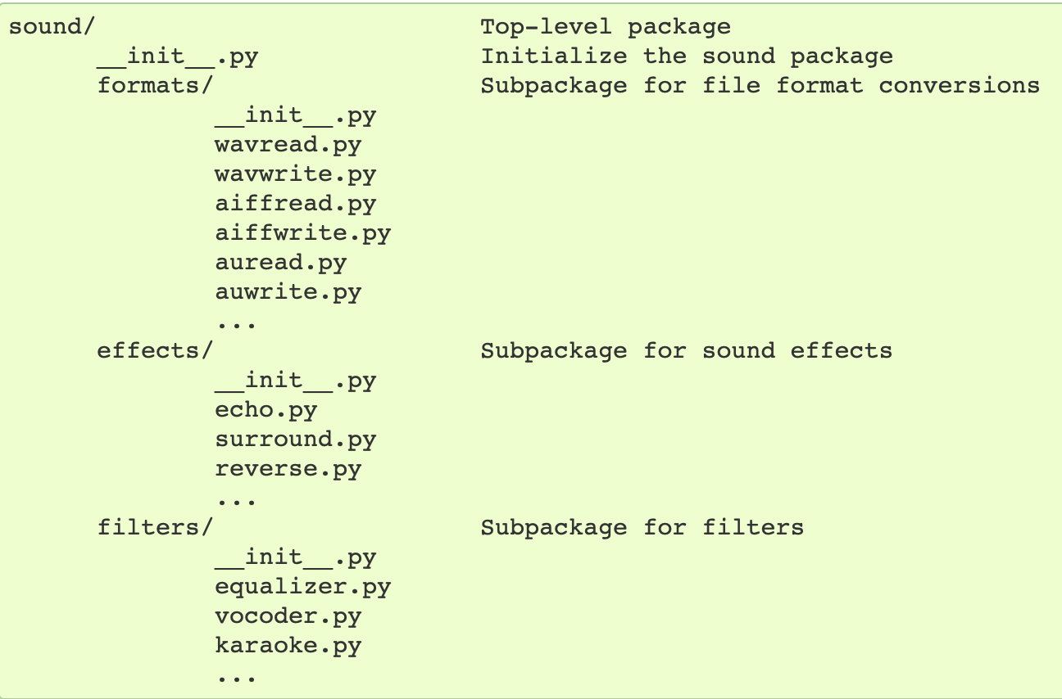
A sound Package
https://docs.python.org/3/tutorial/modules.html

Slide 21
A sound Package
What are these files with funny names?
https://docs.python.org/3/tutorial/modules.html

Slide 22
__init.py__
The __init__.py files are required to make Python treat directories containing the file as packages.
This prevents directories with a common name, such as string, unintentionally hiding valid modules that occur later on the module search path.
__init__.py can just be an empty file
It can also execute initialization code for the package

Slide 23
Importing Modules from Packages
https://docs.python.org/3/tutorial/modules.html

Slide 24
Importing Modules from Packages
import sound.effects.echo
Loads the submodule sound.effects.echo
It must be referenced with its full name:
sound.effects.echo.echofilter(
input, output,
delay=0.7, atten=4
)

Slide 25
Importing Modules from Packages
from sound.effects import echo
This also loads the submodule echo
Makes it available without package prefix
It can be used as:
echo.echofilter(
input, output,
delay=0.7, atten=4
)

Slide 26
Importing Modules from Packages
from sound.effects.echo import echofilter
This loads the submodule echo, but this makes its function echofilter() directly available.
echofilter(input, output,
delay=0.7, atten=4)

Slide 27
Popular Packages
pandas, numpy, scipy, matplotlib, …
Provide a lot of useful functions
Notes:
https://pandas.pydata.org/pandas-docs/stable/getting_started/tutorials.html

