Slide 1
Practical Machine Learning
Week 5. Recurrent Neural Network
Jessee Kung

Slide 2
Outline
Overview
Lab1. Pre-processing for Text Data
Lab2. Long Short-Term Memory
  Spam Message Classification
Lab3. Sequence-to-Sequence Autoencoder
  English to French Translation

Slide 3
Overview

Slide 4

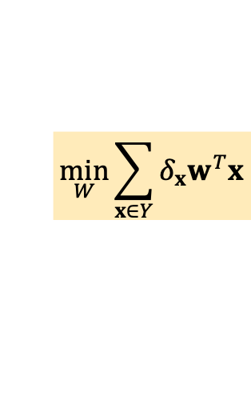

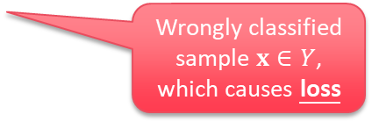
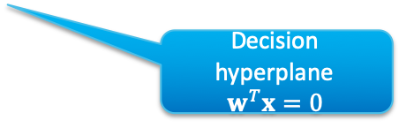
Neural Network
Perceptron
  Learning a model with the weights (experiences) similar to training data
For prediction:
  Evaluate the similarity
Wrongly classified sample $x∈Y$, which causes loss
$$y=w^{T}x$$
For training:
  Minimize the loss
Decision hyperplane
$$w^{T}x=0$$
$$\min_{W}{\sum_{x∈Y}{δ_{x}w^{T}x}}$$
Set of wrongly classified samples
Model weights $w$

Slide 5



Real-World Data: Sequences and States
Problem:
  A lot of real-world data is expressed by variable-length sequences
Spam detection
Fraud detection
Phishing detection
…
Machine Translation
Question answering
…
Paper clustering
News clustering
Email clustering
…
International
Politics
See you on 7pm! → normal
You got a new iphone! → Fraud
Hope you‘re doing great → normal
It’s my pleasure! → normal
Payment changed to 1234 → Fraud
...
Thanks. → Merci!
I agree. → Je suis du même avis.
See you. → À plus.
I'm lucky. → Je suis veinard.
Well done! → Bien vu !
...
Sports
Sequences classification
Sequences generation
(Sequence to Sequence Autoencoder)
Sequences clustering

Slide 6



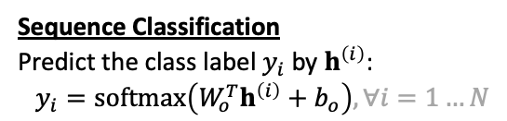





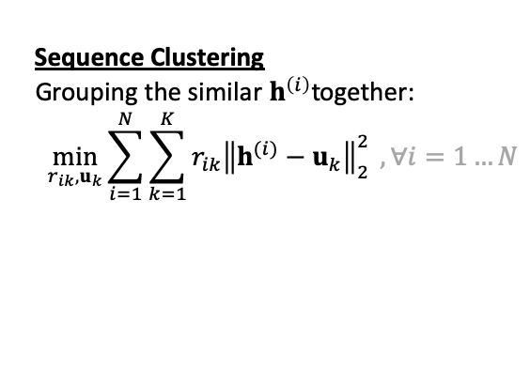


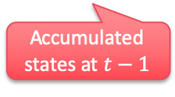


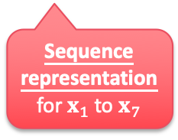



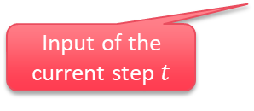






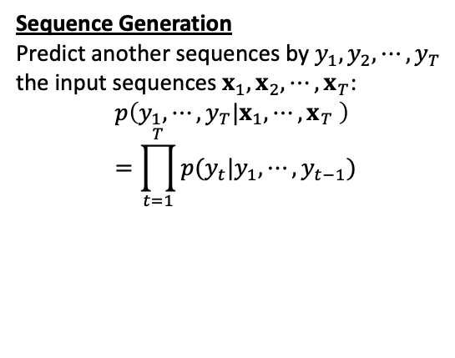
Sequence Learning
Goal:
  Find representation from its contexts
  Basic recurrent model:
Sequence Clustering
Grouping the similar $h^{\left(i\right)}$together:
$$\min_{r_{ik},u_{k}}{\sum_{i=1}^{N}{\sum_{k=1}^{K}{r_{ik}{\left\|h^{(i)}−u_{k}\right\|}_{2}^{2}}} },∀i=1…N$$
$$h_{t}=f_{i}\left(x_{t},h_{t−1}\right)$$
Input of the current step $t$
Accumulated states at $t−1$
$$h_{7}$$
Sequence Classification
Predict the class label $y_{i}$ by $h^{\left(i\right)}$:
$$y_{i}=softmax\left(W_{o}^{T}h^{\left(i\right)}+b_{o}\right),∀i=1…N$$
$$f_{i}$$
$$h_{1}$$
$$f_{i}$$
$$h_{2}$$
$$f_{i}$$
$$h_{3}$$
$$f_{i}$$
$$h_{4}$$
$$f_{i}$$
$$h_{5}$$
$$f_{i}$$
$$h_{6}$$
$$f_{i}$$
$$h_{7}$$
$$x_{1}$$
$$x_{2}$$
$$x_{3}$$
$$x_{4}$$
$$x_{5}$$
$$x_{6}$$
$$x_{7}$$
Sequence Generation
Predict another sequences by $y_{1},y_{2},⋯,y_{T}$ the input sequences $x_{1},x_{2},⋯,x_{T}$:
$$p\left(y_{1},⋯,y_{T}|x_{1},⋯,x_{T} \right)=\prod_{t=1}^{T}{p(y_{t}|y_{1},⋯,y_{t−1})}$$
Sequence representation for $x_{1}$ to $x_{7}$
Hi
1
I
2
need
3
a
4
ticket
5
to
6
Taipei
7
t =

Slide 7
Lab 1. Pre-processing for Text Data

Slide 8
Steps
Word Splitting
Tokenization
Sequence Padding
Embedding

Slide 9
Word Splitting
Illustration:
  Which can be done via tf.keras.text.text_to_word_sequence
  Typically, the steps including:
    Remove stop words and symbols
    Convert word to lower case
    Split stentence into separated words
Convolutional networks are at the core of most state-of-the-art computer vision solutions for a wide variety of tasks.
['convolutional', 'networks', 'are', 'at', 'the', 'core', 'of', 'most', 'state', 'of', 'the', 'art', 'computer', 'vision', 'solutions', 'for', 'a', 'wide', 'variety', 'of', 'tasks']

Slide 10
Word Splitting
To separate words sequences:
  English is natively well separated by ,.?!()~- ., etc.
    Use regular expression for clean-up, e.g.;
    Use keras.preprocessing.text.text_to_word_sequence for word splitting:
  For sentences formed by CJK characters: still a hard task
    CKIP by Academic Sinica
    https://github.com/ckiplab/ckiptagger
    Jieba
    https://github.com/ldkrsi/jieba-zh_TW
text = re.sub(r'(\<[a-zA-Z\s]+(\/)?\>)|[\'\"\\]', ' ', text_raw).lower()
arr = text.text_to_word_sequence(text)

Slide 11
Tokenization
To compute the top K-words in dataset:
  Use keras.preprocessing.text.Tokenizer
  Parameters:
    num_words: The maximum number of words to keep
      With the rest of words left as un-recognized tokens specified by oov_token
      Usually one can set num_words ~ 20000 as common words
  To encode string-based sequence to integer-based sequence:
tokenizer = Tokenizer(oov_token='UNK', num_words=MAX_NUM_DICT_WORDS + 1)
tokenizer.fit_on_texts(X_str)
X = tokenizer.texts_to_sequences(X_str)

Slide 12
Sequence Padding
Deep learning frameworks working relies on batch processing
  A fixed-length sequence data can be helpful
Steps:
  Convert string-based sequence to integer-cased sequence first:
  Use tf.keras.preprocessing.sequence.pad_sequence adjusting sentence to same length
How do you turn this on? → [365, 2, 644, 87, 959, 512]
[365, 2, 644, 87, 959, 512] → [0, 0, 0, 0, 365, 2, 644, 87, 959, 512]
Prepend 0 to a fixed length 10 in this case
[365, 2, 644, 87, 959, 512] → [365, 2, 644, 87, 959, 512, 0, 0, 0, 0]
Append 0 to a fixed length 10 in this case

Slide 13
Embedding
Before learning from sequences:
  Convert tokens and states into embedded spaces:
    Semantics of tokens should be reflected by its positions
    Tokens with similar semantic meanings should be closed to each other
Word Embedding Model:
  Word2Vec, GloVe and FastText ., etc.
Windows
Ubuntu
Linux
macOS
FreeBSD
iOS
Android
hamburger
ice tea
pizza
apple pie
juice
beer
soda
apple
tea
sprites
guava
juice
salads
banana
grapes
fries
wine
potato
['convolutional', 'networks', 'core', 'state', ...] →
0.75
0.86
0.25
0.00
0.10
0.03
0.40
0.88
0.76
0.10
0.31
0.02
0.92
0.95
0.77
0.10
0.07
0.03
0.15
0.18
0.01
1.00
0.95
0.94
0.02
0.25
0.00
0.93
0.93
0.96
0.01
0.05
0.89
0.80
0.02
1.00
$$x_{1}$$
$$x_{2}$$
$$x_{3}$$
$$x_{4}$$
$$x_{5}$$
$$x_{6}$$

Slide 14
Embedding
Option 1:
  Use external data for Word Embedding
    Convert top K-words to pre-trained word vectors, e.g.,:
      GloVe
      http://nlp.stanford.edu/projects/glove/
      Gensim Word2Vec
      https://radimrehurek.com/gensim/models/word2vec.html
    Use keras.layers.embeddings.Embedding as the first layer before LSTM
      With embeddings_initializer assigned and set trainable=False
Option 2:
  Use self-trained Word Embedding
    Use keras.layers.embeddings.Embedding as the first layer before LSTM

Slide 15
Lab 2. Long Short-Term Memory
Spam Message Classification

Slide 16





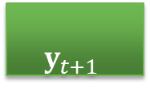






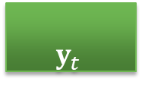













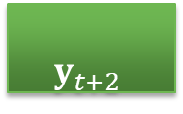

Recurrent Neural Network – Example: Slot Filling Problem
Basic idea of RNN:
  $x_{t}$: Input word vector at time $t$
  $h_{t−1}$: Hidden State
    Something like historical reference
  $y_{t}$: Output probability for each slot
    e.g., Destination or Arrival Time
Destination
Arrival Time
…
…
…
$$y_{t}$$
$$y_{t+1}$$
$$y_{t+2}$$
0.12
0.68
0.06
0.01
0.04
0.03
0.72
0.12
0.01
$$h_{t−1}$$
$$h_{t}$$
$$h_{t+1}$$
$$x_{t}$$
$$x_{t+1}$$
$$x_{t+2}$$
I would like to arrive Taipei on November 2nd
$$\begin{matrix}1.0 \\ 0.92 \\ \begin{aligned}0.4 \\ … \\ 0.3 \\ …\end{aligned}\end{matrix}$$
$$\begin{matrix}0.72 \\ 0.65 \\ \begin{aligned}0 \\ … \\ 0.3 \\ …\end{aligned}\end{matrix}$$
$$\begin{matrix}0.01 \\ 0.05 \\ \begin{aligned}0.98 \\ … \\ 0.96 \\ …\end{aligned}\end{matrix}$$
$$\begin{matrix}0.92 \\ 0.5 \\ \begin{aligned}1.0 \\ … \\ 0.36 \\ …\end{aligned}\end{matrix}$$
$$\begin{matrix}0.16 \\ 0.18 \\ \begin{aligned}0 \\ … \\ 0.45 \\ …\end{aligned}\end{matrix}$$
$$\begin{matrix}0.67 \\ 0.72 \\ \begin{aligned}0.5 \\ … \\ 1.0 \\ …\end{aligned}\end{matrix}$$
$$\begin{matrix}0.1 \\ 0.3 \\ \begin{aligned}1.0 \\ … \\ 0.15 \\ …\end{aligned}\end{matrix}$$
$$\begin{matrix}0.19 \\ 0.21 \\ \begin{aligned}0 \\ … \\ 1.0 \\ …\end{aligned}\end{matrix}$$
$$\begin{matrix}0.67 \\ 0.72 \\ \begin{aligned}0.5 \\ … \\ 1.0 \\ …\end{aligned}\end{matrix}$$
$$\begin{matrix}0.1 \\ 0.3 \\ \begin{aligned}1.0 \\ … \\ 0.15 \\ …\end{aligned}\end{matrix}$$
$$\begin{matrix}0.19 \\ 0.21 \\ \begin{aligned}0 \\ … \\ 1.0 \\ …\end{aligned}\end{matrix}$$
$$x_{1}$$
$$x_{2}$$
$$x_{3}$$
$$x_{4}$$
$$x_{5}$$
$$x_{6}$$
$$x_{7}$$
$$x_{8}$$
$$x_{6}$$
$$x_{7}$$
$$x_{8}$$

Slide 17





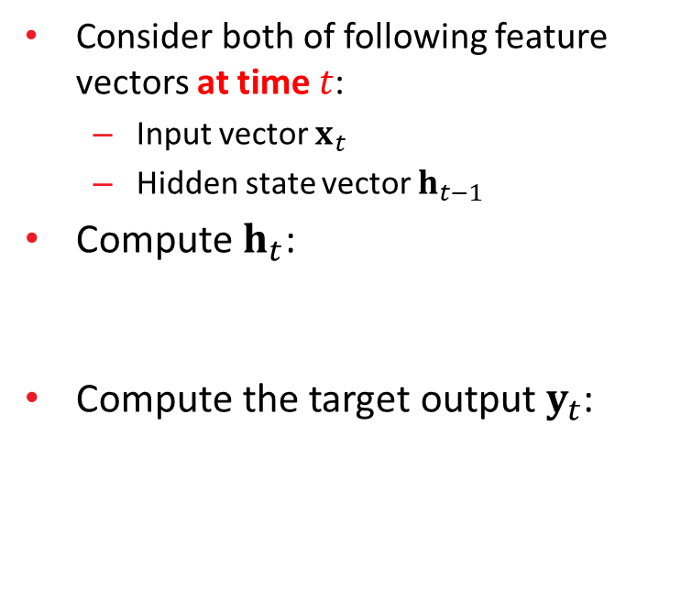






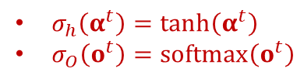
Recurrent Neural Network
Consider both of following feature vectors at time $t$:
  Input vector $x_{t}$
  Hidden state vector $h_{t−1}$
Compute $h_{t}$:
Compute the target output $y_{t}$:
$$y_{t}$$
$$W_{o}$$
+
$$b_{o}$$
$$h_{t}=σ_{h}\left(W_{i}x_{t}+W_{h}h_{t−1}+b_{i}\right)$$
$$h_{t}$$
$$W_{i}$$
+
$$W_{h}$$
+
$$b_{i}$$
$$y_{t}=σ_{o}\left(W_{o}h_{t}+b_{o}\right)$$
$$x_{t}$$
$$h_{t−1}$$
$σ_{h}\left(α^{t}\right)=\tanh\left(α^{t}\right)$
$σ_{O}\left(o^{t}\right)=\text{softmax}\left(o^{t}\right)$

Slide 18
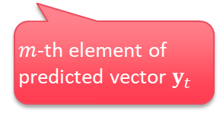


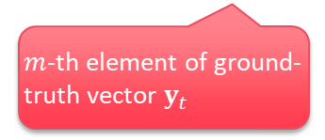

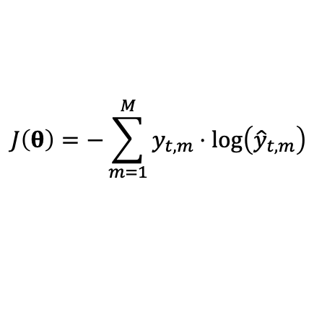



Recurrent Neural Network
Feed-forward (Predicting):
Cost function of Feed-forward:
  Multi-class LogLoss at time $t$:
$$y_{t}$$
$$h_{t}=σ_{h}\left(W_{i}x_{t}+W_{h}h_{t−1}+b_{i}\right)$$
$$y_{t}=σ_{o}\left(W_{o}h_{t}+b_{o}\right)$$
$$W_{o}$$
+
$$b_{o}$$
$$h_{t}$$
$$W_{i}$$
+
$$W_{h}$$
+
$$b_{i}$$
$$J\left(θ\right)=−\sum_{m=1}^{M}{y_{t,m}⋅\log\left({\hat{y}}_{t,m}\right)}$$
$$x_{t}$$
$$h_{t−1}$$
$m$-th element of ground- truth vector $y_{t}$
$m$-th element of predicted vector $y_{t}$
[1] (Section 10.2.2) Ian Goodfellow and Yoshua Bengio and Aaron Courville, "Deep Learning, " MIT Press, 2016. http://www.deeplearningbook.org/
[2] (Lecture Notes Part IV) Milad Mohammadi, Rohit Mundra, Richard Socher, CS224d: Deep Learning for Natural Language Processing, Stanford Univesity.
http://cs224d.stanford.edu/lecture_notes/notes4.pdf

Slide 19
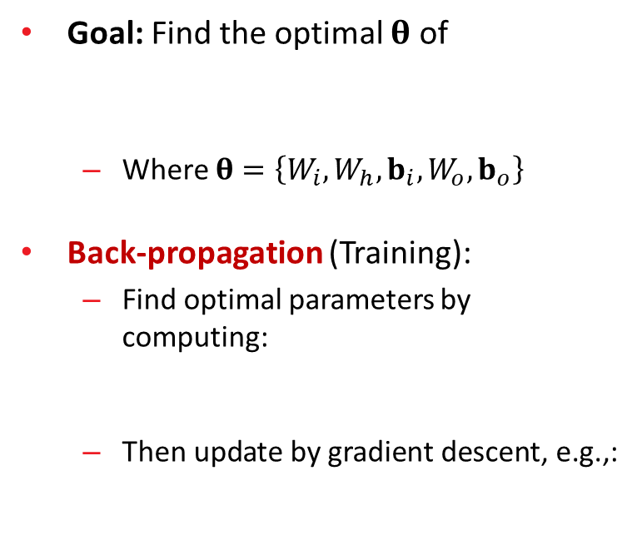


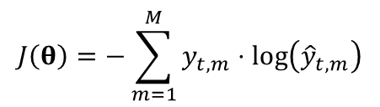
Recurrent Neural Network
Goal: Find the optimal $θ$ of
  Where $θ=\left\{W_{i},W_{h},b_{i},W_{o},b_{o}\right\}$
Back-propagation (Training):
  Find optimal parameters by computing:
  Then update by gradient descent, e.g.,:
$$J\left(θ\right)=−\sum_{m=1}^{M}{y_{t,m}⋅\log\left({\hat{y}}_{t,m}\right)}$$
$$y_{t}$$
$$W_{o}$$
+
$$b_{o}$$
$$h_{t}$$
$$W_{i}$$
+
$$W_{h}$$
+
$$b_{i}$$
$\frac{∂J}{∂W_{i}},\frac{∂J}{∂W_{h}}$, $\frac{∂J}{∂b_{i}}$, $\frac{∂J}{∂W_{o}}$ and $\frac{∂J}{∂b_{o}}$
$$x_{t}$$
$$h_{t−1}$$
$$W_{h}^{(t+1)}=W_{h}^{\left(t\right)}−μ⋅\frac{∂J\left(θ\right)}{∂W_{h}}$$
[1] (Section 10.2.2) Ian Goodfellow and Yoshua Bengio and Aaron Courville, "Deep Learning, " MIT Press, 2016. http://www.deeplearningbook.org/
[2] (Lecture Notes Part IV) Milad Mohammadi, Rohit Mundra, Richard Socher, CS224d: Deep Learning for Natural Language Processing, Stanford Univesity.
http://cs224d.stanford.edu/lecture_notes/notes4.pdf

Slide 20


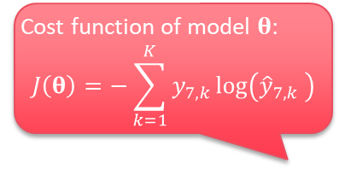







Long Short-Term Memory
Recurrent Neural Network (RNN):
  Gradient vanishing / exploding
  Cannot process long sequences
Cost function of model $θ$:
$$J\left(θ\right)=−\sum_{k=1}^{K}{y_{7,k}\log\left({\hat{y}}_{7,k} \right)}$$
$$h_{7}$$
$$f_{i}$$
$$h_{1}$$
$$f_{i}$$
$$h_{2}$$
$$f_{i}$$
$$h_{3}$$
$$f_{i}$$
$$h_{4}$$
$$f_{i}$$
$$h_{5}$$
$$f_{i}$$
$$h_{6}$$
$$f_{i}$$
$$h_{7}$$
$$x_{1}$$
$$x_{2}$$
$$x_{3}$$
$$x_{4}$$
$$x_{5}$$
$$x_{6}$$
$$x_{7}$$
Hi
1
I
2
need
3
a
4
ticket
5
to
6
Taipei
7
t =
$$\frac{∂J\left(θ\right)}{∂θ}=$$
$$\frac{∂h_{1}}{∂θ}×$$
$$\frac{∂h_{2}}{∂h_{1}}×$$
$$\frac{∂h_{3}}{∂h_{2}}×$$
$$\frac{∂h_{4}}{∂h_{3}}×$$
$$\frac{∂h_{5}}{∂h_{4}}×$$
$$\frac{∂h_{6}}{∂h_{5}}×$$
$$\frac{∂J(θ)}{∂h_{6}}$$
What happens if these are small / big values?

Slide 21
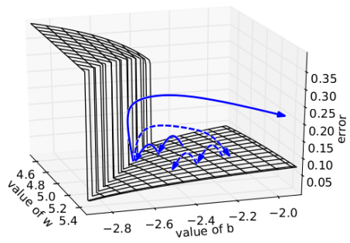
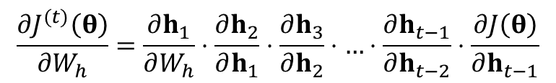



Vanishing and Exploding Gradient Problem
A more general example:
Recurrent Neural Network:
  Hard to be trained
  A Small change in $W_{h}$ causes big
  gradient changes
    Exploding gradient can be handled by clipping
$$\frac{{∂J}^{(t)}\left(θ\right)}{{∂W}_{h}}=\frac{∂h_{1}}{∂W_{h}}⋅\frac{∂h_{2}}{∂h_{1}}⋅\frac{∂h_{3}}{∂h_{2}}⋅…⋅\frac{∂h_{t−1}}{∂h_{t−2}}⋅\frac{∂J\left(θ\right)}{∂h_{t−1}}$$
${0.99}^{1000}=0.000043$
→ Vanishing gradient!
0.99
0.99
0.99
0.99
0.99
${1.01}^{1000}=20959.1556$
→ Exploding gradient!
1.01
1.01
1.01
1.01
1.01
[Pascanu et.al, 2012] Razvan Pascanu, Tomas Mikolov, Yoshua Bengio, "On the difficulty of training Recurrent Neural Networks", arXiv:1211.5063. https://arxiv.org/abs/1211.5063
[See et.al. 2019] Abigail See, Lecture 7: Vanishing Gradients and Fancy RNNs, CS224N Natual Language Processing, Stanford University.
http://web.stanford.edu/class/cs224n/slides/cs224n-2019-lecture07-fancy-rnn.pdf

Slide 22




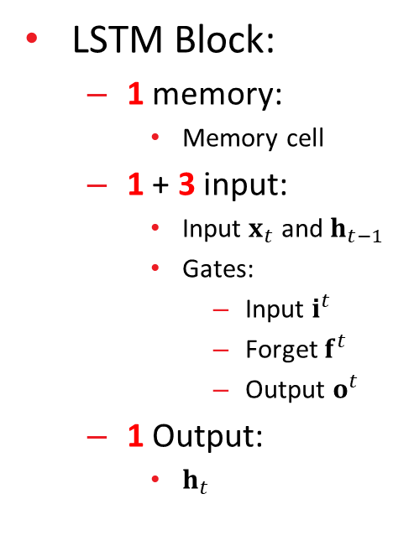




















Long Short-Term Memory Block
LSTM Block:
  1 memory:
    Memory cell
  1 + 3 input:
    Input $x_{t}$ and $h_{t−1}$
    Gates:
      Input $i^{t}$
      Forget $f^{t}$
      Output $o^{t}$
  1 Output:
    $h_{t}$
4
$$h_{t}$$
$$x_{t}$$
$$W_{o}$$
Control if the
output should
be by-passed
$$σ$$
Output Gate
$$h_{t−1}$$
$$b_{f}$$
$$W_{f}$$
$$R_{o}$$
$$b_{o}$$
$$g$$
$$x_{t}$$
Control if the
memory cell should be
forgotten
Memory Cell
Forget Gate
$$h_{t−1}$$
$$x_{t}$$
$$W_{i}$$
$$R_{f}$$
Control if the
input should
be by-passed
$$σ$$
Input Gate
3
$$h_{t−1}$$
$$R_{i}$$
$$b_{i}$$
$$g$$
$$b_{z}$$
2
$$W_{z}$$
$$R_{z}$$
$$x_{t}$$
$$h_{t−1}$$
1

Slide 23






Long Short-Term Memory Block
LSTM Block:
  Input
  Input/Forget/Output gate
  Memory cell
  Output
4
$$h_{t}$$
$$x_{t}$$
$$W_{o}$$
$$z^{t}=σ\left(W_{z}x^{t}+R_{z}h^{t−1}+b_{z}\right)$$
Output Gate
$$h_{t−1}$$
$$σ$$
$$b_{f}$$
$$W_{f}$$
$$R_{o}$$
$$b_{o}$$
$$g$$
$$x_{t}$$
$$i^{t}=σ\left(W_{i}x^{t}+R_{i}h^{t−1}+b_{i}\right)$$
Memory Cell
$$f^{t}=σ\left(W_{f}x^{t}+R_{f}h^{t−1}+b_{f}\right)$$
Forget Gate
$$h_{t−1}$$
$$o^{t}=σ\left(W_{o}x^{t}+R_{o}h^{t−1}+b_{o}\right)$$
$$x_{t}$$
$$W_{i}$$
$$R_{f}$$
$$σ$$
Input Gate
3
$$h_{t−1}$$
$$c^{t}=z^{t}⨀i^{t}+c^{t−1}⨀f^{t}$$
$$R_{i}$$
$$b_{i}$$
$$g$$
$$b_{z}$$
$$h^{t}=\tanh\left(c^{t}\right)⨀o^{t}$$
2
$$W_{z}$$
$$R_{z}$$
$$x_{t}$$
$$h_{t−1}$$
1
[1] (Section 10.10.1) Ian Goodfellow and Yoshua Bengio and Aaron Courville, "Deep Learning, " MIT Press, 2016. http://www.deeplearningbook.org/
[2] (Lecture Notes Part IV) Milad Mohammadi, Rohit Mundra, Richard Socher, CS224d: Deep Learning for Natural Language Processing, Stanford Univesity.
http://cs224d.stanford.edu/lecture_notes/notes4.pdf

Slide 24























LSTM – Intuitive Example
Example:
  LSTM model is trained for ticket booking
4
$$h_{t}$$
$$x_{t}$$
$$W_{o}$$
$$σ$$
Output Gate
$$h_{t}$$
$$g$$
$$b_{f}$$
$$W_{f}$$
$$R_{o}$$
$$b_{o}$$
$$x_{t}$$
Memory
Memory Cell
Forget Gate
$$h_{t}$$
$$x_{t}$$
$$W_{i}$$
$$R_{f}$$
Hi
$$c_{1}$$
$$z_{1}$$
$$c_{0}$$
Input Gate
3
=
+
$$h_{t}$$
$$σ$$
$$R_{i}$$
$$b_{i}$$
$$g$$
$$b_{z}$$
2
$$W_{z}$$
$$R_{z}$$
$$x_{t}$$
$$h_{t−1}$$
1
$$x_{1}$$
Hi , I need a ticket to Taipei
END

Slide 25





LSTM – Intuitive Example
Example:
  LSTM model is trained for ticket booking
4
$$h_{t}$$
$$x_{t}$$
$$W_{o}$$
$$σ$$
Output Gate
$$h_{t}$$
$$g$$
$$b_{f}$$
$$W_{f}$$
$$R_{o}$$
$$b_{o}$$
$$x_{t}$$
Memory
Memory Cell
Forget Gate
$$h_{t}$$
$$x_{t}$$
$$W_{i}$$
$$R_{f}$$
Hi
I
$$c_{1}$$
$$c_{2}$$
$$z_{2}$$
Input Gate
3
=
+
$$h_{t}$$
$$σ$$
$$R_{i}$$
$$b_{i}$$
$$g$$
$$b_{z}$$
2
$$W_{z}$$
$$R_{z}$$
$$\tanh\left(c^{1}\right)⨀o^{1}$$
$$x_{t}$$
$$h_{t−1}$$
1
$$x_{2}$$
$$h_{1}$$
Hi , I need a ticket to Taipei
END

Slide 26





LSTM – Intuitive Example
Example:
  LSTM model is trained for ticket booking
4
$$h_{t}$$
$$x_{t}$$
$$W_{o}$$
$$σ$$
Output Gate
$$h_{t}$$
$$g$$
$$b_{f}$$
$$W_{f}$$
$$R_{o}$$
$$b_{o}$$
$$x_{t}$$
Memory
Memory Cell
Forget Gate
$$h_{t}$$
$$x_{t}$$
$$W_{i}$$
$$R_{f}$$
I
need
$$c_{3}$$
$$c_{2}$$
$$z_{3}$$
Input Gate
3
=
+
$$h_{t}$$
$$σ$$
$$R_{i}$$
$$b_{i}$$
$$g$$
$$b_{z}$$
2
$$W_{z}$$
$$R_{z}$$
$$\tanh\left(c^{2}\right)⨀o^{2}$$
$$x_{t}$$
$$h_{t−1}$$
1
$$x_{3}$$
$$h_{2}$$
Hi , I need a ticket to Taipei
END

Slide 27





LSTM – Intuitive Example
Example:
  LSTM model is trained for ticket booking
4
$$h_{t}$$
$$x_{t}$$
$$W_{o}$$
$$σ$$
Output Gate
$$h_{t}$$
$$g$$
$$b_{f}$$
$$W_{f}$$
$$R_{o}$$
$$b_{o}$$
$$x_{t}$$
Memory
Memory Cell
Forget Gate
$$h_{t}$$
$$x_{t}$$
$$W_{i}$$
$$R_{f}$$
I
need
$$c_{4}$$
$$c_{3}$$
$$z_{4}$$
Input Gate
3
=
+
$$h_{t}$$
$$σ$$
$$R_{i}$$
$$b_{i}$$
$$g$$
$$b_{z}$$
2
$$W_{z}$$
$$R_{z}$$
$$\tanh\left(c^{3}\right)⨀o^{3}$$
$$x_{t}$$
$$h_{t−1}$$
1
$$x_{4}$$
$$h_{3}$$
Hi , I need a ticket to Taipei
END

Slide 28





LSTM – Intuitive Example
Example:
  LSTM model is trained for ticket booking
4
$$h_{t}$$
$$x_{t}$$
$$W_{o}$$
$$σ$$
Output Gate
$$h_{t}$$
$$g$$
$$b_{f}$$
$$W_{f}$$
$$R_{o}$$
$$b_{o}$$
$$x_{t}$$
Memory
Memory Cell
Forget Gate
$$h_{t}$$
$$x_{t}$$
$$W_{i}$$
$$R_{f}$$
I
need
ticket
$$c_{5}$$
$$c_{4}$$
$$z_{5}$$
Input Gate
3
=
+
$$h_{t}$$
$$σ$$
$$R_{i}$$
$$b_{i}$$
$$g$$
$$b_{z}$$
2
$$W_{z}$$
$$R_{z}$$
$$\tanh\left(c^{4}\right)⨀o^{4}$$
$$x_{t}$$
$$h_{t−1}$$
1
$$x_{5}$$
$$h_{4}$$
Hi , I need a ticket to Taipei
END

Slide 29





LSTM – Intuitive Example
Example:
  LSTM model is trained for ticket booking
4
$$h_{t}$$
$$x_{t}$$
$$W_{o}$$
$$σ$$
Output Gate
$$h_{t}$$
$$g$$
$$b_{f}$$
$$W_{f}$$
$$R_{o}$$
$$b_{o}$$
$$x_{t}$$
Memory
Memory Cell
Forget Gate
$$h_{t}$$
$$x_{t}$$
$$W_{i}$$
$$R_{f}$$
I
ticket
$$c_{6}$$
$$c_{5}$$
$$z_{6}$$
Input Gate
3
to
=
+
$$h_{t}$$
$$σ$$
$$R_{i}$$
$$b_{i}$$
$$g$$
$$b_{z}$$
2
$$W_{z}$$
$$R_{z}$$
$$\tanh\left(c^{5}\right)⨀o^{5}$$
$$x_{t}$$
$$h_{t−1}$$
1
$$x_{6}$$
$$h_{5}$$
Hi , I need a ticket to Taipei
END

Slide 30





LSTM – Intuitive Example
Example:
  LSTM model is trained for ticket booking
4
$$h_{t}$$
$$x_{t}$$
$$W_{o}$$
$$σ$$
Output Gate
$$h_{t}$$
$$g$$
$$b_{f}$$
$$W_{f}$$
$$R_{o}$$
$$b_{o}$$
$$x_{t}$$
Memory
Memory Cell
Forget Gate
$$h_{t}$$
$$x_{t}$$
$$W_{i}$$
$$R_{f}$$
I
ticket
$$c_{7}$$
$$c_{6}$$
$$z_{7}$$
Input Gate
3
to
=
+
$$h_{t}$$
$$σ$$
Taipei
$$R_{i}$$
$$b_{i}$$
$$g$$
$$b_{z}$$
2
$$W_{z}$$
$$R_{z}$$
$$\tanh\left(c^{6}\right)⨀o^{6}$$
$$x_{t}$$
$$h_{t−1}$$
1
$$x_{7}$$
$$h_{6}$$
Hi , I need a ticket to Taipei
END

Slide 31
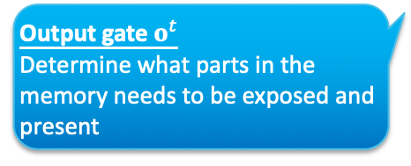
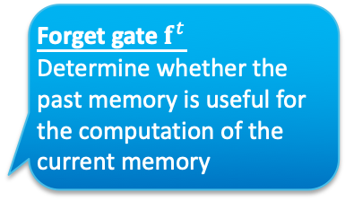
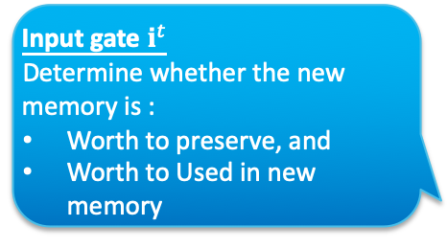
LSTM – Purpose of Each Gate
4
$$h_{t}$$
Output gate $o^{t}$
Determine what parts in the memory needs to be exposed and present
$$x_{t}$$
$$W_{o}$$
$$σ$$
Output Gate
$$h_{t−1}$$
$$b_{f}$$
$$W_{f}$$
$$R_{o}$$
$$b_{o}$$
$$g$$
$$x_{t}$$
Forget gate $f^{t}$
Determine whether the past memory is useful for the computation of the current memory
Memory Cell
Forget Gate
$$h_{t−1}$$
$$x_{t}$$
$$W_{i}$$
Input gate $i^{t}$
Determine whether the new memory is :
Worth to preserve, and
Worth to Used in new memory
$$R_{f}$$
$$σ$$
Input Gate
3
$$h_{t−1}$$
$$R_{i}$$
$$b_{i}$$
$$g$$
$$b_{z}$$
2
$$W_{z}$$
$$R_{z}$$
$$x_{t}$$
$$h_{t−1}$$
1

Slide 32
Lab 3. Sequence-to-Sequence Autoencoder
English to French Translation

Slide 33





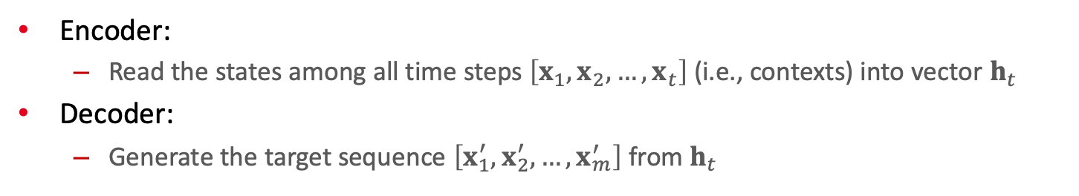



























Sequence-to-Sequence Autoencoder
Encoder:
  Read the states among all time steps $\left[x_{1},x_{2},…,x_{t}\right]$ (i.e., contexts) into vector $h_{t}$
Decoder:
  Generate the target sequence $\left[x_{1}^{′},x_{2}^{′},…,x_{m}^{′}\right]$ from $h_{t}$
Bonjour
j’ai
besoin
d’un
billet
pour
Taipei
END
$$h_{7}$$
$$h_{1}$$
$$h_{2}$$
$$h_{3}$$
$$h_{4}$$
$$h_{5}$$
$$h_{6}$$
$$h_{7}$$
$$h_{1}^{′}$$
$$h_{2}^{′}$$
$$h_{3}^{′}$$
$$h_{4}^{′}$$
$$h_{5}^{′}$$
$$h_{6}^{′}$$
$$h_{7}^{′}$$
Encoder $f_{e}$
Decoder $f_{d}$
$$f_{e}$$
$$f_{e}$$
$$f_{e}$$
$$f_{e}$$
$$f_{e}$$
$$f_{e}$$
$$f_{e}$$
$$f_{d}$$
$$f_{d}$$
$$f_{d}$$
$$f_{d}$$
$$f_{d}$$
$$f_{d}$$
$$f_{d}$$
$$f_{d}$$
$$x_{1}$$
$$x_{2}$$
$$x_{3}$$
$$x_{4}$$
$$x_{5}$$
$$x_{6}$$
$$x_{7}$$
$$x_{1}^{′}$$
$$x_{2}^{′}$$
$$x_{3}^{′}$$
$$x_{4}^{′}$$
$$x_{5}^{′}$$
$$x_{6}^{′}$$
$$x_{7}^{′}$$
$$x_{8}^{′}$$
Hi
1
I
2
need
3
a
4
ticket
5
to
6
Taipei
7
1
Bonjour
2
j’ai
3
besoin
4
d'un
5
billet
6
pour
7
Taipei
8
START
t =
t =
[Sutskever et al., 2014] Ilya Sutskever, Oriol Vinyals, Quoc V. Le, "Sequence to Sequence Learning with Neural Networks", Advances in Neural Information Processing
Systems 27 (NIPS 2014) https://papers.nips.cc/paper/5346-sequence-to-sequence-learning-with-neural-networks

