Slide 1





SPACE INVADER (Python and pygame)
#GROUP- PE_PBL_I2_G3
MEMBERS- Roll no. 9035-9040
Notes:
We designed this template so that each member of the project team has a set of slides with its own theme. Members, here’s how you add a new slide to just your set:
Mark where you want to add the slide: Select an existing one in the Thumbnails pane, click the New Slide button, then choose a layout. The new slide gets the same theme as the other slides in your set.
Careful! Don’t annoy your fellow presenters by accidentally changing their themes. That can happen if you choose a different theme from the Design tab, which changes all of the slides in the presentation to that look.

Slide 2
MEMBERS: Roll NO.
1)VIPIN THOMBARE- 9035
2)PRASANNA EKLAHARE- 9036
3)TANMAY DESHPANDE- 9037
4)TEJAS FUKE- 9038
5)YATIK KHAINAIR- 9039
6)SANGAM MANDWADE- 9040

Slide 3
What The Project Is About?
The game, called Space Invader, is a 2D arcade­like space shooter built with Python and elements of PyGame.
The main idea of the game is for the player to destroy all the enemy spaceships before advancing to next level.
The player spaceship is controlled keyboard and the enemy spaceships have a predefined movement.
The player spaceship can fire the bullets to destroy the enemy spaceships .
With every destruction of the enemy spaceship the score would be increase .

Slide 4
Things We learned :
Various functions related to pygame module used to draw on the screen , to load the images , to define event types and their outcomes .
1. Pygame.display
2. Pygame.image
a. Pygame.image.load
3. Pygame.screen.blit
4. Pygame.event.type
Use of math module for measuring the distance between two points .
Use of random module for giving random coordinates to the enemy spaceships
1.Tkinter module
Root function
Creation of widgates

Slide 5
Game Flow
Start
Player interface
Game window appears
Player icon moves according to commands and enemies move with predefined movement
Bullets are fired
Score increases
Multiple enemies appear with increasing score
Enemy ships collide with player / reach the bottom of the screen
Game over
GAMER
RUN GAME
END GAME
Game Input
View Score
Output receiver
Game Inputs
Game Outputs
GAME CONTROLLER

Slide 6
Work Division
1) Graphics (icons, background ) - Tanmay Deshpande
2) Player spaceship and Movements - Prasanna Eklahare
3) Enemy and their movements - Vipin Thombare
4) Scoreboard ,Music - Yatik Khairnair
5) Collision and difficulty levels - Sangam Mandwade
6) Bullets and their movements - Tejas Fuke

Slide 7

1)Graphics (Images,icons,background)
Group member name-
9037_Tanmay Deshpande

Slide 8

Graphics (Images,icons,background)
Package used is tkinter()
Python offers multiple options for developing a GUI (Graphical User Interface). Out of all the GUI methods, Tkinter is the most commonly used method. It is a standard Python interface to the Tk GUI toolkit shipped with Python. Python with Tkinter outputs the fastest and easiest way to create GUI applications. Creating a GUI using tkinter is an easy task.
Importing the module – Tkinter
Create the main window (container)
Add any number of widgets to the main window.

Slide 9
2)Player and Movements (keyboard inputs)
Group member name-
9036_Prasanna Eklahare

Slide 10
Player and Movements (keyboard inputs)
This task meant creating function which upon calling it, will show player icon on the game screen and giving certain initial coordinates to this player icon
Also we had to define certain events that will occur in the course of game and then defining their consequences
This included defining keys on keyboard for player movement in horizontal and vertical team and also defining what will happen when these keys will be released .
Another crucial part was defining boundaries for player movement so that the player icon doesn't move out of the screen.
This was done by using various functions in pygame such event.type , event.key , .blit and use of if else conditions , while loop , declaration of function and its parameters etc .

Slide 11
3)ENEMIES AND THEIR MOVEMENT
Group member name-
9035_Vipin Thombare

Slide 12
ENEMIES AND THEIR MOVEMENT
In my view making enemies was an important part of game.
For making enemies empty lists were made to store various attributes of enemies.
And then using nested for loops enemies were created.
Here I used different images for making different types of enemies.
And then using append function these were added to list.
Various attributes such as speed and scores of Enemies.
When enemy hits the wall, the enemy reverses its direction.
Different speed was given to every Enemy accordingly.

Slide 13
4) Audio, Scoreboard
Group member name-
9039_Yatik Khairnar

Slide 14
Audio and Scoreboard
Audio
With the help of MIXER module from pygame sound is added to game.
We first import the module and then initialise it.
Then we load the Music file to it.
We also added sound when collision take place.
Score
The score were displayed on screen using render function.

Slide 15
5)Bullets and Their Movements
Group member name-
9038_Tejas Fuke

Slide 16
Bullets And Their Movement:
BULLETS:
This task includes creating of bullets for protecting player from enemies as it is one of the crucial part of game. As enemies approaches player, the player have to hit shot of bullet to enemy by taking judgement of position of spaceship and enemies. A space bar key is defined for shooting bullets
MOVEMENT:
This includes movement of bullets in y direction. there will not be any movement in x direction the x coordinate of bullet is same that of spaceship as it will shoot from spaceship. Change for y direction, y coordinate change is given that is speed of bullet is given.

Slide 17
6) Difficulty levels and collision
Group member name-
9040_Sangam Mandwade

Slide 18
Collision and difficulty levels
Collision included the part of the code which detects when the bullet hits the enemy space craft and adds point to the players score.
Levels is the part of the code which increases the speed as well quantity of enemy space crafts as the score increases .
As the players score increases different types of enemy icon appear on the screen.
We had to create a function for collision purposes containing four parameters functions from math module were used to calculate distance between bullet and enemy space craft.
After collision takes place bullet state was changed to ready , for it to be ready to be fired again.
Levels were added such that when the players score increases more enemies appear on screen , this included using if else loop and creating a logic based on predefined variables.

Slide 19
CONCLUSION:
All in all, building a game for our first year project was much more fun and even challenging than building other projects with databases.
We began the project with absolutely no idea on how graphics work, how a collision detection system works or even how to display an image on the screen and, by the end of the project, we got to a point where we could create our own or modify existing game specific algorithms to suit my needs. We learn many different module of python and also learned how to make a project in team.
In the end, we can conclude that ,even though Python is not highly recommended programming language for game development, but from this project we can conclude that it can be comparatively useful in its own way due to availability of various build-in modules such as pygame and tkinter (for graphics).

Slide 20
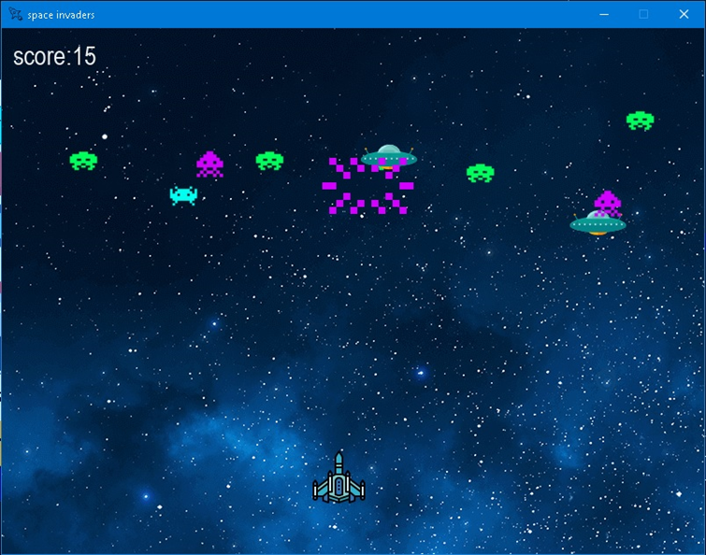
Final outcome :

Slide 21
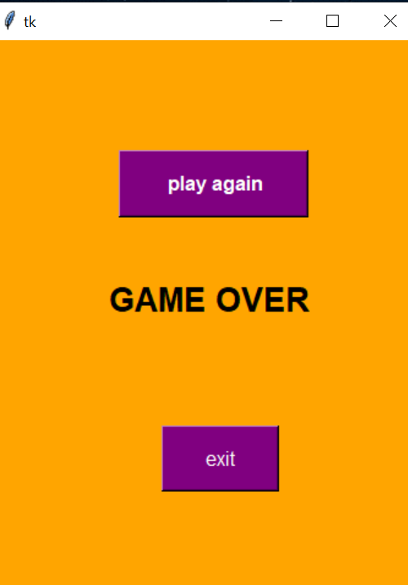
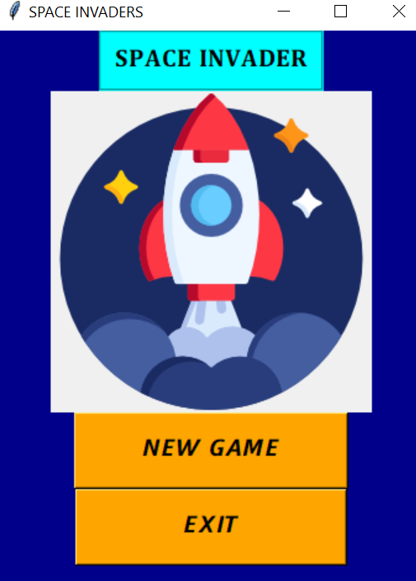
Final outcome :

Slide 22
THANK YOU

