Slide 1


LAND REGISTRATION USING BLOCKCHAIN
DEPARTMENT OF INFORMATION TECHNOLOGY
Rajkiya Engineering College, Azamgarh
Under the Guidance of :
Mr. Ashok Kumar Yadav
Assistance Professor
IT Department
Presenting By :
Dheeraj Kumar(1873613018)
Tanya Srivastava(1907361309001)
Sangam(1873613048)

Slide 2
TABLE OF CONTENTS
Introduction
Blockchain Technology
Literature Review
Problem Statement
Proposed Model & Features
Workflow
Implementation
Pros & Cons
Conclusion

Slide 3
INTRODUCTION
The land registry system is one of the very important department in any governance system that stores the records of land ownership. There are various issues and loopholes in the existing system that give rise to corruption and disputes.
Land Registration system using blockchain is a distributed system that will store all the transactions made during the process of land buying.
This will also be helpful for buyers, sellers and government registrars to transfer the land ownership from seller to new buyer as well as it will accelerate the process of registration.
Goal is to create tamper proof systems and to remove third party reliability for transactions.

Slide 4
BLOCKCHAIN TECHNOLOGY
A digital ledger that keeps the record of all transactions taking place on a peer-to-peer network.
All information transferred via blockchain is encrypted and every occurrences recorded means it cannot be altered.
Encrypted information can be shared across multiple providers without risk of a privacy breach.
The features of Blockchain can be easily utilized in Real estate so that we can design highly secure and fraud tolerant model with removal of third party reliability.

Slide 5
LITERATURE REVIEW
Research Papers | Their work | Reference
Blockchain-based framework for secure and reliable land registry system | A secure and reliable framework for land registry system using Blockchain has been proposed. The proposed framework uses the concept of smart contract at various stages of the land registry and gives an algorithm for pre-agreement. | Shuaib, Mohammed, Salwani Mohd Daud, Shadab Alam, and Wazir Zada Khan. "Blockchain-based framework for secure and reliable land registry system." Telkomnika 18, no. 5 (2020): 2560-2571.
Securing Land Registration using Blockchain | This paper discusses about a secure land registry implemented using blockchain which works on the basis of majority consensus. | Krishnapriya, S., and Greeshma Sarath. "Securing land registration using blockchain." Procedia Computer Science 171 (2020): 1708-1715.

Slide 6
Blockchain technology and land registry | This paper also highlights the functionality of a blockchain land registry solution that can be adopted by the Republic of Cyprus and it suggests the implementation of a small pilot that can be used as proof of concept. | Themistocleous, Marinos. "Blockchain technology and land registry." Cyprus Review 30, no. 2 (2018): 195-202.
Blockchain based land registry system using Ethereum Blockchain | In this paper, this explore the possibilities and problems solved by using a blockchain based system for land ownership transfer. The system is based on Ethereum Blockchain that will store all the transactions made during the process of land ownership transfer. | Khan, Rijwan, Shadab Ansari, Sneha Jain, and Saksham Sachdeva. "Blockchain based land registry system using Ethereum Blockchain." J. Xi’an Univ. Archit. Technol (2020): 3640-3648.

Slide 7
PROBLEM STATEMENT
Develop a land registry system using blockchain to remove fraudulent and intermediaries. With blockchain we can overcome the limitations (e.g. centralization) of the existing land registries and offer a trusted service that provides significant benefits to the participants.

Slide 8
PROPOSED MODEL & FEATURES
A blockchain based land registry system will provide many abilities as compared to the old registry system.
In blockchain, there is a decentralized control and storage of records that have the potential to increase the trust and give rise to the collaborative system.
By using blockchain, the efficiency of the land registry system will be increased and result in better synchronization and countering the security issues resulting from human-made disasters and availability issues of information.
Technologies Used :
Ethereum Blockchain(Truffle Suite)
Solidity
Ganache
Metamask
Android Studio
Flutter framework
Web3Dart

Slide 9
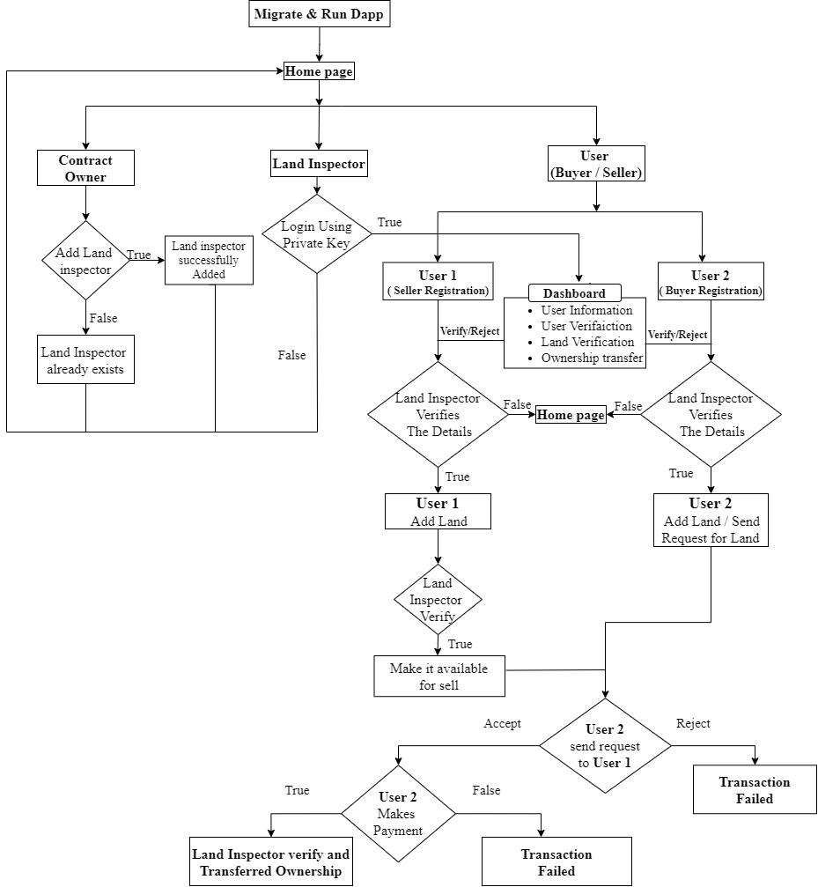
WORKFLOW

Slide 10
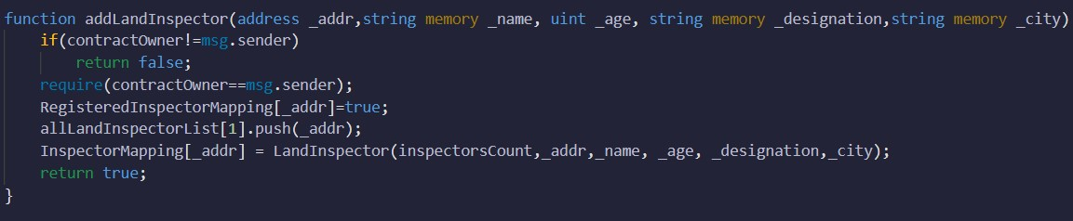
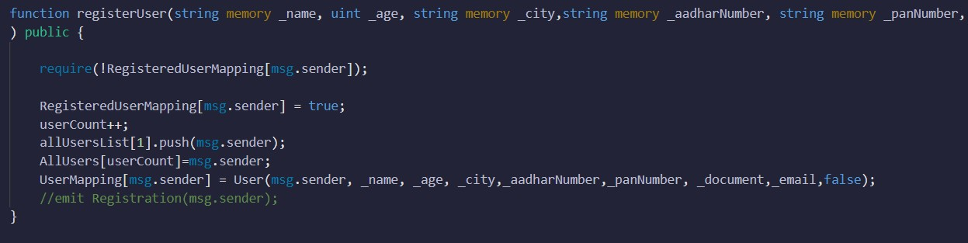
IMPLEMENTATION
Add Inspector:
User Registration :

Slide 11
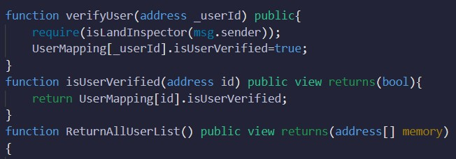
User verification by Land Inspector :

Slide 12
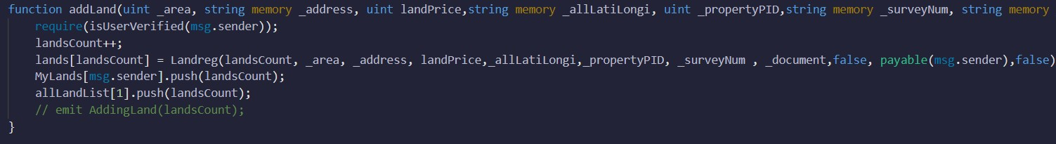
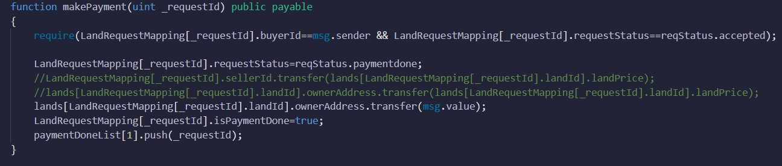
Add Land :
Payment :

Slide 13
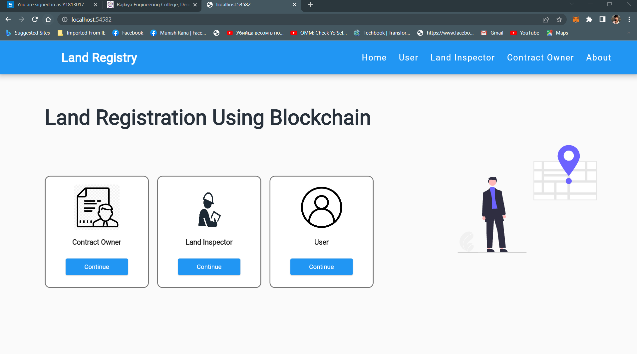
Running Decentralized Application:
Home Page: Home page contains contract owner, land inspector and user interface.

Slide 14
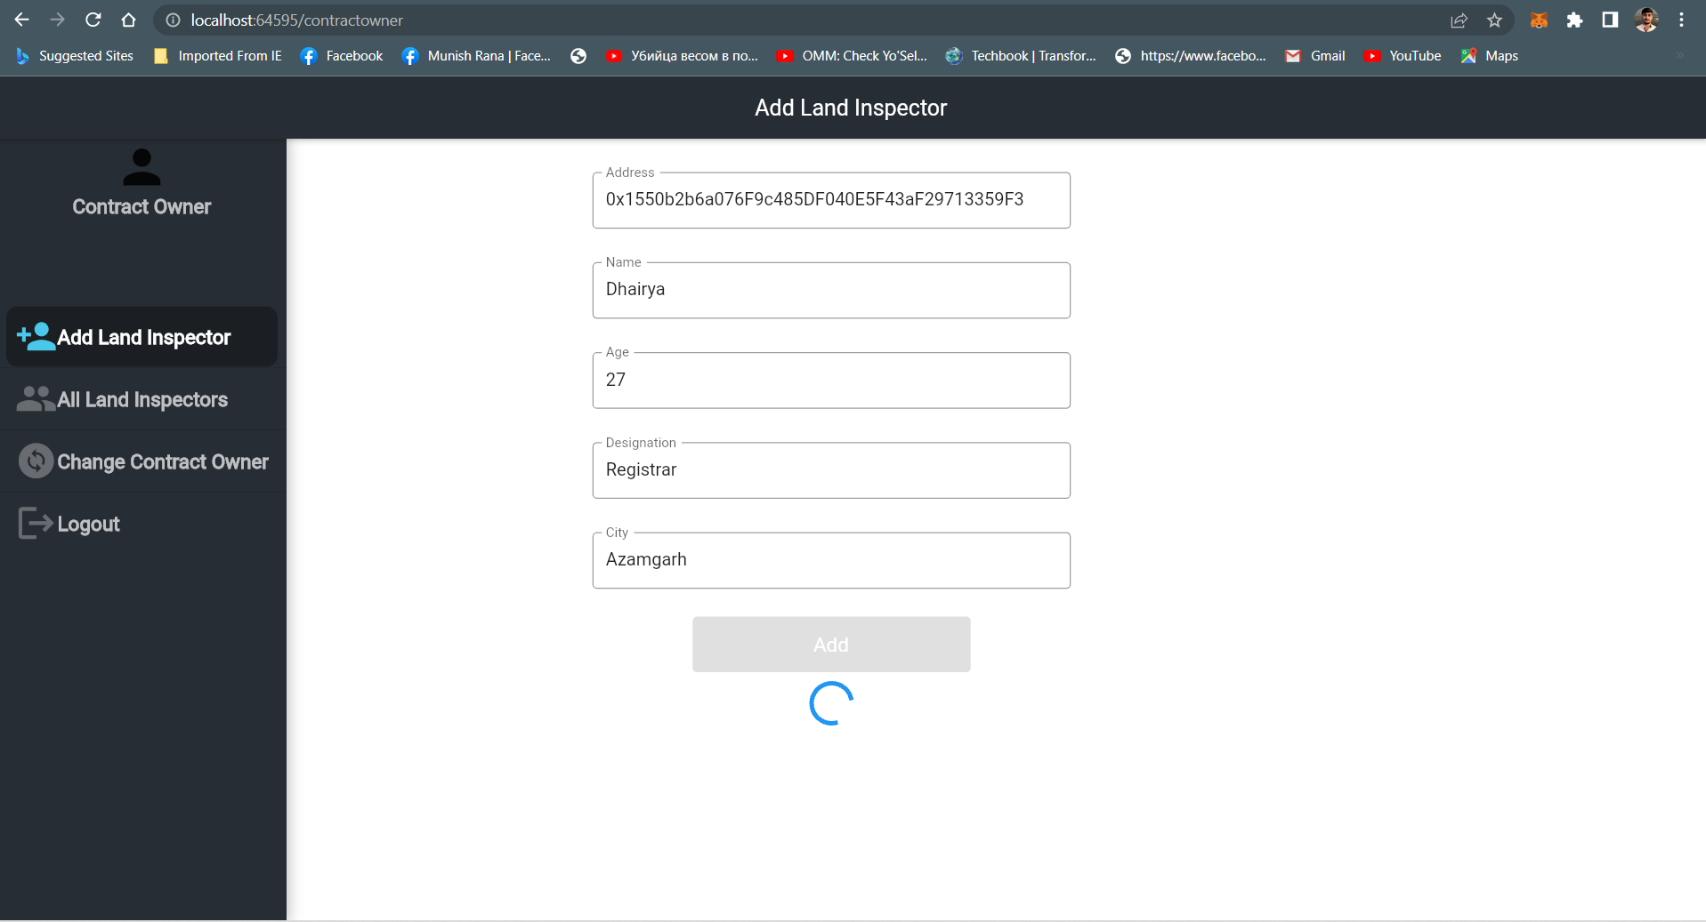
Contract Owner: Contract owner is government authority who adds land inspector.

Slide 15
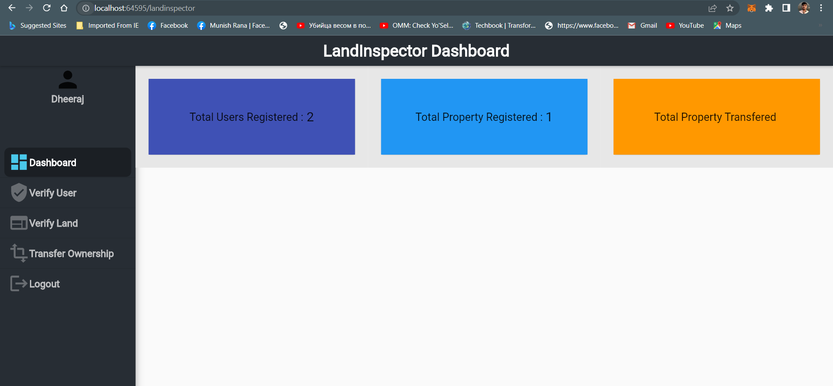
Land Inspector: Land inspector login using his private key and he verifies user details, land ownership and transfer ownership.

Slide 16
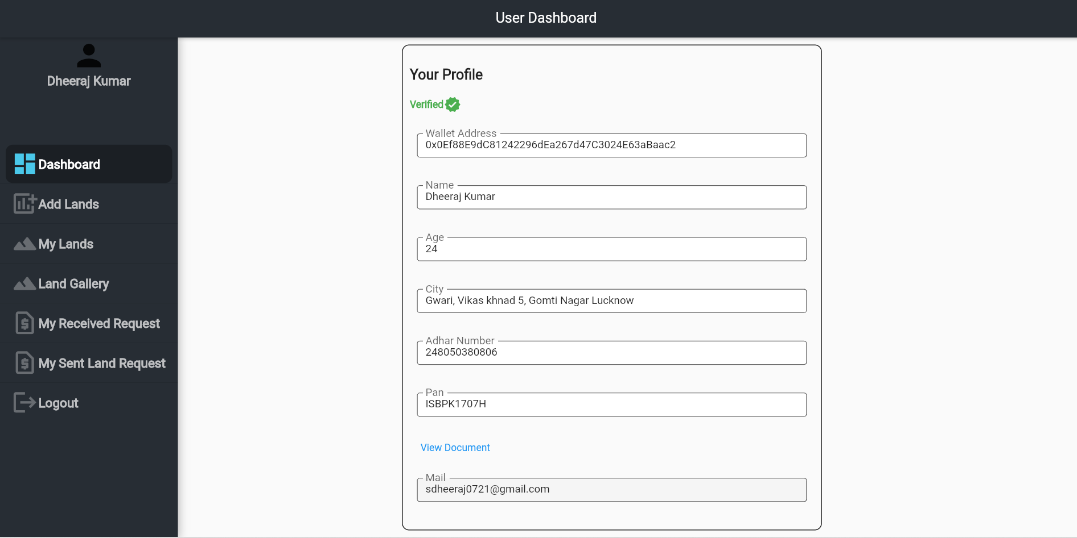
User Registration: User registers with his personal details and after verification of his details by land inspector, user can login and got to user dashboard.

Slide 17
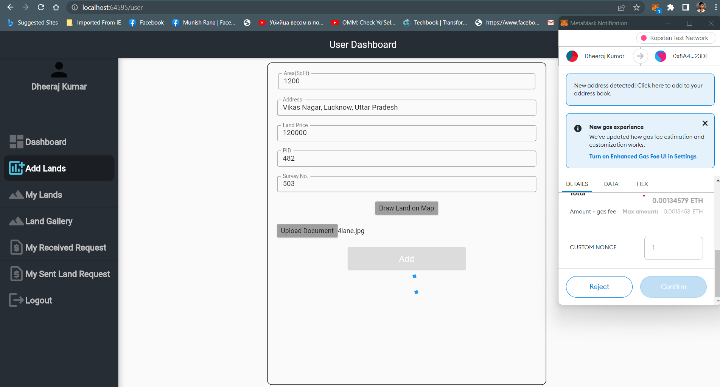
Add Land: User1 adds land and land inspector verifies land details of the user1.

Slide 18
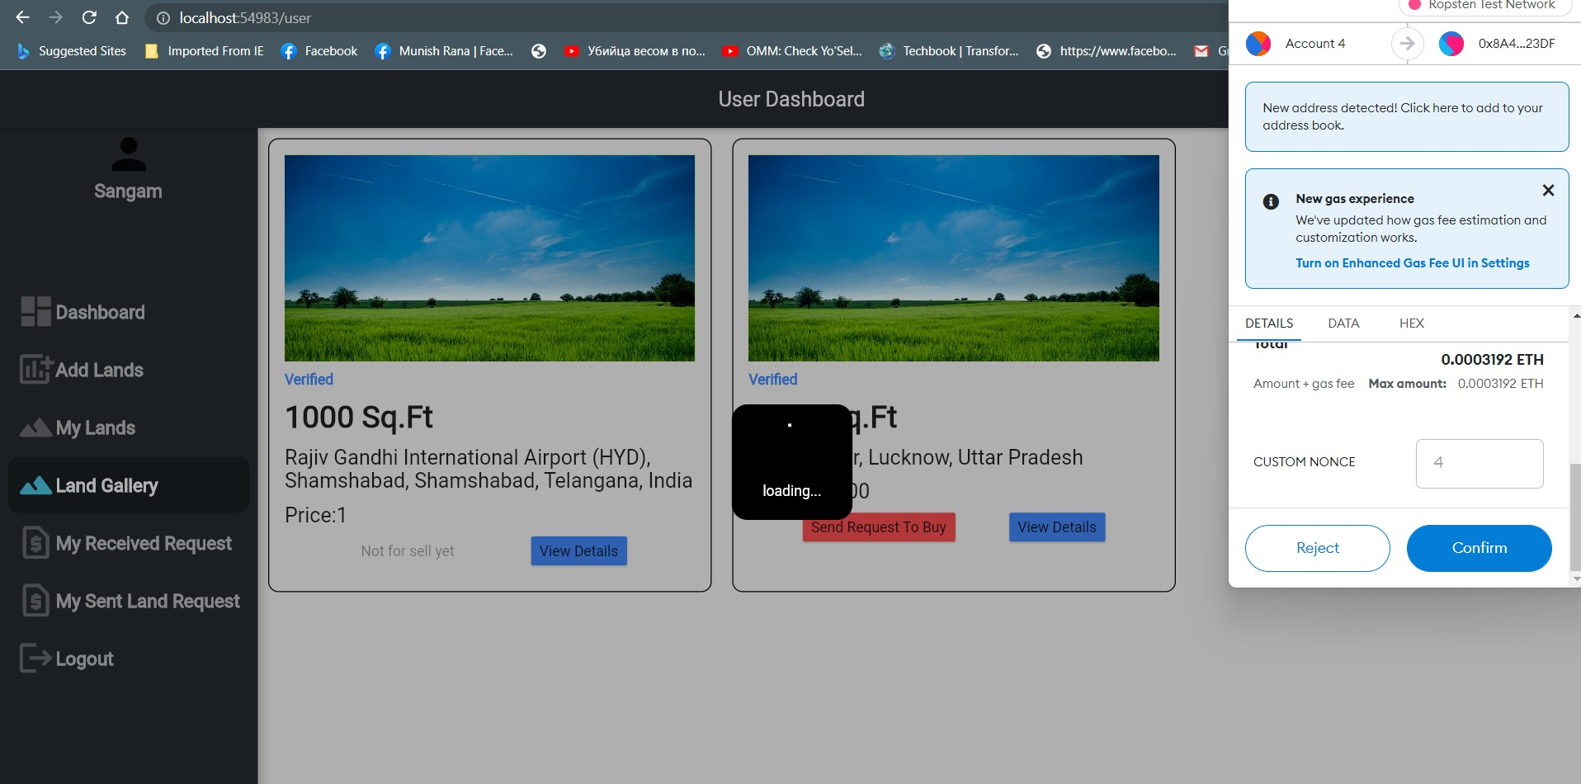
Request for Land: User2 requests for buying land from user1.

Slide 19
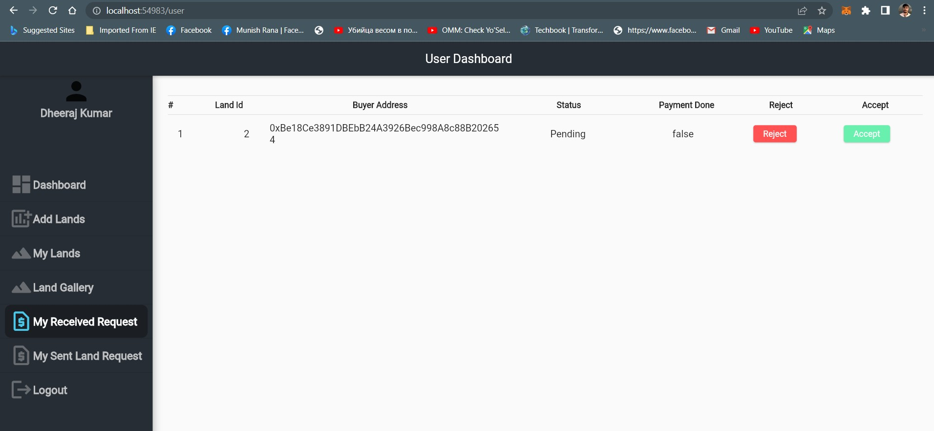
Accept Request: User1 can accept/reject request sent by user2. If user2 accepts the request then user1 makes payment.

Slide 20
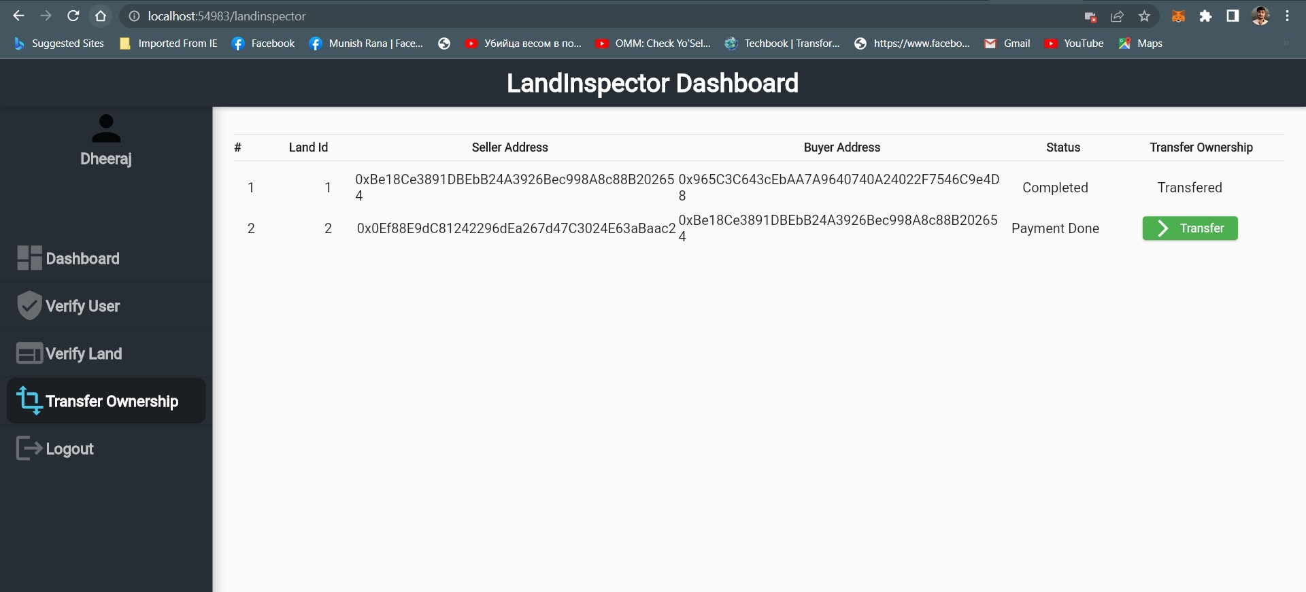
Transfer Ownership: When user2 makes payment, land inspector transfer the land ownership to user2 from user1 after verification of payment.

Slide 21
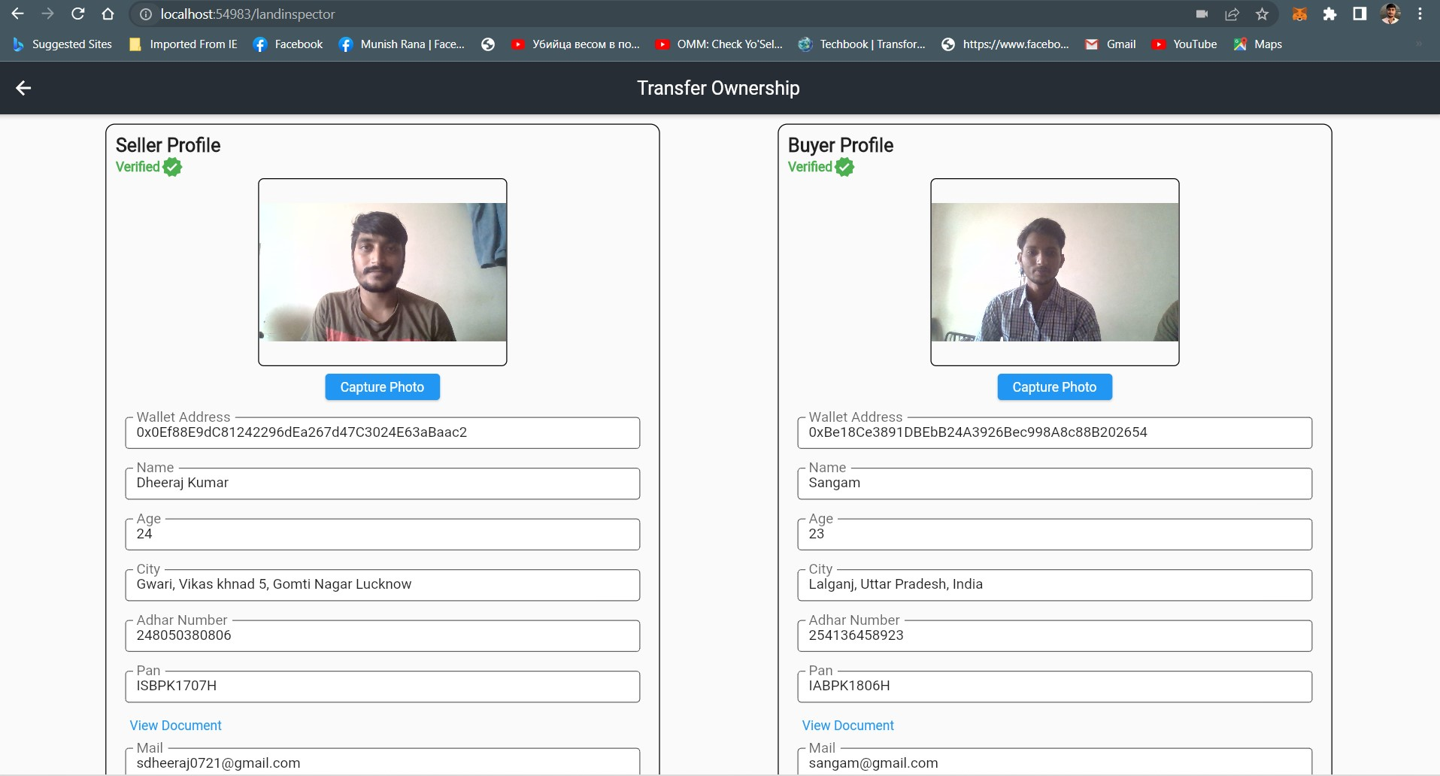
Transferring Ownership:

Slide 22
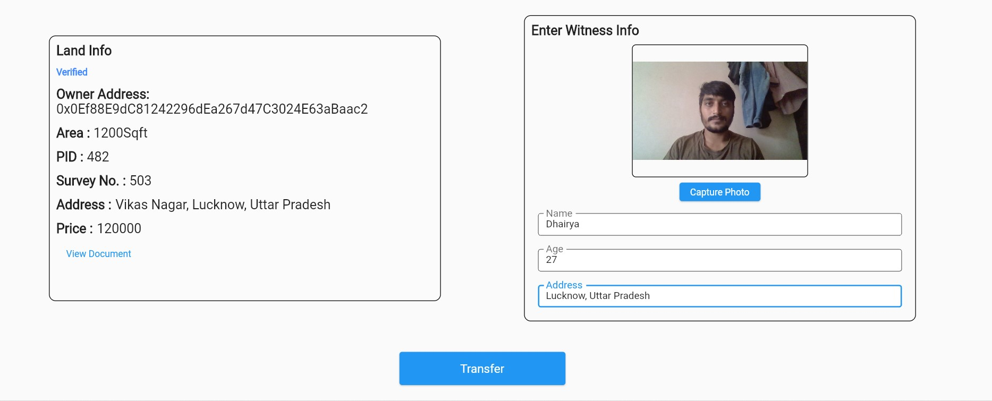

Slide 23
PROS
Improve the land registry system
Remove fraudulent and intermediaries
Make more transparent and keep all transactions as records
Consume less time
CONS
High gas consumption due to congestion network

Slide 24
CONCLUSION
We have successfully completed executed our project where backend part of land registration in which we have covered contract owner, user registration and land inspector dashboard. For the backend part, we used Ethereum Blockchain (Truffle Suite), Solidity language and Ganache platform. In this implementation we have used the concept of Proof-of-Work algorithm and some other algorithms.
Before this we have not implemented the backend part and understood how to integrate backend with frontend. So, now for frontend, we have used Flutter Framework, Web3Dart, and Metamask Chrome Extension. By using flutter framework, we have created android application as well as web application which is very user-friendly to use this system.
For future work, we are looking to provide rental property in our system. Because many people wants to lend the property on rent.

Slide 25
Any Query?

