Slide 1

SMART INDIA HACKATHON 2026
TITLE PAGE
Problem Statement ID - SIH26090
Problem Statement Title- AI-Driven Market Linkage and Smart Cataloging Mobile Application for Marginalized Artisans
Theme- Miscellaneous
PS Category- Software
Team ID-
Team Name- Zyra

Slide 2
KARIGAR – AI Digital Assistant for Artisans
Zyra
Problem | Solution
Language Barrier | Voice-first Tamil / Hindi / English interaction
Poor Product Photos | AI Photo Studio & Quality Enhancement
Difficult Cataloging | Auto-generated product details & keywords
Unfair Pricing | Material + Labour based Fair Price Assistant
Unused Raw Materials | AI Product Ideas
Limited Market Access | Marketplace-ready listing & publishing
VOICE → PRODUCT → LISTING → MARKET
Key Innovation: Not another marketplace — a digital enablement layer connecting artisans to existing marketplaces

Slide 3
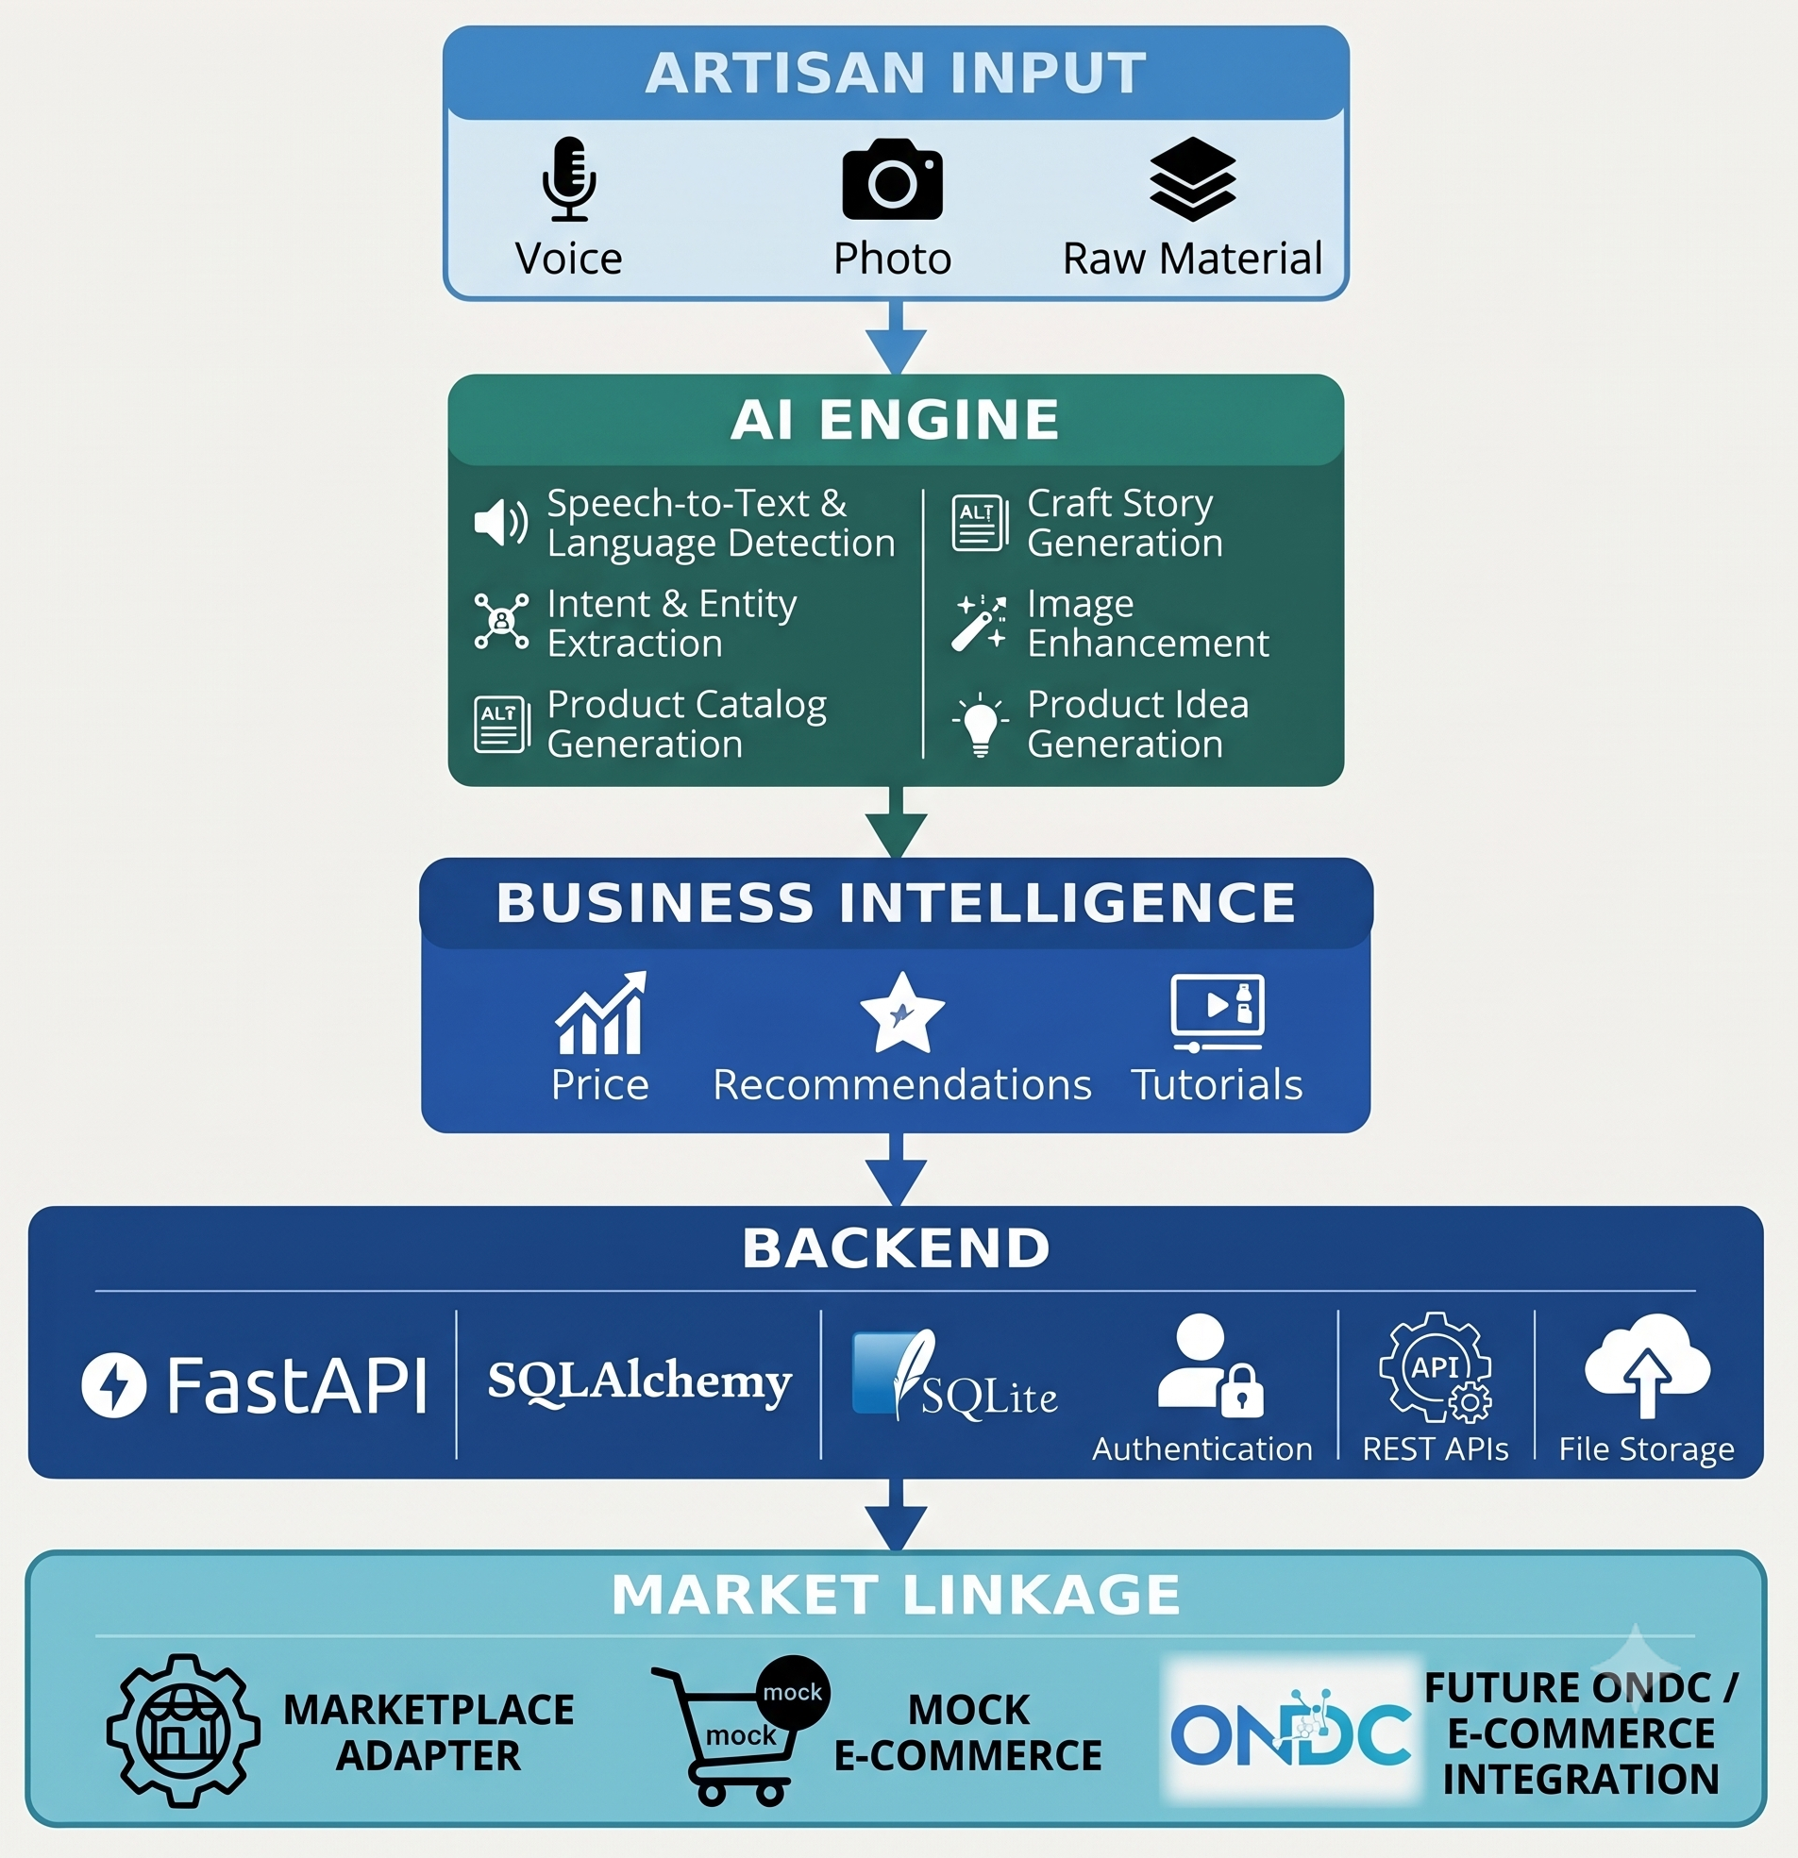
TECHNICAL APPROACH
Frontend
React
TypeScript
Vite
Tailwind CSS
Backend
Python
FastAPI
SQLAlchemy
SQLite
AI
Faster-Whisper
IndicTrans2
Ollama
Open-source LLM
Computer Vision
OpenCV
Pillow
rembg
Integration
REST APIs
Marketplace Adapter Architecture
Zyra
ARCHITECTURE DIAGRAM
TECH STACKS

Slide 4
FEASIBILITY AND VIABILITY
Zyra
FEASIBILITY
MAJOR CHALLENGES & SOLUTIONS
VIABILITY
CHALLENGES
SOLUTION
Voice-first interaction + simple UI
Limited digital literacy
Regional language barrier
Poor product photographs
Difficulty writing descriptions
Lack of pricing knowledge
Limited product innovation
Dependence on a single marketplace
Low internet / computing resources
Multilingual speech and translation
AI Product Studio
Automatic catalog generation
Explainable fair-price engine
Raw Material → Product Ideas
Marketplace adapter architecture
Lightweight/local AI where possible
For Artisans
Easy product digitization without requiring technical expertise.
For E-commerce
Receives better structured, standardized product listings.
For Government / NGOs
Can support digital inclusion and artisan empowerment programs.
For Future Expansion
The same architecture can support additional:
Indian languages
Artisan communities
Craft categories
E-commerce platforms
AI models
Technical Feasibility
Uses established open-source AI technologies.
Local AI models reduce dependency on paid cloud APIs.
Modular architecture allows individual AI components to be improved independently.
FastAPI provides lightweight and scalable REST APIs.
SQLite enables rapid deployment for the prototype.
Marketplace adapter architecture allows future platform integrations without redesigning the application.
Operational Feasibility
KARIGAR is designed for artisans with limited digital experience.
Instead of:
Login → Forms → Categories → Description → Photo Editing → Pricing → Listing
KAI simplifies the experience into:
Speak → Review → Publish
Large controls, minimal forms and multilingual interaction reduce the digital learning curve.

Slide 5
IMPACT AND BENEFITS
Raw Material Cataloging
Artisans can digitally catalog and sell available raw materials through external e-commerce channels.
AI Photo Quality Coach
Instead of simply enhancing an image, KAI explains what is wrong:
Craft Story Preservation
Converts the artisan's personal narration into a digital product story.
AI Skill & Tutorial Recommendation
Recommends relevant learning resources based on the artisan's material, craft and product goals.
Voice-Controlled Business Assistant
Artisans can perform common actions through voice:
“Show my products.”
“Add five kilograms of bamboo.”
One standardized KAI listing can be adapted for different authorized e-commerce channels.
Multi-Market Ready
“Image is too dark.”
“Background is distracting.”
Zyra
IMPACTS
BENEFITS
Social Impact
Reduces digital literacy barriers.
Enables artisans to interact in their familiar language.
Gives marginalized artisans greater independence in digital commerce.
Preserves individual artisan stories and knowledge.
Encourages participation in the digital economy.
Economic Impact
Enables year-round digital selling capability.
Improves product presentation.
Helps artisans make more informed pricing decisions.
Reduces dependence on intermediaries for basic digital cataloging.
Makes products easier to discover across digital commerce channels.
Environmental Impact
Unused / Excess Raw Material
AI Product Suggestions
New Product Possibilities
Reduced Material Wastage
Example: Excess Bamboo → Product Ideas → New Craft Product → Digital Listing

Slide 6


RESEARCH AND REFERENCES
Zyra
REF 01 • GOVERNMENT DIRECTIVE
REF 02 • HCI / RURAL COMPUTING
Ministry of Social Justice & Empowerment (MoSJE)
Medhi, I., et al. (ACM TOCHI)
“AI-Driven Market Linkage & Smart Cataloging for Marginalized Artisans”, SIH 2026 (PS: SIH26090).
“Designing Mobile Applications for Low-Literate Users: A Case Study from India.”
github.com/vedantchalke36/sih-2026-problem-statements
dl.acm.org/doi/10.1145/3290605.3300433
REF 03 • VOICE UI RESEARCH
REF 04 • NATIONAL MISSION
Patel, N., et al. (ACM CHI)
Bhashini – National Language Translation Mission
“VoiceFirst: Designing Voice-Based Mobile Interfaces for Low-Literate Users in Rural India.”
Ministry of Electronics and Information Technology (MeitY), Government of India.
dl.acm.org/doi/10.1145/3313831.3376174
bhashini.gov.in
REF 05 • INDIC SPEECH MODELS
REF 06 • AI POLICY
AI4Bharat (IIT Madras)
NITI Aayog National Strategy
“Open Indic Speech and Translation Models for Next Billion Indian Language Users.”
“National Strategy for Artificial Intelligence #AIforAll — Empowering Rural & Grassroot Communities.”
ai4bharat.org
niti.gov.in/national-strategy-artificial-intelligence
REF 07 • ETHICS & SOCIAL GOOD
REF 08 • ICTD THEORY
Sambasivan, N., et al. (ACM FAccT)
Toyama, K. (MIS Quarterly)
“AI for Social Good in the Global South: Re-evaluating Design Assumptions & Algorithmic Parity.”
“Technology as Amplifier in International Development: Bridging Skill & Digital Literacy Chasms.”
arxiv.org/abs/2201.05324
ssrn.com/abstract=1703878

