Slide 1
Project Profile
Project Title: VBS
Project Definition:- It is simple application which will
be used in exhibitions or seminars to keep track of
companies & their projects also the clients who have
visited that seminar/exhibition.
Technologies:-
Mobile Application: React Native
Backend: Firebase/PHP

Slide 2
Project Description
Objective
-> It is a website and mobile application where any
company/client can register and access it from the
same place.
->If client downloads this application , then they can
find their interested company details and product.
->It is an application that can also be used during
different types of exhibition or product promotion
activities to get client details and information of the
person visiting the event.

Slide 3
User Specification
USERS OF THE SYSTEM
->In our system there are three users who can work on the system they are :
Admin
User
Company/Exhibitor
Admin:- Admin can login then after manage the site.
Admin can reset their password.
Admin can manage their profile.
Admin can manage events and user’s details.
Admin can make changes in every content related to event and user.

Slide 4
User Specification
Visitor:-
Visitor can view about latest events which are scheduled .
Visitor can place inquiry in interested companies .
Visitor can get exhibitors list after verification.
Visitor can manage his profile.
Visitor can give feedback.
Visitors can switch to signup as company , if they want to promote their business.

Slide 5
User Specification
Company/Exhibitor:-
Company can view about latest events which are
scheduled .
Company can register for promotion in interested
exhibitions .
Company can get visitors list after and during event.
Company can manage his profile.
Company can give feedback.

Slide 6
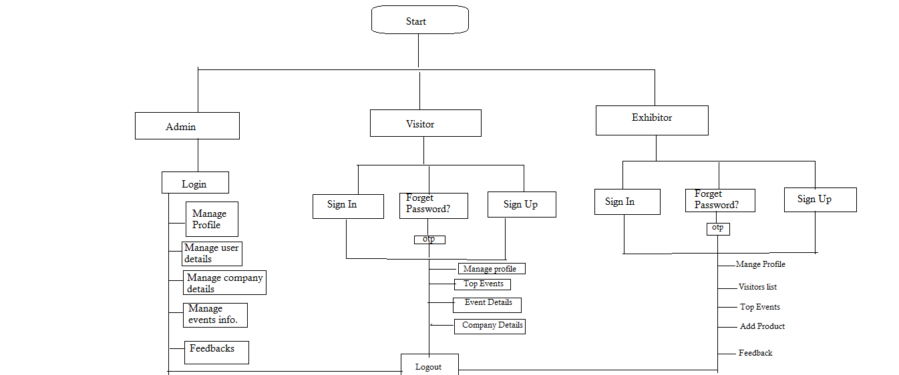
Flow

