Slide 1

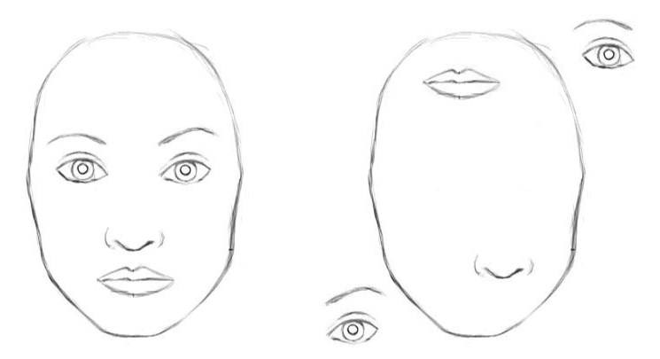

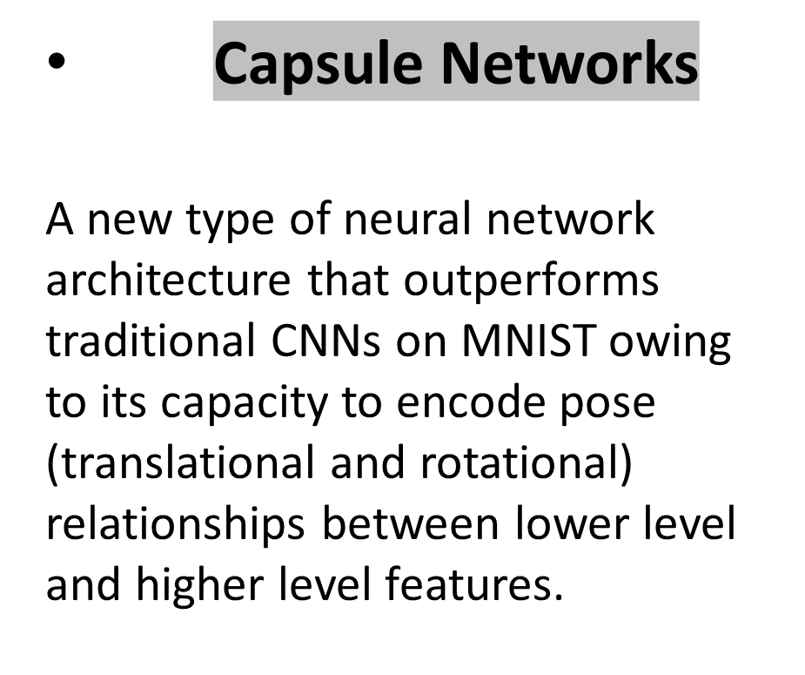
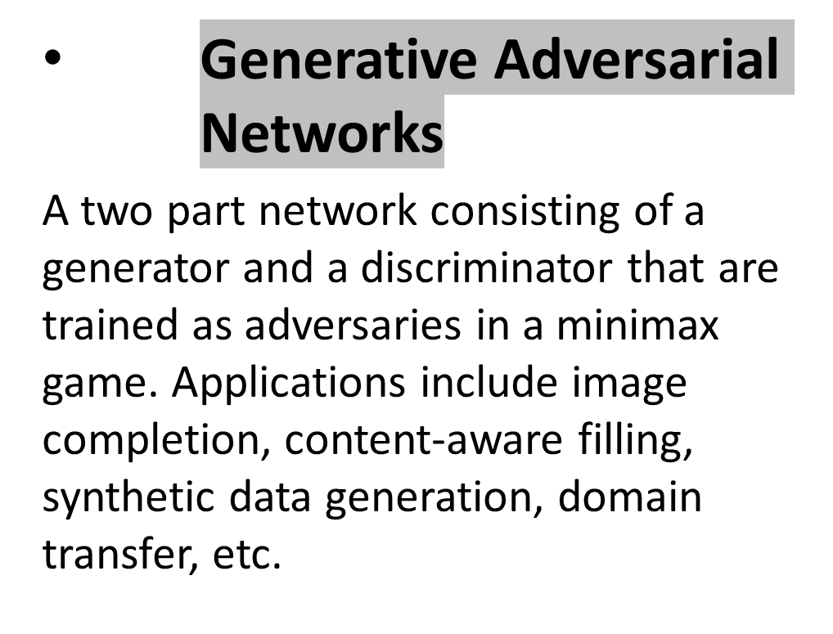
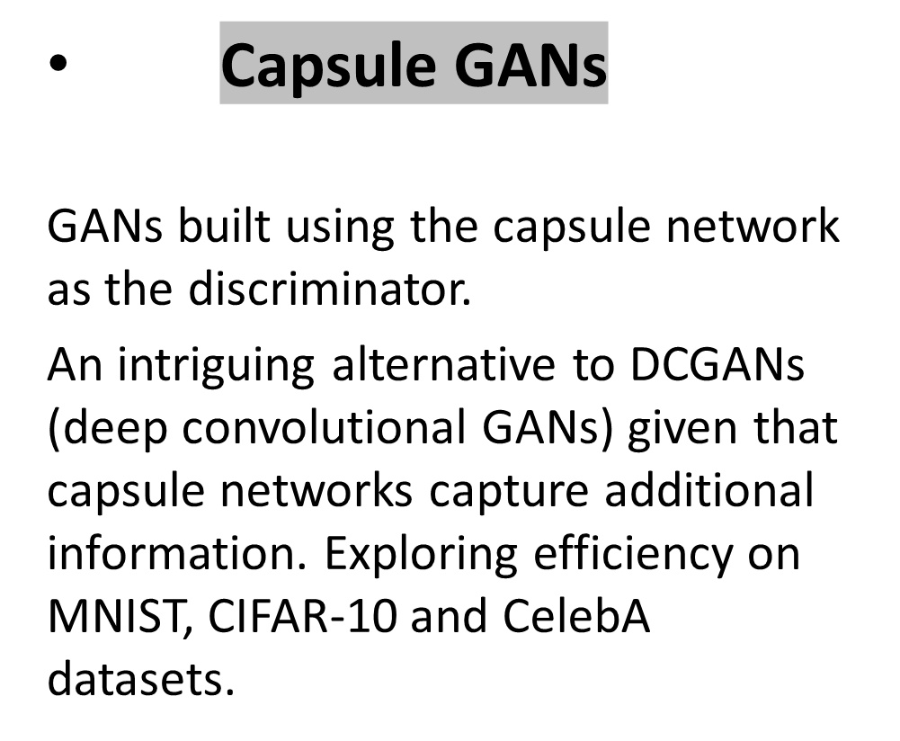
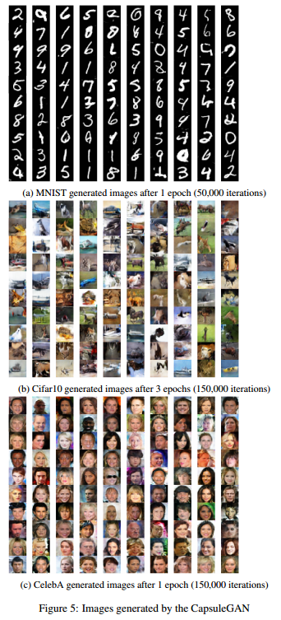

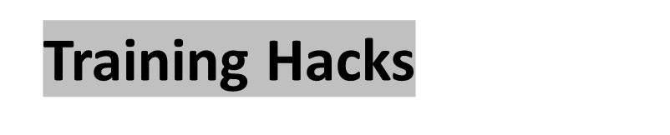
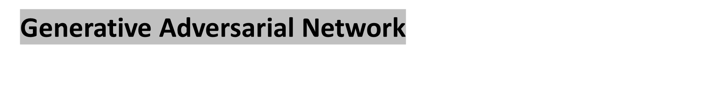
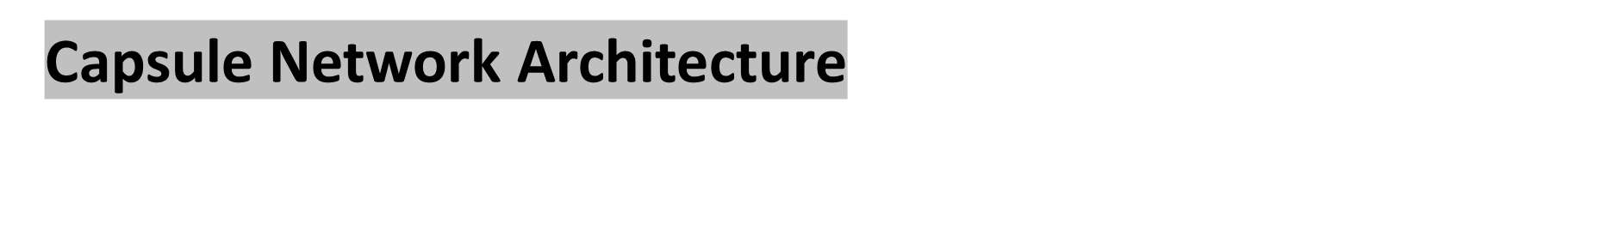
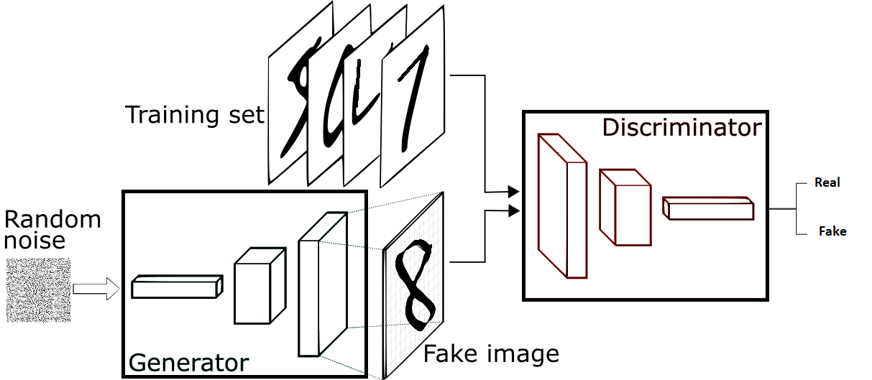
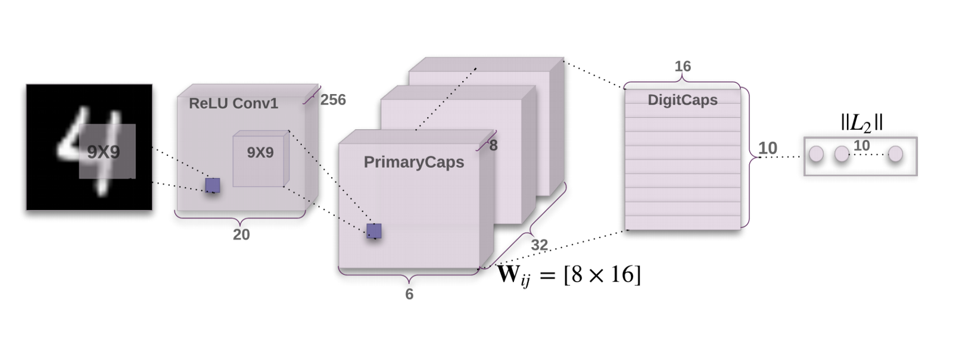
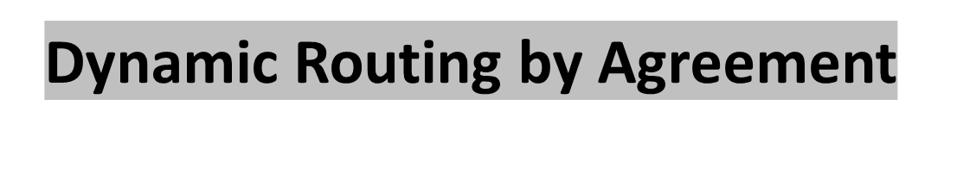
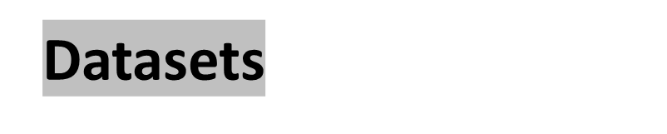
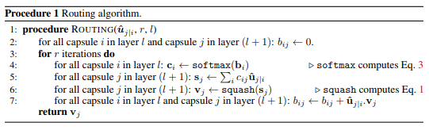




Exploring the Efficiency of Capsule Networks in GANs
Nitin Kishore Sai Samala, nsamala@cs.umass.edu
Sruthi Chilamakuri, schilamakuri@cs.umass.edu
CICS, University of Massachusetts Amherst
Motivation
Experimental Results
Capsule Networks outperform CNNs; Capsule GANs may produce better results than DCGANs
Normalize inputs between -1 to 1
Use tanh as the last layer of generator
Sample from a gaussian distribution
Construct different mini-batches for real and fake
LeakyReLU to avoid sparse gradients
Use Conv2d + stride for Downsampling and Upsampling
Adam optimizer with lr=0.0002
Add some artificial noise to inputs to D
The loss function used in capsule networks is provided in Eq. 4.
Tk is an indicator variable which is equal to 1 if object of class k exists in the image and 0 otherwise. m+ and m- are hyperparameters and are set to 0.9 and 0.1 respectively.

