Slide 1
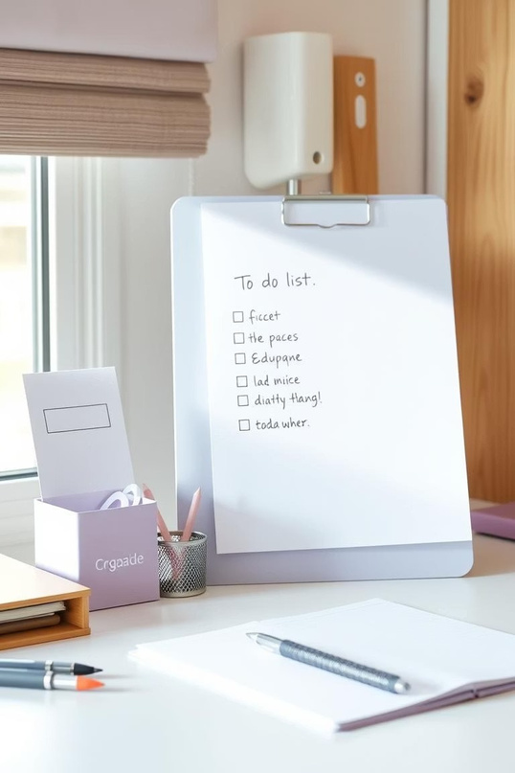
Mastering Your Day: The Ultimate To-Do List Guide
Welcome to your guide to mastering daily tasks. This presentation will transform your productivity. Discover how to conquer your to-do list.

Slide 2

The Power of a Well- Crafted To-Do List
Mental Clarity
Declutter your mind. Organize thoughts effectively.
Clear Goals
Define objectives. Stay focused on what matters.
Track Progress
Monitor accomplishments. Celebrate small wins daily.

Slide 3
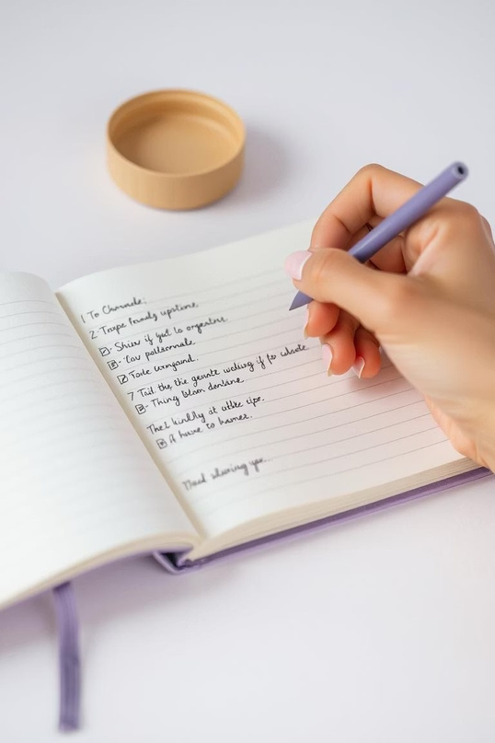

Getting Started: Setting Up Your First To-Do List
Brain Dump
Write down every task. Include big and small items.
Categorize Tasks
Group similar items. Use categories like "work" or "personal."
Break Down
Divide large tasks. Create actionable, smaller steps.

Slide 4


Why To-Do Lists Matter: Boosting Productivity and Reducing Stress
Boost Productivity
To-do lists help you stay on track. They ensure key tasks are completed. See your daily output increase quickly.
Reduce Stress
Clear tasks reduce mental load. Fewer forgotten items mean less anxiety. Gain peace of mind.

Slide 5


Digital vs. Paper: Choosing the Right To-Do List Format for You
Digital Benefits
Access anywhere. Sync across devices. Set reminders easily. Integrate with calendars and other apps.
Paper Benefits
Tangible and satisfying. No distractions from notifications. Promotes focused deep work. Simple and reliable.

Slide 6
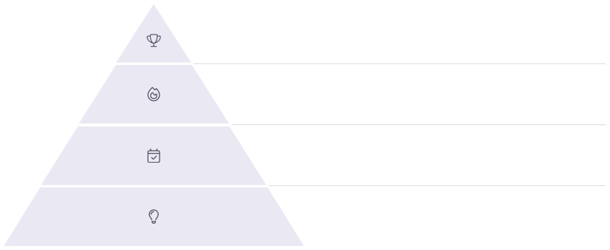
Prioritization Techniques: Conquer the Most Important Tasks First
Impactful
Highest value, biggest results.
Urgent
Needs immediate attention.
Scheduled
Tasks with deadlines.
Lower Priority
Nice to-dos, less critical.

Slide 7
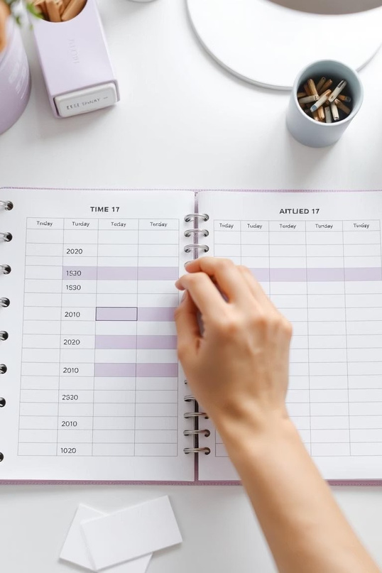
Time Blocking and Scheduling: Integrating Your To-Do List into Your Day
1
Morning Focus
Block time for critical tasks. Start your day strong.
2
Midday Check-in
Review progress. Adjust as needed. Stay flexible.
3
Afternoon Wrap-up
Tackle smaller items. Prepare for tomorrow.

Slide 8

Avoiding Common Pitfalls: Overwhelm, Procrastination, and Incomplete Tasks
Combat Overwhelm
Break tasks into tiny steps. Focus on one at a time. Celebrate small accomplishments.
Beat Procrastination
Use the 5-minute rule. Start small to gain momentum. Reward yourself for progress.
Finish Tasks
Set realistic goals. Review daily. Prioritize ruthlessly.

Slide 9




Tools and Apps for Enhanced To-Do List Management
Explore various digital tools. Find one that fits your workflow. Many offer integrations and features. Experiment to find your perfect match.

Slide 10
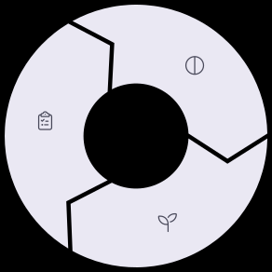
From Chaos to Control: Implementing a Sustainable To-Do List System
Adapt & Refine
Your system should evolve. Adjust methods as needed. Stay flexible.
Daily Review
Start and end each day reviewing
your list. Prioritize for the next day.
Consistency is Key
Make it a habit. Regular use builds momentum. Stick with it daily.

