Slide 1

Trustworthy E-voting System
https://github.com/sangatisurekha/Final-review
Batch No: B-12 Project Guide:
S.Surekha (164G1A05A8) Dr.G.K.V.Narasimha Reddy, Ph.D
B.Sheshi Rekha (164G1A0595) Professor & HOD `
P.Rohith (164G1A0582)
K.Simran (164G1A0596)
Srinivasa Ramanujan Institute of Technology
Department of Computer Science & Engineering

Slide 2
Contents
Introduction
Abstract
Module Description
Output
Conclusion
References

Slide 3
Introduction
The online voting system is the system that aims to eliminate the need to cast the votes using paper or having to gather in person.
To maintain voters integrity and to create pleasant experience for the voters.
The administrator’s effort is much reduced by checking the election status of all the localities individually forms a place and it is easy for him to announce the election result.
Voting system is mainly used to avoid illegal polling.

Slide 4
Problem Statement
Building a trustworthy voting system by providing integrity, accountability and irreversible. And it could increase voter turnout because of convenience, and it helps to reduce fraud voting.

Slide 5
Existing System
In the current system, voting is generally done either by writing your opinion on the paper or by electronic voting machines.
In this voters cast their vote from the polling stations held at particular locations by standing in long queues.
In this system their is chance of occuring illegal activites.
It takes a lot of time to declare the results.

Slide 6
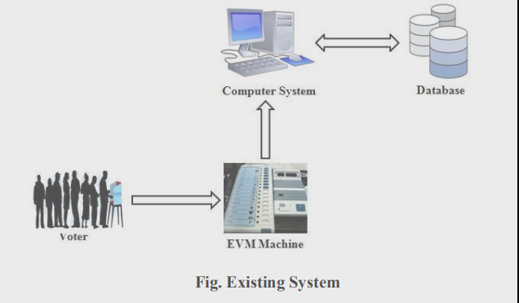

Slide 7
Proposed System
The proposed system is a web based application.
As it a web application voters can cast their votes from any location.
No user can cast multiple votes. And the results will declare in very less time.
By this system voters can cast votes easily and fastly. As they can access the system without going to polling booths and standing in long queues.
And it is very helpful to people who are unable to go to polling booths.

Slide 8
Module Description
The Proposed System consists of two modules:
Administrator Module
Voter Module

Slide 9
Contd…
Administrator Module:
Administrator interface consists of user name
and unique password to login onto the system.
The following tasks performed by the administrator:
1. Select Candidate-
Here the admin can select the list of candidates in
the election.
The candidates will be added to the list only after
completing the procedures.

Slide 10
Contd…
2. Add election-
Here the election to be conducted is selected.
To add an election should be give required fields like
name,description, start date, end date along with timings.
3.Select candidate list
4.Voting Structure
5.Counting and Characterizing the results

Slide 11
Contd…
Voter Module:
First voter should register for the election. On
the day of election voter login through voterid and
password.
1.Authentication & Voting
2.Candidate List
This facilitates the voter to view the candidate
names and the election name.

Slide 12
Contd…
3.Vote-
This provides the voter with a list of candidate with
in his/her election along with selection option to select the preferred candidate from the list.
5.View Results-
This provides user friendly representation of the votes
obtained by each candidate.
It includes the votes obtained by each candidate.
6.Logout

Slide 13
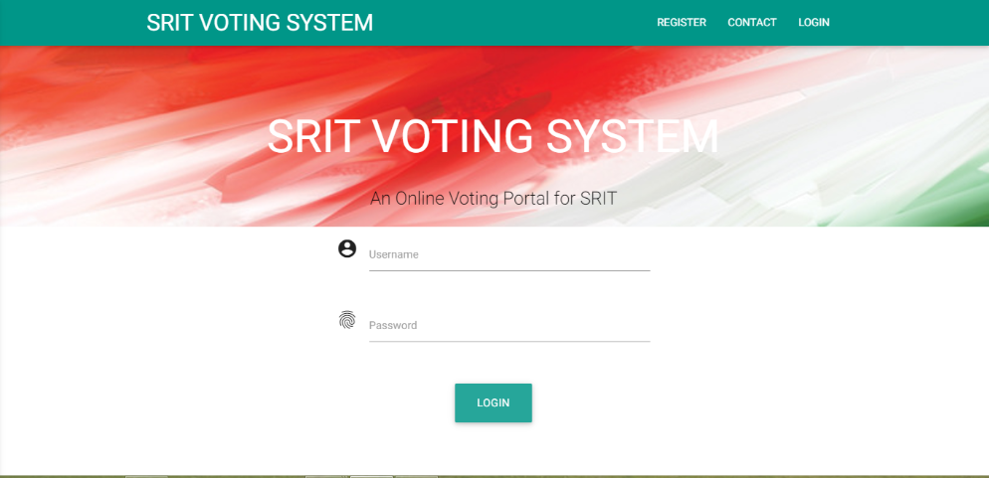
Output Screens
Fig: 1 admin and voter login form

Slide 14
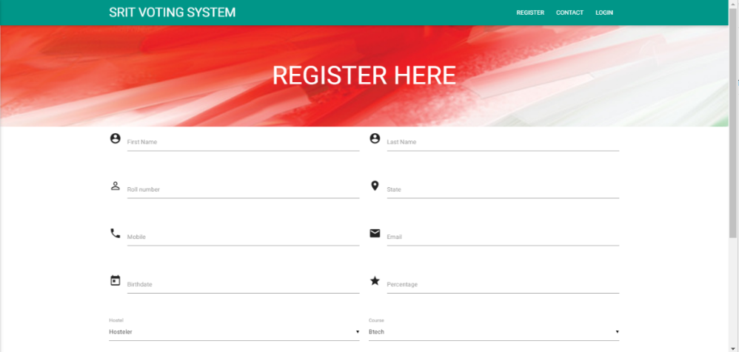
Fig:2 voters register for the election

Slide 15
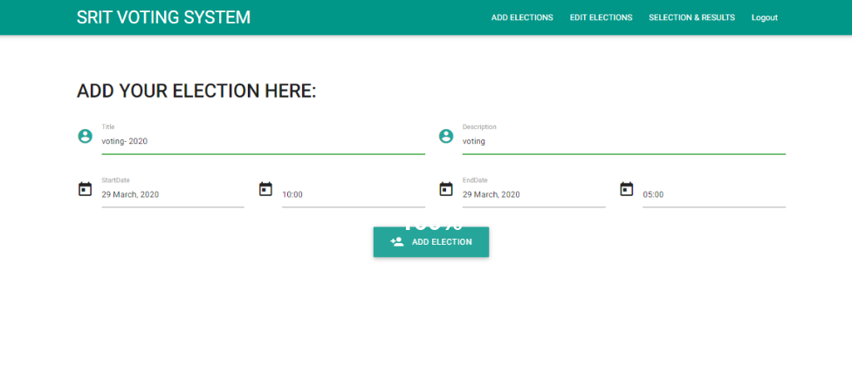
Fig: 3 Admin add the election

Slide 16
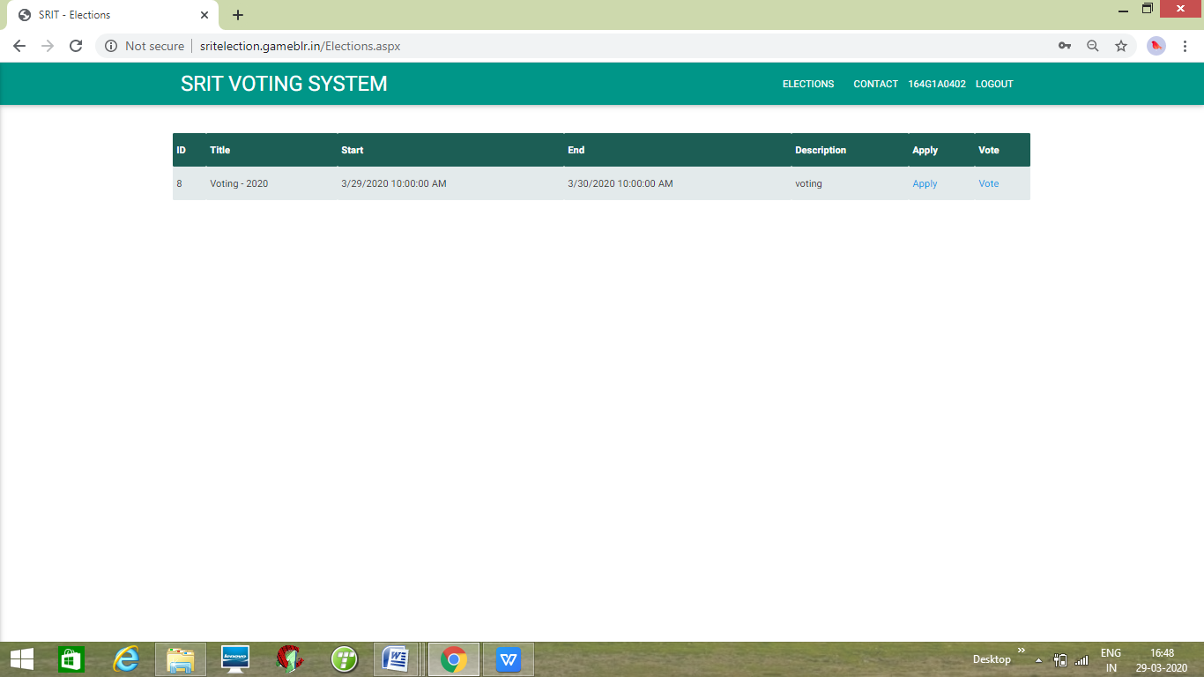
Fig: 4 participants can apply for the elections

Slide 17
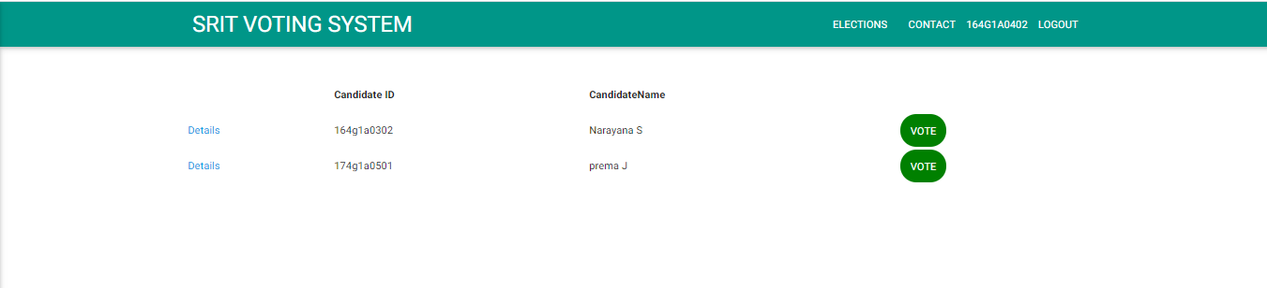
Fig: 5 voter vote for candidate

Slide 18
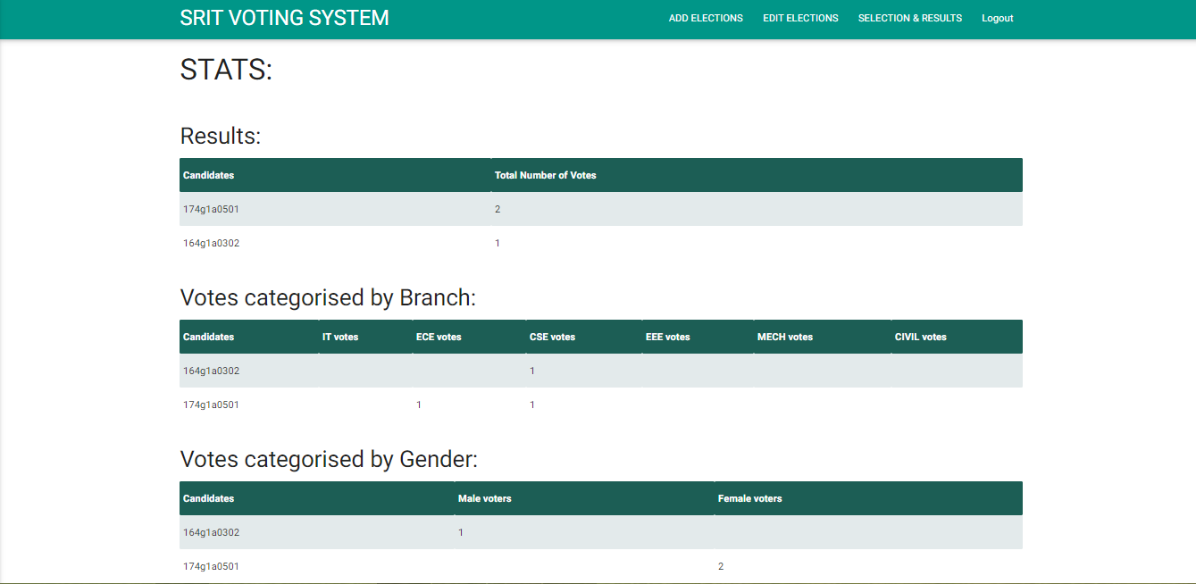
Fig: 6 characterising the results

Slide 19
Conclusion
This system offers significant cost benefits over paper elections in a vote to vote comparison. It reduces the time required to set up and conduct elections. With the advent technology and internet in our day to day life, we were able to offer advanced voting system to voters both in the college and outside through our voting system.

Slide 20
References
[1] Kumar, Sanjay, Walia, Ekta (2011). Analysis of Electronic Voting system in Various Countries. International Journal on Computer Science and Engineering, 3(5), 1825- 1830.
[2] Emad ABU-SHANAB, Michael and Heba Refai (2010). E-voting Systems: A Tool for E-democracy.
[3] Kanika Garg , Kanika Garg, Sachin Bisht(2019). A Comparitive Analysis on E-Voting System Using Blockchain. International Conference on Internet of Things.

Slide 21
Thank you
Queries
?

