Slide 1
INSURANCE ASSESSMENT AND RISK PREDICTION

Slide 2
Why ?
Life insurance application process is antiquated.
Extensive information to identify risk classification and eligibility, including scheduling medical exams, a process that takes an average of 30 days.
The result? People are turned off.

Slide 3
What ?
To develop a predictive model that accurately classifies risk using a more automated approach, and enable company and customers to opt of an insurance policy at the earliest.

Slide 4
How ?
Data Analysis
Data Pre-processing
Data Split
ML Model Building
ML Model Evaluation
Selecting the best Model

Slide 5
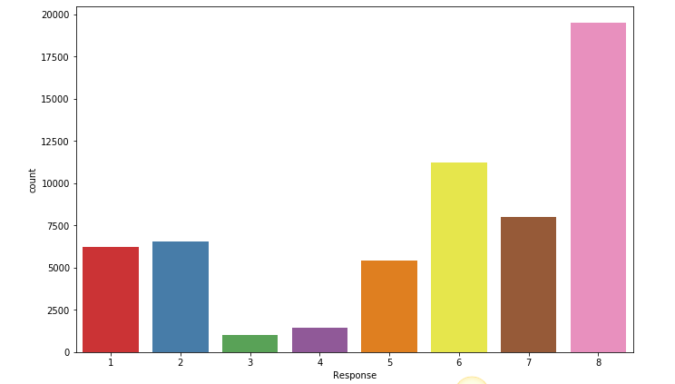
What does the Outcome look like?

Slide 6
Process and Conclusion
Four different models were tried.
Decision Tree proves to be the best among the different models.

Slide 7
Thank YOU!

