Slide 1
CS5330 · FINAL PROJECT · SPRING 2026
Real-Time Object Recognition and AR Overlay
Using deep learning to turn any everyday object into an augmented reality anchor
Sangeeth Deleep Menon · NUID 002524579 · Raj Gupta · NUID 002068701 Khoury College of Computer Sciences · Northeastern University

Slide 2
MOTIVATION
Traditional AR needs a printed marker. What if the object itself was the marker?
PROJECT 4 GAVE US
PROJECT 5 GAVE US
AR rendering
Deep learning
3D graphics overlaid using a chessboard calibration target to estimate camera pose
CNNs and Vision Transformers trained to classify images from a camera
This project combines both. No marker required.

Slide 3
DATA AND PIPELINE
10 classes · 1419 images · 4-step pipeline
CLASS
IMAGES
SOURCE
1
Classify
book
161
Webcam
Crop center ROI, run through MobileNetV2 to get class and confidence score
cup
173
Webcam
keyboard
152
Webcam
pen
171
Webcam
2
Smooth and reject
phone
159
Webcam
5-frame majority-vote removes flicker; entropy check labels uncertain frames as Unknown
glasses
130
Web
headphones
110
Web
3
Estimate pose
laptop
123
Web
Fixed-depth pinhole model back-projects the ROI into 3D at 0.5 m
ps5_controller
102
Web
tablet
138
Web
4
Render
Project 8 box corners with cv2.projectPoints, draw wireframe box and floating label

Slide 4
ARCHITECTURES AND RESULTS
Three approaches, one winner
CUSTOM CNN
VISION TRANSFORMER
TRANSFER LEARNING ❖ DEPLOYED
ObjectCNN
ObjectViT
MobileNetV2
• 3-layer conv network
• 8x8 patch embedding
• ImageNet pretrained
• 64x64 RGB input
• 64 patches per image
• 224x224 RGB input
• BatchNorm + Dropout 0.4
• 4 transformer layers
• Fine-tuned classifier head
• Trained from scratch
• Trained from scratch
• Dropout 0.3
• 2.19M parameters
• 0.83M parameters
• 2.24M parameters
79.7% on 5 classes
43.2% on 10 classes
88.8% on 10 classes

Slide 5
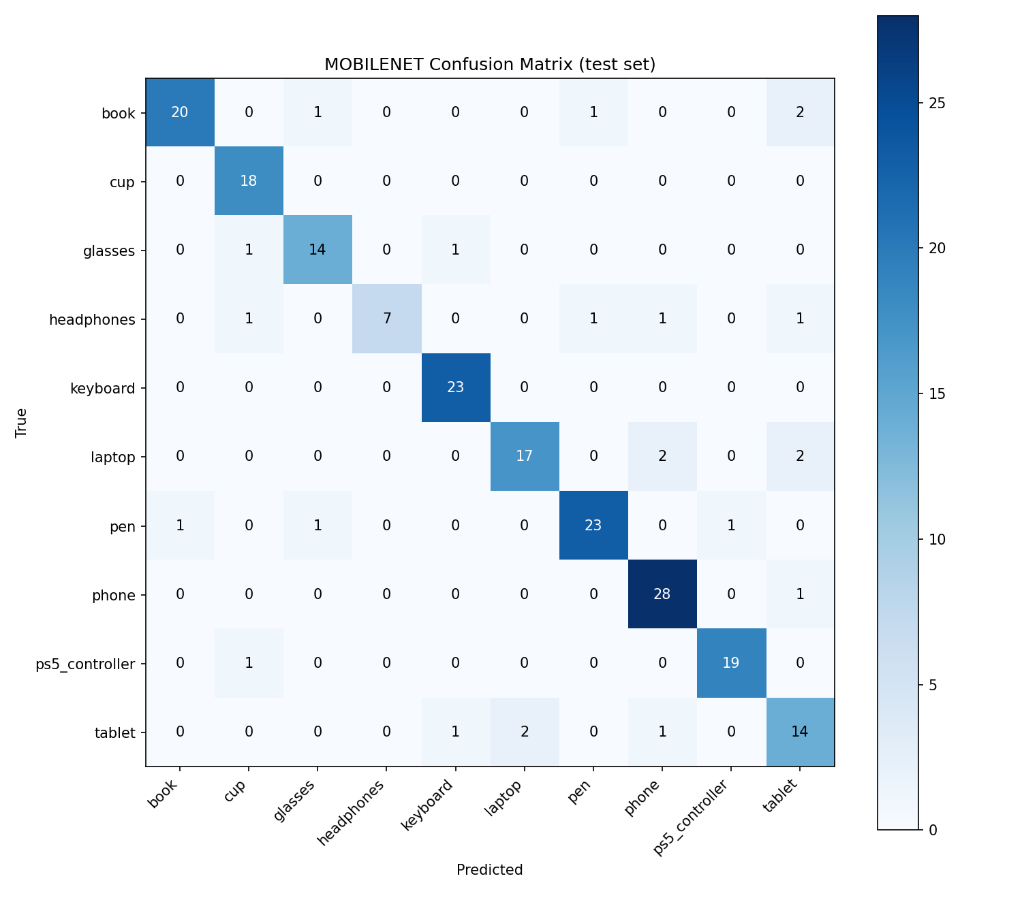
WHERE IT STRUGGLES
Confusion tells the story
TABLET — WEAKEST CLASS
Flat rectangular devices look nearly identical to phones and laptops at certain angles. Tablet finished at 70% precision, the lowest of all 10 classes.
HEADPHONES — CAUTIOUS MODEL
100% precision but only 63.6% recall. The model almost never guesses headphones incorrectly, but it often misses them entirely.
ROOT CAUSE
Errors are driven by visual ambiguity at class boundaries. PS5 controller (web-only) scored 95% on both metrics and glasses recovered to 87.5%, so data source alone does not predict failure.

Slide 6
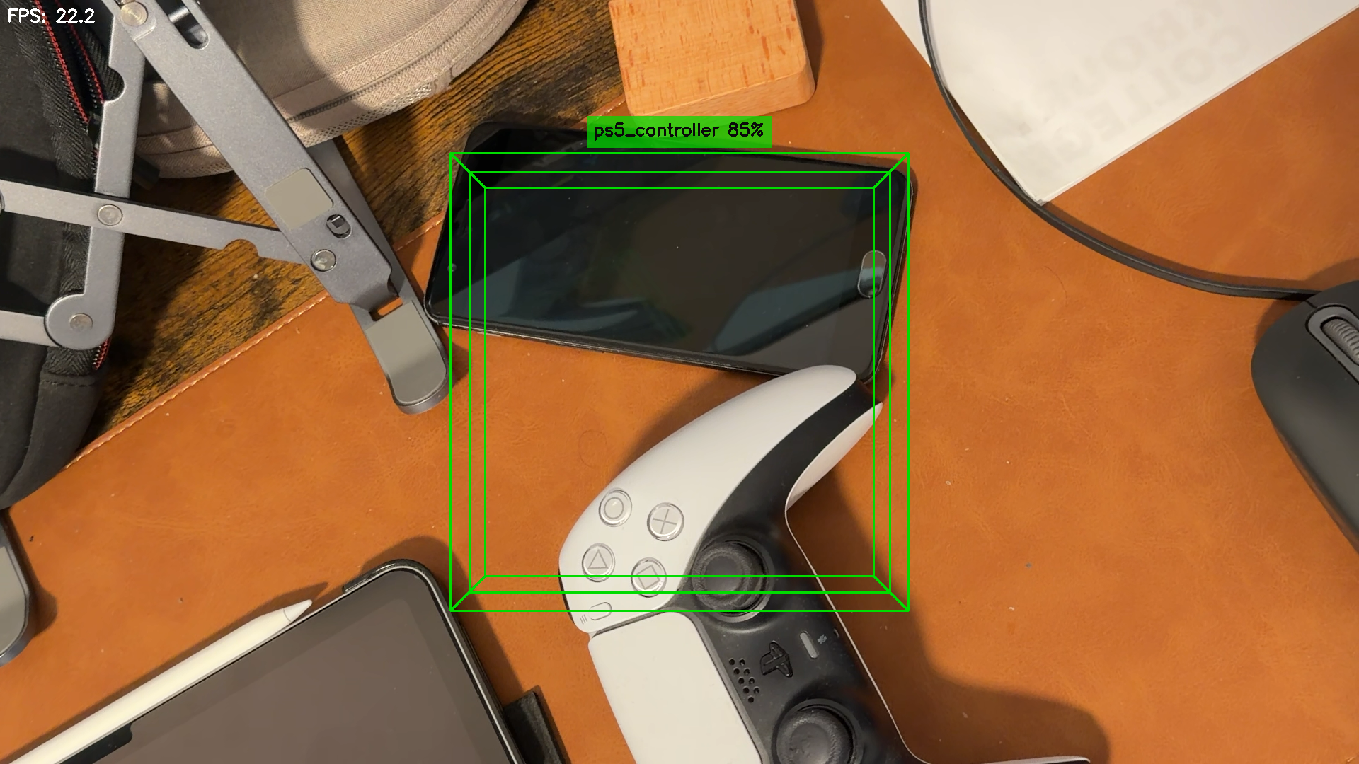
DEMO CAPTURE
AR overlay in action
A PS5 DualSense controller is in the center ROI. The model predicts ps5_controller at 85% confidence.
The green 3D wireframe box is cleanly anchored with visible front and back faces. The label tag appears above the front face.
LIVE SESSION STATS
20-30
0.50
FPS live
Confidence threshold

Slide 7
SUMMARY
10
88.8%
20-30
0
object classes
test accuracy
fps live
printed markers
REMAINING LIMITATIONS
ALREADY ADDRESSED
!
Fixed center ROI
✓
5-frame majority-vote buffer eliminates label flickering
Objects off to the side are not detected
!
Fixed depth (0.5 m)
✓
Entropy-based rejection shows Unknown when no familiar object is present
Box scale is incorrect at very different distances
Sangeeth Deleep Menon · NUID 002524579 · Raj Gupta · NUID 002068701 · CS5330 Spring 2026 · Northeastern University

