Slide 1
GIT

Slide 2
What is git?

Slide 3
What is git?
A distributed version control system. (Global Information Tracker)
Open source project originally developed in 2005 by Linus Torvalds.
A command line utility.
You can imagine git as something that sits on top of your file system and manipulates files.
Notes:
Version control system is a system that records changes to a file or set of files over time so that you can recall specific versions later
Distributed means that there is no main server and all of the full history of the project is available once you cloned the project

Slide 4
Installing Git
Windows: git-scm.com/download/win
Mac: git-scm.com/download/mac
Linux: sudo apt-get install git (Ubuntu)
or: sudo yum install git (Fedora)
Once installed check Git version: git --version

Slide 5
First time Git setup
Your Identity:
git config --global user.name “Your Name”
git config --global user.email example@smartosc.com
Checking your settings:
git config --list

Slide 6
Commads

Slide 7
Git commands
For most of the basic interactions with git you’ll mainly use 10 commands that we’ll cover here:
git init
git clone
git fetch
git status
git add
git commit
git pull
git push
git merge
git checkout

Slide 8
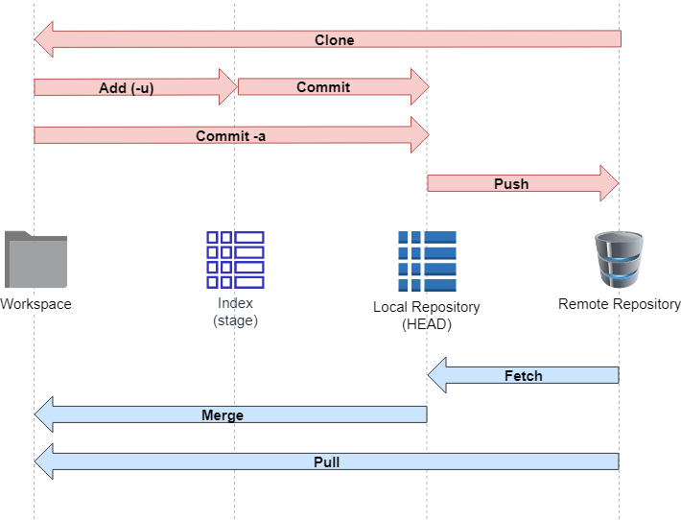
Git data transport commands

Slide 9
Git process

Slide 10
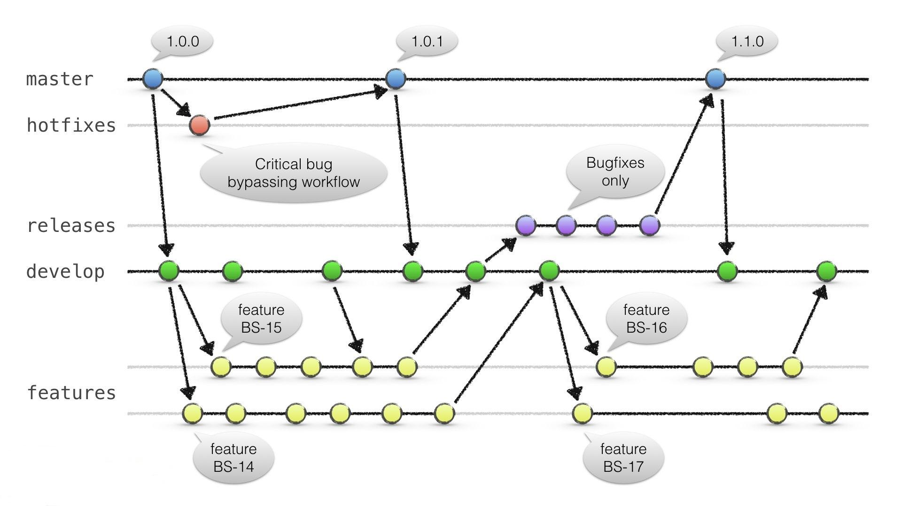
Git process

Slide 11
Demo

Slide 12
References:
Git cheat sheet:
https://jan-krueger.net/git-cheat-sheet-extended-edition/
http://ndpsoftware.com/git-cheatsheet.html
Git process:
https://nvie.com/posts/a-successful-git-branching-model/
Git GUI Client Tool:
https://git-scm.com/downloads/guis

Slide 13
Q&A

