Slide 1
memory.block.pool
buffer_view
time_event
buffer
shared_buffer
object
smart pointer
object.pool
querier
context
querier.rdb
querier.redis
querier.http
executor
thread pool
dump manager
service
service.application
service.service
service.
schedulable
network
socket
acceptor
distributed object storage system
group
group
repository
depot
object
observer
log
log.file
log.console
log.socket

Slide 2





CGDK.network
CGDK.system
C++17 standard, C#
CGDK.server
CGDK.admin
tcp,udp
http,web socket
p2p
update
system.object
system.buffer
system.thread
log
group
time_event
service framework
querier
distributed object storage
admin server
admin client
host agent
CGDK
admin server
…
windows
linux
…
windows: iocp
android, linux : epoll
C++17 standard, C#
clients
unity 3D
unreal
web
…
for windows, linux, NDK
SQL Server, MySQL, redis, http …
for windows, linux
windows: OLE-DB, ODBC
linux : ODBC
web server

Slide 3

















CGC.II.
CGDK
admin server
…

Slide 4






Slide 5


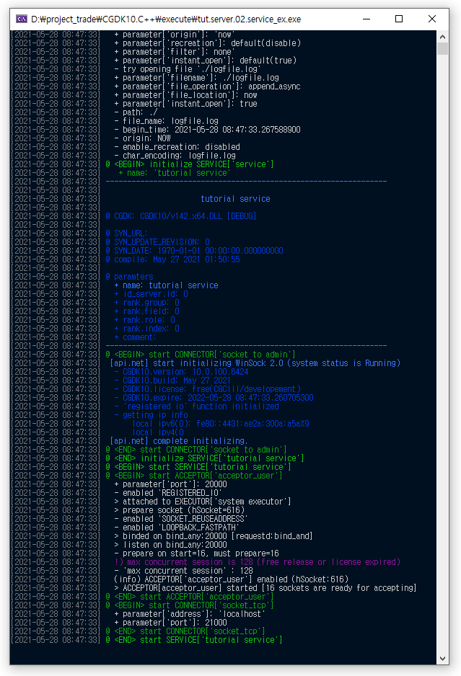
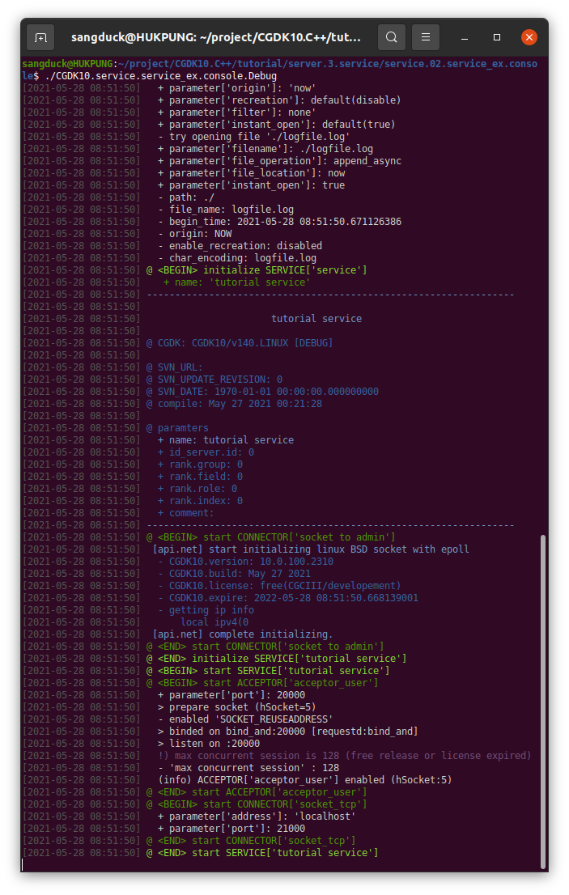

Slide 6


















