Slide 1



AI Agents Meet Blockchain: A Survey on Secure and Scalable Collaboration for Multi-Agents
Empowering Decentralized Intelligence in the Web3 Era
Md Monjurul Karim, Dong Hoang Van, Sangeen Khan, Qiang Qu*, Yaroslav Kholodov
Date: 02-02-2025
Shenzhen Institutes of Advanced Technology, Chinese Academy of Science, Shenzhen, China University of Science and Technology Beijing, China, and
Innopolis University, Innopolis, Russia.
Notes:
1

Slide 2
Agenda
Introduction
Motivation and Backgrounds
Synergy Between AI Agents and Blockchain
Applications and Empirical Case Studies
Empirical Case Studies
Research Challenges
Future Directions
Conclusion

Slide 3
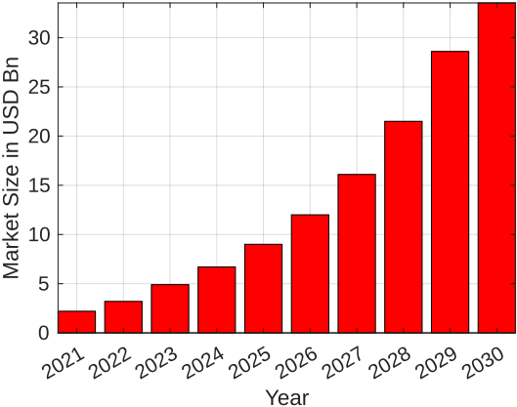
Introduction
Key points
Web3 Growth: $33.53B market by 2030, driven by decentralized ecosystems.
Blockchain in Web3: Transparency, security, decentralization (e.g. DeFi, DAOs).
Al in Web3: Enhances decision-making, anomaly detection, and scalability.
Expansion
Web3 Pillars: Decentralized governance, user-owned data, smart contracts.
Example: Defi’s $200B Total Value Locked (TVL) and AI-driven risk assessment.
CAGR (2022-2030) 43.6%

Slide 4
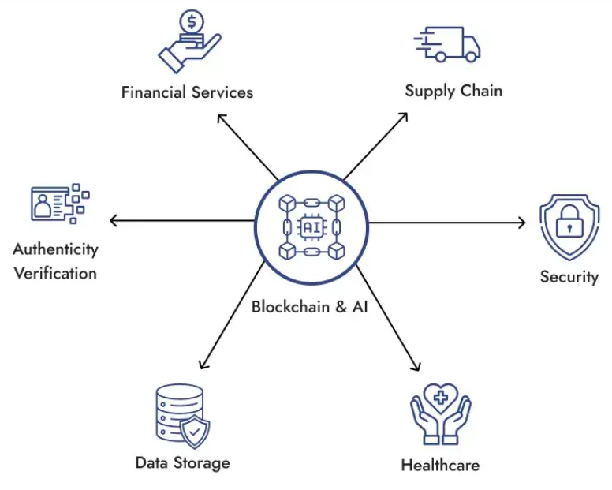
Motivation
Key points
Challenges in Web3: Scalability, interoperability, energy consumption.
AI Agents: Autonomous decision-making, real-time analysis, generative capabilities.
Multi-Agent Systems (MAs): Collaborative problem-solving in decentralized environments.
Expansion
Case: Blockchain's role in DA0 governance (5,000+ DAOs managing billions).
Problem-Solving: Al agents address latency, trust gaps, and resource optimization.

Slide 5
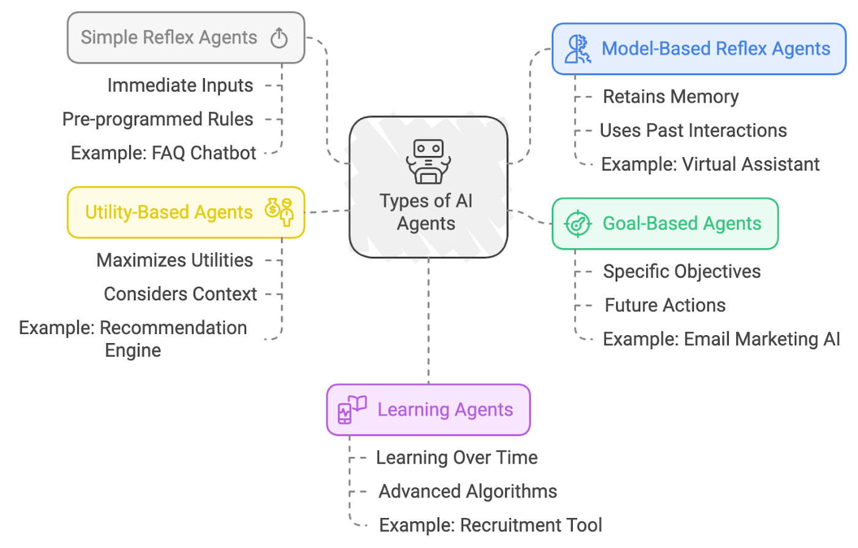
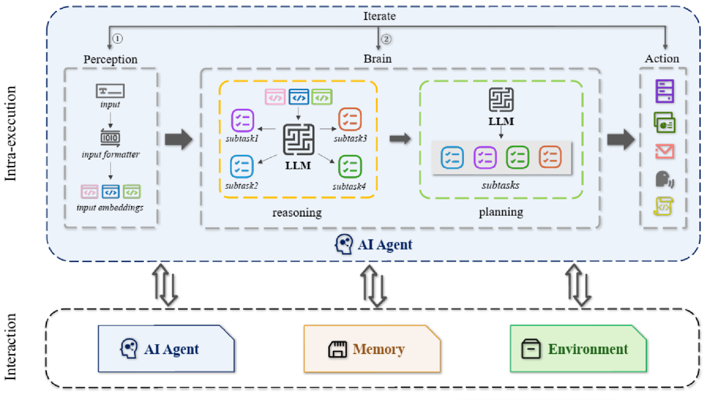
Background
Overview of AI Agents
Working of AI Agent
Definition of AI Agent: An AI Agent is an intelligent entity capable of perceiving its environment.
Functionality: It can make decisions and execute actions.
Perception: The AI Agent's ability to gather information from the environment and extract relevant knowledge.
Planning: The process by which an AI Agent makes decisions to achieve a specific goal.
Action: Actions taken by the AI based on the environment and its planning.

Slide 6

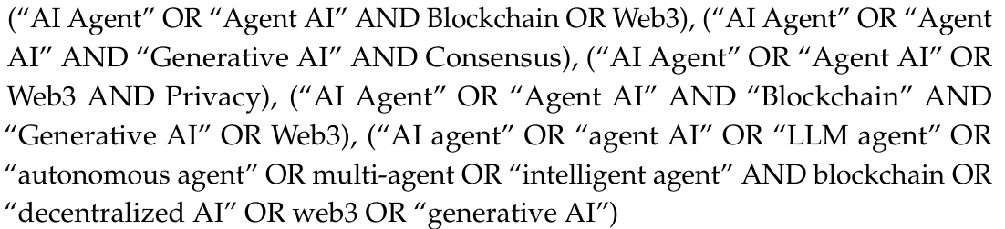
Research Method
Literature Search Keywords
Database and Search Process
Literature sourced from IEEE, ACM, Springer, ScienceDirect, and Web of Science.
Systematic search identified 140 articles in initial round.
Reduced to 110 after first screening of and further narrowed to 80.

Slide 7
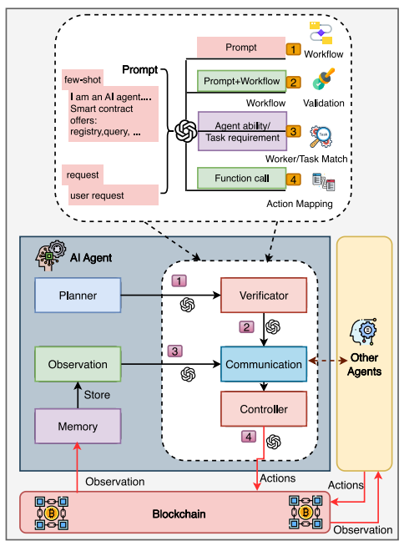
Synergy Between AI Agents and Blockchain
AI Enhancing Blockchain
Intelligent Consensus: Proof-of-Thought (PoT), Proof-of-Compute (PoC).
Zero-Shot Learning: Fraud detection without prior training.
Vulnerability Detection: Ensemble LLMs for smart contract security (98.8% accuracy).

Slide 8
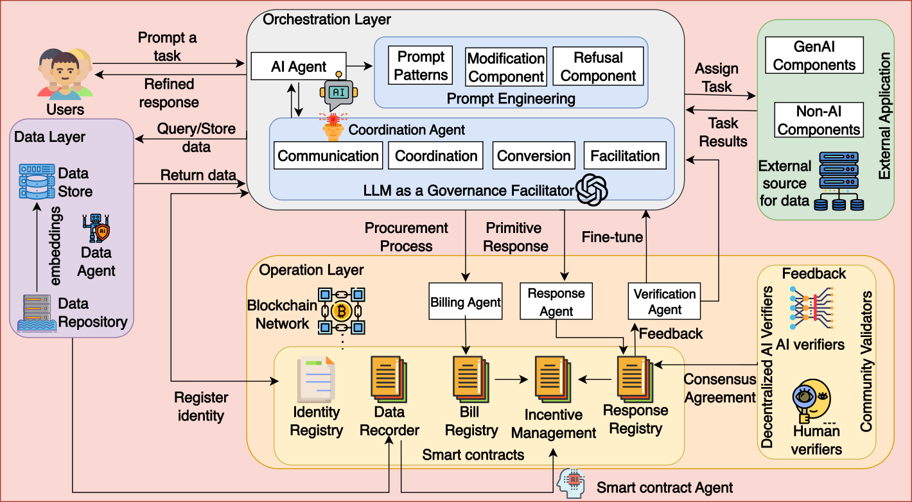
Synergy Between AI Agents and Blockchain
Blockchain Empowering AI Agents
Secure Infrastructure: Ethereum Al Agent Coordinate Or (EAAC), IPFS integration.
Governance: Decentralized voting for multi-agent collaboration (mABC framework).
Dynamic Environments: Blockchain’s on-Chain and off-chain data integration develops adaptive agents.
Example: BlockAgents framework for Byzantine fault tolerance

Slide 9
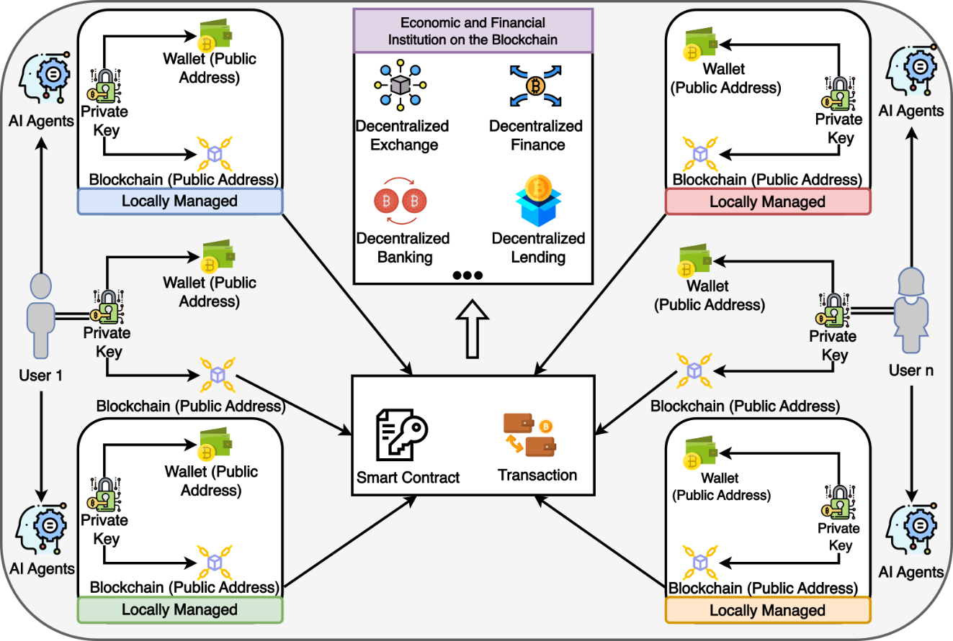
Applications
Asset Management: Tamper-proof ownership tracking via smart contracts.
DeFi: AI-driven trading strategies (e.g., CryptoTrade agent with 24% throughput increase).
DAOs: LLM-powered governance (e.g., Luna influencer with 45% user retention).
Supply Chain: Dynamic collaboration across stakeholders.
Edge computing: Resource allocation in loT networks.

Slide 10
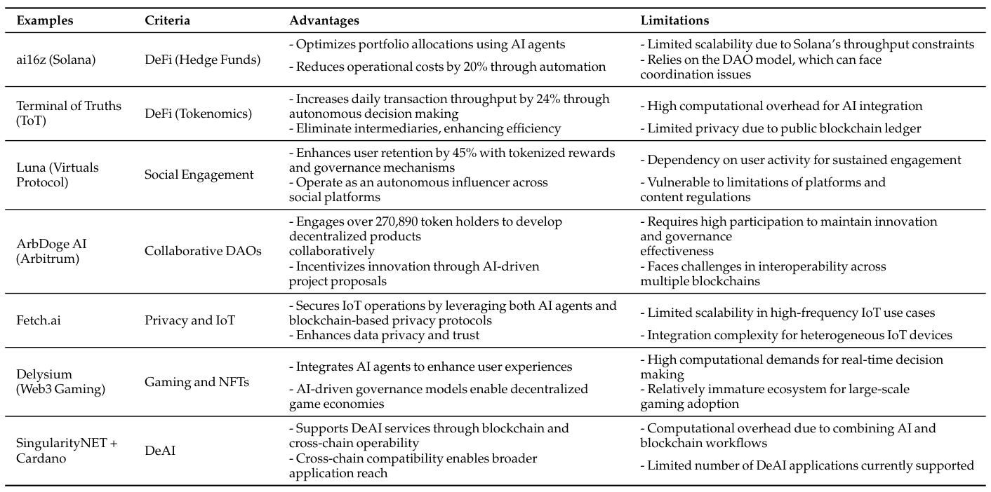
Empirical Case Studies

Slide 11
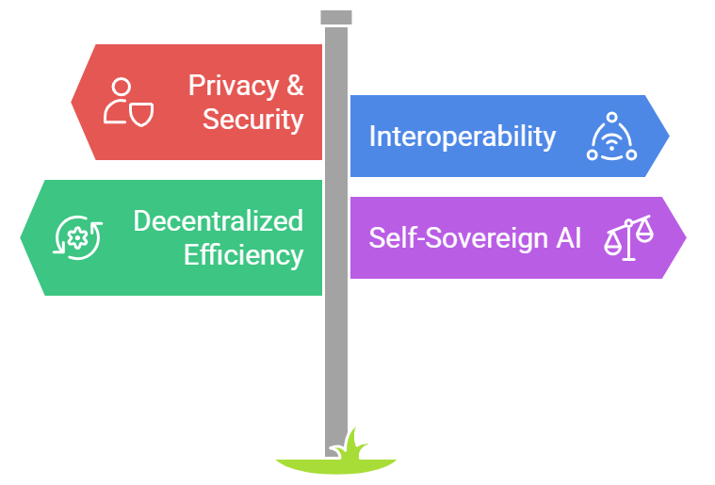
Research Challenges
Key Challenges
Privacy& Security: Multi-agent eavesdropping, quantum steganography risks.
Interoperability: Cross-chain communication (e.g., Talus, Delysium bridges).
Decentralized Efficiency: Balancing computational overhead and autonomy.
Self-Sovereign Al: Accountability for untethered agents (e.g., Proof-of-Personhood).

Slide 12
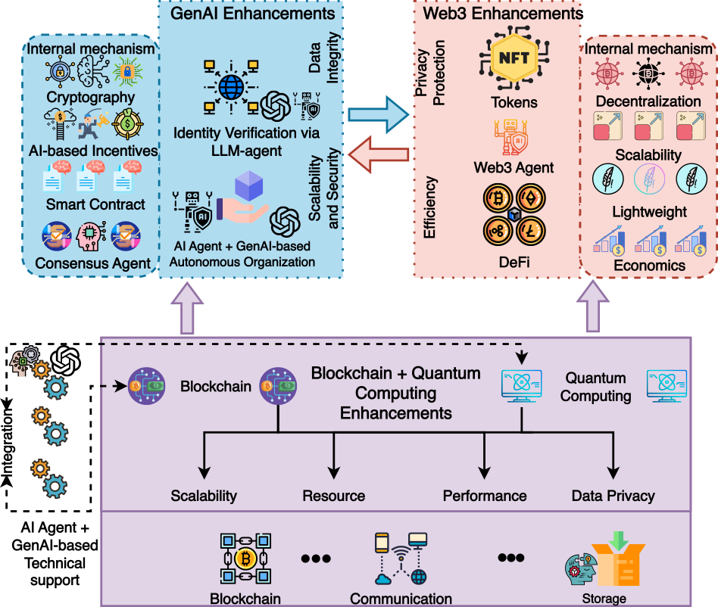
Future Directions
Future Directions
Quantum Computing: Quantum-resistant protocols for blockchain-Al fusion.
Ethical Governance: ETHOS framework for decentralized accountability.
Responsible AI: AI systems should promote fairness and transparency.

Slide 13
Conclusion
Key Takeaways
Blockchain and Al agents synergize to enable secure, scalable decentralized systems.
Transformative applications in DeFi, DAOs, supply chains, and edge computing.
Critical challenges: Privacy, interoperability, and ethical governance.
Call To Action
Foster collaboration between academia and industry to advance decentralized intelligence.

Slide 14
Any Questions ?

