Slide 1
Resume Tracking System
Foundational Project - 1
Anand Pratap Singh (12020084)
Francis David Vuppuluri (12020028)
Lavanya SN (12020075)
Puneet Srivastava (12020026)
Sangeeta Thakur (12020088)

Slide 2
Presentation Overview
Agenda
Overview
Business Understanding
Getting to Data
Modelling
Evaluation
Conclusion

Slide 3
Introduction
The Pandemic has affected the world in many ways. One of the aspects heavily affected by the pandemic is the job market. The volatility in that current job market is unheard of and has impacted industries across the world. The Human Resource teams also find it challenging now to retain the right employee and due to the fluctuation, the cost of hiring has also drastically shot up.

Slide 4
Objective
This project aims to act as a filter and a step towards effective employee hiring by factoring in high probability of retention.
Focus Areas
Reduce the cost of hiring
Maximise employee retention
Softwares and Versions used:
Beautiful Soup 4.9. 1
Python 3.8
Jupyter Notebook
Snowflake Enterprise Edition

Slide 5

Project Overview
Extract relevant information: Skills, location, company and years of experience
Output skills, location, estimated current salary:
Candidates
VS
Job opening
Training a regression model on the Job Openings Data using Salary as a dependant variable
Job Openings w/ Salary
Likelihood score of Candidate accepting a position based on extracted features
Input the candidate data into the model and predict their current salaries.
Candidate Profiles

Slide 6
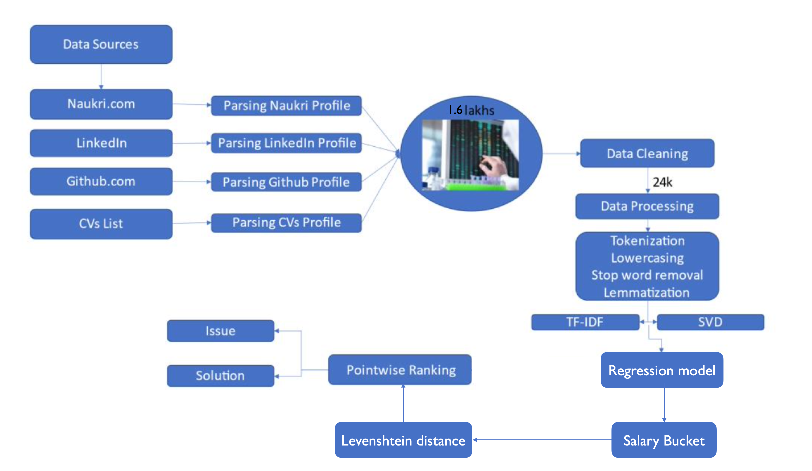
Process Architecture

Slide 7
Data
Extract relevant information: Skills, location, company and years of experience
What do we need?
Job Openings Information
Scrap and extract all the available Job openings in the target region. For Project: naukri.com
Candidate Information
Scrap and extract all profiles of the applicants on the company job portal and careers websites like LinkedIn.com.
Job Openings w/ Salary
Candidate Profiles

Slide 8
Data Cleaning
Goal: compare the extracted Job Openings Data and Candidate Profile
To conduct an effective comparison, the foremost step is to make sure both the datasets are comparable and compatible
Expected columns in both the datasets
Job Title/Candidate Name
Location
Skills
Company
Experience
Additionally, in the Job Opening Dataset we want the column: Offered Salary

Slide 9
Data Preprocessing
Job Openings Dataset
Number of Openings: 24,143
Number of skills in the current dataset : >7000
Experience: 1 Continuous Numerical Variable
Regions: Various Cities in India
Salary: 1 Continuous Numerical Variable
Skills: The number of skills in the current dataset is abnormally high. This may be due to synonymous usage of text.
Regions: To conduct an effective analysis, the various locations available in the dataset are categories into 4 directional zones.

Slide 10
Data Preprocessing
Skills Data Preprocessing
Using the means of TF-IDF and LSA, the column skills is brought down from 7000 features to 300 features
What do we have
24,143 Job openings with 305 features to analyse
Final Training Dataset
Number of Openings: 24,143
Number of skills: 300
Experience: 1
Regions: 4
Salary: 1
Training a regression model on the Job Openings Data using Salary as a dependant variable

Slide 11
Modelling
Split the Training Dataset: Job Opening Data
80-20 Train-Test Split
Training a regression model on the Job Openings Data using Salary as a dependant variable
Training the model using the 80% data with Salary as a dependant variable
Test the model accuracy by verifying the model predictions against the test data salary values
Input the candidate data into the model and predict their current salaries.

Slide 12
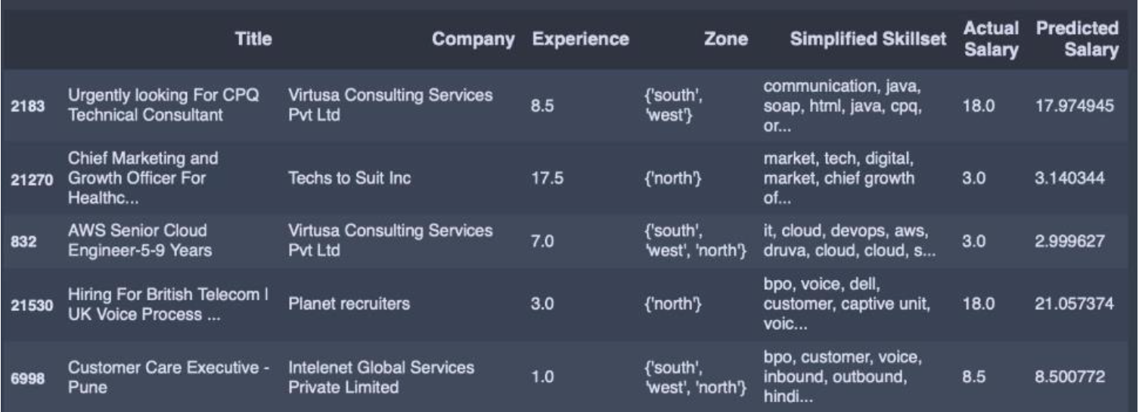
Modelling
Improve Model Accuracy
What do we want
Salary Predicted by the model ≈ Actual salary in the 20% test data

Slide 13
Modelling
Once we have a good predictor of Salary
Input the candidate data into the model and predict their current salaries.

Slide 14
Deployment
Create stages, databases, tables, user, role and warehouses on Snowflake.
Load data into a table from S3 bucket.
Using AWS Sage Maker Notebook instance for model preparation and Execution.
Using Snowflake instance and pull data into a Pandas data frame.
Visualising the data and performing basic feature engineering.
Unload a dataset into S3 and using it to train a machine learning model.
Run a batch of data through model and load the results back into Snowflake.

Slide 15
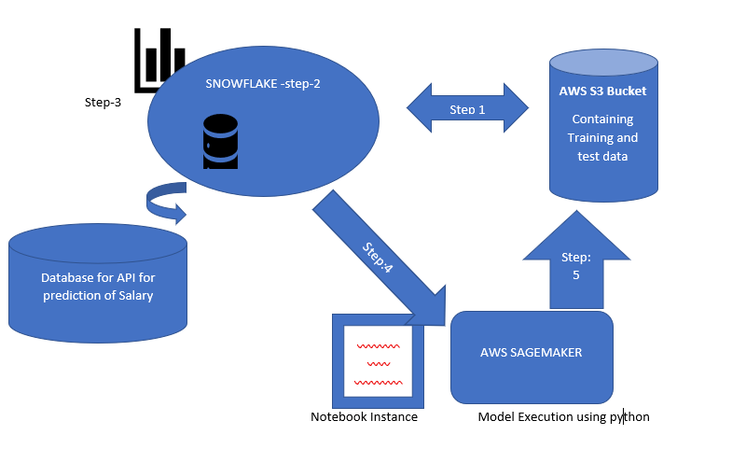
Architectural view of deployment

Slide 16
Evaluation
We have candidate dataset, now with the Predicted Current Salary, based on Skills, Zone and Work experience
1. Using the candidate dataset, extract Job Openings for each candidate where Predicted Current Salary lies within the range of (0.7 - 1.2) times the Maximum Salary offered in that job
2. Evaluate the skills of the extracted Job Openings and the Candidate to determine the relevance of the Job Offer
3. Extract the best Job Openings for each candidate based on Salary, Zone, Experience and Skills

Slide 17
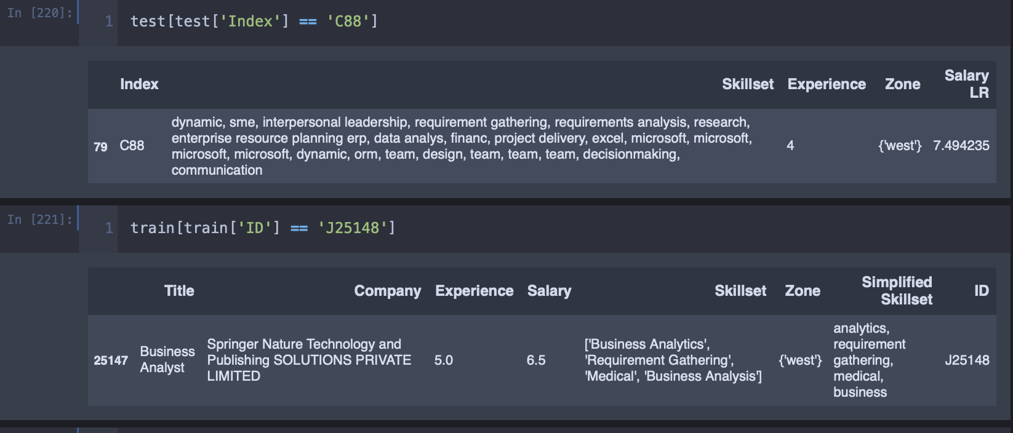
Evaluation
Model: The model accuracy is acceptable, based on the skills, regional zone and experience - the model is appropriately giving out the expected salary of a candidate, within a reasonable range

Slide 18
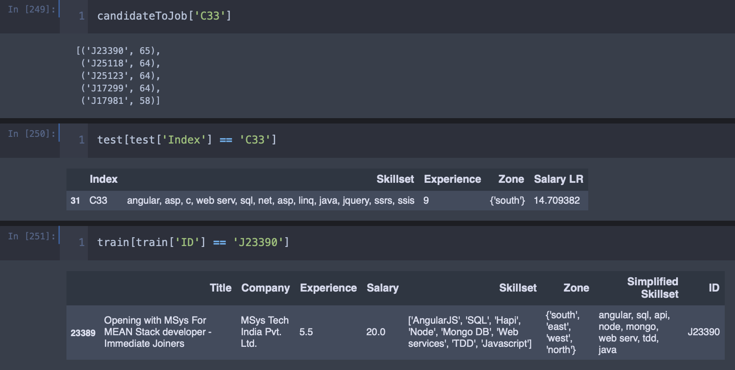
Evaluation
Candidate
Job Opening
Lastly, extract the best Job Opening for each candidate based on Salary, Zone, Experience and Skills

Slide 19
Conclusion
Our system will provide better and efficient solution to current hiring process. This will provide potential candidate to the organisation and the candidate will successfully be placed in an organisation which appreciate his/her skillset and ability, which will increase employee retention. This model can be used for all domains after training it for various domain as required.

